Slide 1
PowerLink Views and Subsets
The New Face of MAPICS
What do they do and how can they help me?
            John Grindley
            John.Grindley@cistech.net

Slide 2
Agenda for Today
Power Link Views
  What are they?
  View considerations
    Code files – value, alias, or value and alias
    Control number of decimals (save “real estate”)
    Change headings (again to save “real estate”)
    Column Statistics – count;total;average
    Presentation Schemes – column vs. row
    Multiple views for multiple tasks
Notes:
Browser gives COMPLETE DATA VIEW!!

Slide 3
Agenda for Today
Browser Subsets
  What are they?
  Subset considerations
    Major data queries
    Relational operators – equal, not equal, contains, starts with, greater than, less than
    Operand type – constant value, list, range
    Value – prompt or lock in value(s)
    Use of and/or in logic for multiple parameters
Create Reports with new views and subsets

Slide 4
VIEWS
Like Columns on a Spreadsheet
Vision of the Information needed to Capture
Creative Imagination on what can be attained
Move from Green Screen to Powerlink
Move from Powerlink and Beyond

Slide 5
VIEWS – What Are Our Choices?
Which attributes (fields) do we need to see?
In what order do we see them?
Do we want to see code file ID’s (value) or descriptions (alias) or both?
How many decimal places do we need on numeric fields?
Do we want to highlight information to make it stand out.
Do we want to total some columns, average them, and get a line count?
Notes:
NEEDED FIELDS
If not using revision control in item revisions in EPDM, take it off the view. If not using value class in item warehouse, take it off the view.
If using XA informational fields for something else, rename heading. Packing code in the item revision is a popular one. Department is a good 4-character field. Our customer number in Procurement can be used for vendor category, that is large, small, woman-owned, disadvantaged, etc. if your company must track that. (FYI-With Integrator I can rename the field so no matter where that attribute is viewed in the system all are clear that this field is used for this purpose.) User fields in Browser are fantastic for tracking information that is “near and dear” to my company but there’s no special field for that info…but rename in views and cards.
ORDER – most important toward left of view so easily viewable. Less important ones in scroll area to the right..
You can temporarily drag and drop a field for a different view, but it is temporary and will return when you exit
the object.
CODE ID’S & DESCRIPTIONS –
New users may need both.
More experienced may want only codes to conserve space
Casual users may need just description
DECIMAL PLACES
Purchasing needs 4 to buy those tiny hardware items.
Accounting may want to see all 8. We know how our “bean counters” love those numbers.
Most of us can deal with 2 for $ fields and possible whole numbers for units mfg’d or purchased components.
TOTAL COLUMNS
Where appropriate.
Outstanding PO items due this month.
Sales for today.
$ value of scrap transactions this month.

Slide 6
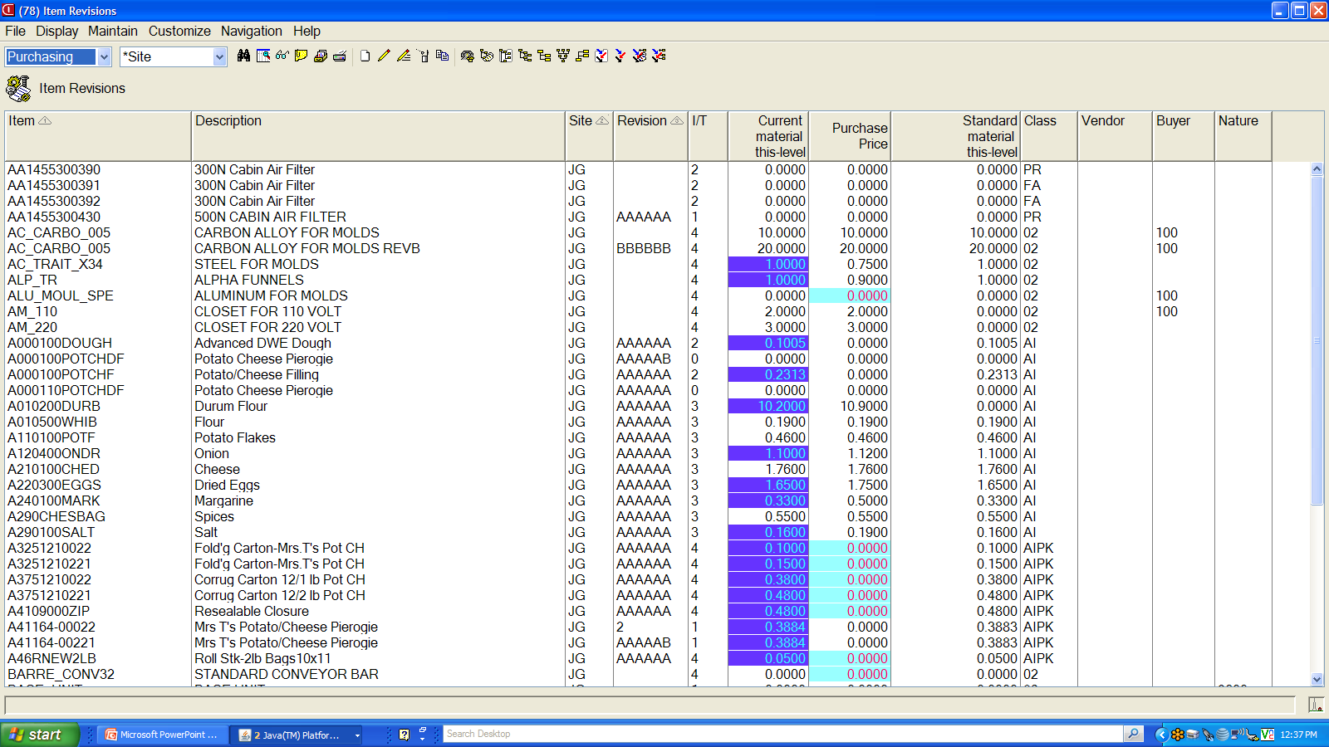
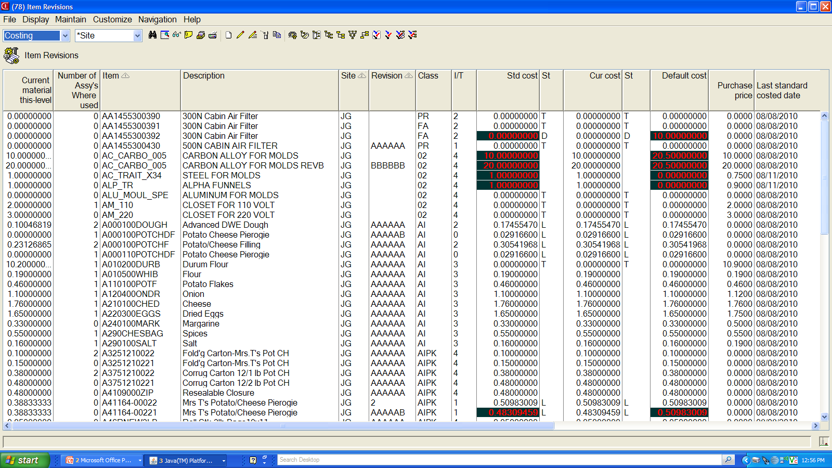
Current Material
cost not equal
to purchase price
Purchase Price
equal to zero.
Std Material cost
not equal
to Unit Cost Default
Notes:
Purchasing wants to see different information than our friends, the bean-counters. The items are the same, but the information about each item is different. THAT IS WHAT A VIEW IS—DIFFERENT INFORMATION ABOUT SAME RECORDS!

Slide 7
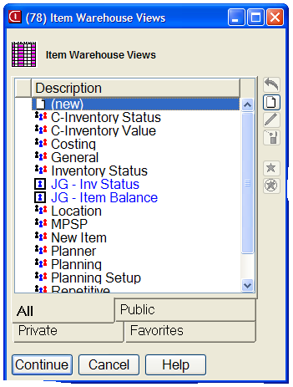
View Dialog Box
Icons have replaced ADD, Change, Delete, and Apply commands.
Private views in blue; public views in black.
New ICONS to identify favorite views
Notes:
Name all public customization clearly and concisely.
Group your private customization at the top by beginning with a period (favorites in R7).

Slide 8
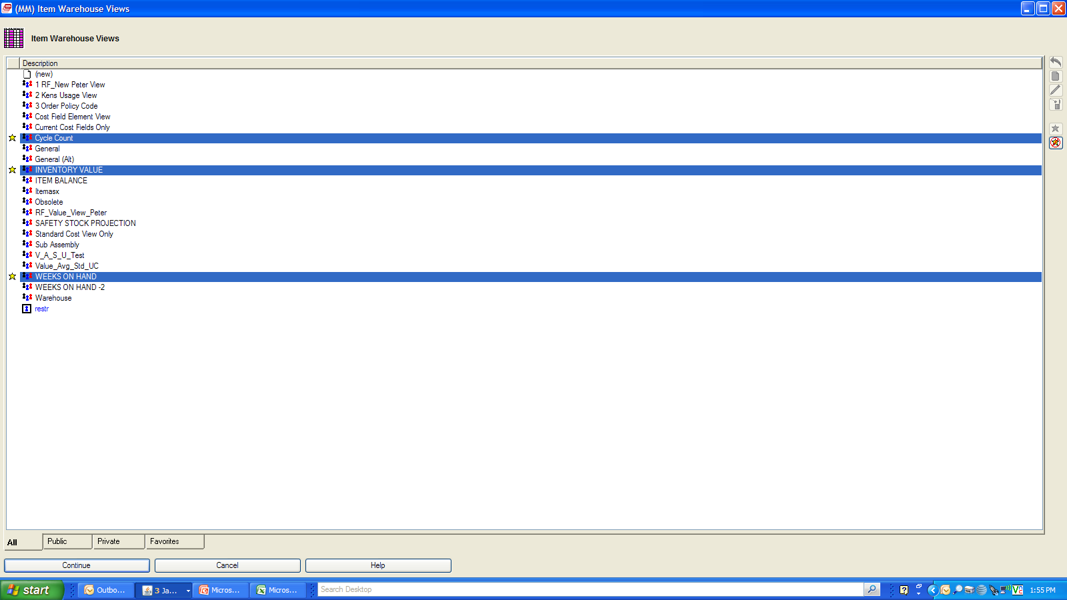
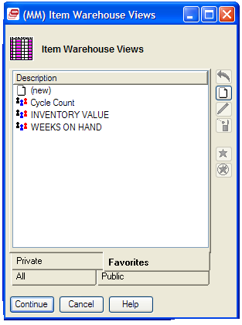
Assigning Favorites
Select views which are favorites then click on Star. They will appear in Favorites dialog box.

Slide 9
Attributes to See?
What do my tasks require?
Do I need multiple views for different tasks?
What regular reports can I get/create in Powerlink by creating different views?
Good use of “real estate” – abbreviating headings to conserve space.
Double line headings – CTRL + ENTER
Notes:
SPEED – client/server explanation – bar won’t go to the bottom
MULTIPLE VIEWS: Examples
Item Warehouses – not exactly what’s needed. I can see every field in this file. Consider:
Planning view with just the planning codes you use,
Purchasing view with vendor, vendor lead time, min, max, safety stock, etc.
Costing view
Consider having record entry views to double check that all those required settings were entered.
Dates view helpful in some objects
Personal views
Double line headings – CTRL + | (above forward slash.

Slide 10
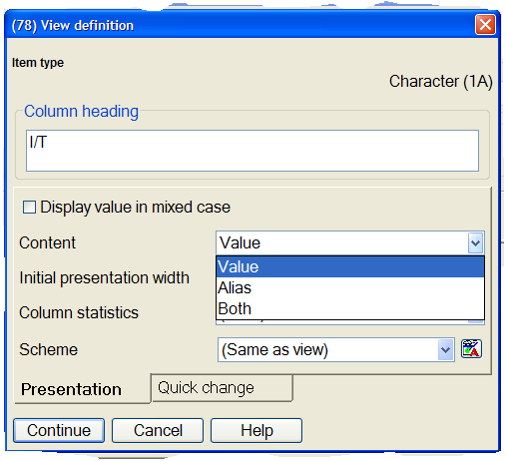
Column Header Parameters
Change codes to show numeric code or description or both.
Notes:
CODE VALUE & ALIAS
For ANY code file.

Slide 11
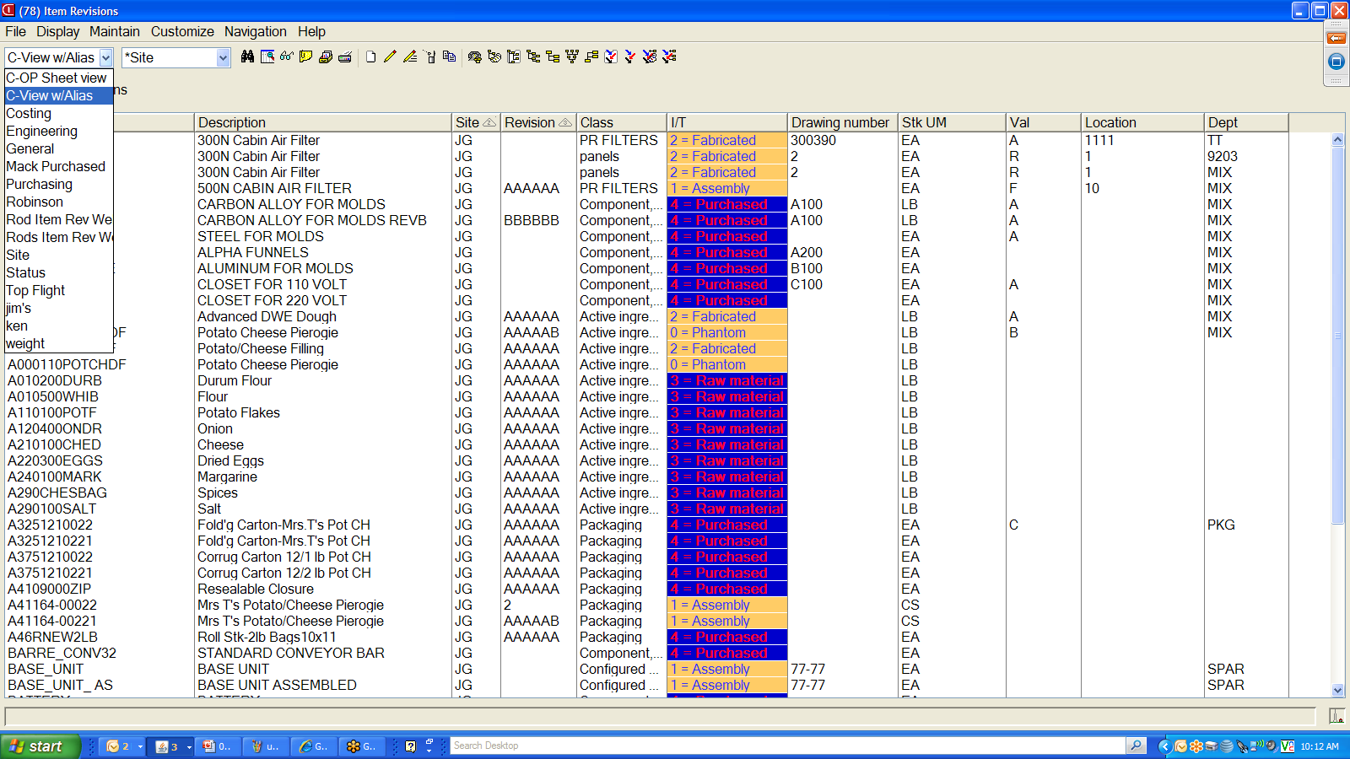
View Based on Value & Alias
Notes:
First, check your choices for views. Perhaps XA has provided what you need or one of your co-workers has created a good view for your use.

Slide 12
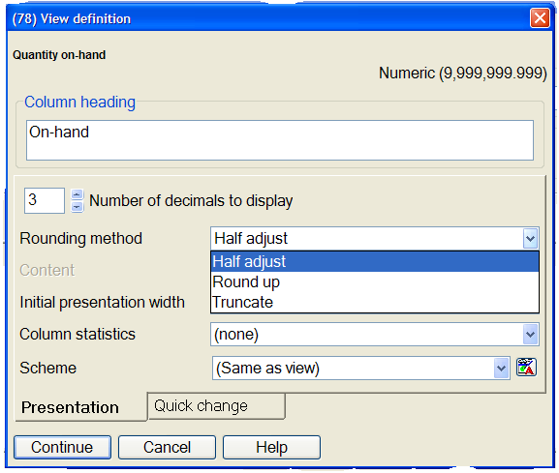
Column Set-up Parameters
Change number of decimal places and set rounding method.
Notes:
NUMBER OF DECIMALS
ENABLE COLUMN TOTAL
MUST SET FOR EACH VIEW

Slide 13
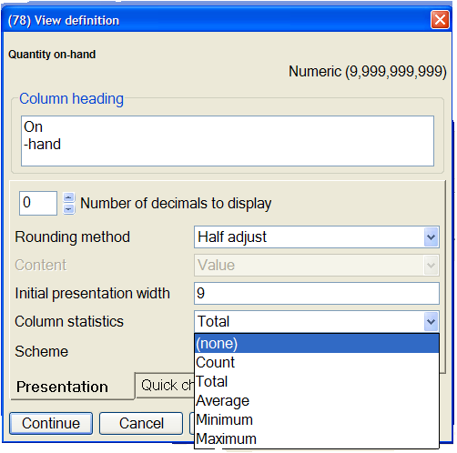
Column Set-up Parameters- Statistics
Are statistics needed and which one is required.
Notes:
NUMBER OF DECIMALS
ENABLE COLUMN TOTAL
MUST SET FOR EACH VIEW

Slide 14
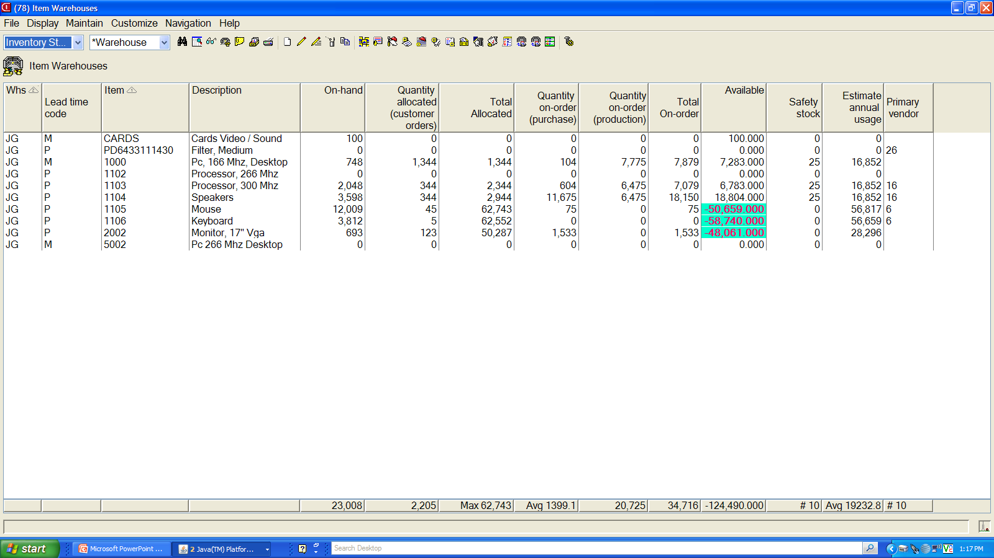
Column Set-up Parameters
Negative available
in Color Scheme
Totals, Count , Average, Minimum, and Maximum
displayed at bottom of page based on statistic chosen.
Notes:
NUMBER OF DECIMALS
ENABLE COLUMN TOTAL
MUST SET FOR EACH VIEW

Slide 15
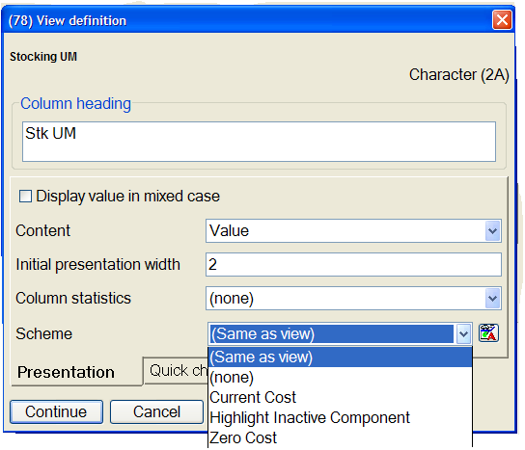
Column Set-up Parameters – Color Scheme
Creation or selection of color scheme to highlight an attribute.
Notes:
NUMBER OF DECIMALS
ENABLE COLUMN TOTAL
MUST SET FOR EACH VIEW

Slide 16
Selecting Attributes? (Views & Subsets)
If visible in “Available Attributes” box, just select.
If not visible, you can scroll or page down to locate field.
If not visible, you can also use Search button.
  Less is better when searching; i.e., use fewer letters to avoid eliminating the attribute from list. Example: date the order was created might be “create,” “order create” or “order created” date.
  To bring back entire attribute list after searching, click again on SEARCH, select CLEAR, and CONTINUE. List returns.
Notes:
WAYS TO FIND NEEDED ATTRIBUTES
SEARCH SAMPLES:
Create date, Order create date or Order createD date? Use create to search

Slide 17
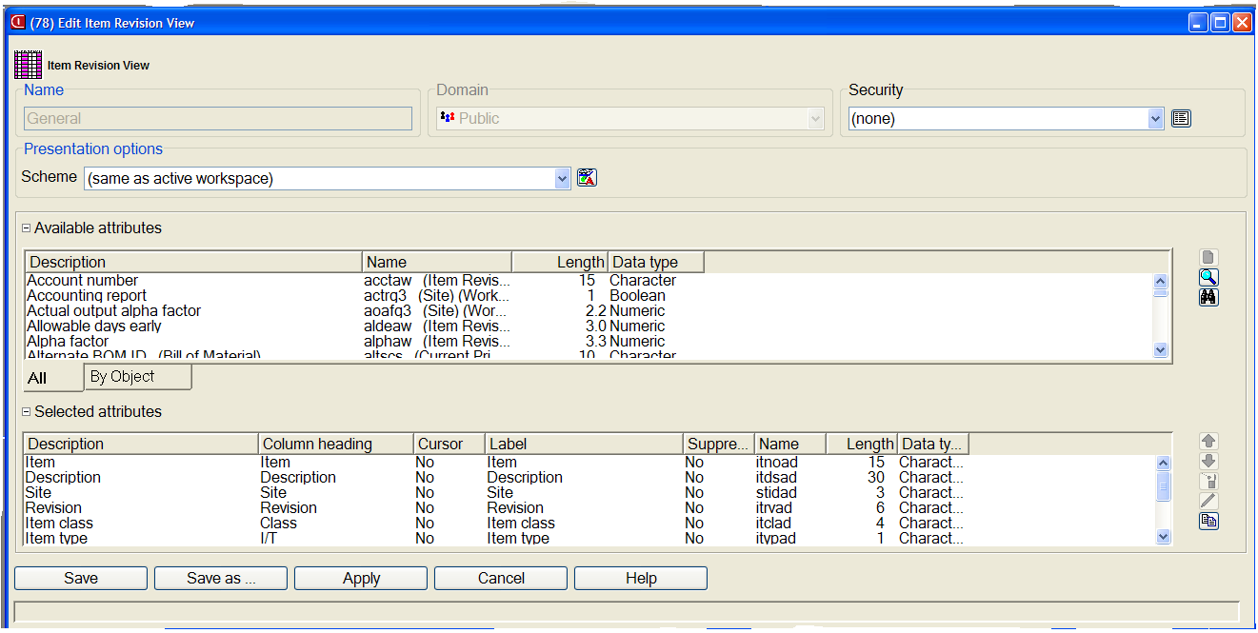
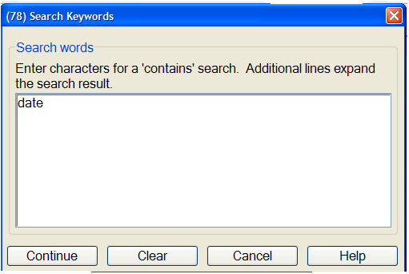
Selection of Attributes
Click on Icon for “ADD”,‘SEARCH”, or “CUSTOMIZE”
SEARCH” box appears to enter Attribute description.
Notes:
To search: in view, subset, card, click SEARCH. Enter key word and select CONTINUE. Make selection from subset of fields.
To clear search and get all fields back in R6 – Select Search again, click CLEAR and CONTINUE.

Slide 18
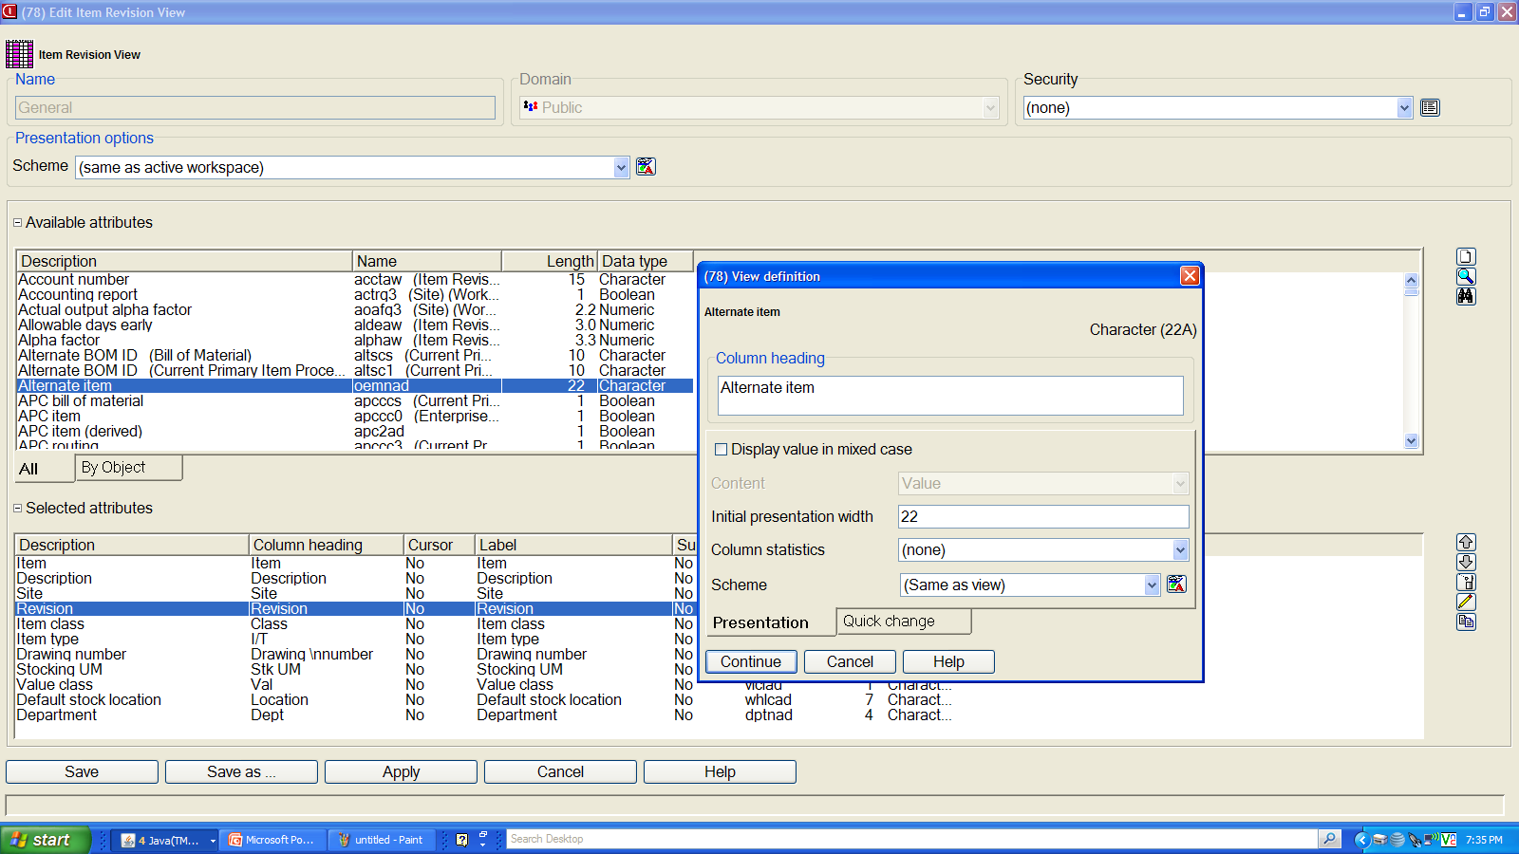
Aligning the column sequence
Highlight attribute below which you want the new attribute.

Slide 19
Selecting Attributes? (Views & Subsets)
If exact attribute name is known, click in available attribute box, and select first letter of attribute on keyboard. Takes you to first field in that letter sequence. Example: “w” for warehouse.
Sometimes “trial and error” is required since many field names are similar.
Usually select the field without the file name designation in parentheses.
Select Customize on definition screen for more information (real XA field name, size, data type).
Notes:
WAYS TO FIND NEEDED ATTRIBUTES
SEARCH SAMPLES:
Create date, Order create date or Order createD date? Use create

Slide 20
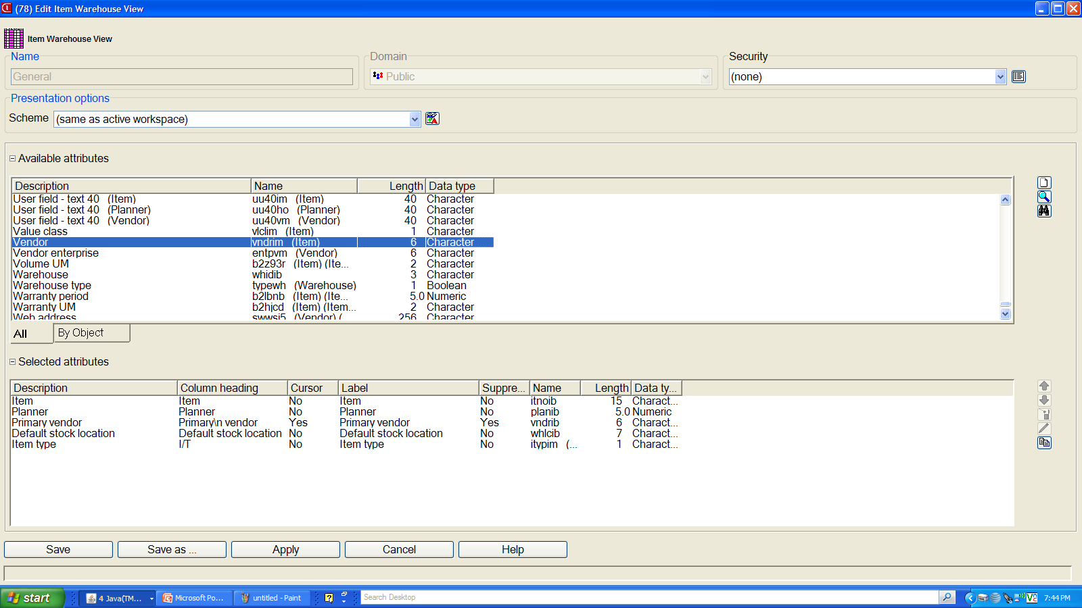
QUICK SEARCH
Click in Available Attributes section and hit the “V” key on the keyboard to get quickly to Vendor OR “W” to get to Warehouse, etc.

Slide 21
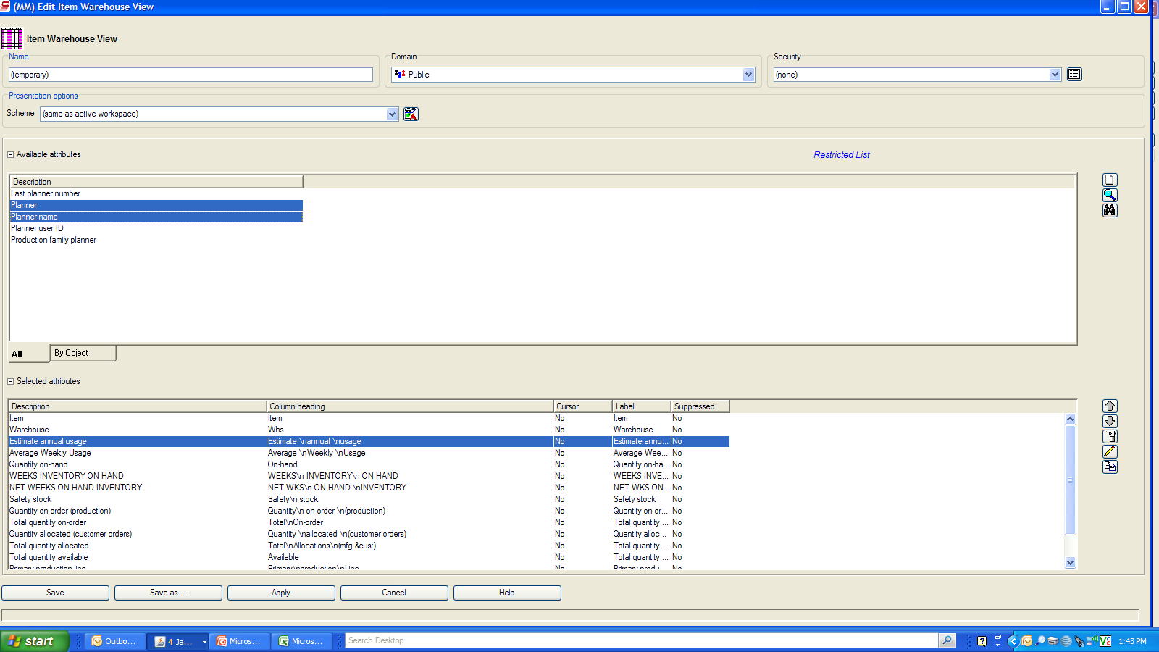
QUICK ADD of Multiple Lines
While holding down the Control Key on Keyboard, select multiple attributes, and then click on “Add” button.
The selected attributes will be added based on the position of the selected attribute in the bottom section.

Slide 22
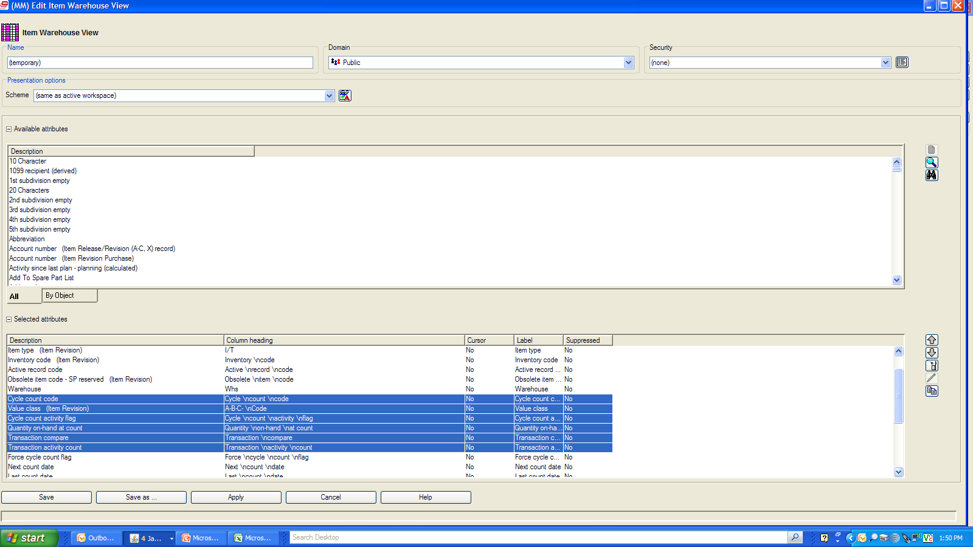
Deletion of Multiple Lines
While holding down the Shift Key and Control Key on Keyboard, user can select a range of attributes to delete. Then click on Trash Can Icon to delete lines

Slide 23
Examples of How Views Can Be Used
Data Verification/Validation
Capacity Planning
Inventory Status and Planning

Slide 24
Data Validation/Verification
EPDM Implementation
Item Revision/Facility Master/ Routing Operations
Item Warehouse Records
Vendor Masters
PO Line items
Customer Masters
CO Line Items
Workorder Master

Slide 25
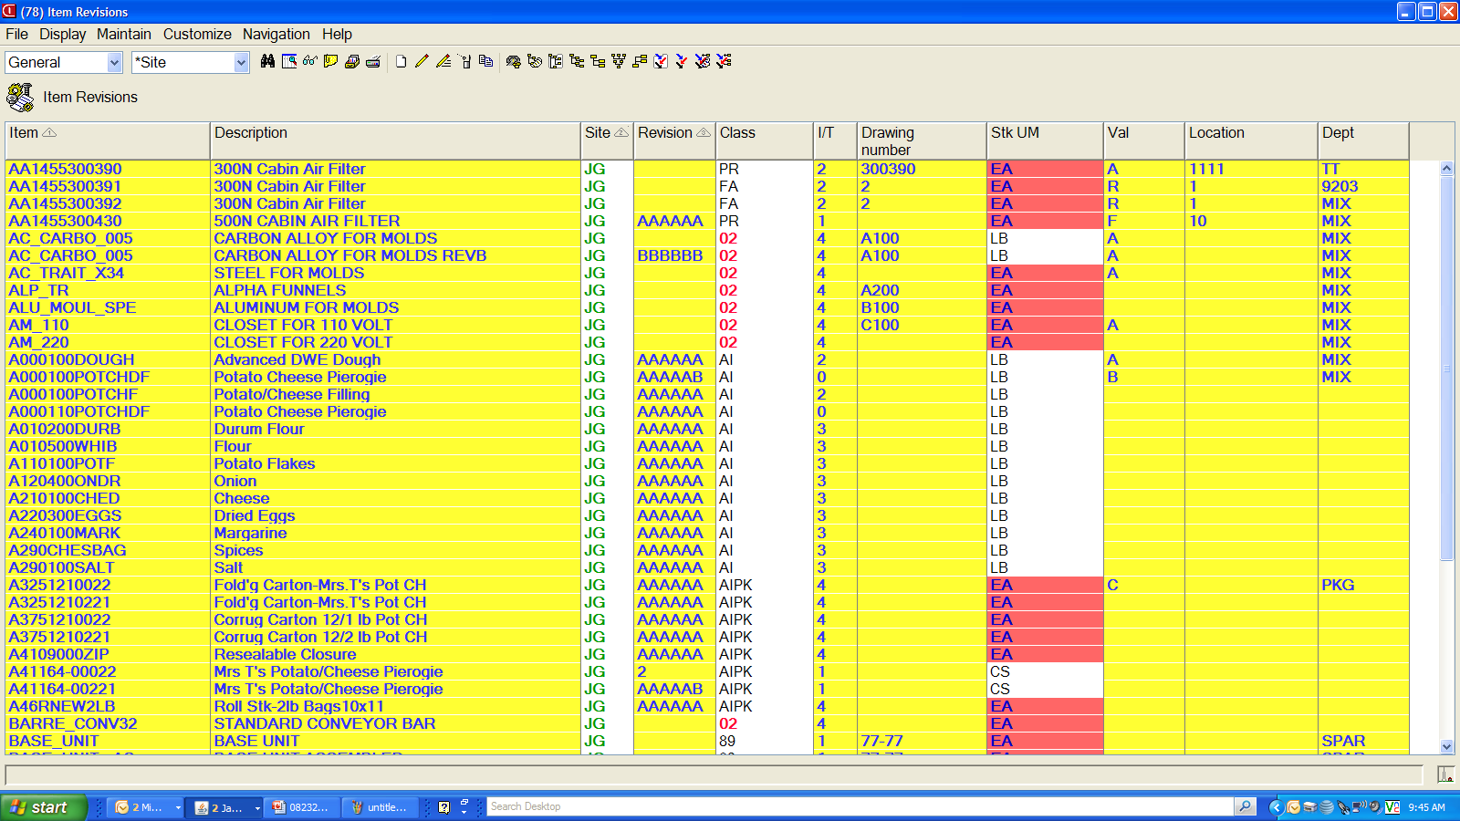
Data Validation/Verification
Notes:
Here’s a view in Item Revisions, the EPDM item master record. This view was created for a presentation.

Slide 26
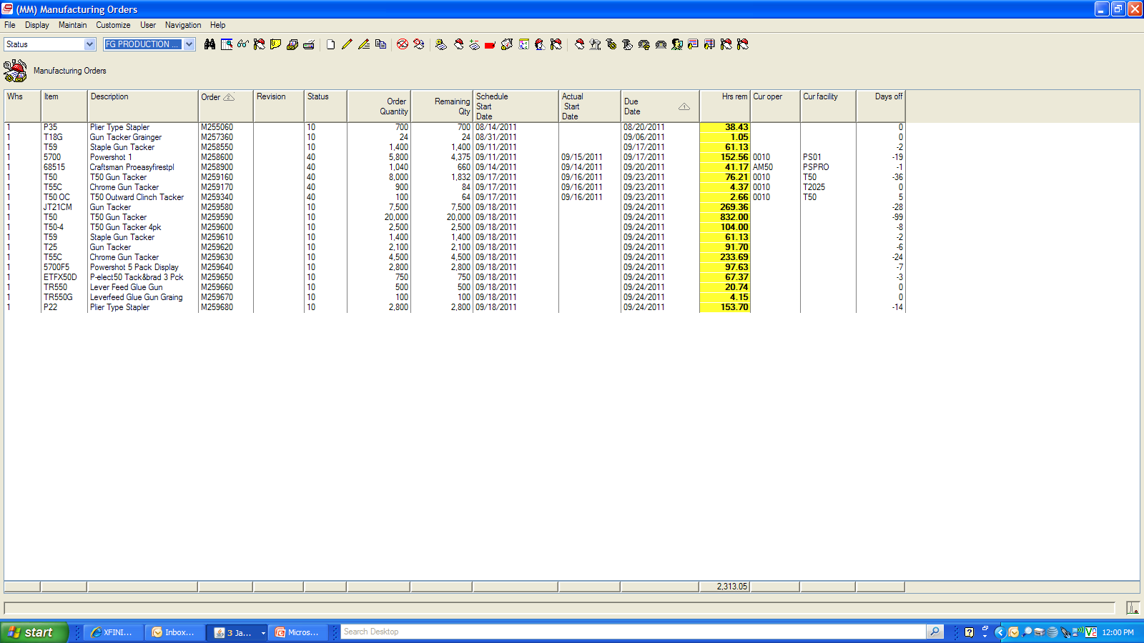
Hours Remaining Workorders/Schedule

Slide 27
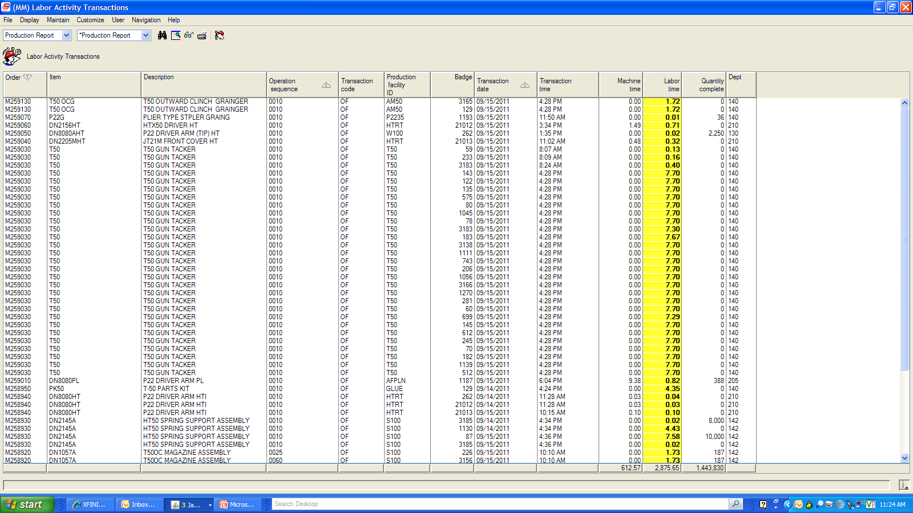
Capacity Planning/Tracking Labor Time

Slide 28
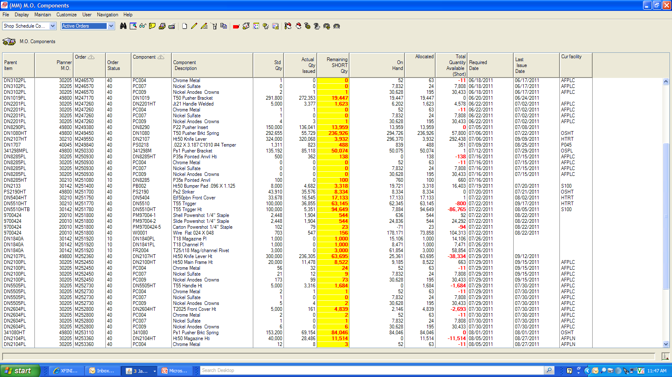
Inventory Status – Shortage Report

Slide 29
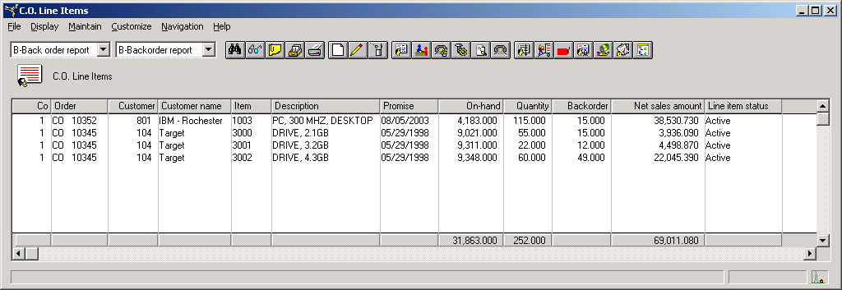
Reports - Backlog
Notes:
REPORTS:
Why dump your data into Excel and delete columns when you can “tweak” your view, give it the name of your report, and just local print—if no data manipulation is necessary.
But you can easily dump data into Excel by exporting to the clipboard and pasting into Excel or by exporting to a text file and bringing into a spreadsheet. Allows for enhancing appearance or manipulating data.

Slide 30
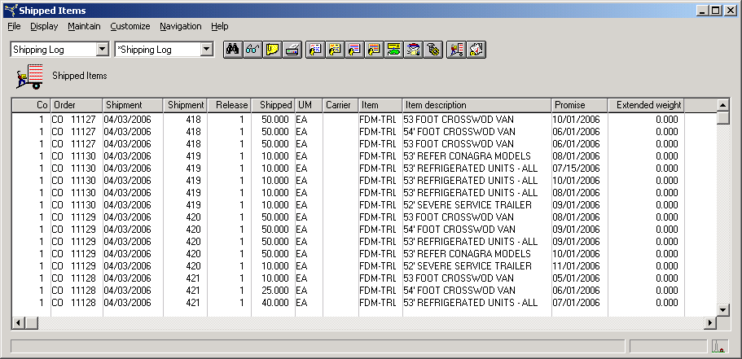
Reports – Shipping Log

Slide 31
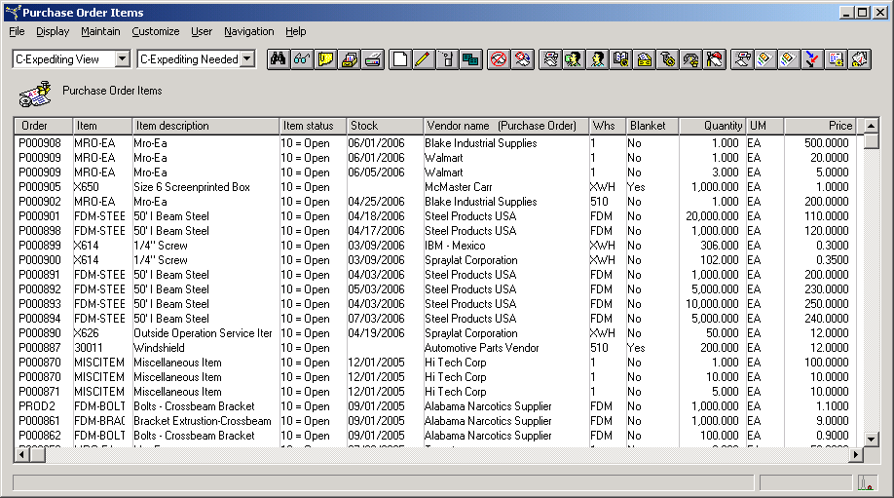
Reports – Late PO Items

Slide 32
Just Print or Export to Excel
Local Print of reports is totally acceptable - headings and data - no rekeying needed.
To enhance or enter formulas for data manipulation:
  Click File/Export to Clipboard/and paste in Excel.
  If extra large data quantity, may need to Export to Text and bring into Excel.

Slide 33
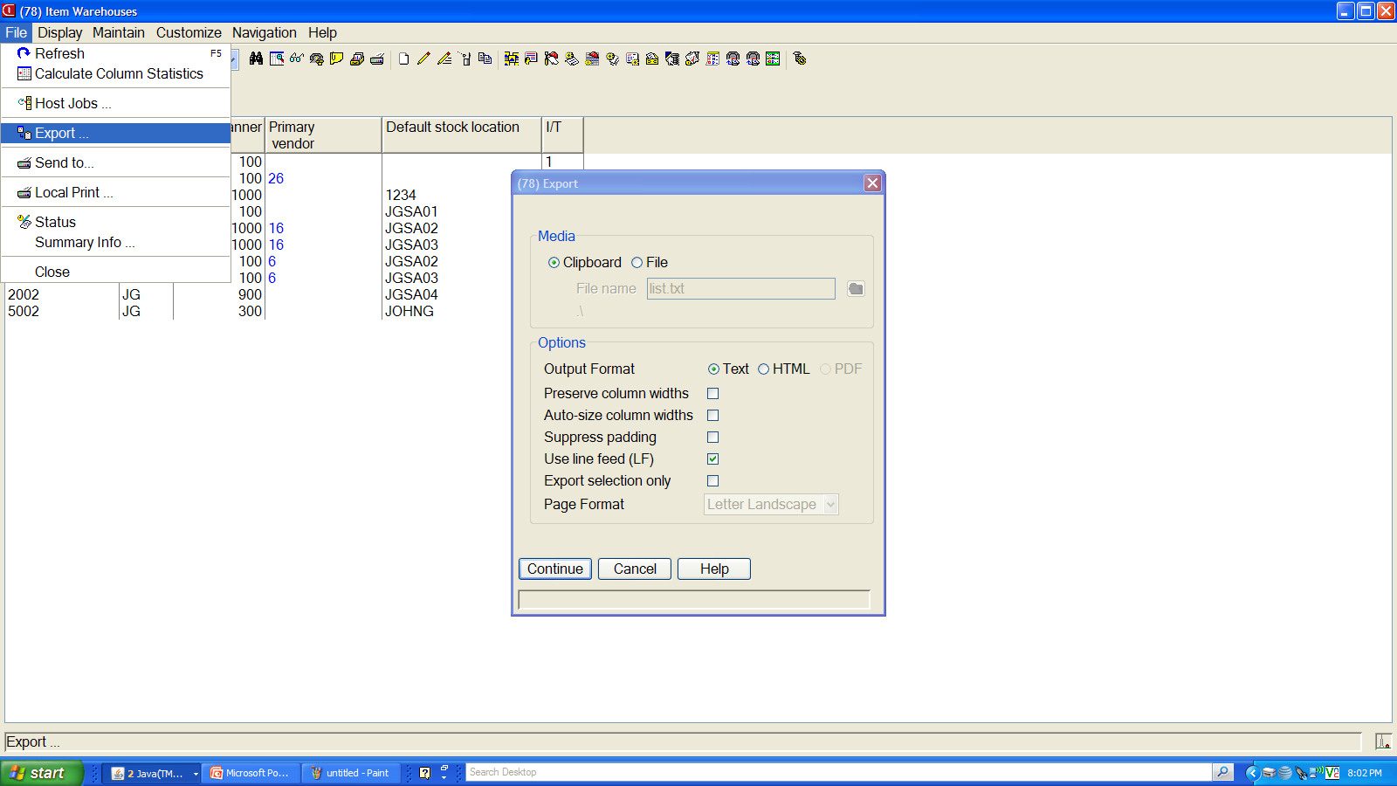
Print or Export File to add Calculations
Local print.
Or Export to
Clipboard/ Text File
Notes:
Negative items to troubleshoot/cycle count.

Slide 34
Let’s create a view!

Slide 35
SUBSETS
(rows of a spreadsheet; i.e., groupings, filters, etc)
Notes:
SUBSETS WE ALWAYS CREATE (developers typically have not sat at your desk and done your job):
Customer Service – orders by user ID
Engineering – “missing” field subsets like cost
Materials – negative on-hand
Procurement – past due
Production – daily MO production
Why YOUR SPECIAL SUBSETS:
Because of field usage:
Packing code used for customer information
Department used for
User fields and switches used as approval switches or vendor cage code for defense contractors or customer designation in the item master/revision??????
Because of outside databases brought into Browser, if you have Integrator
QA program
OEM information file
EDI information

Slide 36
SUBSET DEFINITION
What Are the Four Sections (logic choices)?
Section 1
Relational operator
  Equal/not equal
  Inequality
    Greater than
    Less than
Containment
  Contains
  Starts with
  Ends with
Also “does not” options

Slide 37
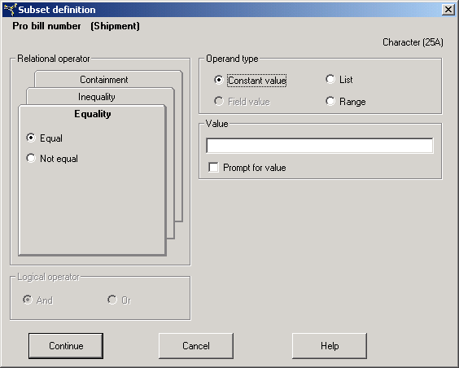
Relational operators
Operand types

Slide 38
SUBSET DEFINITION –
Section 2
Operand type
  Constant value
  List
  Range

Slide 39
Make selection – click on Radio Button.

Slide 40
SUBSET DEFINITION –
Section 3
Value
  Create prompt Option
  Or lock in value
  Automatic date selection – use system date to roll information search forward.

Slide 41
Operand types
Enter value
Create
Prompt option

Slide 42
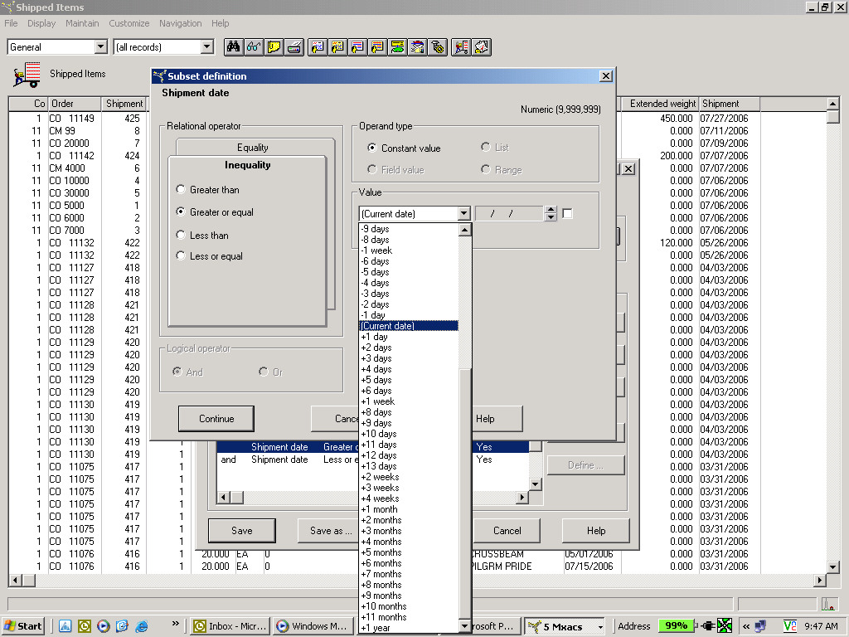
Automatic date selection

Slide 43
SUBSET DEFINITION –
Section 4
And/Or for multiple parameters
  Normally AND is appropriate.
  OR example: multiple description fields; i.e., tell the system to look in primary description field, first extended description field, or second extended description field.

Slide 44
Operand types
Use of And/Or

Slide 45
Customization Security
What level of customization security is needed:
  Public
  Private
  Group security called “Public but Restricted”
Public only for “super users” and IT…best choice.
Changes to XA defaults—don’t recommend it. Make a new version based on the default with your changes.

Slide 46
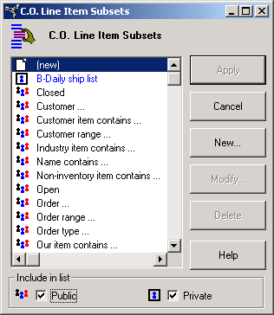
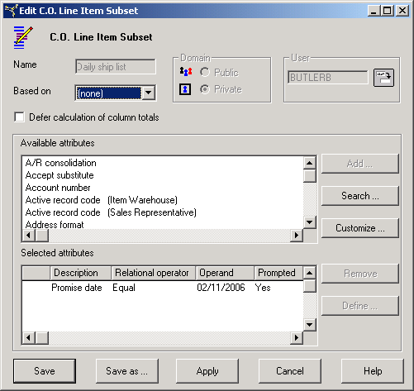
Subset Security 6.0
Public in black; private in blue.
Security category for private.
Doesn’t mean security level.
Notes:
Security category:
Public = “None”
Private = user name
Lock = User definition name

Slide 47
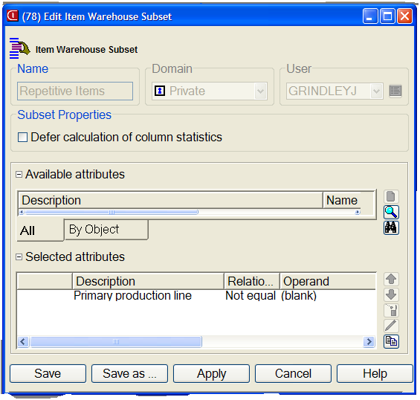
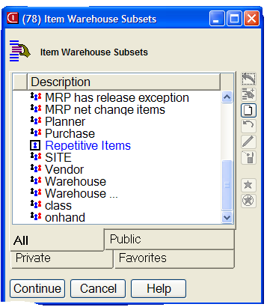
Subset Security 7.8
Apply
Append
Create
Undo
Change
Security category for private.
Public in black; private in blue.
Delete
Select dialog
box to only show private, public or ALLsubsets
Notes:
Security category:
Public = “None”
Private = user name
Lock = User definition name

Slide 48
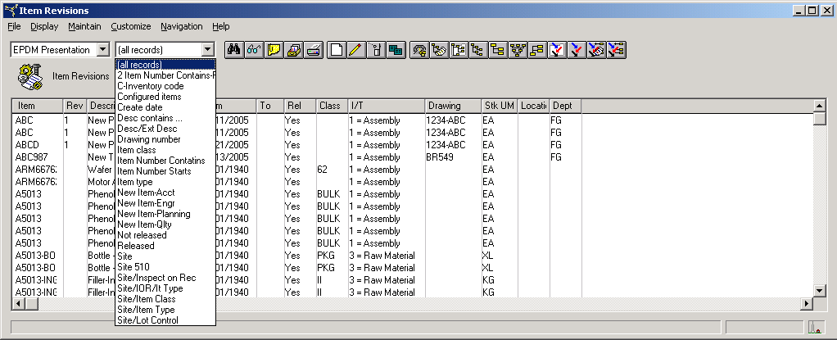
Why Use “Public But Restricted” Customization?
To shorten dropdown list of subsets or hide data from most users. (For setup instructions, see Chapter 3 of XA Browser documentation.)
Notes:
Using the subset illustration but can work for views, cards, or card files.

Slide 49
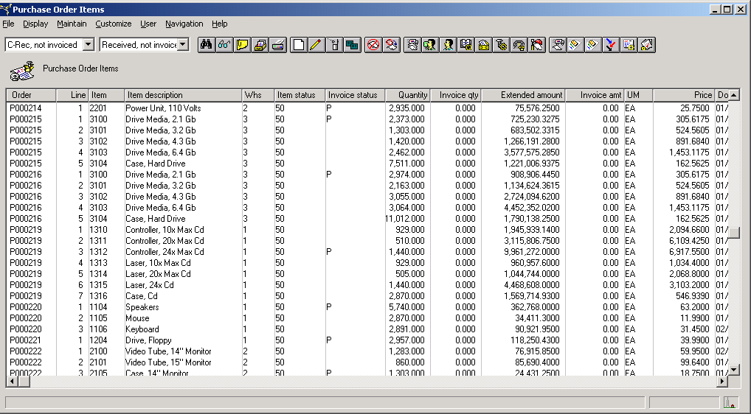
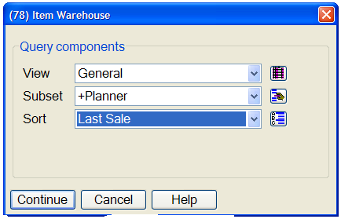
Reports – Combination of View, Subset and Sort (Local print or export to Excel)
Notes:
REPORTS
What did we ship today?
New items entered this week?
PO’s in a particular status—open, fully delivered but not invoiced.
MO’s for today.
Which items are missing costing?
Negative inventory

Slide 50
Let’s create a subset!

Slide 51
SORTS

Slide 52
SORTS – What Are Our Choices?
Sort by any attribute or combination of attributes
  Record number is usually the default (CO/MO/PO, item number, vendor number, customer number)
  Description is not normal sort, but you may need that.
  Date: newest or oldest record at top
  Highest value at top, etc.
  Combination example: Item Warehouses by item type, then primary vendor, then lead time
Format
  Ascending
  Descending

Slide 53
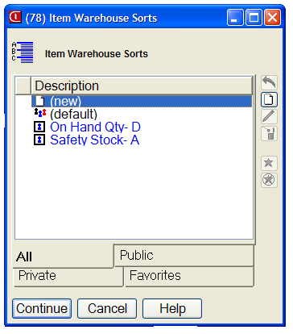
Sort Selection – Public and Private
Create new SORT
Modify existing SORT
Delete existing SORT
Naming convention suffix
“D” for descending
“A” for ascending.

Slide 54
SETTING PREFERENCES

Slide 55
Setting Preferences –
All of Browser
Display font size
Print font size
Size of clipboard
Card file tabs
Tracking history

Slide 56
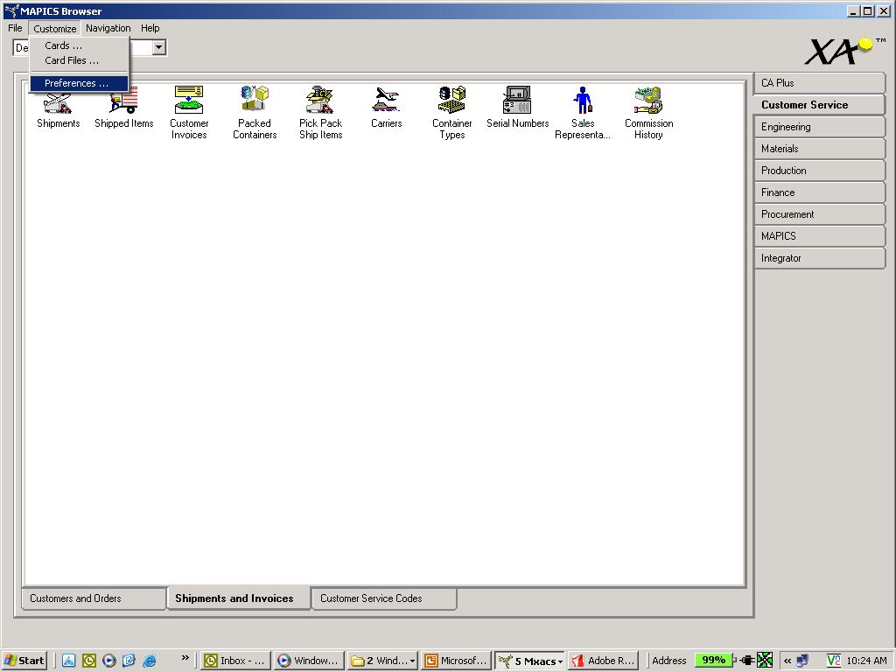
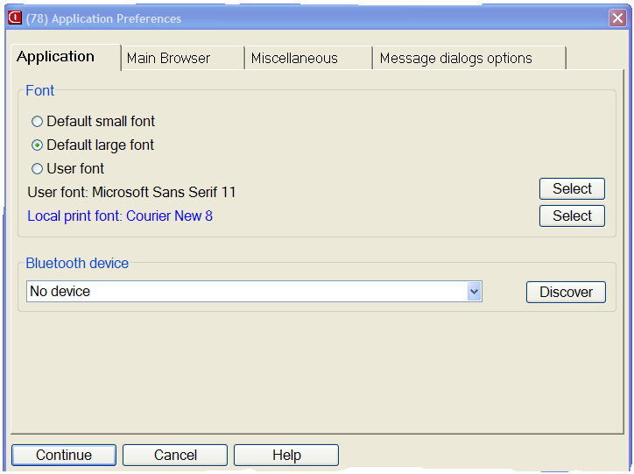
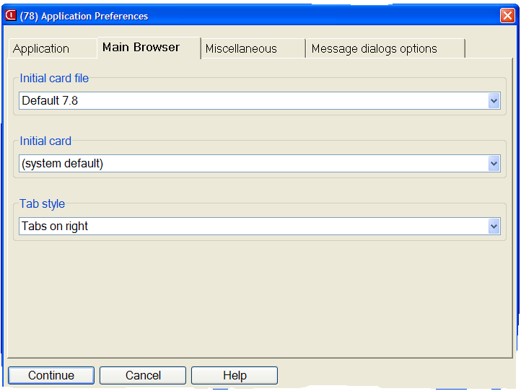
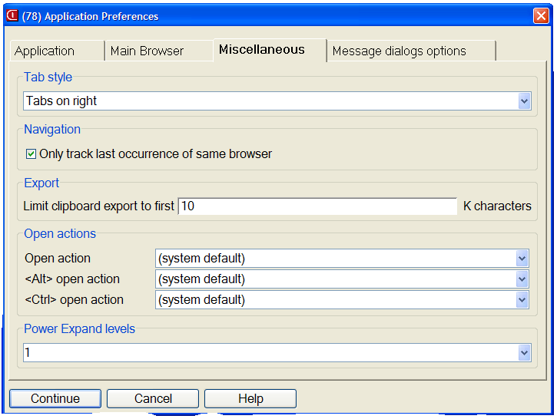
Click on tabs to
Change cards

Slide 57
Setting Object Preferences
For each OBJECT, it is very important to take advantage of views and subsets deemed important by you or your department, especially if renaming attributes (normal fields or user fields) or if interfacing to outside databases. If you always use the default “General” view—you may be missing key information!
Expedite record entry in Browser by setting preferences to lock in default settings.
Notes:
Review all objects where you will be inquiring or creating records.

Slide 58
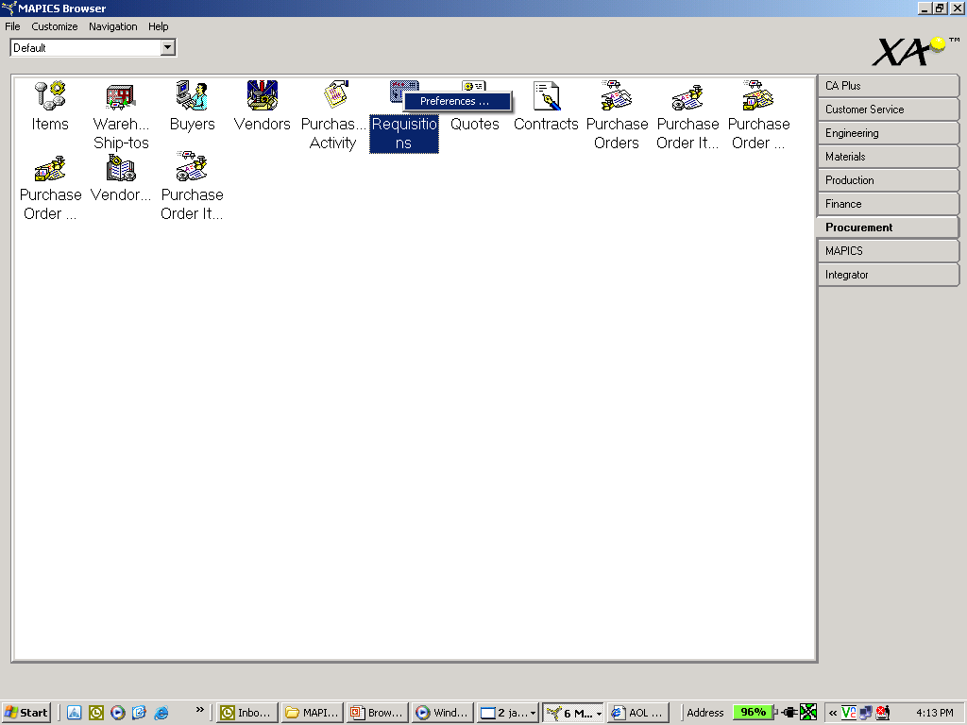
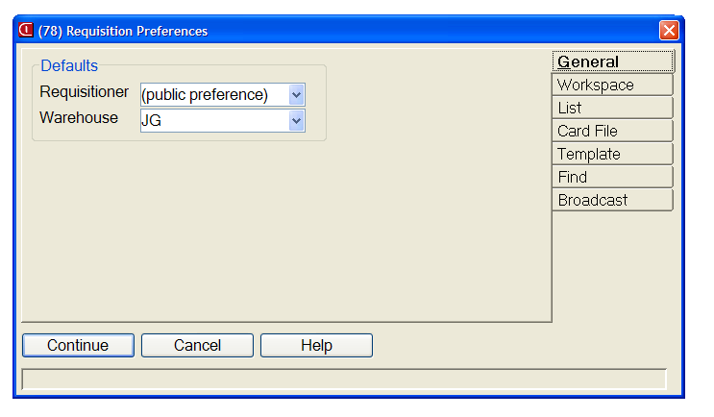
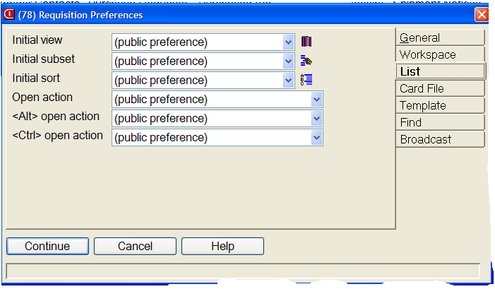
Right click, select Preferences, and select choices.

Slide 59
Did We Cover the Agenda?
Powerlink Views
  What are they?
  View considerations
    I want MY data fields.
    Code files – value, alias, or value and alias
    Control number of decimals (save “real estate”)
    Change headings (again to save “real estate”)
    Column Statistics
    Schemes
  Create Reports

Slide 60
Did We Cover the Agenda?
Powerlink Subsets
  What are they?
  Subset considerations
    Major data queries
    Relational operators – equal, not equal, contains, starts with, greater than, less than
    Operand type – constant value, list, range
    Value – prompt or lock in value(s)
    Use of and/or in logic for multiple parameters
  Customization security levels
  Create Reports

Slide 61
How can I leverage Powerlink?
CISTECH Quickstart
2-4 departments, 2-4 days of assistance
1.5 day of general training
½ day with each department to develop tailored views, subsets, workbenches, create reports, etc.
Result: at the end of the engagement, users have incorporated Powerlink into their daily activities to become more productive.
Notes:
Though we just promised to cover views and subsets, we provided “freebies.”

Slide 62
Thanks for attending today!

