Slide 1


CISTECH
IFM ENHANCEMENT PACKAGE
IFM ENHANCEMENT MODULES/SUITE
A suite of IFM Enhancements from CISTECH which provide you better tools to manage your XA IFM Financial Applications.
Our clients have insisted on improvements over the years to improve efficiencies in IFM. These products are a result of our knowledge and efforts.

Slide 2
The CISTECH IFM Tools
THE IFM ENHANCEMENT MODULES/SUITE
FAST CASH IFM ENHACEMENT –allows your Team to Streamline AR cash allocations – provides for quick allocations of Customer Payments over the current IFM slow and tedious Cash Allocation from Cash/Deposits in your Ledgers and Cash Books – Great for high Volume Shipments/ARI in IFM – keep AR Ledgers Clean!
EFT/ACH FOR IFM - Electronic Funds Transfer saves your XA Team time and money. Take your AP Payment process paperless with electronic payments to vendors with this great tool.
AP PENDING FOR IFM - An audit tool to quickly reconcile purchase receipts not invoiced and balance accruals - a ‘must have’ for RNI Reconciliation and the management of Variances & Cash Flow!
ELECTRONIC LOCKBOX FOR IFM - Streamline AR cash Receipts and IFM AR Allocation Processes by importing cash receipts from data received from your bank. Clear separation of Wire Allocations when interfaced with your XA IFM system!
IFM GLI ENHANCEMENT – Review your Unassigned, Assigned, and Posted Inventory, PC&C, Repetitive GLI Detail History. A MUST have for posting your GLI Detail in Summary for Ledger Impact!
SPLIT ACCOUNTS FOR IFM (and AM) – Designate a Clearing Account, and allows you to split the Charge, or Offset Amount, to up to 4 other accounts from your Items Cost Content for GLI Transactions– great for Cost of Sales by Material, Labor, and Purchased/Manufactured Overhead !

Slide 3
IFM Fast-Cash Module
CISTECH FAST CASH
Make IFM AR payment processing more accurate and efficient with CISTECH IFM Fast-Cash – a lean tool for reducing DOS and improving Cash Flow !
CISTECH’s Fast Cash for IFM was developed to optimize the cash application process, and is particularly valuable to companies that process high volumes of invoices and deductions, especially from large retail chains such as Pharmaceutical Outlets, Target, Wal-Mart and other major distributor/retailers.
Fast Cash enhances your existing Infor XA IFM Cash Receipts and Allocations processes by integrating payment matching, write offs, credit processing as well as other functionality required to manage and support enterprise cash flow application processes.

Slide 4
IFM Fast-Cash Module
Benefits of using Fast Cash
Reduce time and effort required to apply customers payments.
Apply multiple coded deductions to individual invoices – addresses Lean for Finance!
Increase customer satisfaction through increased processing accuracy of customer payments to IFM XA Settlement Lines and improve your Cash Flow and Customer Support accuracy!
Improve control of applied credits with a closed-loop processing method for each Entity/Personal Account, or Allocation Groups !

Slide 5
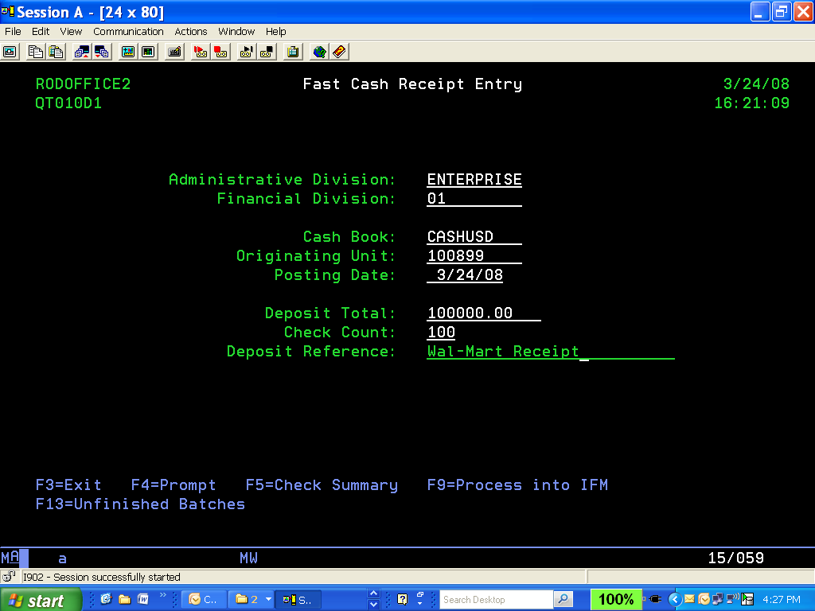
IFM Fast-Cash Module
Fast Cash Features and Functions
Fast Cash improves access and selection of open invoices and credit memos, assists with matching deductions to invoices and allows multiple deductions on a single invoice.
This enhancement also provides for assigning multiple, pre-defined deduction types to a single invoice; it balances deposit totals; and generates credits for overpayments.

Slide 6

Cistech IFM ACH/EFT
CISTECH EFT ENHANCEMENT
Paying your IFM AP Invoices Electronically….
Eliminate costly IFM Check Processing and Paper to settle with your Suppliers and improve Supplier Relationships

Slide 7
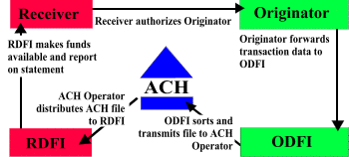
How EFT/ACH works with IFM ?
EFT = Electronic Funds Transfer
ACH = Automated Clearing House
Your Supplier
Your Finance Team uses CISTECH XA EFT/ACH System
Your Teams Bank – ie.’ AM South
Your Vendors Bank
Originator -any individual, corporation or other entity that initiates entries into the Automated Clearing House Network – THIS WOULD BE YOUR XA IFM AP PAYMENT LIST TRANSACTIONS ..WE BRIDGE IFM AND YOUR BANK!!
Originating Depository Financial Institution (ODFI) -A participating financial institution that originates ACH entries at the request of and by (ODFI) agreement with it's customers. ODFI's must abide by the provisions of the NACHA Operating Rules and Guidelines.
Receiving Depository Financial Institution - Any financial institution qualified to receive ACH entries that agrees to abide by the NACHA Operating Rules and Guidelines
Receiver -An individual, corporation or other entity who has authorized an Originator to initiate a credit or debit entry to a transaction account held at an RDFI (Your Suppliers Bank).

Slide 8

How Cistech, XA and EFT Work
The Cistech EFT/ACH Interface creates a file during normal IFM AP Payment List processing to enter the EFT/ACH Processing Network. Your Bank expects you to transmit to their Internet Site…we provide it …..
XA IFM
Payment Processing
No more Printing and Stuffing Checks !!
Jacana
Software to
Email/Fax
Remittance
XA Remittance
Detail
Payment File
For Bank
CISTECH
EFT/ACH
INTERFACE
Email or Fax of Vendor Remittance of XA IFM Payments to each supplier – Savings!
Your IFM CISTECH IFM EFT File and Internet Link to your Bank

Slide 9
Benefits of CISTECH EFT/ACH
Eliminate the need for Pre-Printed, or Electronic Check Forms – Significant Win and Controls!
Eliminate some of the major costs of Check Printing (Forms, Employee time, toner, preparation)!
Eliminate mailing costs for IFM AP Checks and Remittance Detail – Significant Win!
Eliminate Lost Payments caused by USPS and private carriers – Supplier Relationship Win!
Provide the Vendor with immediate payment detail, via fax or email, in many cases, even prior to the vendors bank notification !!
Creates a file of the Payment Information, TAILORED FOR YOUR BANK(S) EFT/ACH, that is easy to submit via the Internet or the Banks FTP site. We can help every step of the way !!
Email tracking allows for you to validate that the Vendor was sent the remittance information following the IFM AP Payment processing – Resend email and save time for your Team!!
The IFM EFT/ACH File includes the IFM AP Payment List information for quick reference to IFM Payment Detail – Matches IFM Detail and Cashbook Ledger Entries exactly !!
Maintains the Integrity of XA Transaction Settlement Lines for Vendor Invoices, which can link to the ACH/EFT File created for bank processing to M-Tek Suppliers of goods and services.
Improves Vendor Relationships and communications with their teams.

Slide 10
CISTECH EFT/ACH for IFM Pre-Requisites
Infor XA IFM Release 4 through 7
Jacana or other 3rd Party Electronic Document Distribution Software if user desires Emailing/Faxing of Remittance Section of AP Payment to Suppliers
Cistech AFT/ACH Software Interface for Infor IFM – Tailored for your bank and release of IFM.
Development for the XA IFM AP Remittance Section format to be used for Vendor Email or Fax (Cistech form templates available for Remittance)
Server(s) for Email and Fax solutions for the ACH/EFT remittance detail to be provided by the user. Cistech can provide a turn-key solution so simply let your Account Executive
Recommend on-site Education/Training for IFM Team Users and IT Support staff – your Account Executive will most likely include 2 to 3 days for Accounting and IT personnel for proper turnover of the processes.

Slide 11
AP PENDING - Overview
Monitor and Reconcile Purchase Receipts-not-Invoiced with a Powerful Reporting System developed for Infor IFM XA
CISTECH’s AP Pending helps you quickly and accurately reconcile the accrued liability of your Receipts Not Invoiced account, including the ability to remove Purchased Overhead to match your GL Rules for RP and CA Transactions.
The complex Infor RP and CA transactions directly affect the accuracy of your Balance Sheet, and improper calculations can result in adjustments to asset or liability accounts of millions of dollars to your Organizations P&L – a great tool for Finance.
By bringing together all elements of inventory, warehouse, invoices and receipts in dynamic reports, you’re able to more quickly validate the accrual account, and be proactive before problems occur.

Slide 12
AP PENDING - Benefits
Benefits of using CISTECH AP Pending
Properly reconcile your Infor XA IFM “Un-invoiced Receipts” liability account
Enable accurate balance sheet representation of asset and liability accounts
Minimize large adjustment transactions – negative RP’s, AP Credits, GLJ’s
Prove P&L Variance Entries from the CA Transaction with Date Sensitive Extracts and Reports
Use as a tool to review Costs, and Purchased Inventory Variances that might warrant cost or Supplier intervention
Ensure compliance with internal and external audit requirements

Slide 13
AP PENDING - Features
AP Pending Features and Functions
AP Pending reporting capabilities give you flexible, real time access to vital information. On your balance sheet for any period, you can:
Review invoiced and un-invoiced warehouse inventory receipts
Review purchase price variances
Review plant warehouse inventory receipts
Review open IFM balances for inventory charge line receipts and invoices paid-to-date
Gain immediate access to Inventory IFM charge lines for specific material receipts, cost adjustments and settlements by vendor, purchase order or other reporting elements
Support your finance team’s compliance to Sarbanes-Oxley and government regulated requirements for proper retrieval, support and documentation
Create Excel output during reporting for quick analysis by purchasing teams

Slide 14
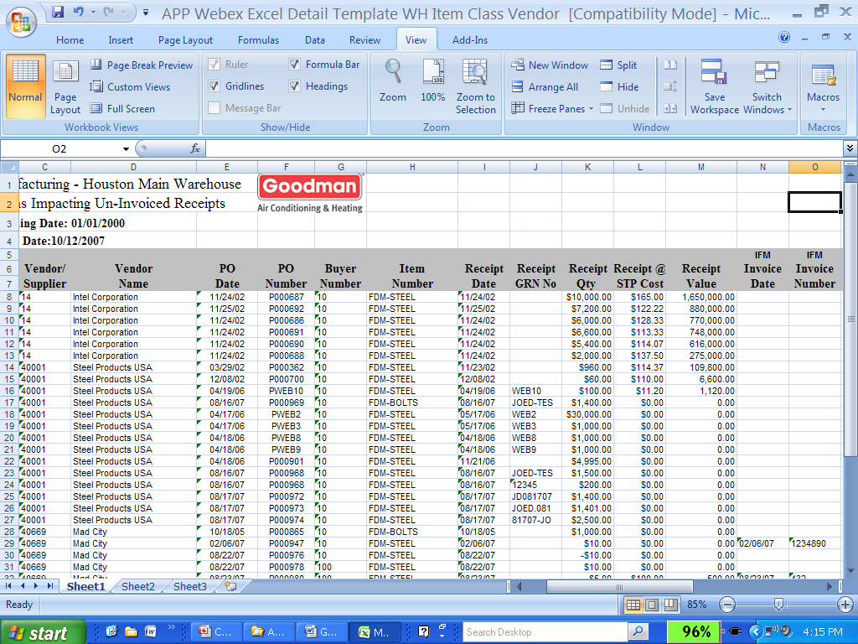
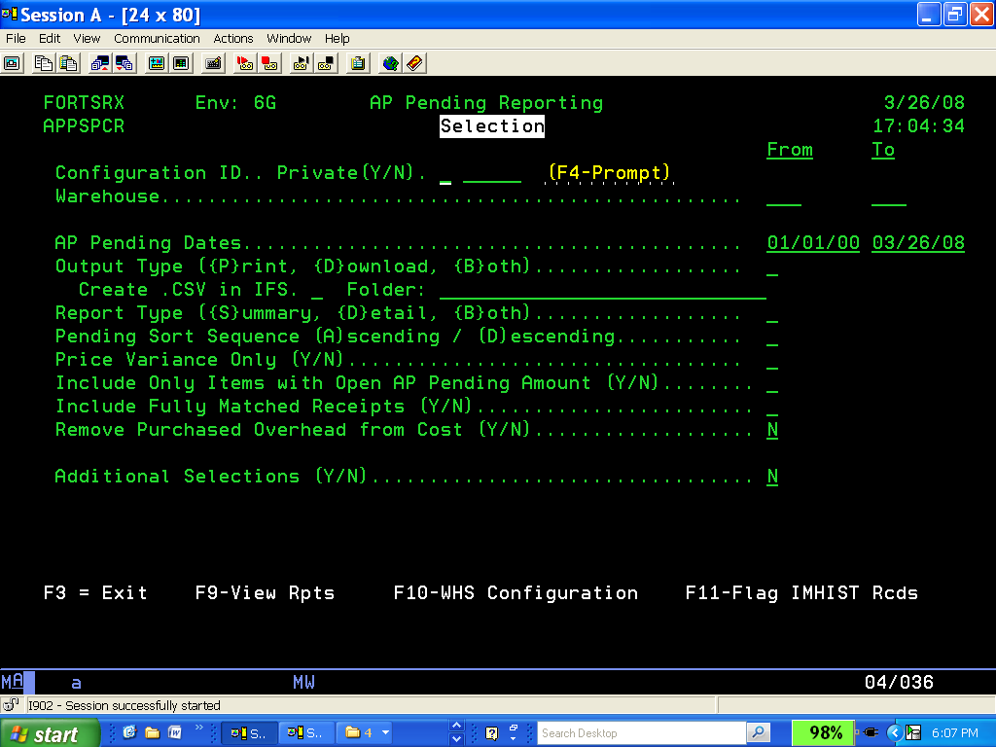
AP PENDING - Features
Audit your RP Transactions and see the impact of your PPV (CA) - slice and dice with Office Excel once AP Pending obtains the exact detail or summary information for Inventory Transactions and IFM Charge Lines - your True AP Pending Results!
Not just for Finance, but, can evaluate Material Receipts from History in many Configurations, provide Variances by Supplier for Buyers, and comes ready with MS Office Templates for import into Excel for immediate distribution.

Slide 15
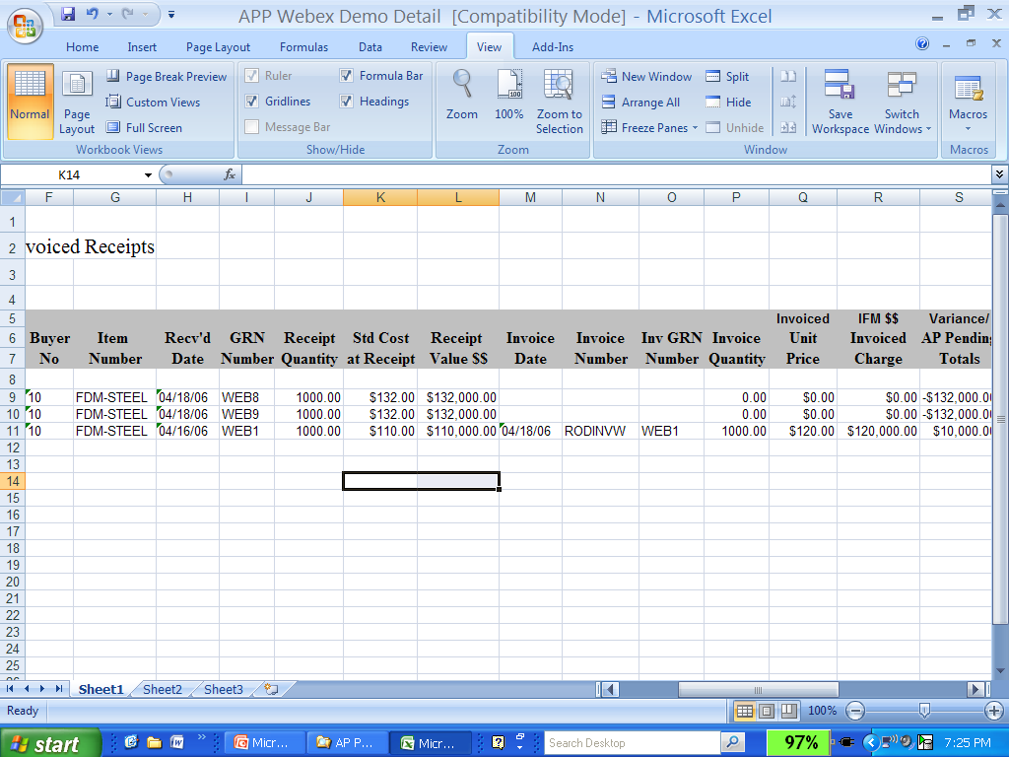
AP PENDING - Features
Multiple Environments, Warehouses, and User Configured W/H Criterion, allow for you to review Inventory Receipts, Open AP by Period (with retro-active ability to prove Receipts-Not-Invoiced), and to review IFM Summary, or Detail, for Inventory Receipts for that Period– you have a complete tool for using in multiple areas at your Plants !!
Receipt Data
IFM Charges
The Integration of Inventory Receipts with IFM Charge Lines – allows your Buyers, Materials Team, and Finance to use the CISTECH AP Pending Tool to review areas needing immediate attention and to support Perpetual to Book Fiduciary Responsibilities !
Support your CA Summary impact to IFM, and quickly identify Supplier Materials with High Impact variances - Financial Tool, Buyer Tool, Materials Tool for Incoming - Team Win !

Slide 16
CISTECH – IFM LOCKBOX
Streamline your AR Cash Application Process
CISTECH IFM LOCKBOX

Slide 17
CISTECH LOCKBOX - PURPOSE
CISTECH’s LOCKBOX tool allows cash receipts to be posted into IFM from a file received from your financial institution.
IFM Deposits in your
Cashbook
CISTECH
IFM LOCKBOX
INTERFACE
SOFTWARE
Your Bank
Deposit Request

Slide 18
CISTECH – IFM LOCKBOX
What is CISTECH Lock Box
Lockbox Transfers provide real-time accounting benefits of simple, paperless cash receipts, and better control and management of receipts and their posting dates. CISTECH’s Lockbox tool generates activity reports that give accounting the opportunity to proof and edit activity transaction details prior to the actual posting.
BENFITS OF LOCKBOX
Save the cost of manually keying information received from your financial institution.
Provide faster and more reliable cash receipt postings – CASH FLOW and IMPROVED CUSTOMER SERVICE DELIVERY OF DATA !
Eliminate the time consuming, manual cash receipt entry.
Gain better control your receipts and receipt schedules with real-time accounting DIRECTLY TO YOUR IFM CASHBOOKS AND IFM GENERAL LEDGER!

Slide 19
CISTECH – IFM LOCKBOX
Lockbox Features and Functions
Automatically generated reports with detailed error tracking.
Editable proof reports.
Receipts may be changed to Miscellaneous Cash records and sent to IFM through the Legacy System Bridge (LSB) application.
Detailed system checking to ensure that data is not overwritten.

Slide 20
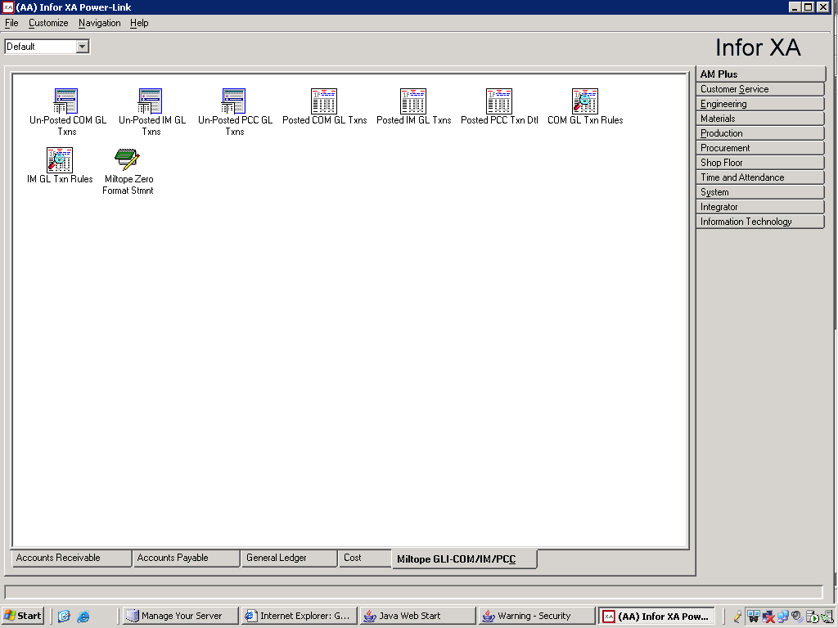
The Cistech GLI Enhancement Module
Unposted and Posted GLI Detail Objects
UNPOSTED GLI
POSTED GLI
Make sure all of your GLI Detail is posted quickly
Quickly Review any “Un-Assigned” Transactions
Predefined Subsets for reviewing Variances and specific Transactions before they impact your AM, or IFM General Ledger
Get Pro-active easily with the CISTECH GLI
As Entries are passed into IFM and removed from your GLI Files the detail that support EXACT Journals is captured in the CISTECH Posted GLI Detail Objects
Predefined Subsets for quickly reviewing Period/Nature – Charge, Offset and Variance impact
Supports Summary Activity
The XA GLI Files and new CISTECH GLI Posted Detail History Objects are all part of the new Cistech “GLI ” for XA R6 or XA R7 Power Link !!
A “MUST HAVE” FOR IFM/AM USERS FOR SARBOX COMPLIANCE
A GREAT TOOL FOR IFM USERS TO ELIMINATE ‘DATA MINING’ OR INTEGRATING IFM DETAIL FROM IFM AP CHARGE LINES AND UAQNCPP GL DETAIL !!

Slide 21
CISTECH GLI Benefits
Easy access with new Browser GLI Business Objects for Unposted and Posted GLI Transactions
The ability to review your Unassigned, Assigned, and any Invalid GLI Transactions in Browser
Review your GLI Transactions BEFORE they are booked – question variances and high dollar amounts that might be in error before they are booked to your Ledger
The ability to review GLI Detail that has been posted to your XA General Ledger – detail to quickly support Summary GL Entries from REP, COM, IM, and PC&C.
Capturing the Exact Journal with the Posted GLI Detail
Pre-Packaged Views/Subsets/Sorts for managing your GLI Detail eliminate ‘data mining’ during Month-end and Audits
Sarbox Compliance, and Audit support for AM with Cistech GLI – a User Benefit for IFM.

Slide 22
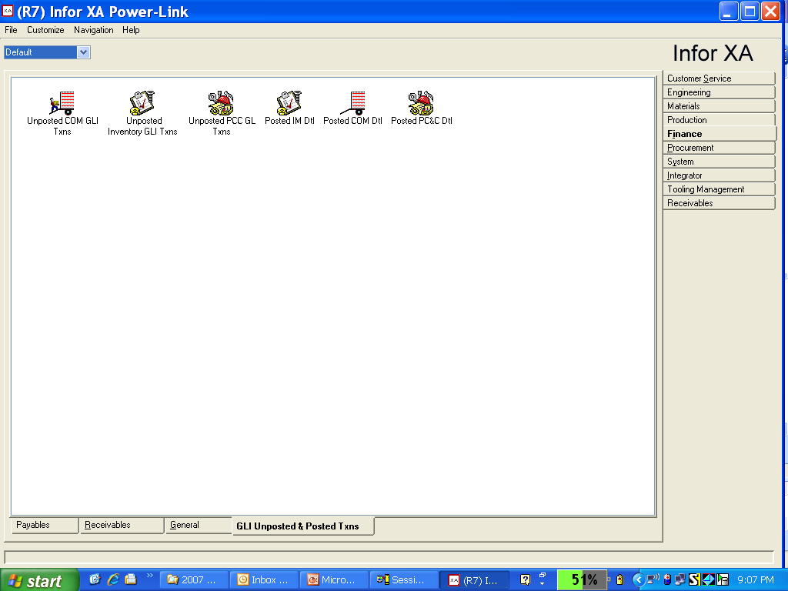
CISTECH GLI Flow
CISTECH Trigger Programs
update the Posted GLI Detail
Files when you “Create GL Entries”. This insures the EXACT detail is
captured and available to support your entries Summary or Detail Journals!
Create GL Entries
IM, COM, or PC&C
Process
TEMGEN
Posted GL
YAA7REP
Posted GL Lines

Slide 23
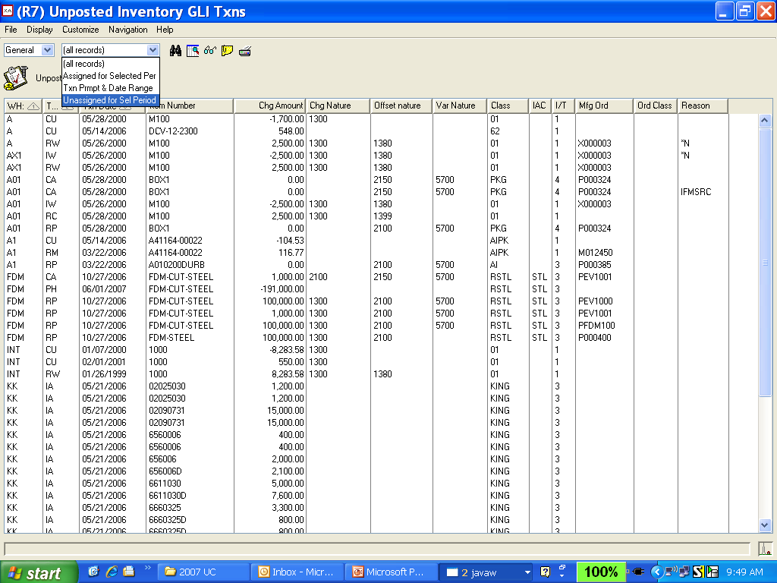
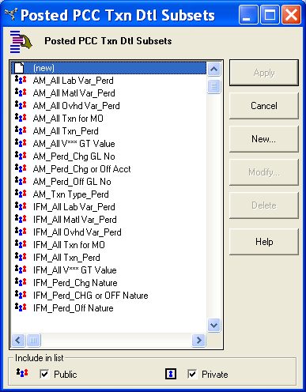
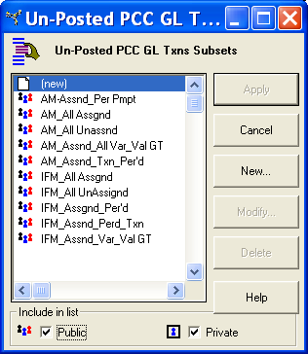
CISTECH GLI – Unposted Integration
Predefined Subsets for AM/IFM – Assigned and Unassigned Objects
THE CISTECH GLI ENHANCEMENT IS PLUG AND PLAY FOR R7

Slide 24
Manage Posted Transactions – CISTECH GLI
As your IM, COM, and PC&C GLI Transactions are
Posted, and then moved to the CISTECH Posted GLI Objects,
..the EXACT JOURNAL NUMBER is captured for the
Detail, even if you Summarized your Entries !!

Slide 25
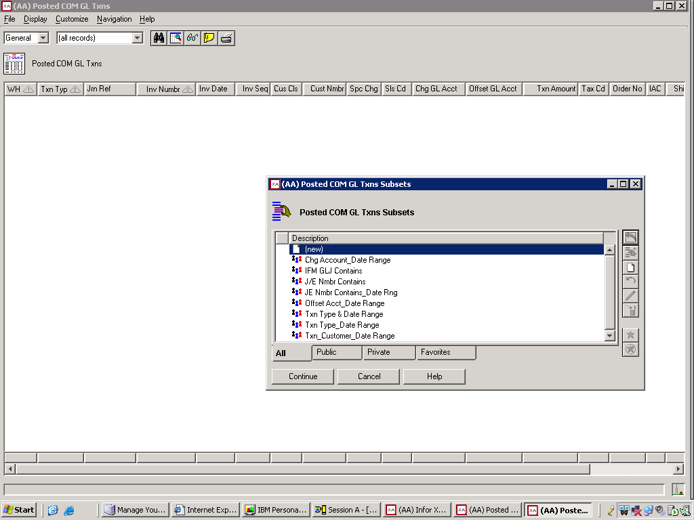
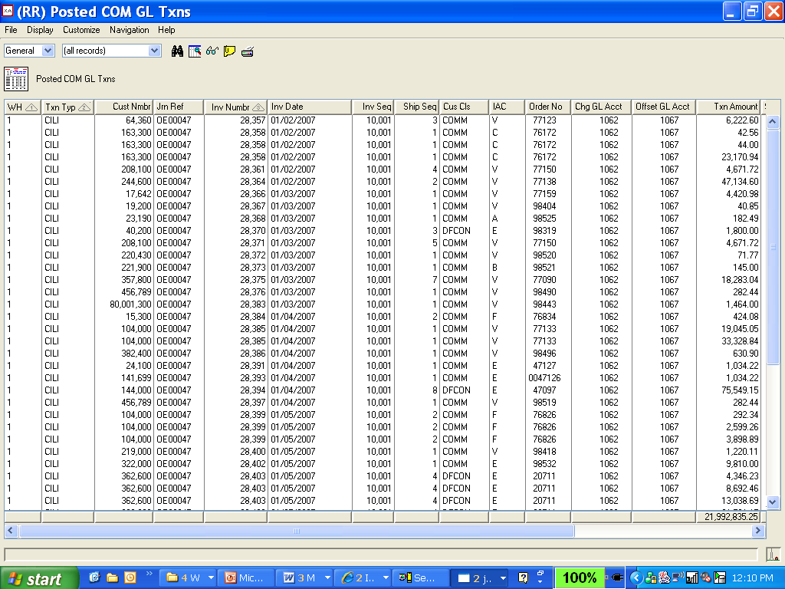
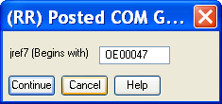
Manage Posted Transactions – CISTECH GLI
Regardless of AM, or using IFM, the CISTECH GLI Enhancement Module let’s your Finance Team quickly prove a Journal that was posted from IM, PCC, COM, or REP GLI Detail.

Slide 26
Financial Enhancement Summary
Why Invest in the CISTECH Financial Enhancements ?
FAST CASH = Reduce Cash Allocation Time, decrease DSO, improved Customer Service and accuracy
EFT/ACH = Eliminate Check Printing Time , eliminate Forms, better control of Remittance Processes and Supplier Relationship improvements
ELECTRONIC LOCKBOX FOR IFM = Immediate visibility on Cash Availability, time savings for recording deposits and eliminate manual IFM Cash Deposit Transactions. Married with EFT/ACH – a really tangible Cash Management Tool Set.
AP PENDING = Manage your Un-Invoiced Receipts, prove your P&L Variances, improved visibility of Costing, Materials and Cash Flow
GLI ENHANCEMENT MODULE FOR IFM & AM – A must have for AM Users posting GLI Detail to the Ledger in Summary. For IFM Users, an efficient tool to review GLI Detail before it posts, and to more quickly support Journal Entries booked from IM, PCC/REP, and from COM.
TANGIBLE COST SAVINGS – IMMEDIATE BENEFIT AND RETURN ON INVESTMENT

Slide 27
FINANCIAL ENHANCEMENTS FOR IFM
AP Pending - $1,500 (+ 1-2 day of services)
FastCash - $4,500 (+ 1-2 days services)
Electronic Funds Transfer (ACH) - $4,500 (+3-5 days services)
Lockbox - $4,500 (+ 3-4 Days Services)
GLI Interface - $7,500 (includes services)
The entire suite of products - $20,000 (+ services)
  All products have an optional annual fee of 20% that entitles customers to 24/7 support and free upgrades
  All products come with a 90 day warranty

Slide 28
THANK YOU !
To discuss putting the CISTECH Financial Enhancement Package, or any module in place at your Organization, you may contact:
Ben McCormick
CISTECH, Inc
Ben.McCormick@cistech.net
704-814-0016
FOR MORE INFORMATION GO TO: http://www.cistech.net/XA-Offerings/Cistech-Enhancements.aspx

