Slide 1
Transform Your Procurement Process with
Supplier Portal!
Ben McCormick Phil Joseph
Ben.mccormick@cistech.net phil.joseph@catavolt.com
704 301 8418 678 916 3868

Slide 2
The Problem: Supplier Communication
…can be inefficient
  Their systems may be manual
  Your systems may be manual (fax, e-mail, etc)
  Our orders may be lost in their swamp
  Their e-mail communications may get lost in our swamp
  Auto-fax systems don’t provide a central repository of PO status.
…can be error prone
  Orders, lines, dates, quantities can get mixed up
  Releases get missed
  Drawings get lost
  Scraps of paper get misplaced

Slide 3
Why it’s a problem
Higher production costs
  Extra inventory to buffer unreliable suppliers and communication failures
  Production delays or shutdowns due to stockouts
  Expedited shipping
Higher cost of quality
  Out-of-date specs and requirements
Higher staff costs
  Buyer resource spent administering paperwork, following up, calling suppliers, updating spreadsheets…
Higher materials costs
  Time spent doing admin functions should instead be used to negotiate materials pricing

Slide 4
Our Solution
For the supplier…
Notification that we placed an order
Online access to real time order list
One-click acknowledgment
Easy notification of shipment
For the buyer…
Prompt, two-way communication
Instant visibility of supplier commitments
Instant visibility of shipments
All integrated into Power-Link

Slide 5


The Conversation
Accept or propose change
Create PO
Negotiate
(Accept)
(Accept)
Customer
Supplier
Receive
Ship

Slide 6
Simple scenario
Buyer
Place the PO
See Supplier Accept
Supplier
View Scheduled Receipts
Accept (VA)

Slide 7
Change scenario
Buyer
Place the PO
Review change
Accept change
See Supplier Accept
Supplier
View Scheduled Receipts
Propose change
See Customer Accept
Accept (VA)

Slide 8
Pro-active notification
Place the PO
Issue a release
Change a PO quantity or date
Automatic text message
  Order placed, check e-mail
Automatic e-mail
  Link provides one-click access to portal
e-mail
text
message
Buyer
Supplier

Slide 9
Now let’s show you…

Slide 10
Supplier Portal Highlights

Slide 11


Supplier can see your requirements
Orders placed by their customer
  Items, quantities and dates
Both item numbers: customer’s and their own
Confirm by date
Forecast: Annual view of open and planned orders
Forecast

Slide 12
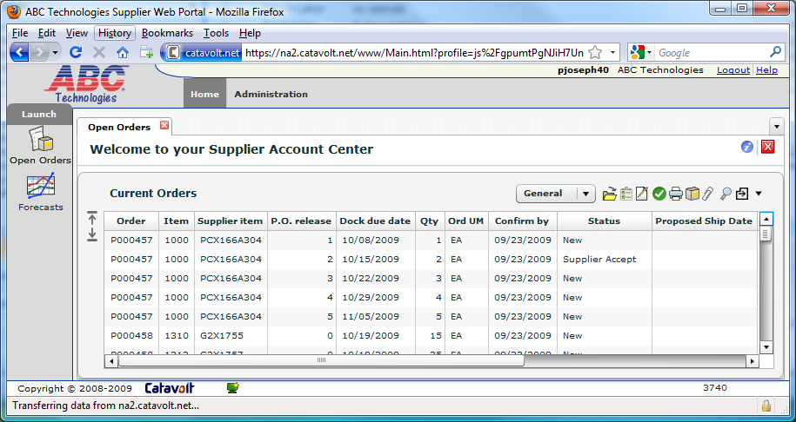
Supplier View
Orders placed by buyers via Procurement Management
Suppliers can see both your item and their internal item number
Confirm delivery per line item by date
Supplier gets an e-mail each time a PO line item or release is created

Slide 13
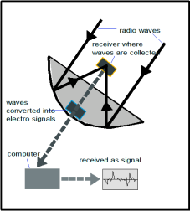
Supplier can also see…
PO Attachments
  Drawings, spec sheets
PO Comments
  Header, line, release
Supplier has clear understanding of what you need

Slide 14
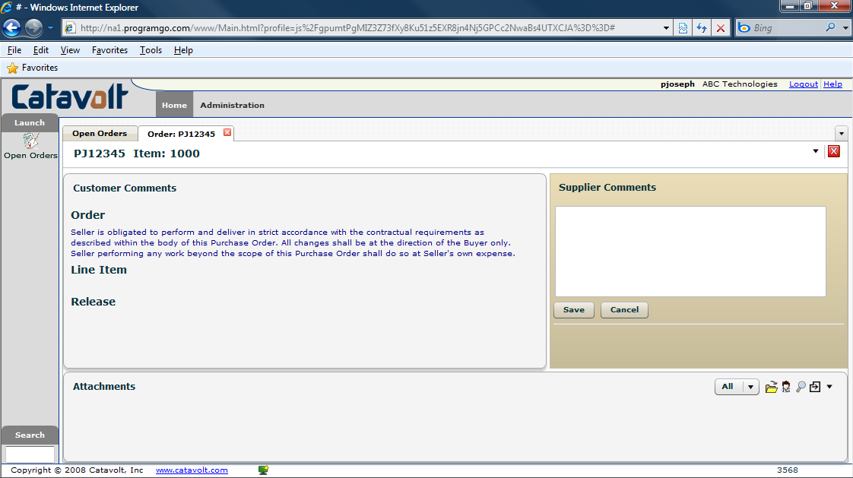
Comments and attachments
Supplier Comments
PO
Comments
Two-way attachments

Slide 15
Supplier retrieves attachments
XA
Portal
Attachments
Fire
wall
User
FTP
XA
Attachments
Suppliers can see attachments with one click
External attachment files stored in secure location
  Can be separate from internal attachment location

Slide 16
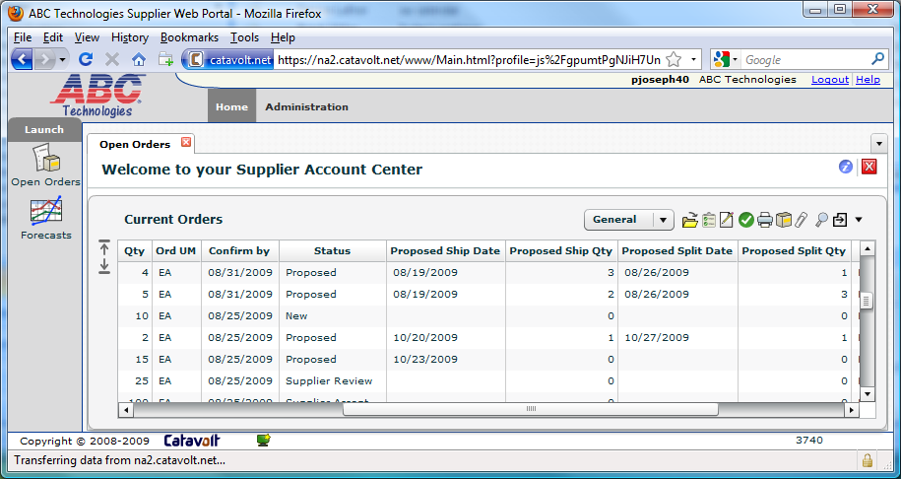
Supplier Response
Status
Proposed…
  Ship date
  Ship quantity
  Split date
  Split quantity

Slide 17
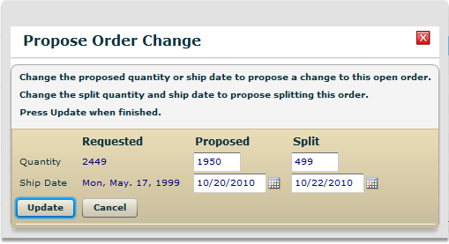
Supplier Response
Same quantity, different date
Partial quantity on requested date
Split shipment

Slide 18
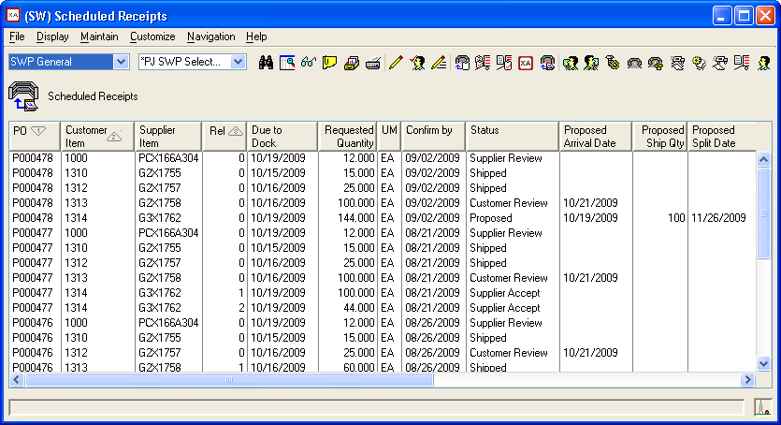
Buyer’s Power-Link View
Same as the Portal
Can be the same view
…or a similar one
  Add Vendor
  Remove Vendor Catalog
See supplier commitments and proposals

Slide 19
Buyer can see…
Orders under review by Supplier
Orders accepted or not accepted
Changes proposed by Supplier
Supplier’s comments
Suppliers attachments
You have clear understanding of their commitments; no confusion in the hand-off

Slide 20
Real Time Feedback
Supplier actions show up in Power-Link
Buyer can take action as required
Supplier
Review or Accept
Propose change
Buyer
No action required
Review, Accept or Reject

Slide 21

Shipping
Supplier
Receiving
Print labels
Upload attachments
Send shipment notice
Export
Decl
Certificate
of Origin
Packing List
Receive goods via Materials Management

Slide 22
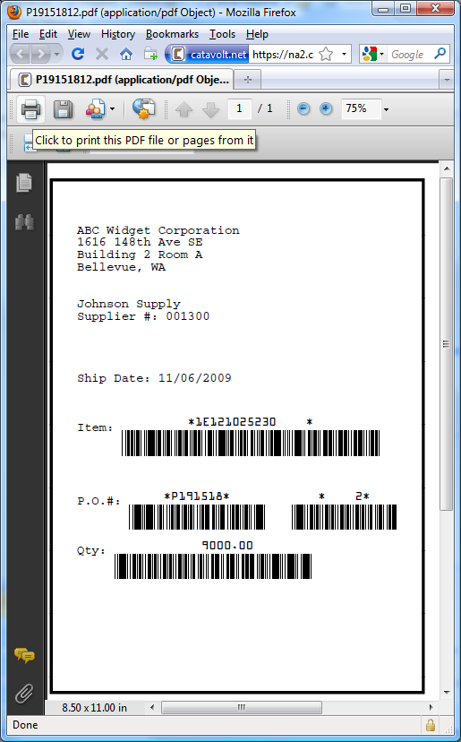
Item labels
Bar coded labels with Item and PO…
  Used for receiving and inventory transactions
Integrator transaction program
  Creates PDF, sends to Portal
Prompt on Portal
Supplier can print as many as they need on their local printer

Slide 23
Supplier uploads attachments
XA
Portal
Attachments
Fire
wall
User
FTP
XA
Attachments
Supplier can attach shipping documents, import papers, etc.
We attach documents to…
  Scheduled Receipt for buyer viewing convenience
  Purchase Order for history

Slide 24
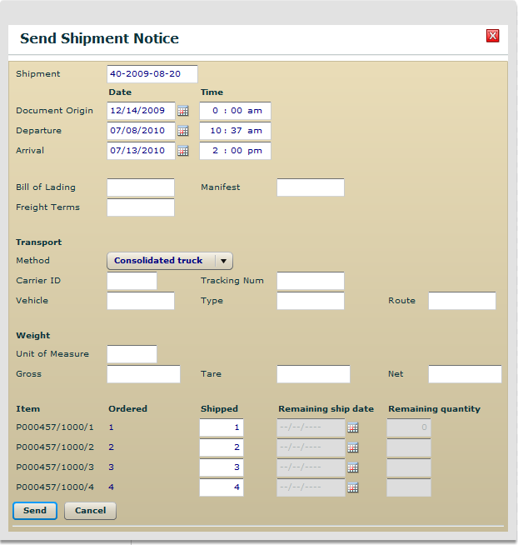
Send shipment notice
Select multiple lines
Fill in quantity shipped per line
If short, add date for rest
  Same as proposing a split quantity
Creates Shipment Notice in Power-Link

Slide 25
Supplier Portal
Implementation & Benefits

Slide 26
IDF Design – Built with XA tools for XA Companies
Fast start-up
Low cost
Low risk
Low maintenance
  Uses core XA data…no external database
Enterprise Integrator and System-Link provide the foundation, Catavolt technology extends IDF to the web

Slide 27
Integrated for Buyers
All internal activities done using same UI
User actions on normal menus
Supplier comments appear on card
Attachments appear in normal place
The Portal looks and acts like part of XA

Slide 28
Implementation Estimate
Installation (3 days)
  Import Integrator objects & host code
  Configure System-Link server and Portal
  Tailor links for e-mail and attachments
Buyer-side setup (1 day)
  PO’s (assume PM/OBPM used today)
  Planned Orders (assume MRP/AVP used today)
Supplier-side setup (2 days)
  Train customer to administer suppliers
  Review and tailor tools for training suppliers
Not included: User exit code changes

Slide 29
Supplier Portal Pricing
Software As A Service (SaaS)
  Low monthly expense for full access to Supplier Portal functionality
  No capital expenditure! No annual fees! All in monthly fee!
  Monthly cost dependent on number of XA Users
    License gives unlimited Suppliers!
    Implementation costs (6 days) separate from SaaS cost
    For pricing details contact:
    Ben McCormick
    ben.mccormick@cistech.net
    704 814-0016 or 704 301-8418

Slide 30
Benefits Summary
Improved relationship with suppliers helps manage costs down
Reduce inventory investment
Reduce plant downtime caused by stockouts
Reduce costs by improving efficiency of procurement team
Reduce materials costs with increased focus on negotiation
Improve decision making with visibility of supply chain
Improve receiving process via ASN’s

Slide 31
Q&A
Phil Joseph
phil.joseph@catavolt.com
678 916 3868

