Slide 1
Creating & Using Compound Cards
How to define a Compound Card to maximize information
Jim Simunek
Jim.simunek@cistech.net

Slide 2
What is a Compound Card?
Compound Cards are similar to a workbench but on a card instead of using Broadcast & Receive
Compound cards are only available at Release 7 of XA
Creating compound card is similar to creating a PowerPoint slide in that there can be anywhere from 2 to 4 ‘sections’, with each section displaying different information about an item/order

Slide 3
What is a Compound Card?
In a ‘list’ section, the toolbar allows for ‘Drill Down’ information and/or file maintenance options
After creating the compound card be sure to add the card to a card file for display
Use ‘Customize’ ‘Preferences’ (‘Card File’ tab) to set the default card file (Initial Selection) and active card (Initial Card)

Slide 4
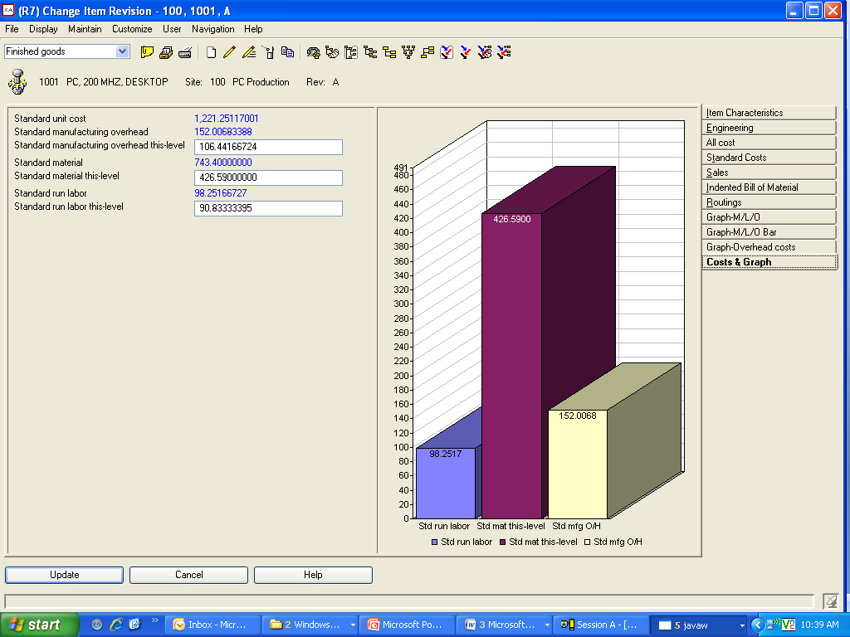
2 Section Compound Card

Slide 5
Card Types
Attribute – holds/displays fields
List – List of records controlled by View, Subset and Sort
Overview – Icons display information about the file with drill down capabilities
Graph – For numeric data (i.e. costs) bar, pie or line graphs
Tabbed – holds other cards (not available for Compound section)
Compound – up to 4 sections displaying information about the item

Slide 6
Attribute Card
Holds fields that, optionally, can be maintained
Can insert:
Blank lines
Column headings (over either text or data)
Column breaks

Slide 7
List Card
Holds a list of items, orders, etc.
List on card is controlled by a view, subset and sort
Toolbar

Slide 8
Overview
Displays information using icons and drill down options
Personally, I have never found a use for Overview cards

Slide 9
Graph Cards
Use graph cards to display compare numeric information:
Costs
On Order
On hand
Graph can be pie, bar, line, stacked bar or stacked line

Slide 10
Tabbed Card
Cannot be used in a Compound Card section
Tabbed card holds other cards
Useful for grouping ‘similar’ cards

Slide 11
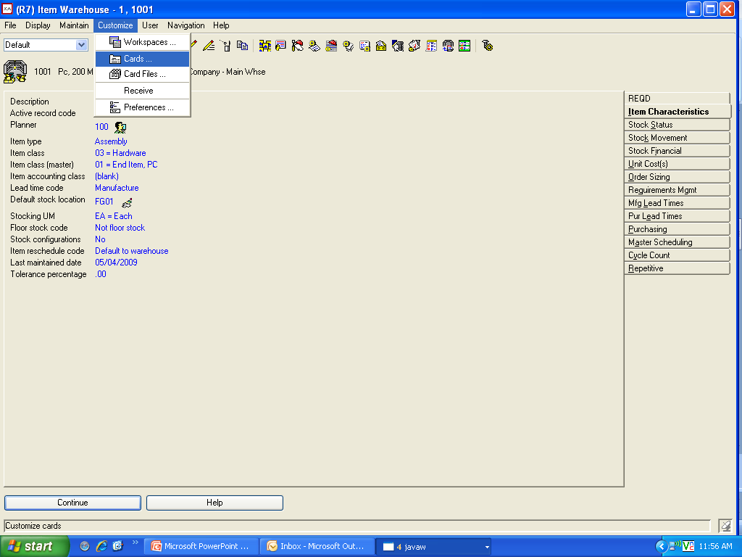
Creating A Compound Card
Use ‘Customize’ then ‘Cards’ to begin the creation process

Slide 12
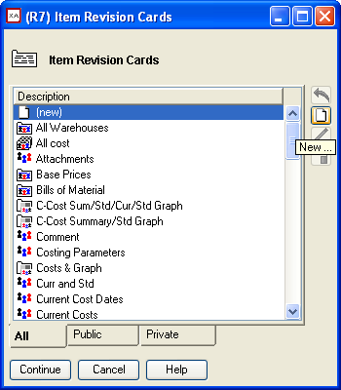
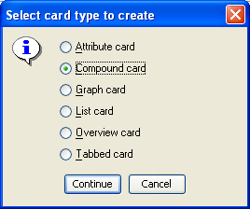
Creating a Compound Card
After selecting a ‘new card’ option, the ‘card type’ dialog will be displayed:

Slide 13
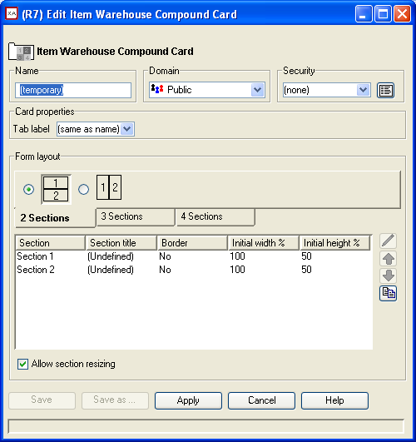
Defining the Sections
After selecting the ‘Compound Card’ you must select how many sections will be in the card (2, 3 or 4)
The layout defines how each section will be displayed on the card
Each section can have it’s own height and width

Slide 14
Defining the Sections
Single click on a section profile, then click on the pencil to change (or double click on a section number)

Slide 15
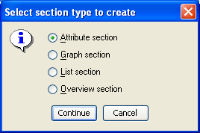
Defining a Section
The first decision is the type of section:
Attribute
Graph
List
Overview
Section type will determine the options displayed on the next window

Slide 16
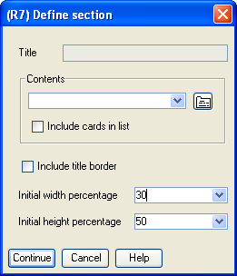
Defining a Section
To define the section of the card, click on the button to the right of the ‘Contents’
Define the height and width percentages
Title Border will list the ‘Contents’ in the section of the card

Slide 17
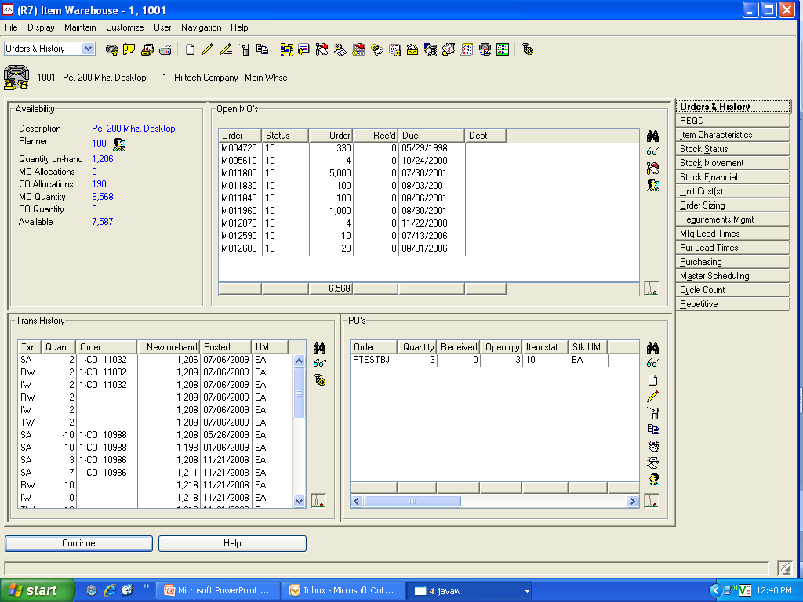
4 Section Card
Title Border
Top Section 30/70 Width
Toolbar
Bottom 50/50 Width

Slide 18
Attribute Section
Select the fields to be displayed in the Attribute Section
Add blank lines, column headings or column breaks
Enter a name, apply the attributes to the section

Slide 19
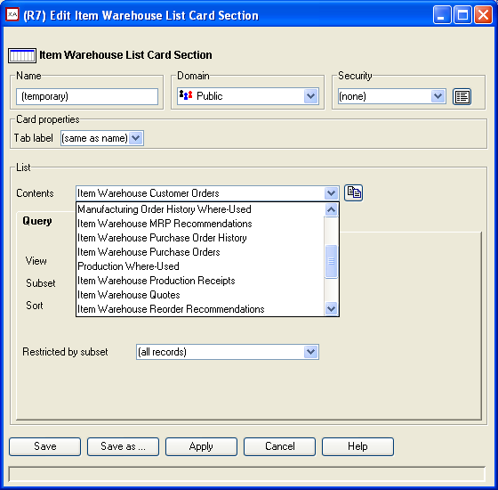
List Section
Files (Contents) are pre-defined by XA
Select the file to be displayed on the card
Use the buttons to the right of the view, subset and sort to:
Define the fields (view)
Records displayed (subset)
Sort Sequence

Slide 20
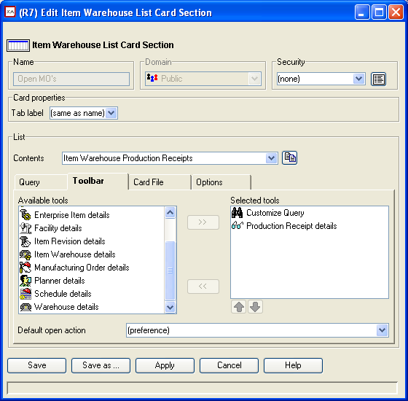
List Section
Use the ‘Toolbar’ tab to add function buttons to the card
Use the buttons to bring up a card file with information about the record displayed

Slide 21
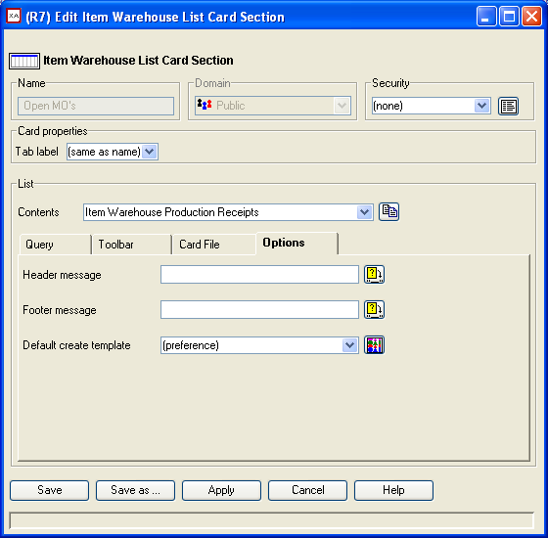
List Section
Use the ‘Options’ tab to add:
Header messages
Footer messages
Template (if the ‘Add’ option is selected from the Toolbar)

Slide 22
Graph Section
Select the ‘Graph Type’
On the ‘Series’ tab, select the file. Depending on the file selected, Presentation options will be activated
On the ‘Sample’ tab, select the fields to be used in the graph
On the ‘Options’ tab, select 3D mode and where the legend will appear
‘Labels’ tab determines where graph labels will appear

Slide 23
Overview Section
Select the ‘Overview’ to be used or create a new ‘Overview’
Decide whether or not to include details
Select large or small icons

Slide 24
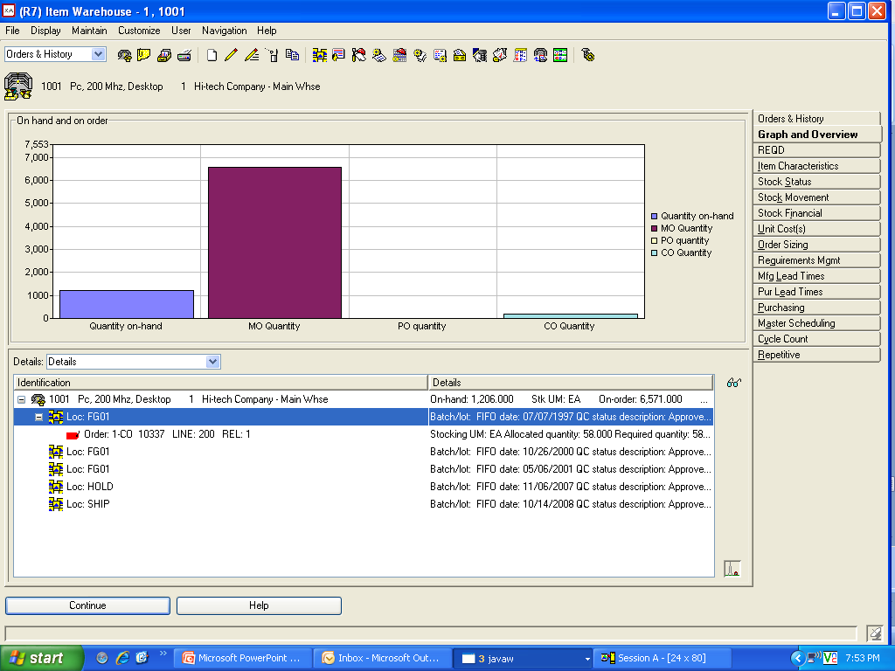
Graph and Overview Sample

Slide 25
4 Section Card

Slide 26
Suggested Compound Cards
Manufacturing Orders
Component Section (list)
Operations Section (list)
Transaction History Section (list)
MO Header information (attribute)
Purchase Orders
Vendor information (attribute)
Open Items (list)

Slide 27
Suggested Compound Cards
Item Process Record
Bill of Material (list)
Routing (list)
Parent Item information (attribute)
Customer Orders
Customer information (attribute)
Items (list)
Shipments (list)

Slide 28
Suggested Compound Cards
Item Warehouse
Item on hand/on order quantities (attributes)
Open MO’s (list)
Open CO’s (list)
Transaction History (list)

Slide 29
Summary
Once you’ve chosen a file to use to create the compound card, determine how many sections and what information you want in each section
Define the sections
Contents
Toolbar (if list)
Add the card to a card file
Define your preferences if you want the compound card to be the first card open when double clicking on an item

Slide 30
Summary
Compound cards will improve productivity in that all information required is available in one place
Toolbar allows for detailed inquiry on records in a list
Use Preferences to have the correct card showing when displaying information from a record in a list
Compound Cards are an outstanding addition to the features available in PowerLink!

Slide 31
Thank you for Attending For follow up information Contact either: Brock.miller@Cistech.net Ben.mccormick@Cistech.net
Questions?

