Slide 1
Faster and Easier Record Entry with Custom Templates & Card Files
Jim Simunek, Senior Consultant
Jim.Simunek@cistech.net
Notes:
Streamlining processes/lean initiatives by Jim Simunek earlier this year.
We all are dealing with working smarter with a lean staff.

Slide 2
Agenda for Today
What is a template and how is it used?
What is a card file?
What is the relationship between a template and card files?
Customization Hints

Slide 3
What is a template?
The Template defines the fields that are displayed during Add, Change & Copy Functions
Templates can bring default values into specific fields when adding, changing or copying records.
The Template defines the Card File and Active Card to be used
You can have multiple versions of the template in any object/file if needed.

Slide 4
What is a template?
Templates are located under the “Maintain” menu option.
You can tie the template to your custom card file; use different card files with different templates when needed.
You can set default values for ‘Return here to create another’ and ‘Preview before create’.
There are also settings, per field, for:
Position Cursor
Retain Value
Default Value

Slide 6
Creating a template
Give public templates a name that is clear to users.
Add each field that is almost always the same and enter the default value with ability to change if needed.
Add other fields that you want the user to populate with a required value. Being on the create screen will highlight it’s importance.
Select card file that template should open when you click CREATE. Usually the initial card is the top one in the custom card file, but that can be changed if desired.
If desired, check “Return here to create another.”
Usually check “Preview before create” which moves user into the custom card file to enter additional information.

Slide 7
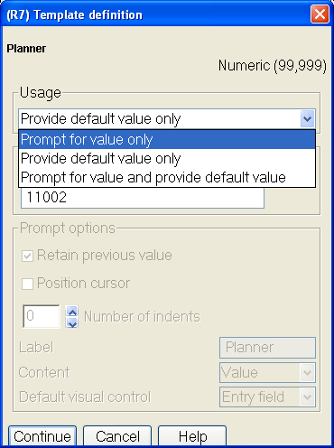
Creating a template
USAGE

Slide 8
Creating a template
USAGE of each field can be set to:
“Prompt for value only” which means field will be blank and you must fill in the value. Attribute appears on create screen as a blank.
“Provide default value only” means you select a value that is always the same. Attribute does not appear on create screen.
“Prompt for value and provide default value” means that you are choosing a default value. But the field appears on create screen and can be changed.
All fields to be on create display will be checked.

Slide 9
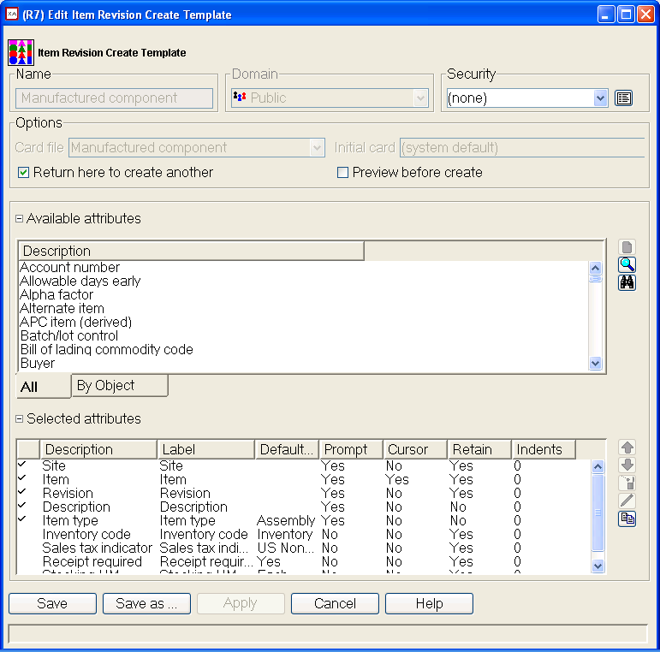

Slide 10
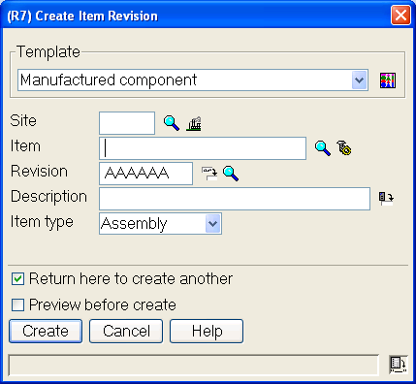

Slide 11
Creating a template
OTHER OPTIONS
POSITION CURSOR can be set for the cursor to fall on this field on the create screen.
LABEL allows changing what the attribute is called on the create screen. DEFAULT VISUAL CONTROL can change the format of the attribute. Example: from dropdown to radio buttons.
RETAIN PREVIOUS VALUE sets the system to always keep the record information from the previous entry. Helpful to know which have been entered, but you can change to be blank, if desired.
CONTENT lets user set whether defaulting info will show a code or a description of the code or both.

Slide 12
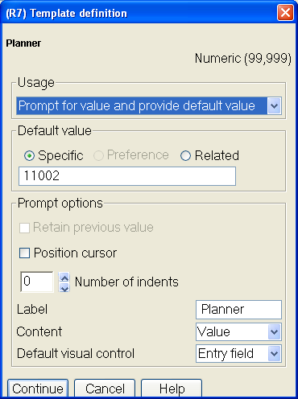
Creating a template
OTHER OPTIONS

Slide 13
Creating a template
Position attributes on create screen by “dropping & dragging” in R6 or using up/down arrows in R7.
Tie template to appropriate custom card file.
BE AWARE: if your template contains a blank value and you do not populate it, it will “blank out” any value coming from other records. Example: account number on PO item create template will blank out account information coming from the item master/item revision. Okay usually for MRO but not for production items.

Slide 14
Good template usage
EPDM – entering new item revisions
Item types usually have other common defaults. Example: Type 4 purchased parts usually also have:
Inventory code of 1=Inventory
Receipt required=Yes
Batch/lot
Purchase tax indicator= Non-taxable
Same site
Initial release to PDM = YES**
Perhaps common item classes (example MRO)
Perhaps inspect on receipt.
Current (and standard) material-this level gives a warning message if nothing entered in the record. Trick, if desired: Set these fields in the template as $0.00000001.

Slide 16
Good template usage
EPDM/Materials Management
Entering new item warehouse records
Finished goods in MRP environment template:
Lead Time Code: M = Manufactured
Order Policy Code: G = Period of Supply or A= Discrete Order Quantity
Plan Customer Orders: 5 = Yes, after MRP start date
Include Inventory Balance: Yes
Master Schedule Item Code: = Not a master scheduled item
Master Level Print Code: = Always printed
Combine Requirements: 0 = Do not combine requirements
Master Level Item Code: M = Multiple source master level item

Slide 18
Using MFG Parts Item Warehouse template:
planning fields are populated correctly
document control creates the item warehouse by selecting the CREATE icon
on right and clicking CREATE button on create prompt (3 clicks).
Planning and/or purchasing can add vendor lead time, etc.

Slide 19
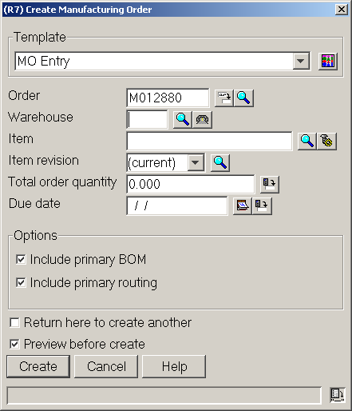
Simplified entry for MO Create

Slide 20
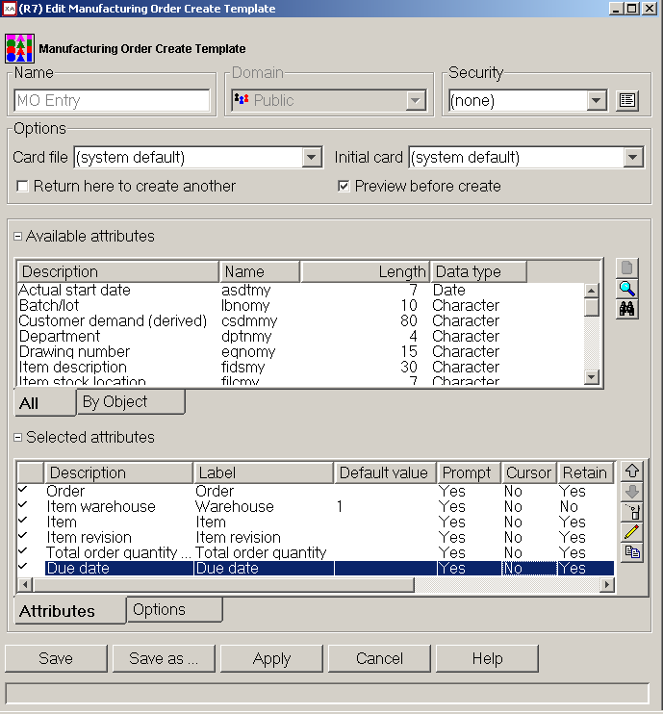
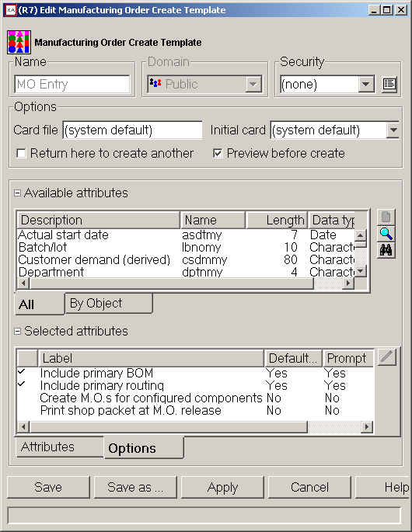
Good template usage
Order-based Production Management – new MO

Slide 21
Maintaining the Template Options box with Options tab
No check marks so will not appear on create prompt.

Slide 22
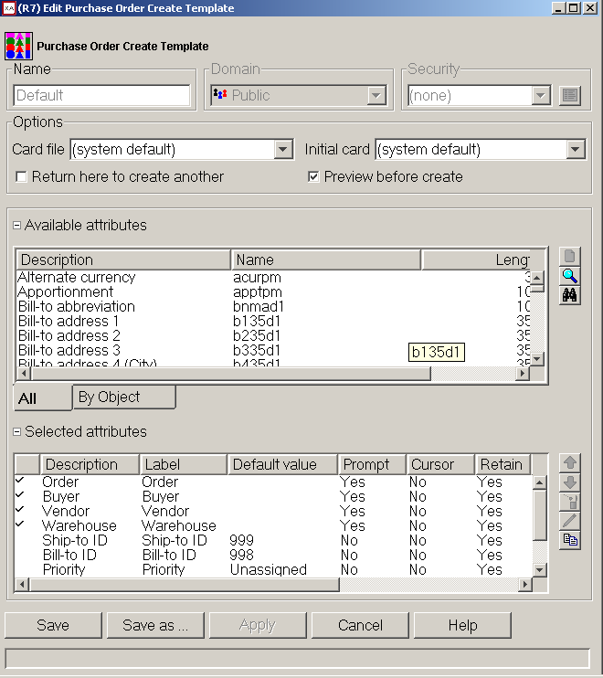
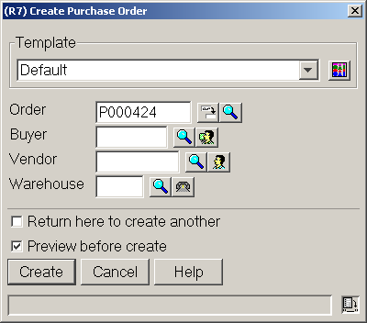
Good template usage
Procurement Management – PO header and items

Slide 23
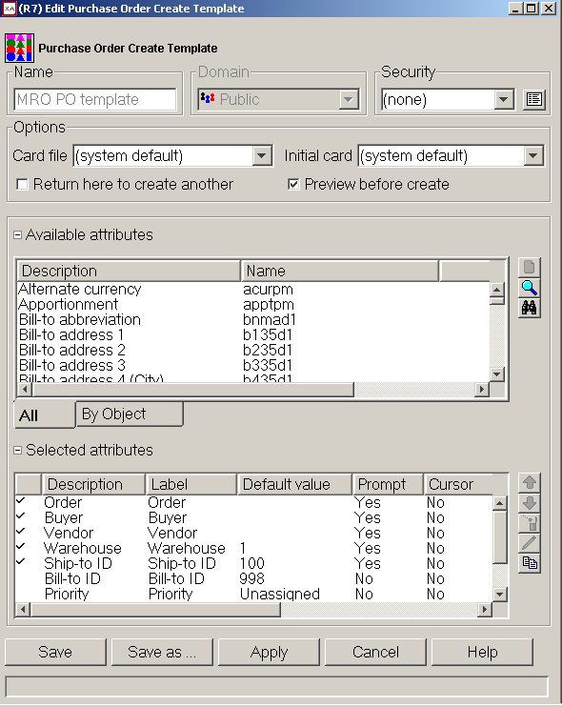
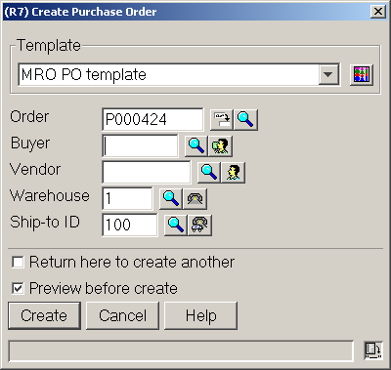
Good template usage
Procurement Management – PO header and items

Slide 24
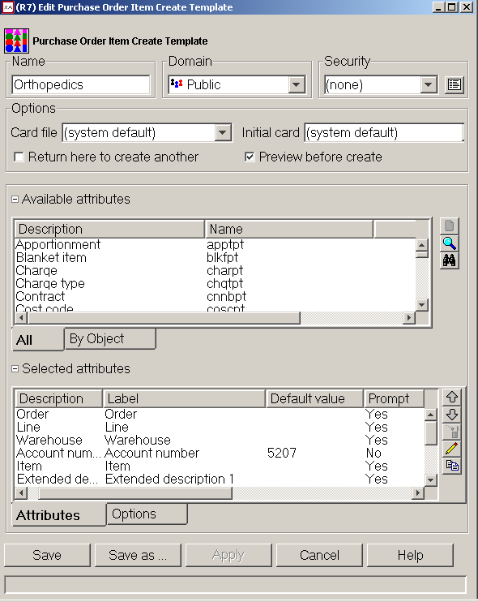
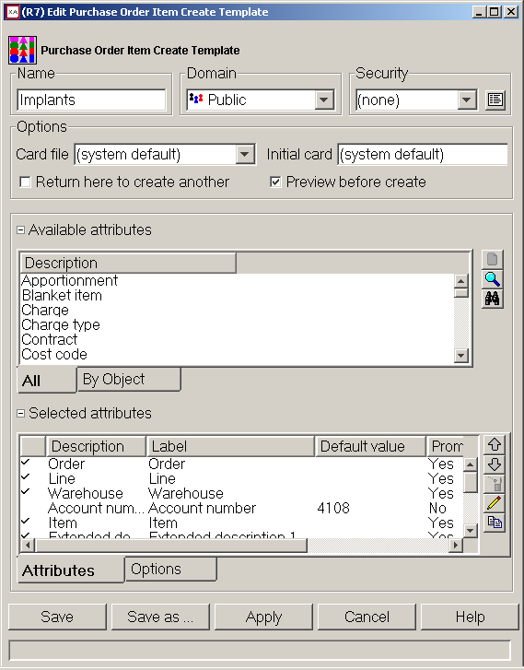
Good template usage
Procurement Management – PO and items

Slide 25
Other good template uses?
Materials Management – Purchase Schedule Receipts
Receiving template with just the transactions and other necessary fields; i.e., Reference, GRN, Batch/lot, etc.
Item warehouse records – engineering can create w/planning codes without knowing which are required.
Cycle count items sequential count template defaulting current date and counted by or assigned to.
Procurement Management
Blanket release template – control whether release create screen returns with open quantity for item or is blank.

Slide 26
Questions regarding Templates?

Slide 27
What is a card file?
A Card File holds Cards
PowerLink main Card File equates to multiple menu screens in green screen.
Card file organizes all information in a specific record by topic on individual cards.
Information comes from:
create screen keyed in by user or template setting
master records
dynamic information from transactions

Slide 28
What is a card file?
Cards styles include:
Attribute cards – holds fields
Overview cards – graphical display of data on order, in BOM, etc.
List cards – subsets, views, sorts
Compound cards – attributes, graphs, lists on same card
Graph cards – Pie charts, bar graphs, etc
Tabbed cards – holds other cards

Slide 29
What is a card file? Full default set
Great for inquiry for full details.

Slide 30
What is a card file? Custom card file
Much better for new item entry!

Slide 31
Card Types
Attribute – holds/displays fields
List – List of records controlled by View, Subset and Sort
Overview – Icons display information about the file with drill down capabilities
Graph – For numeric data (i.e. costs) bar, pie or line graphs
Tabbed – holds other cards (not available for Compound section)
Compound – up to 4 sections displaying information about the item

Slide 32
Attribute Card
Holds fields that, optionally, can be maintained
Can insert:
Blank lines
Column headings (over either text or data)
Column breaks

Slide 33
List Card
Holds a list of items, orders, etc.
List on card is controlled by a view, subset and sort
Toolbar

Slide 34
Overview
Displays information using icons and drill down options
Personally, I have never found a use for Overview cards

Slide 35
Graph Cards
Use graph cards to display compare numeric information:
Costs
On Order
On hand
Graph can be pie, bar, line, stacked bar or stacked line

Slide 36
Tabbed Card
Cannot be used in a Compound Card section
Tabbed card holds other cards
Useful for grouping ‘similar’ cards

Slide 37
Compound Card

Slide 38
Customizing Cards
When customizing an attribute card, you can insert:
Blank lines
Headings over the field description
Headings over the data
Column breaks allow for displays on both the right and left side of the card

Slide 39
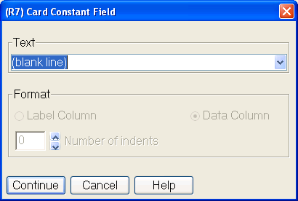
Customizing Cards

Slide 40
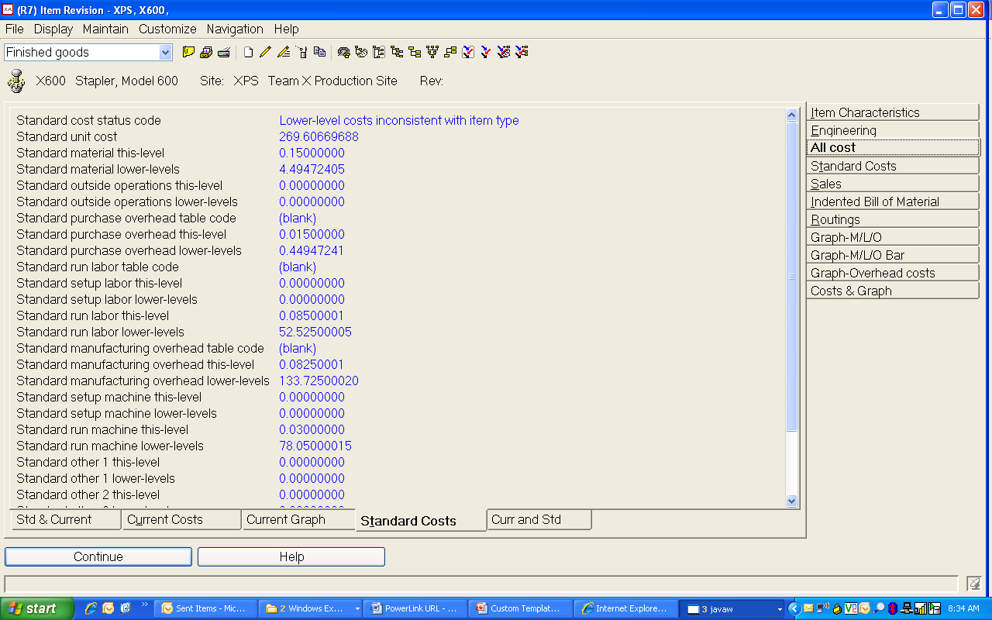
XA Standard Cost Card

Slide 41
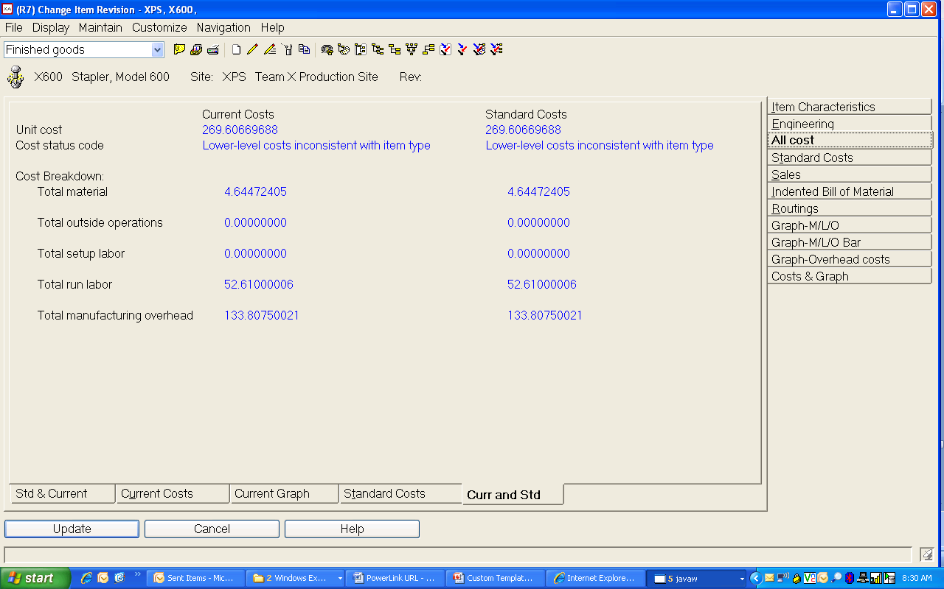
Customized Cost Card

Slide 42
Customization Hints
Only super users should have ability to create public customization. Others should have private.
Consider a naming convention for public customization (no user names and clear descriptions, etc.).
Rarely change defaults. Instead, create a new card file/cards based on the default
Limit use of private templates since defaulted fields are so important.
Rename user fields, if you own Integrator.

Slide 43
Customization Hints
Take full advantage of setting preferences for all customization (views, subsets, sorts, card files, templates). In R7, use “Favorites” to filter views and subsets and R7 Presentation Schemes for visual data management.
If procedure is to use templates, YOU MUST ALWAYS USE THE CORRECT TEMPLATE.
Defaults set in template will be missed.
Typically if you have used incorrect template, delete record and recreate using correct one—OR, look at template and change all the settings which should have been selected using the right template

Slide 44
Customization Hints
Place attributes needing entry near top of card and leave general information/defaulted settings near bottom. For views, place most important info near top in setup (on left on screen).
Tie template to custom card file and set checks for “Return here to create another” and for “Preview before create” as needed.
Always remember other groups need information from the records we create. Simplify for their inquiry/maintenance needs, too.

Slide 45
How Can I Leverage PowerLink? CISTECH Quickstart
½ day of general training on views, subsets, workbenches, etc.
½-1 day with each process group (Procurement, Planning, etc) to tailor PowerLink Apps to streamline your workflow
Result: at the end of the engagement, users have incorporated Browser into their daily activities to become more productive.
Notes:
Though we just promised to cover views and subsets, we provided “freebies.”

Slide 46
Thanks for joining us today!

