Slide 1
Enhanced Security
Management, Separation of Duties and Audit Support for XA
Belinda Daub, Senior Consultant Technical Services
belinda.daub@cistech.net
704-814-0004
Notes:
"Enhanced Security Management, Separation of Duties, and Audit Support for XA"

Slide 2
Agenda
Concepts, best practices, and tools to meet requirements for internal controls:
Separation of Duties
Routine User Access Review
Security Change Management
Role-based security management
New!
Notes:
Discuss these three primary requirements, best practices, how they are handled by XA customers today and demonstrate tools that simplify the process for meeting audit requirements.

Slide 3
Meeting Audit Requirements
How do XA customers handle this today?
  Write queries against the eight XA files
    Output to work files
    Download to Excel
    Cut and paste
  Must account for
    Unlocked tasks
    Private authorities
    Group access
    Environment Access
    Custom Applications
    Manual tasks (not tracked by application security)
  IFM Security
    Different files
    Translate authority levels to tasks

Slide 4
Meeting Audit Requirements
Challenges
  Very time-consuming and costly to the organization
    Security Manager coordinating reviews and managing identified risks
    IT personnel assembling information and resolving risks
    Area Owners reviewing and approving user access
  Must have a thorough understanding of CAS and IFM security logic and data base relationships
  Data owners must understand what the application tasks do
  Data owners rarely know all the users and what they do
  Security request forms are difficult to create
  Often ineffective - ‘just going through the motions’

Slide 5
Meeting Audit Requirements
Even if legislation were not enforcing these controls,
we should implement them ourselves.
By protecting our company,
we also protect ourselves, our families
and all those who have a vested interest
in the company’s future.
However,
implementing such controls
should not consume the resources
of the organization.

Slide 6
Separation of Duties

Slide 7
SOD Concepts
Separation of duties concepts
  No single person has sole control over the lifespan of a transaction. One person should not be able to initiate, record, authorize and reconcile a transaction.
  Assures that mistakes, intentional or unintentional, cannot be made without being discovered by another person.

Slide 8
SOD Concepts
Best Practices
  The level of risk associated with a transaction should come into play when determining the best method for separating duties.
  Duties may be separated by department or by individuals within a department.
  Separation of duties should be clearly defined, assigned and documented.
  Separation of duties should be able to be demonstrated to an outside party.
  Increase the review and oversight function when it is difficult to sufficiently separate duties (compensating controls).

Slide 9
Meeting Audit Requirements
What conflicts should be configured?
  Purchase to Pay
  Order to Cash
  Personnel/Labor to Payroll
  Administer security and maintain application data
How do you define a conflict?
  A function may be multiple XA Tasks
    Create Purchase Orders
      POR COPY Procurement PO Copy
      POR CREATE Procurement PO Create
      AM6M1001 Purchasing Enter/Edit Pos
      AM6M1013 Purchasing Create POs from Offline files
  Any PO Create task can conflict with any AP Invoicing task
    thousands of conflict variations
Doing this manually would consume your IT resources for an extended period (for every audit)

Slide 10
SOD Violations Management with Enhanced Security

Slide 11



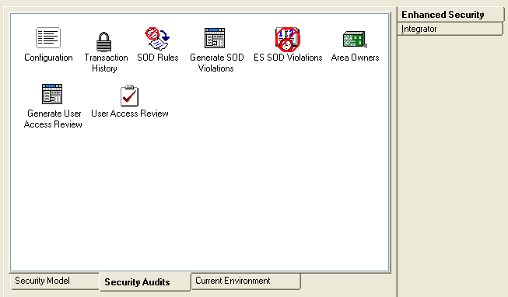
ES Security Audit Tools
Manage SOD Rules and Violations
  Configure rules by area, task or combination
  Run the violations build program
  Review and address violations
  Finalize the SOD Analysis for Auditors
ES includes a Model
for SOD Rules
  Common SOD Conflicts
  Tailor to your needs
  IFM and CAS security

Slide 12
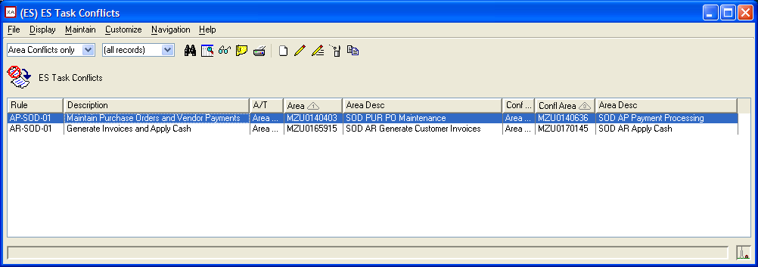
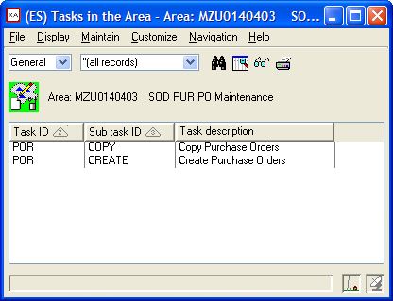
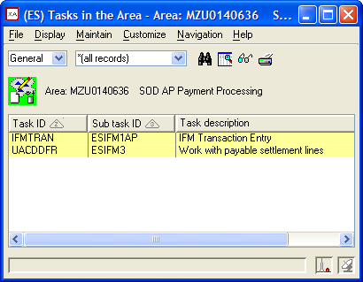
Configure SOD Rules
SOD Rules – two conflicting tasks or areas (group of tasks)

Slide 13
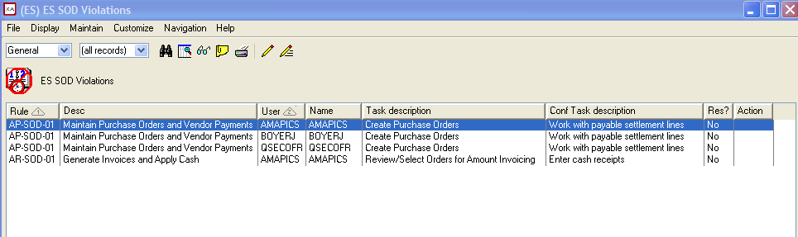
ES Security Audit Tools
Generate the SOD Violations file to review all violations

Slide 14
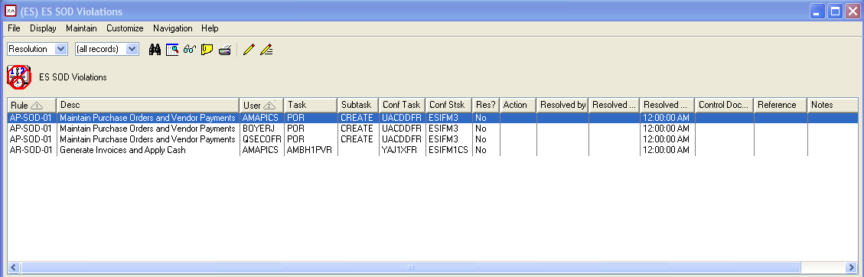
ES Security Audit Tools
SOD Violations Review – Resolution View
  Manage resolutions within the application
    Fields provided for tracking activities
    Assigned security administrators subset to their action list
    Compliance manager subset by resolved/unresolved violations

Slide 15
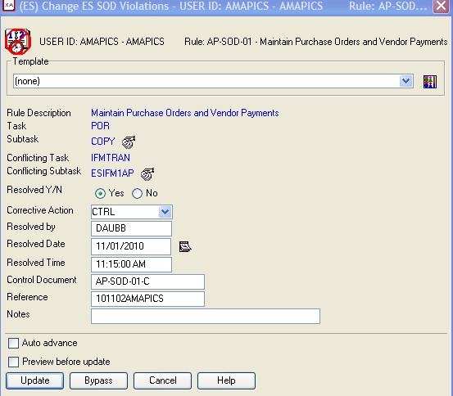
ES Security Audit Tools
SOD Violations Management
Action to take:
Revoke authority to task
Verify Compensating control
Remove Conflict
Resolution tracking:
Resolved by
Date and Time
Reference Information:
Control Document Number
Reference for documentation specific to this violation
Notes with information pertaining to the resolution or reason the conflict can be removed from the rules

Slide 16
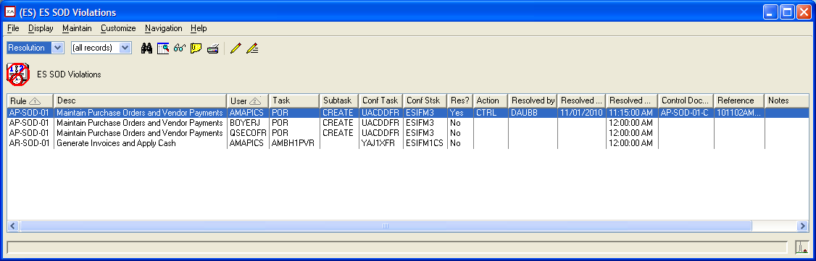
ES Security Audit Tools
SOD Violations Management
  View transaction history and current user rights (will discuss later) to show that user access has been revoked in accordance with SOD review
  Export to PDF using Power Link
  Perform this review process as often as necessary
  Use a test environment to determine if changes in security will create SOD violations before you make them
User Info

Slide 17
User Access Review

Slide 18
Access Review Concepts
Basic Concepts
  Ensure that users can only perform those activities necessary to do their assigned jobs
  Ensure that users who own the data are controlling who has access to view and change it
  All security changes have been made in accordance with internal controls

Slide 19
Access Review Concepts
Best Practices
  Formal request and approval for new users and requested changes
  Users assigned to own responsibility for the integrity of the data (not IT)
  Review and approval processes should be clearly defined, assigned and documented.
  Review activities should be able to be demonstrated to an outside party.

Slide 20
Meeting Audit Requirements
Extract User Access information
  Manually extract applications tasks as well as user authority to them
    Extract to Excel via Query
    Unlocked tasks, private authorities, and group authority
    CAS and IFM task security
    Present in a format that is manageable
  Identify owners for application tasks
    Many owners for the same area (different companies, divisions, locations)
    Owner may not know the users or what their jobs require
  Manage approval process
    Provide user authority to each owner for review and approval
    Consolidate results and verify changes are completed

Slide 21
User Access Review with Enhanced Security

Slide 22



ES User Access Review
Regular User Access Review
  Configure Areas in CAS to be included in the review
  Assign Business Owners for areas
  Owners perform review for assigned areas
  Security Manager finalizes the review

Slide 23
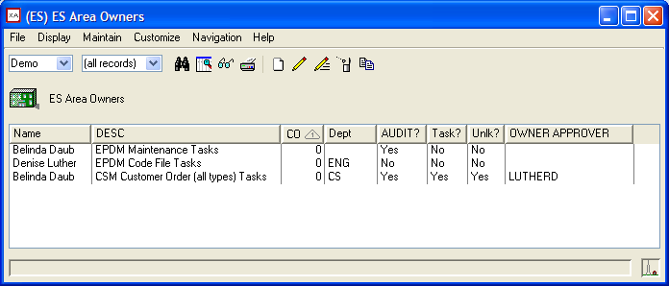
ES User Access Review
Configure Review Areas by Owner
  Specify the Owner of each area
  Specify Owner approver
  Omit unlocked tasks
  Approval at the area or task level
  By company and/or location/department
    Configure company and/or department for each user

Slide 24
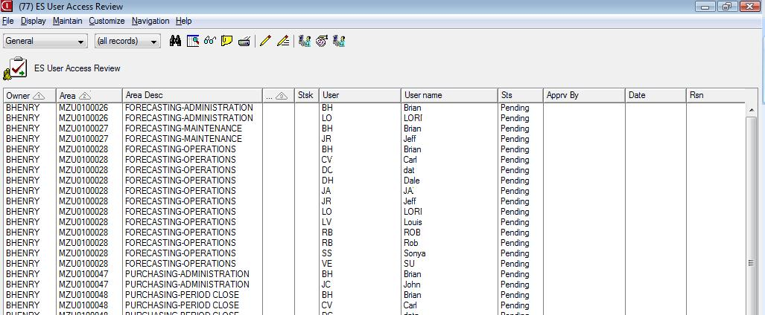
ES User Access Review
Generate and Review User Access to Areas/Tasks
  Subset by owner
  Approve or reject each user’s access to area or task

Slide 25
ES User Access Review
Finalize Review Results
  Verify all approvals received
  Verify all rejections have resulted in changes to user access
  Export to Excel or PDF for auditors

Slide 26
Security Management with Enhanced Security

Slide 27
ES Monitor Security Changes
Manage Security Changes (transaction history)
  Review changes to security
    Security file changes journaled
    Extracted nightly
    Translated to actual user rights to tasks
    Includes when the change was made and by whom
    You decide how long to keep this history

Slide 28

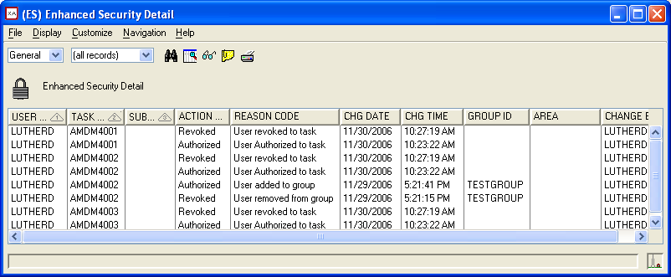
Detailed Transaction History
Determine how a user has gained access to a task
View who made the change and when
Verify if changes were made that were not requested/approved
Quickly identify corrective action
Audit for temporary access (granted and revoked)
Includes User fields and customize to meet your needs

Slide 29
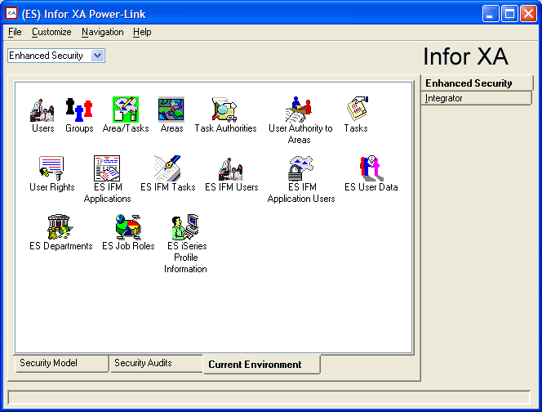

Visibility to XA Security
CAS Security
IFM Security
iSeries Profiles
User Info
  Dept
  Job Role
and
USER RIGHTS!!!

Slide 30
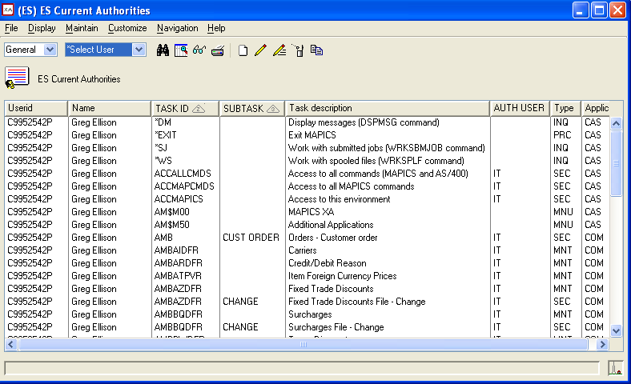
Security Management
View current user rights in the environment
A. User being reviewed
B. Tasks the user is granted
A
B
C
C. How access was granted
Private (user id)
Group (group id)
Not locked (blank)
  IFM Tasks are included so you can see everything the user can do

Slide 31
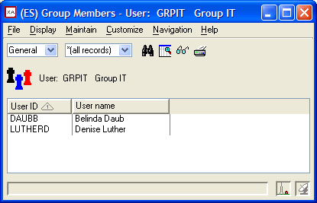
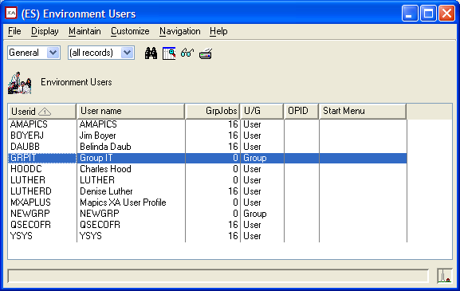
Visibility to XA Security
Navigate from Users to other CAS files
  Groups the user is in
  Members of the group
  User Rights to tasks
  others

Slide 32
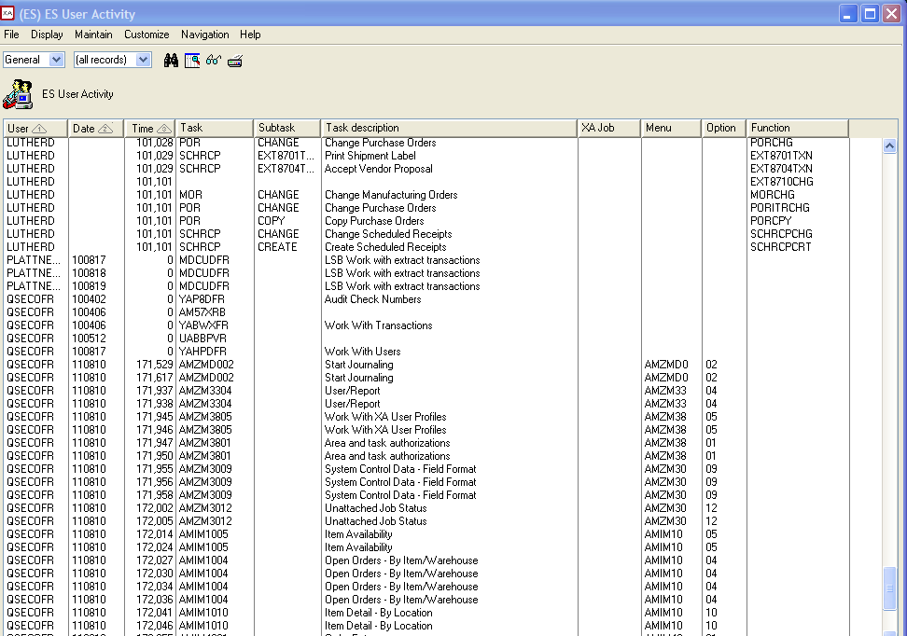
What do users actually use?
View actual user activity
  Green Screen Menu options taken
  Changes to client objects
  IFM maintenance
Useful for cleaning up user authority to tasks they do not use

Slide 33
Security Management
iSeries User Profiles – view and print
  Power Users
  Special Authorities
  Logon Statistics
  Password Info
  Groups and group membership
  Startup information
iSeries Object Authorities
  Object Owner
  Public authority
  User Authority

Slide 34
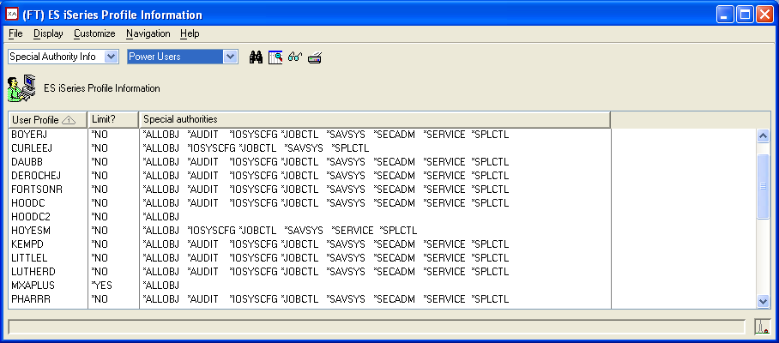
Security Management
iSeries User Profiles – Power Users

Slide 35
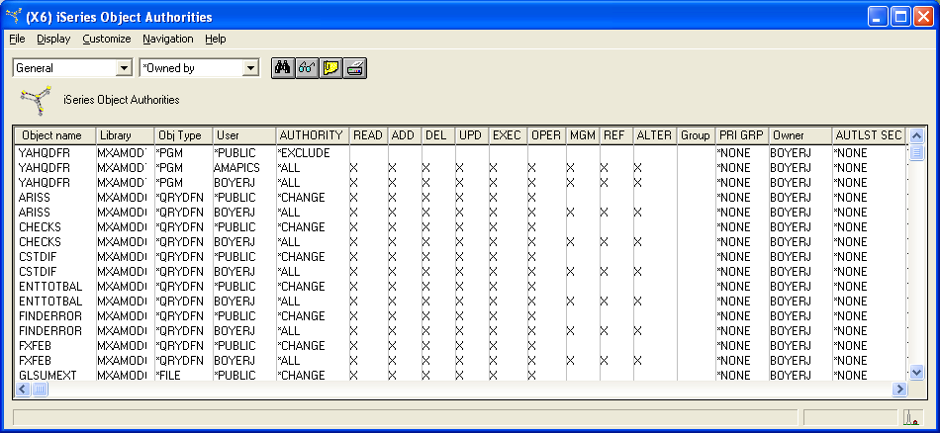
Security Management
Object Authorities – view and print
  All objects – all libraries
  User rights – display/maintain
  XA objects not owned by AMAPICS

Slide 36
Role-Based Security Management with Enhanced Security

Slide 37
Security Management
CAS Security
Areas
Users
Groups
Private authorities
Tasks

Slide 38
Security Management
Role-Based Security
Users
Areas
Groups
Roles
Tasks
Enhanced Security
CAS Security

Slide 39
Security Management
NEW LAYER OF SECURITY – JOB ROLE
  Users assigned to one or more roles
  Roles attached to one or more CAS groups
  Groups authorized to ES Areas
  ES Areas control authority to tasks
Routine Maintenance
  Add new user to appropriate role(s)
  Transition a user from one role to another
  Remove a user from assigned role(s)
  Add a role temporarily for backup of personnel
Application attaches the user to the CAS groups defined for the role(s)

Slide 40
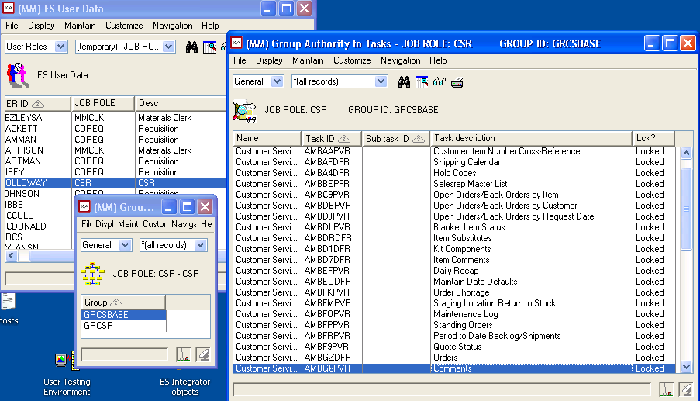
Security Management
View role information

Slide 41
Security Management
Auditing Role-Based Security
  Area owners review and approve role access to functions that update the data
  Role owners approve the users in roles
  SOD validation as users are added to roles
    Warning message when violation will result
    Much simpler than reviewing every user and every task

Slide 42
Thank you!
Questions?

