Slide 1
Enhancement Summary
Moving Forward with XA
IFM Enhancements
R7.8 & R9

Slide 2
ERP XA IFM Enhancements
Reorganized UI
Entity Related Maintenance
Level 1 Implementation
Usability Enhancements
Real Time Credit Update
Performance Improvements
User Fields
Balance Summaries
Separation Of Duties
Security Changes
ERP
ERP
Financials

Slide 3
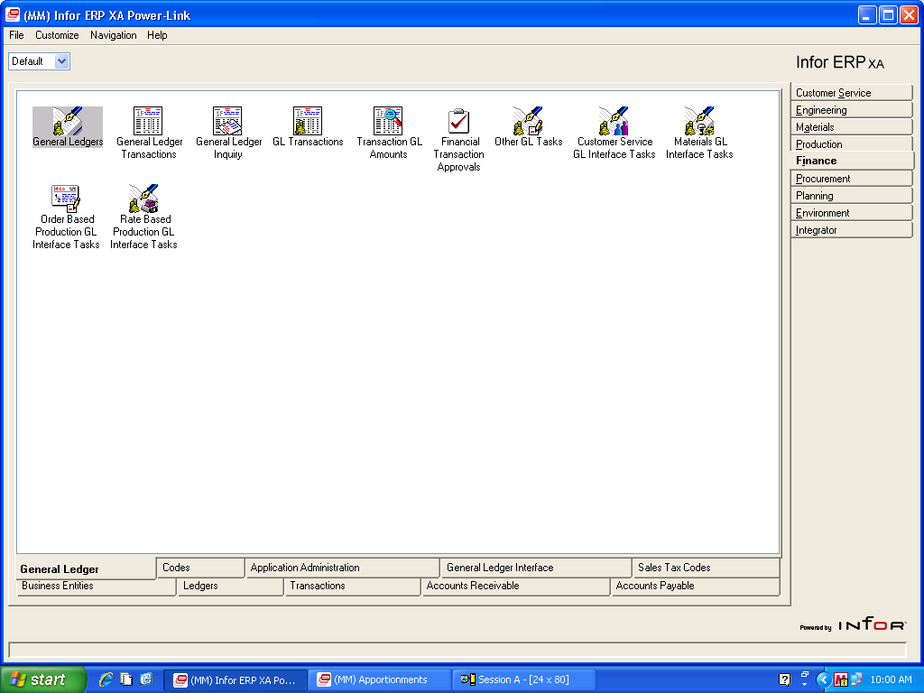
User Interface

Slide 4
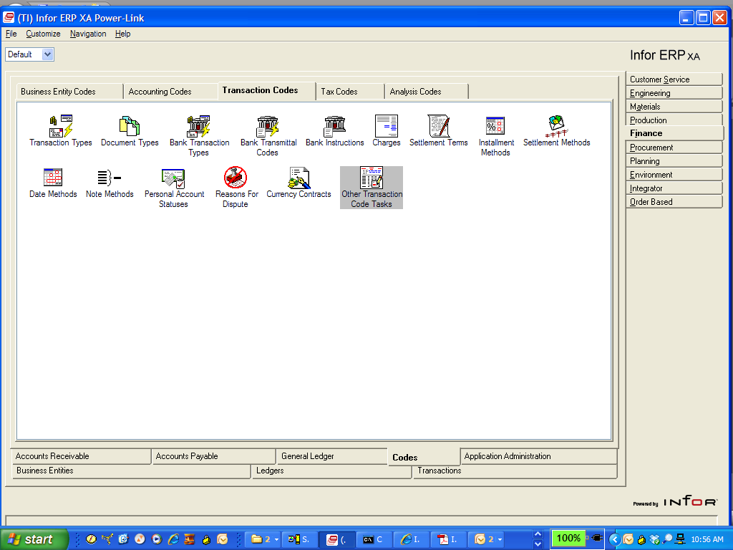
IFM User interface

Slide 5
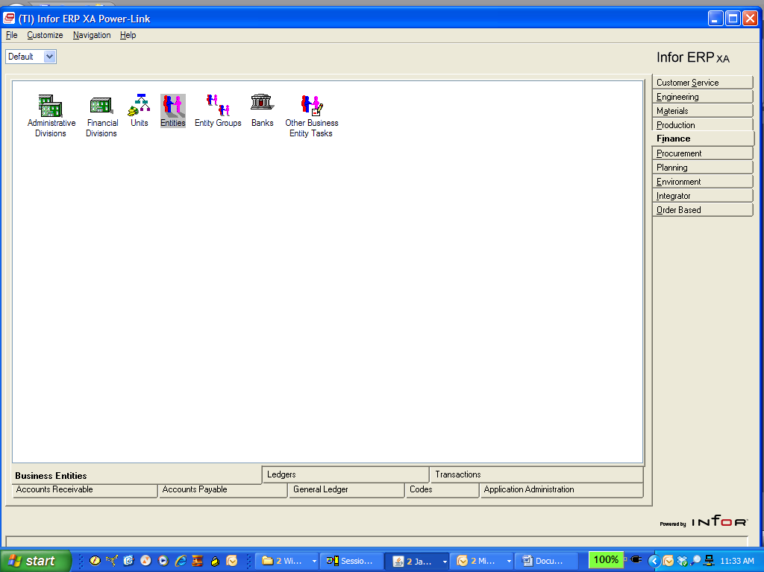

Slide 6
AP Ledgers

Slide 7
AP Personal Accounts

Slide 8
Level I example
Transaction Types

Slide 9
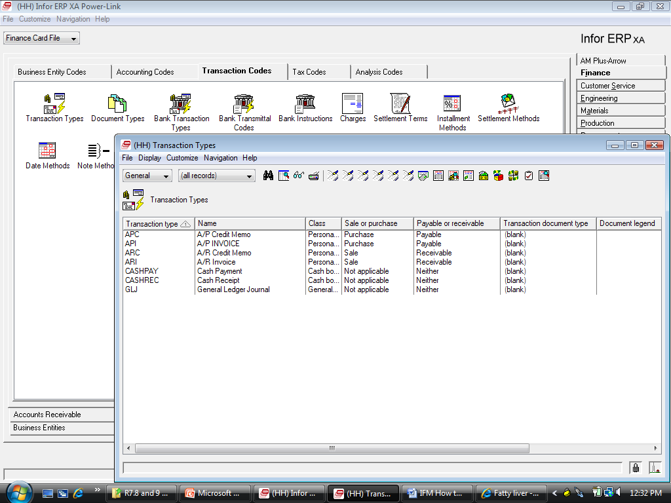
Transaction Types
Level II

Slide 10
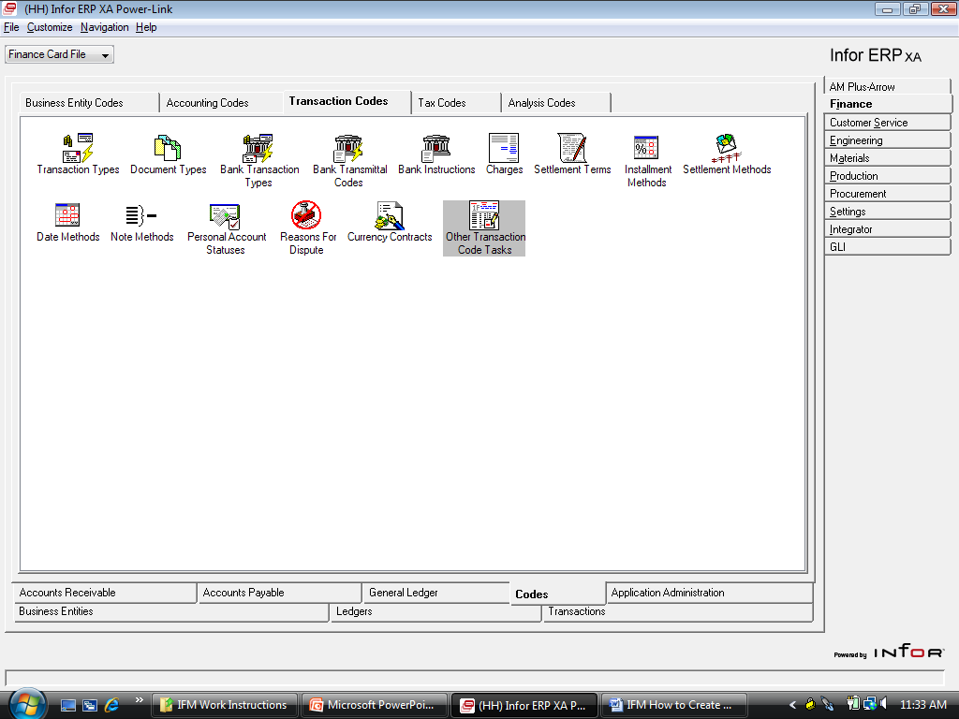
MAINTAIN TRANSACTION TYPES
Level I

Slide 11
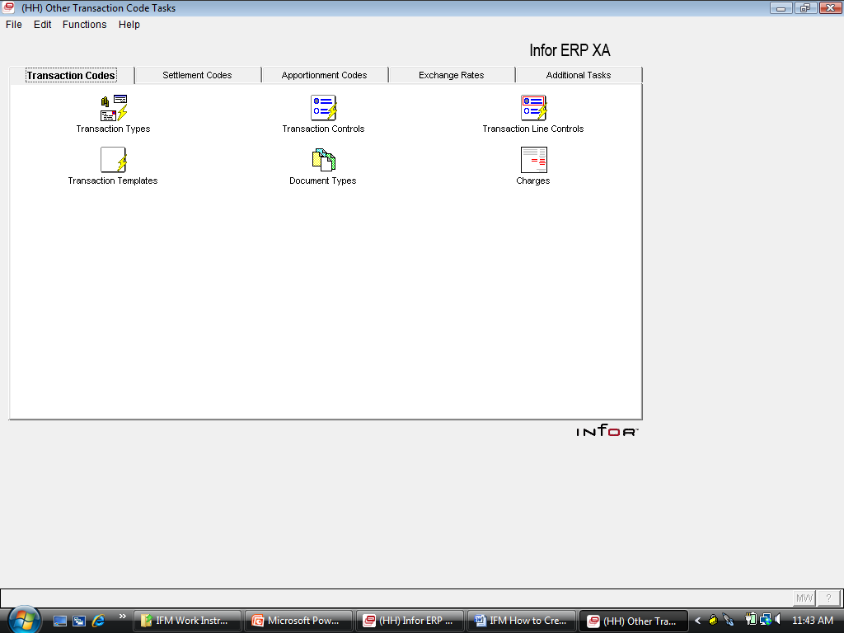
Level I

Slide 12
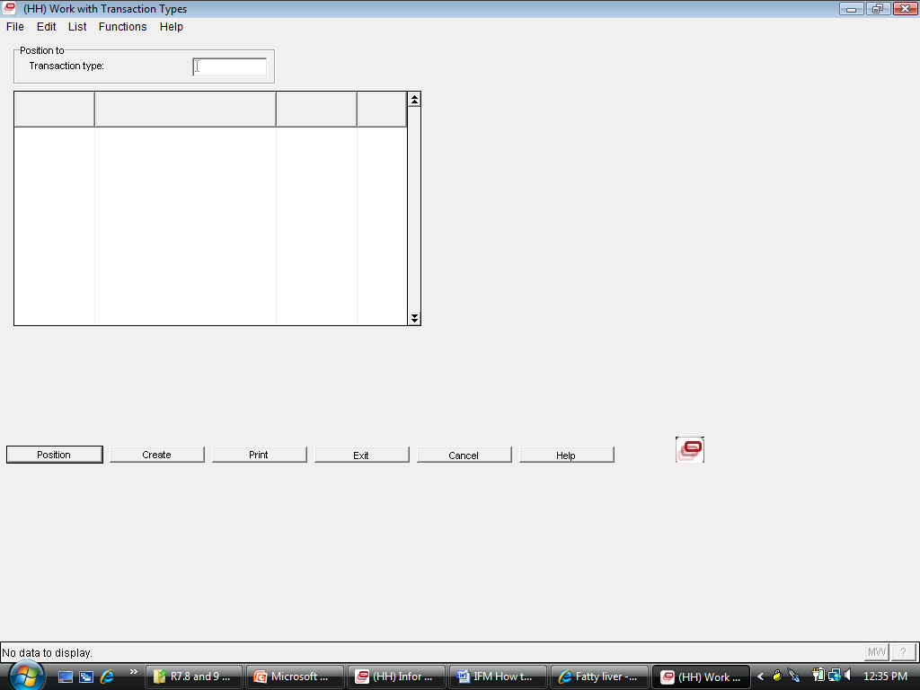

Slide 13
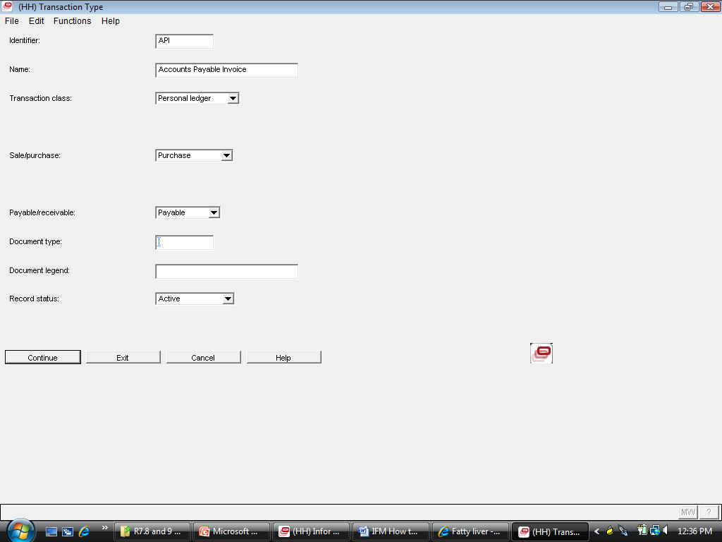
Enter the ledger class – AR and AP are Personal ledgers, and your other choice is Cashbook or General Ledger.
Is this transaction used in the Sales or Purchasing Process?
Will the Transaction Type be used as a Payable or a Receivable, or none for GL Transaction Types, for example a Journal Entry.

Slide 14
AP Cash Books

Slide 15
AP Transaction tasks

Slide 16
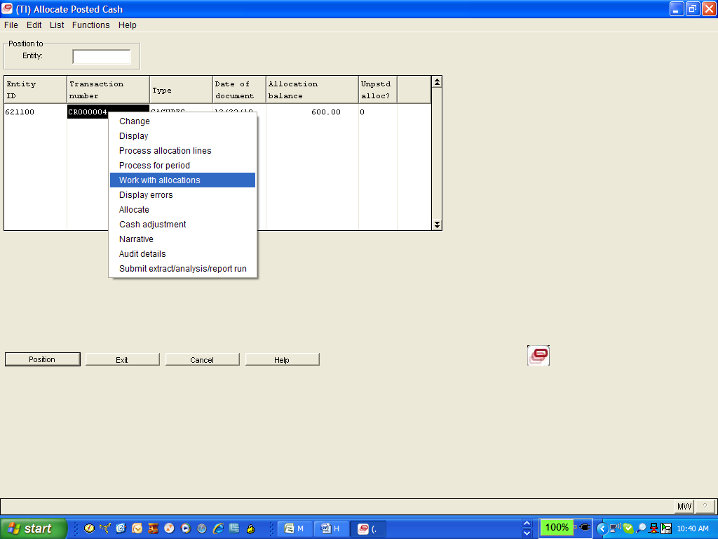
Right Click Replaces Option Numbers

Slide 17
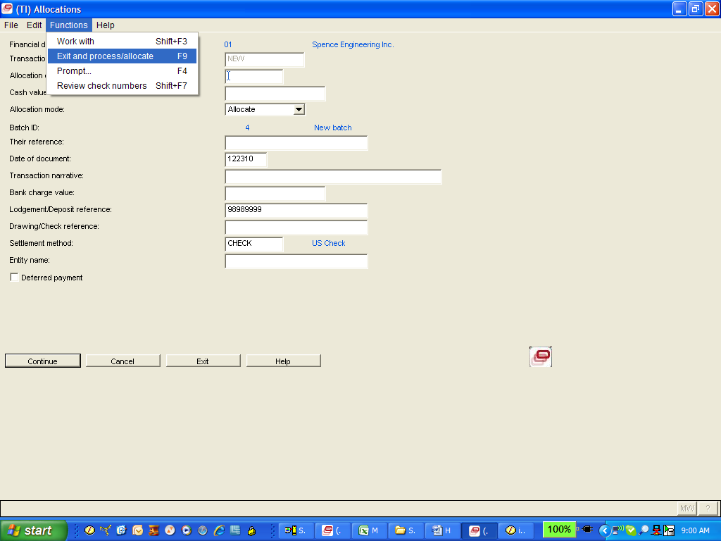
Functions Replace F Keys

Slide 18
AP Approvals
Function Menu from Other Tasks menus show Actions like “Display Printer Output”
Or “Change User Defaults” (*ID)

Slide 19
AP Cash Tasks

Slide 20
AP Checks

Slide 21
AP Reports and Inquiries

Slide 22
AP Notes
Currently Unable To Maintain Std Menus

Slide 23
AP Interdivision Trading

Slide 24
AP LSB

Slide 25
AP Taxes

Slide 26
AP Additional Tasks
Use CAS Menu Maintenance
AM5U0Z Additional Tasks Business Entities
AM5U1Z Additional Tasks A/R
AM5U3Z Additional Tasks A/P
AM5U5Z Additional Tasks G/L
AM5U6Z Additional Tasks IFM Codes

Slide 27
IFM IDF

Slide 28
Organizational changes

Slide 29
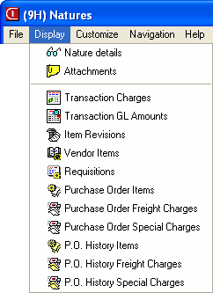
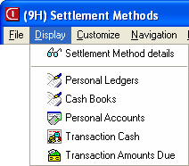
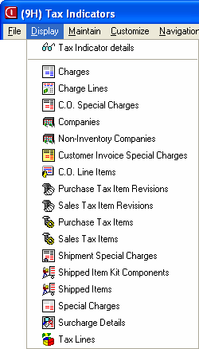
Where are things used?

Slide 30
Better Organization
Ledgers Card Shows AR Ledger
From AR Ledger Show AR Transactions

Slide 31
Security
Level II Powerlink Functions Moved to regular CAS security (not special IFM security)
Task/sub-task
Field security
Applies to client only
Easier to use and understand
Will all default to “Locked”

Slide 32
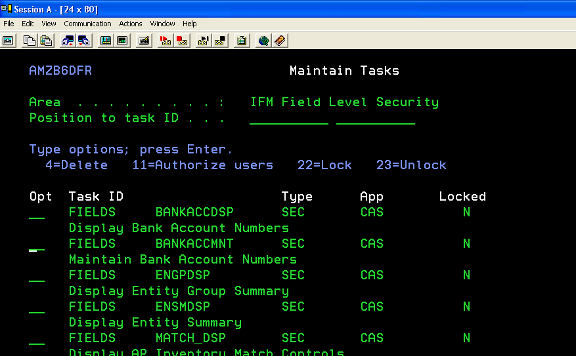
IFM Field level security
Applies across all IDF objects

Slide 33
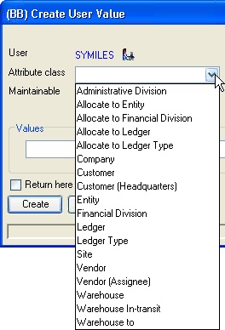
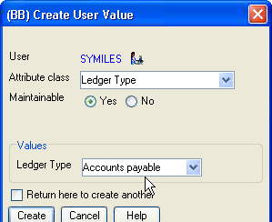
Auto-Content Security
Easy to authorize to AR, AP…
Applies across all objects
Does not require Enterprise Integrator

Slide 34
Separation of duties
Payments vs. PO’s
Allow, suspend
With or without entity

Slide 35
Maintenance
IFM Entities
Customers / Vendors
Notes:
When IFM is installed, users can create and maintain customers in CSM and vendors in PM. Changes to customer and vendor information made in CSM and PM are automatically reflected in the Entity object and vice-versa.
When you create customers and vendors, you now have more flexibility in assigning numbers. In CSM, customer IDs are no longer required to be based on the entity ID and ledger suffix. In PM, assignee vendor IDs need not match the entity ID. In both cases an application-wide option allows you to choose whether to enforce the rule or not.

Slide 36
The Family Of Entity-related Objects And Code Files Is Now Maintainable
Entities
Entity Revision
Personal Accounts
Personal Account Revision
Entity Contacts
Entity Aliases
Entity Groups
Entity Tax Identifiers
Entity Bank Account Revisions.
Banks
Tax Cities
Tax Counties
Personal Account Statuses
Collection Statuses
Regions
Notes:
In the above list, two objects have been renamed. Entity Data has been renamed Entity Revision, and Personal Account Data has been renamed Personal Account Revision. In both cases, the attributes from the current Revision (or Data) records has been merged into the main object to make the application easier, more intuitive, and more productive for the end-user.

Slide 37
Maintenance
New database attributes in Customer, Vendor, and Entity records include
E-mail Addresses
Mobile Phone Numbers
Web Addresses

Slide 38
Entity Maintenance
XA PowerLink

Slide 39
Entity Setup Comparison
Green Screen
PowerLink
11 Screens
Entity
Entity Data (2)
Contact
Personal Account
Personal Account data (2)
Customer 4
System Driven
6 Screens
Entity
Personal Account
Customer (4)
User Choice

Slide 40
Entity Maintenance

Slide 41
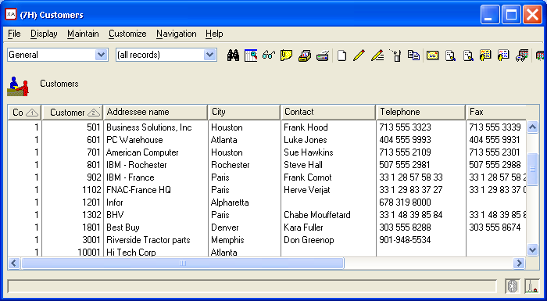
ERP XA Entity Maintenance: Create customer
Click “Create”

Slide 42
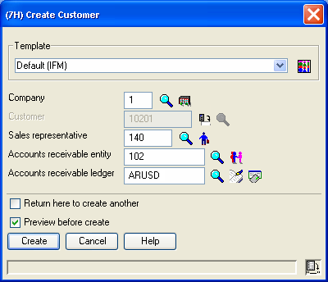
ERP XA Entity Maintenance: Create customer
Company
Customer ID
Sales rep
Entity
Ledger

Slide 43
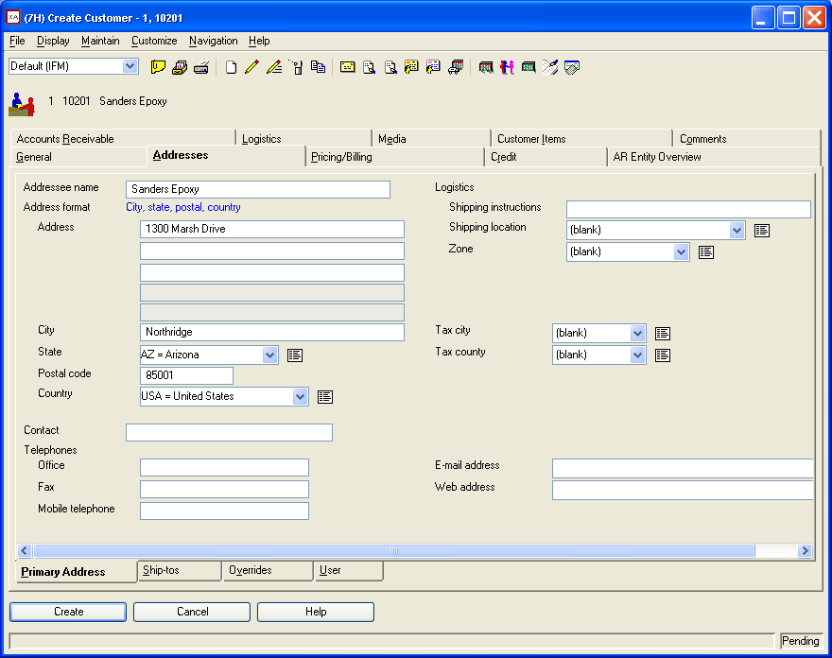
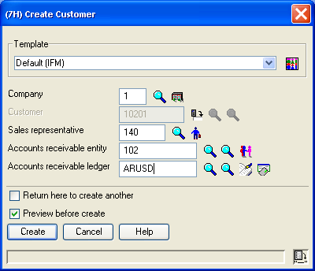
ERP XA Entity Maintenance: Create customer
Click “Create” to create customer

Slide 44
ERP XA Entity Maintenance
Auto-synchronize with Entity
Address, contact
Same for Vendor

Slide 45
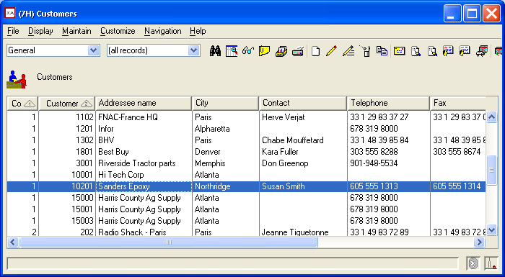
ERP XA Entity Maintenance: Create customer
Customer created

Slide 46
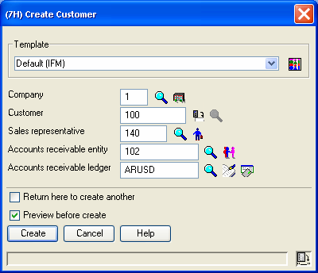
ERP XA Entity Maintenance: Create customer
Option to key in customer number

Slide 47
ERP XA Entity Maintenance: Create customer
Click “Create”

Slide 48
ERP XA Entity Maintenance: Create customer
Company
Customer ID
Sales rep
Entity
Ledger

Slide 49
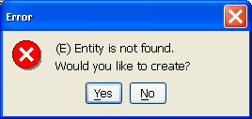
ERP XA Entity Maintenance: Create customer
Option to create entity

Slide 50
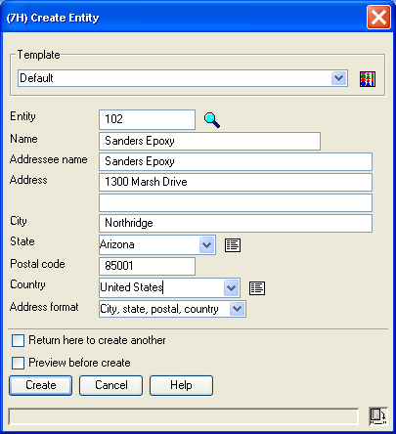
ERP XA Entity Maintenance: Create customer
Entity address

Slide 51
ERP XA Entity Maintenance: Create customer
Entity created

Slide 52
ERP XA Entity Maintenance: Create customer
Click “Create” to create customer

Slide 53
ERP XA Entity Maintenance: Create customer
Customer and Entity created

Slide 54
ERP XA Entity Maintenance: Create customer
Click “Create”

Slide 55
ERP XA Entity Maintenance: Create customer
Company
Customer ID
Sales rep
Entity
Ledger

Slide 56
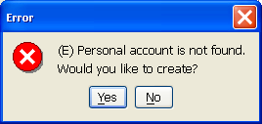
ERP XA Entity Maintenance: Create customer
Option to create personal account

Slide 57
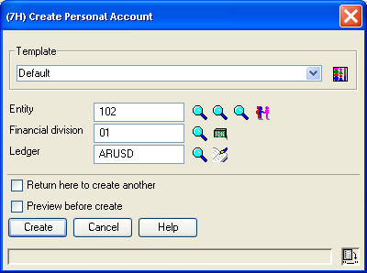
ERP XA Entity Maintenance: Create customer
Entity
Financial Division
Ledger

Slide 58
ERP XA Entity Maintenance: Create customer
Personal account created

Slide 59
ERP XA Entity Maintenance: Create customer
Click “Create” to create customer

Slide 60
ERP XA Entity Maintenance: Create customer
Customer and Personal Account created

Slide 61
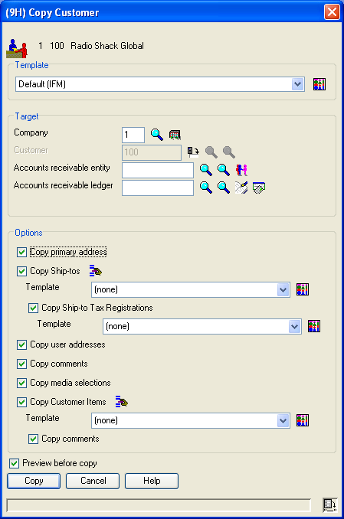
Copy Customer
Primary address
Ship-to’s
User addresses
Comments
Media selections
Customer items
Comments

Slide 62
Copy vendor
Templates
Copy vendor items

Slide 63
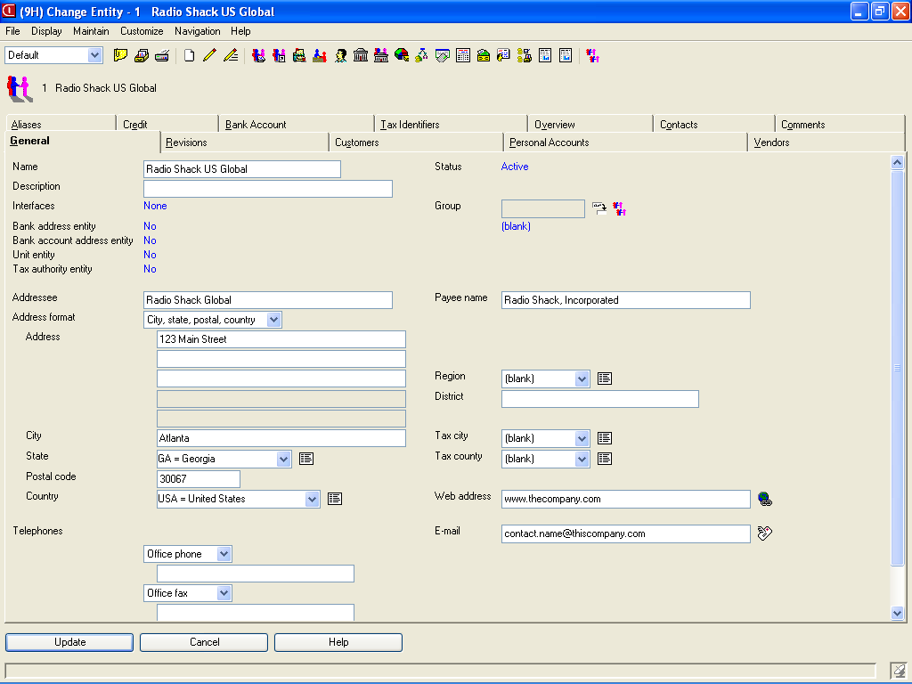
Maintain Entity
Everything in one place
Current Revision is automatically updated

Slide 64
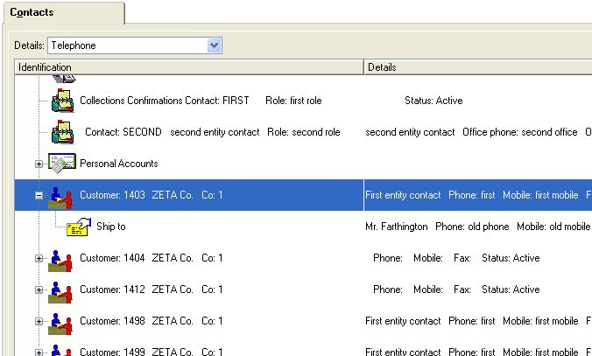
Entity cards
Contacts
Addresses
Phone numbers
Ship to’s
More…
…and just click to maintain!)

Slide 65
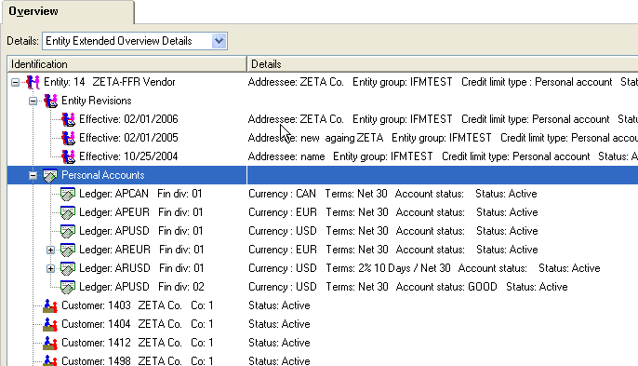
Entity cards
Customers, Vendors
Personal Accounts
Bank accounts
Ledgers
Revisions
…everything!

Slide 66
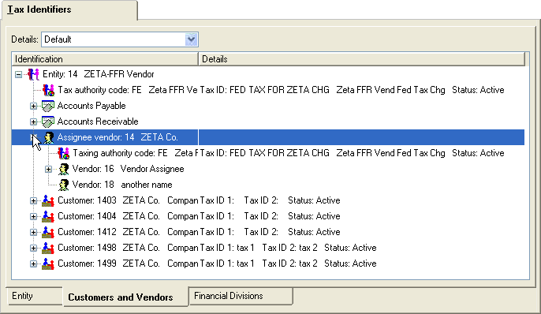
Entity cards

Slide 67
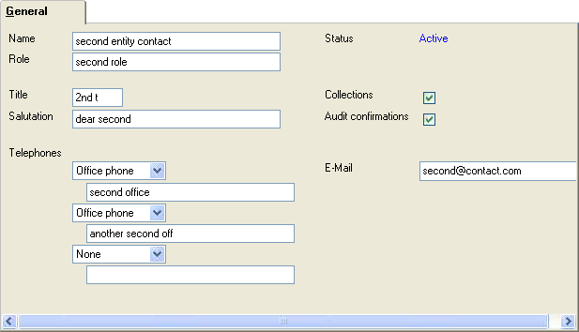
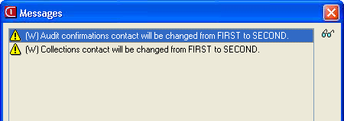
Entity Contact

Slide 68
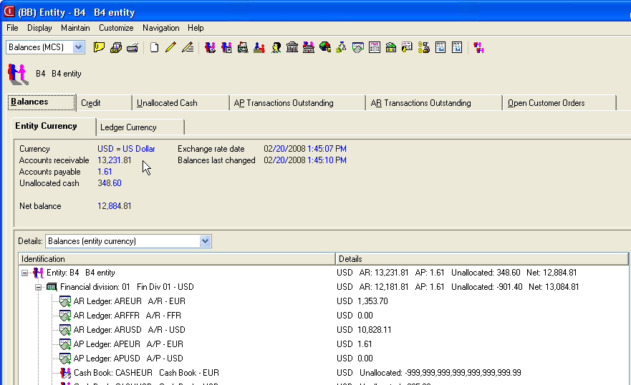
Balances
Detail
Status

Slide 69
Entity Maintenance
Entity
Personal Account
Customer
Vendor
Contact
Individual
Security Settings

Slide 70
New Trading Partner Balances
Admin Division
Entity Group
Financial Division
Entity
Personal Account

Slide 71
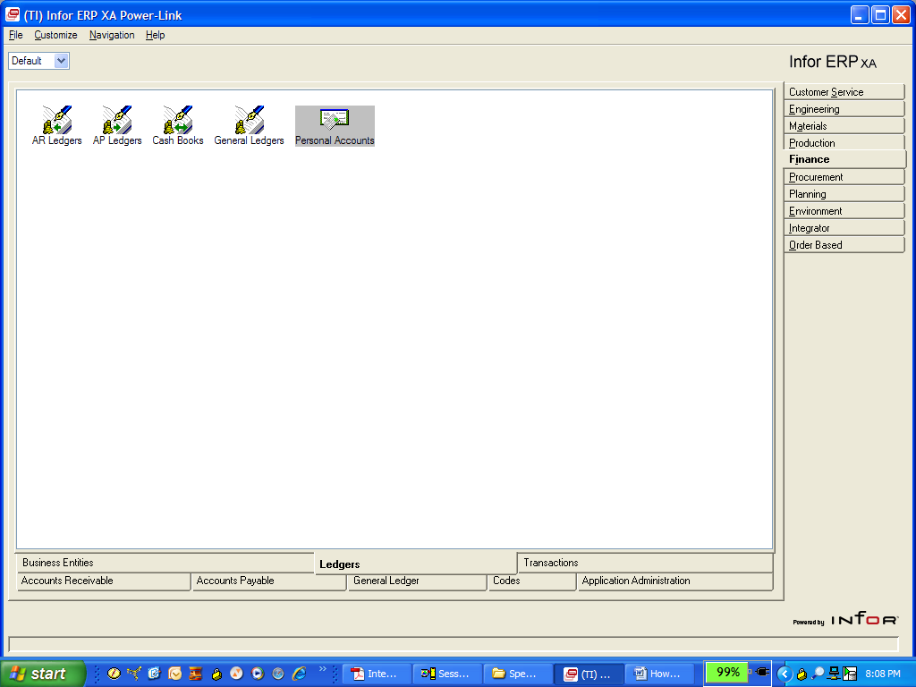
Aged Ledger Balances
Execute from Personal Accounts Object

Slide 72
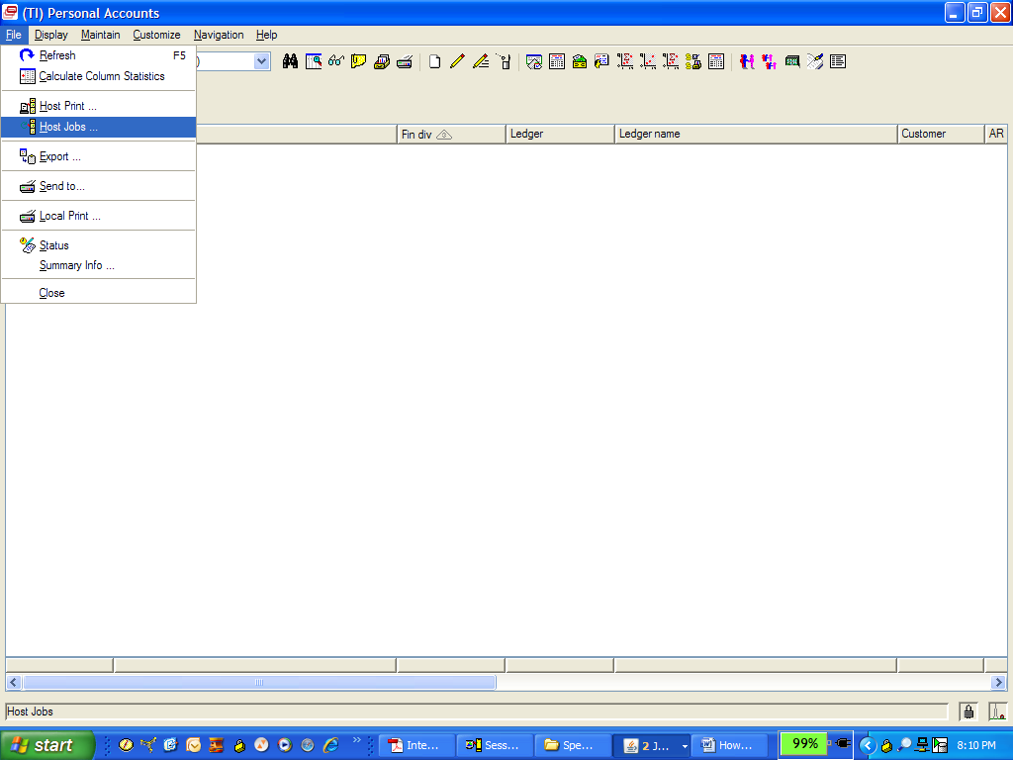
Aged Ledger Balances
Host Job

Slide 73
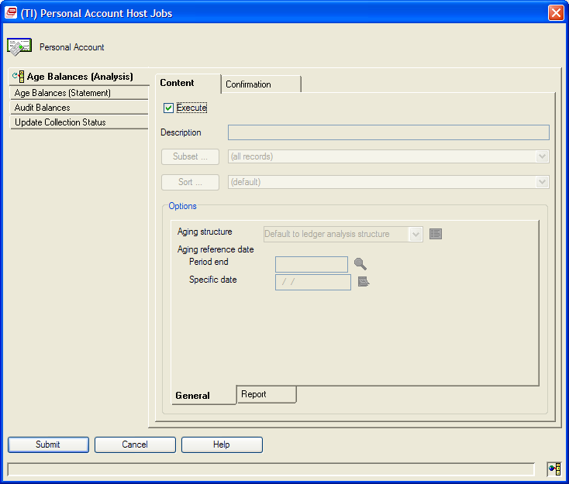
Aged Ledger Balances

Slide 74
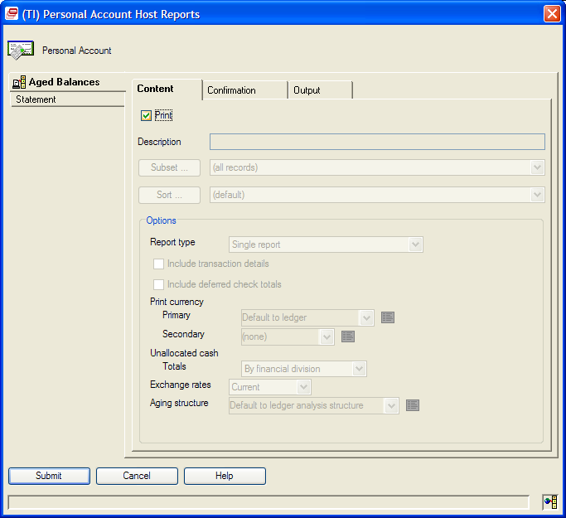
Aged Ledger Balances

Slide 75
Credit improvements
R7.7: Entity Financial Division Balances file
Updated as a scheduled job
Checked by COM at End Order
R7.8 Real-time update
Create Customer Order
Post invoice
Apply cash receipt

Slide 76
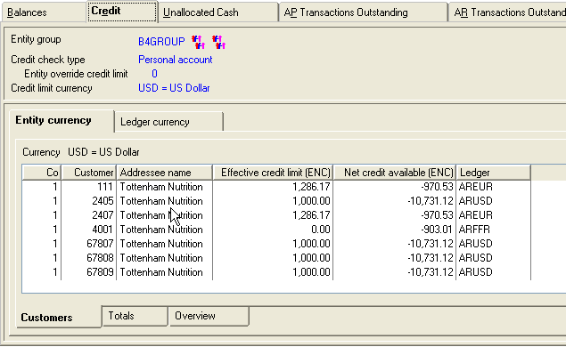
Credit improvements
Client summary files also updated real-time
Same drill-down available

Slide 77
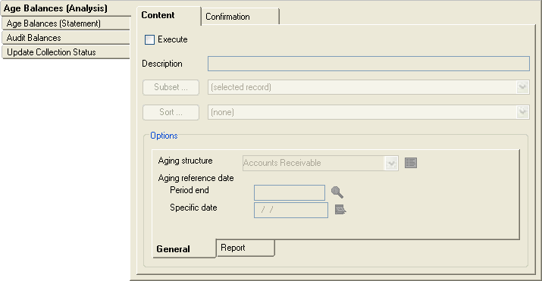
Aging by Personal Ledger
ERP
Automatic aging at least once per day
Can run more often via host job
Authorize to host job in CAS security
ERP
Financials

Slide 78
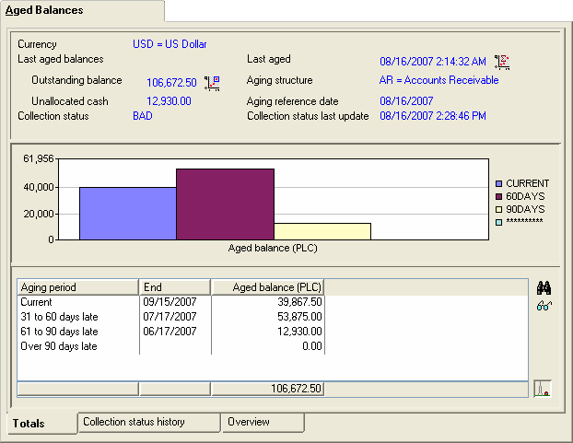
Aging
ERP
Aged balances shown in both graph and table form
ERP
Financials

Slide 79
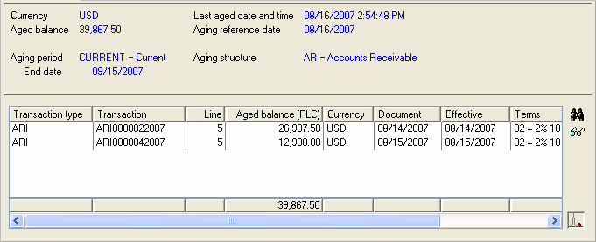
Aging
ERP
Aged balances shown in both graph and table form
Drill down to transactions from either one.
ERP
Financials

Slide 80
IFM – Functions in process
Phase I – “Establishment”
All table maintenance
Entities, divisions, ledgers, withholding tables…
45% of menu options
Phase II – “Transactions”
Journal entries
Cash receipts
AR Invoices
AP Invoices
Phase III – “The rest”
Reports
Etc.

Slide 81
Sarbanes-Oxley
R6
R7
Security
Objects
Fields & Content
CAS
EI: Automated
Integrator
EI: Automated
Data changes
MAPICS objects
MAPICS transactions
Integrator objects
Integrator transactions
Yes
Yes
Yes
Yes
Trigger
EI: Automated
EI: Yes
Processes
Change objects
Yes

Slide 82
Credit and Balances
Encourages PowerLink in the IFM world
Better data
User fields in Entities
Better Office Integration

Slide 83
The Real Benefits
A Tool Is As Good As The Use You Make Of It
R9 Allows Your Company’s Information Infrastructure To Be Nimble
React To Business Needs
New Standard Application Function
Instant Custom Function
Unite People With Better Integration
Departmental Systems
External Users
Off-site Internal Users

Slide 84
Get All of Your Questions Answered

