Slide 1
XA R7/9 PowerLink
Moving Forward with XA
Order Based Production Management
John Grindley
John.Grindley@cistech.net

Slide 2
Agenda
OBPM change from R6.0 to R9.0
Manufacturing order entry and maintenance
New Objects in OBPM to replace GS
MRP Recommendations
Bells and Whistles

Slide 3
OBPM - Managing Orders and Recommendations
Who does it ?
The production Planners manage the M.O.’s.
The Buyers manage PO and MRP “Buy Recommendations”. Keep in mind that a Planner can represent a Buyer which aids in MRP Review.
What do they do ?
Identify what needs to be made or bought.
Ultimately create an MO or PO.
Release Orders to the floor and to the vendors.
Manage their orders progress and react to delays or issues.
Ensure their completion and closure.

Slide 4
Application Settings added to OBPM

Slide 5
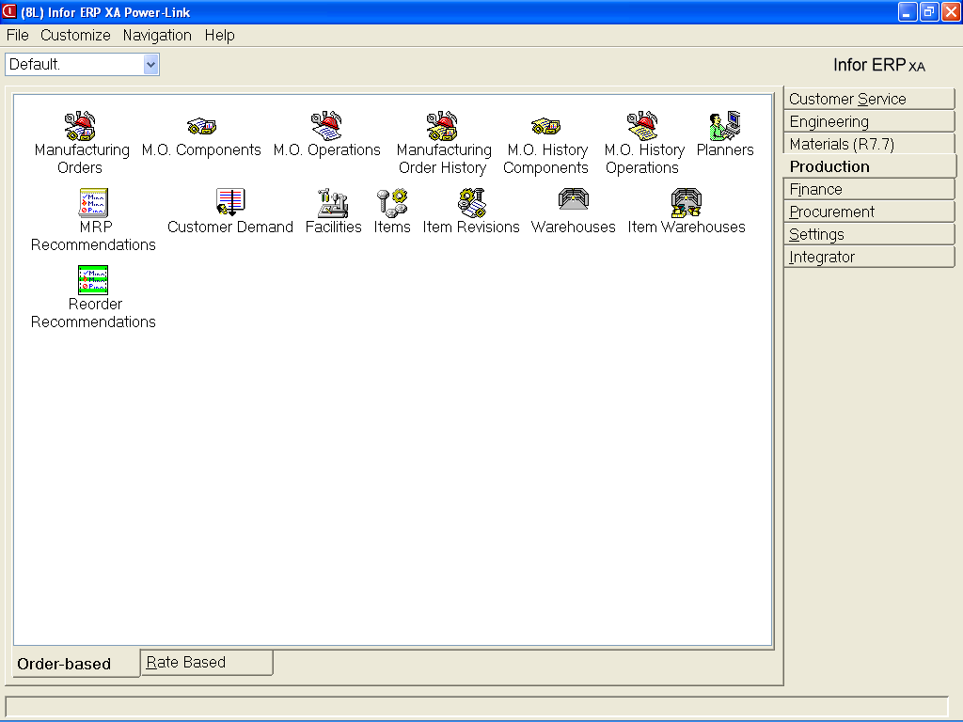
OBPM
Who does it in MRP Recommendations-
Production Controller/Planner for mfg items
Buyers for Buy Recommendations

Slide 6
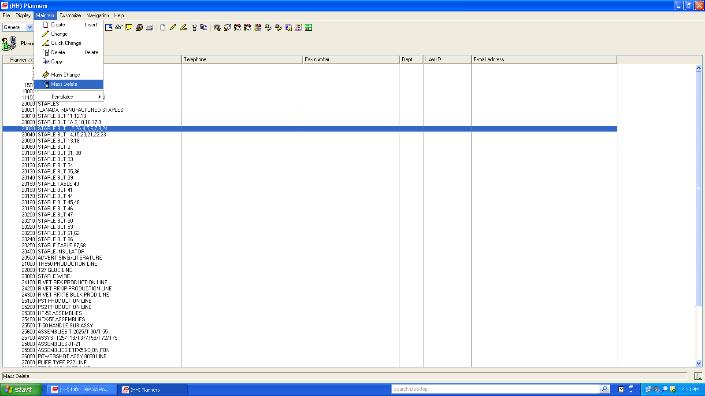
Planner Object adds Mass Delete Option.
Display options remain the same
Icons are added to Drop downs –
added Post Release 6.0

Slide 7
OBPM
Use to create and release manufacturing orders to begin production…or to check MO status.

Slide 8
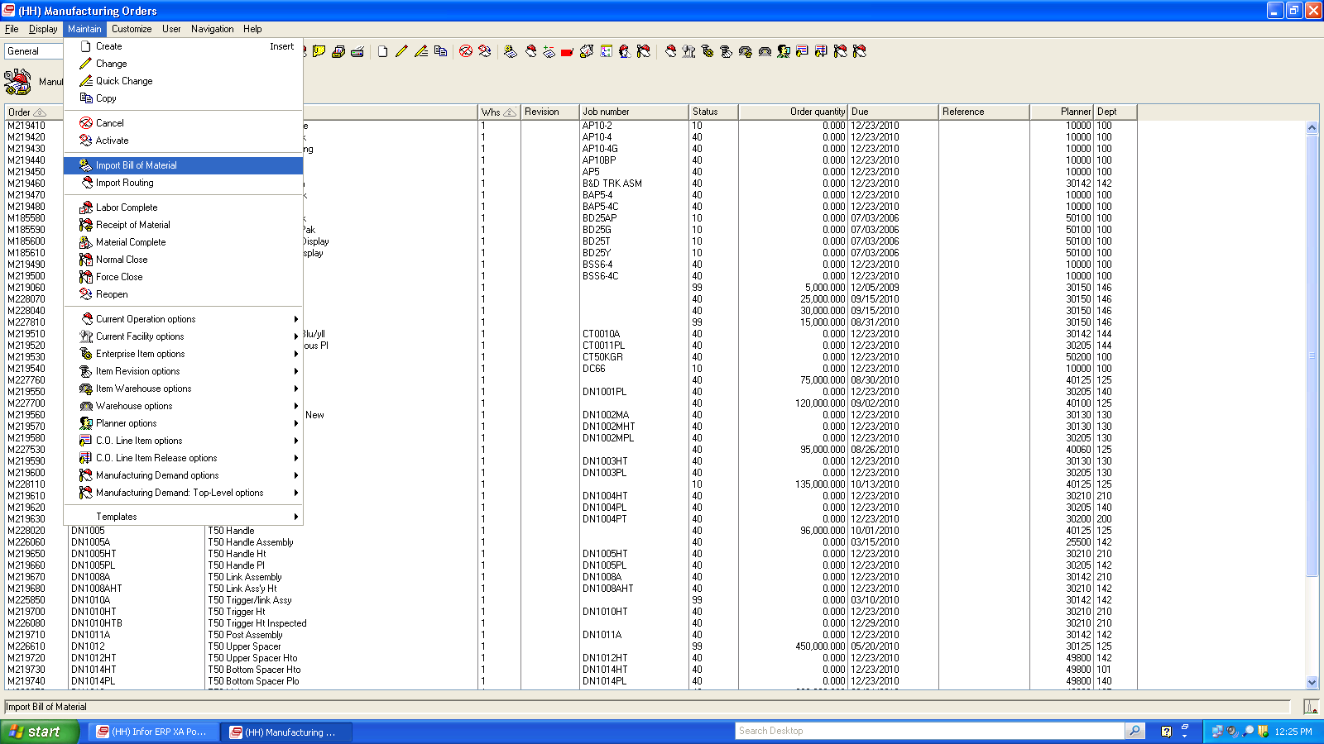
OBPM- Maintenance added import BOM and Router
Added post 6.0

Slide 9
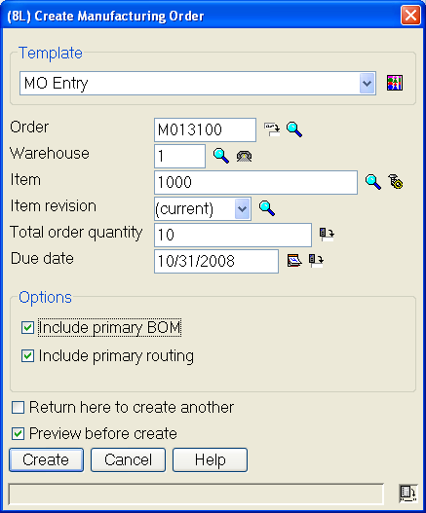
Create Manual Manufacturing Orders
If using EPDM, you can choose to use alternate bills and/or routings.

Slide 10
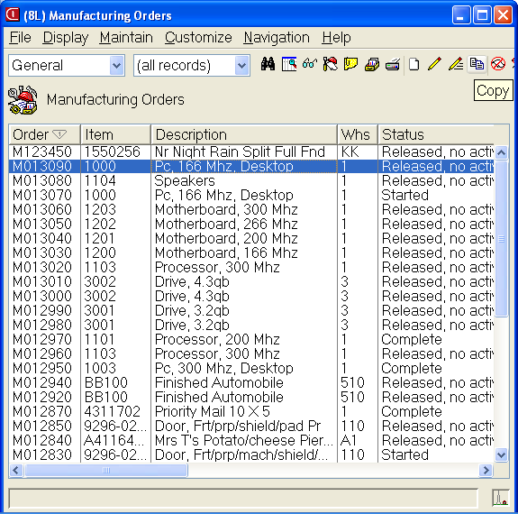
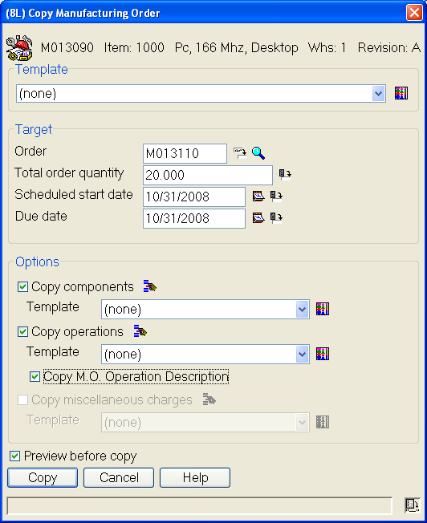
Copy Manufacturing Orders
From Open MO or History
Options to Copy
Header
Components
Operations
Misc charges

Slide 11
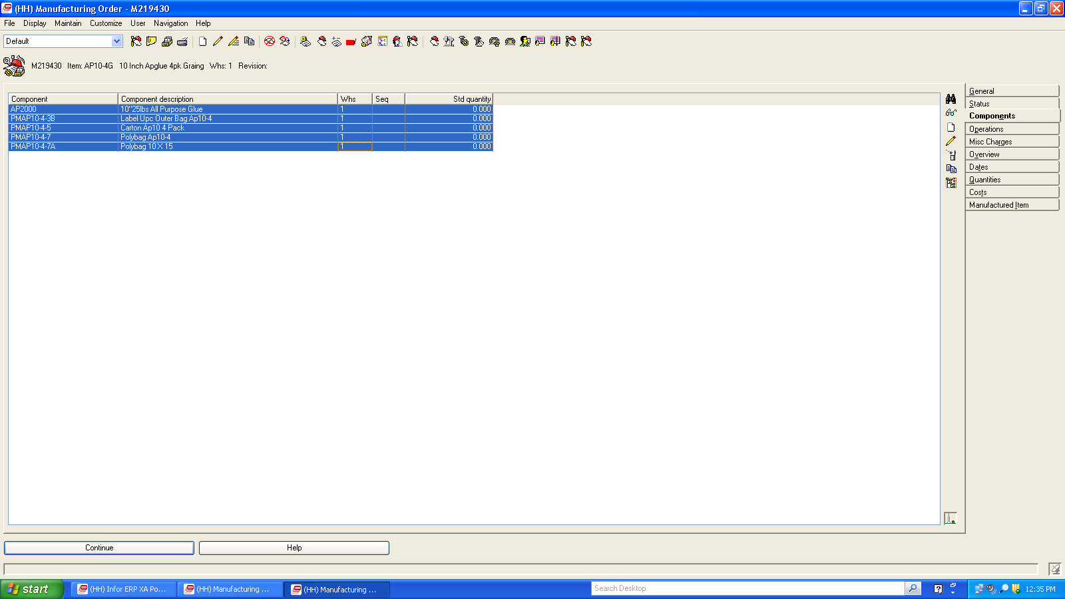
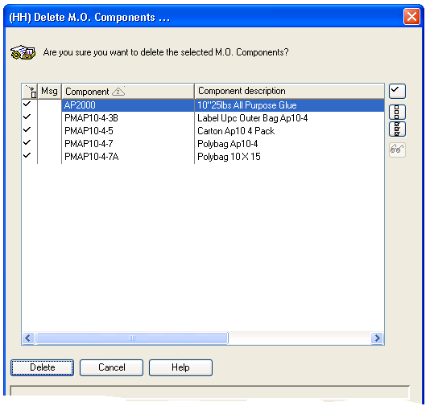
Mass Delete Components on Workorder
Highlight each line item and then click
On delete ICON. Launches Dialog box below

Slide 12
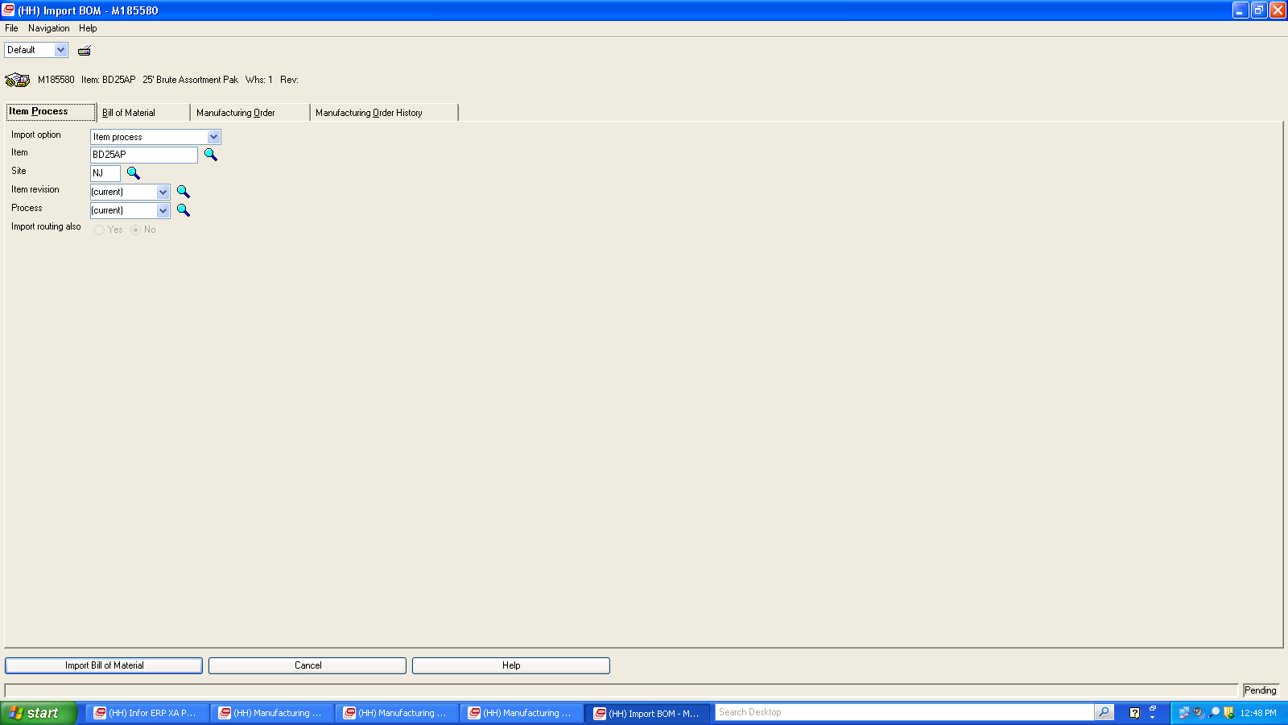
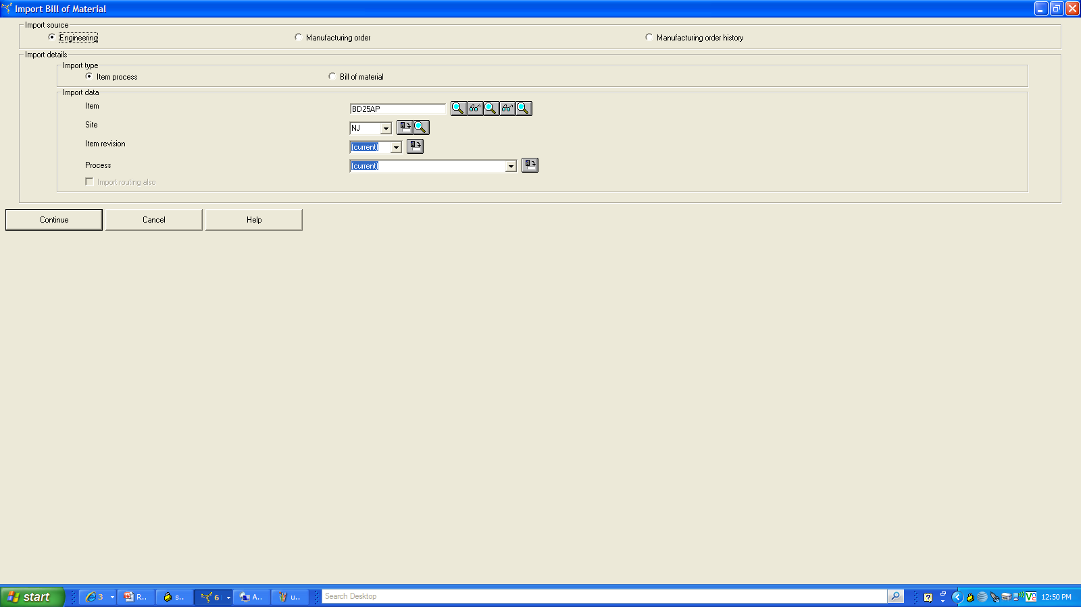
Import of BOM with additional Flexibility
Release 9.0
Release 6.0

Slide 13
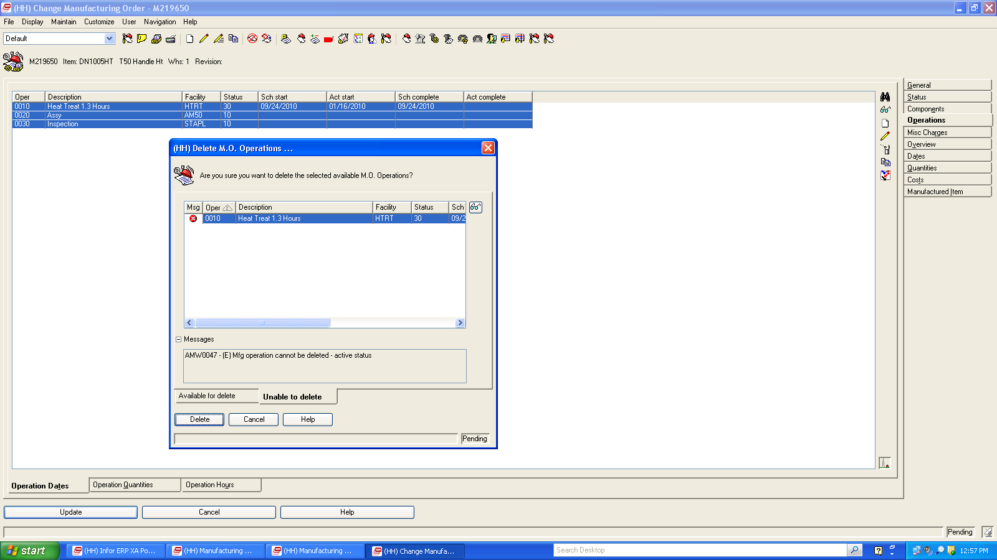
Mass Delete Operations on Workorder
Highlight each line item and then click on delete ICON. Launches Dialog box. However if there is activity on the operation the DELETE function is not allowed.

Slide 14
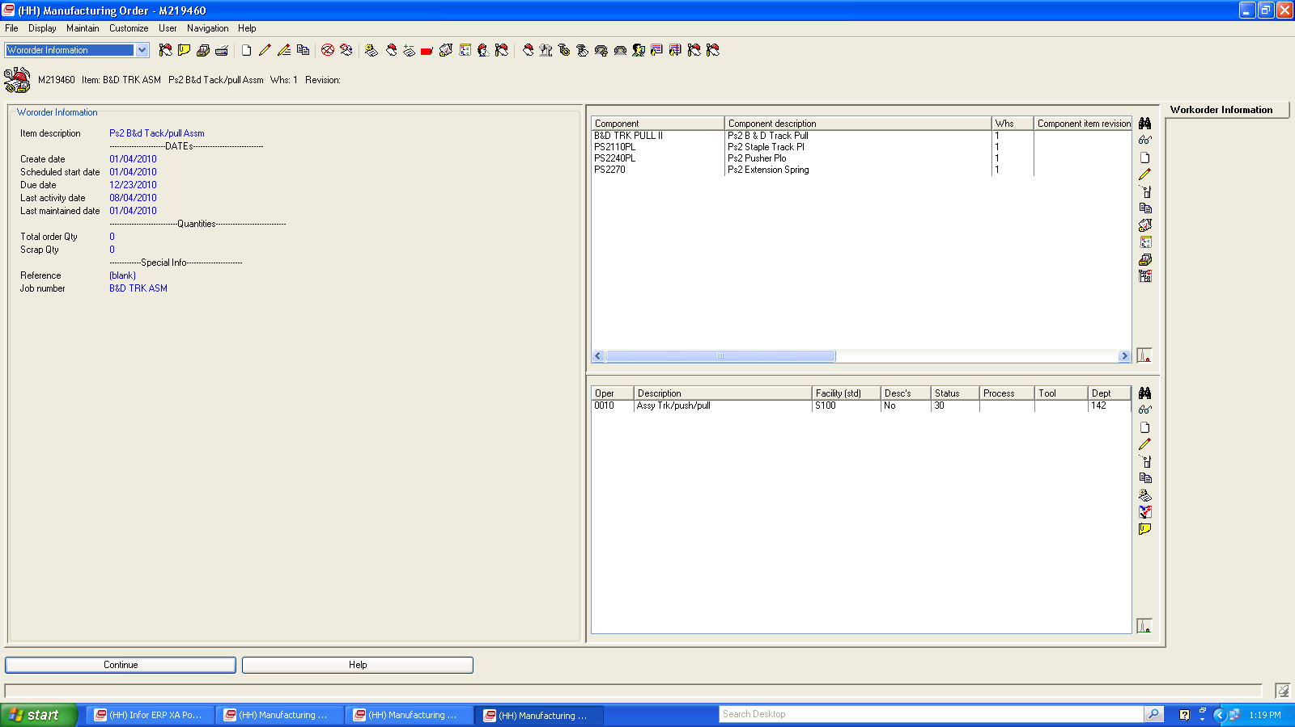
Creation of Compound Cards can be used in
place of tabbed Card file and workbenches
2nd section is Components
box to add and change components
with additional tools.
First section has
MWO information
3rd section is Operations
box to add and change operations
with additional tools.

Slide 15
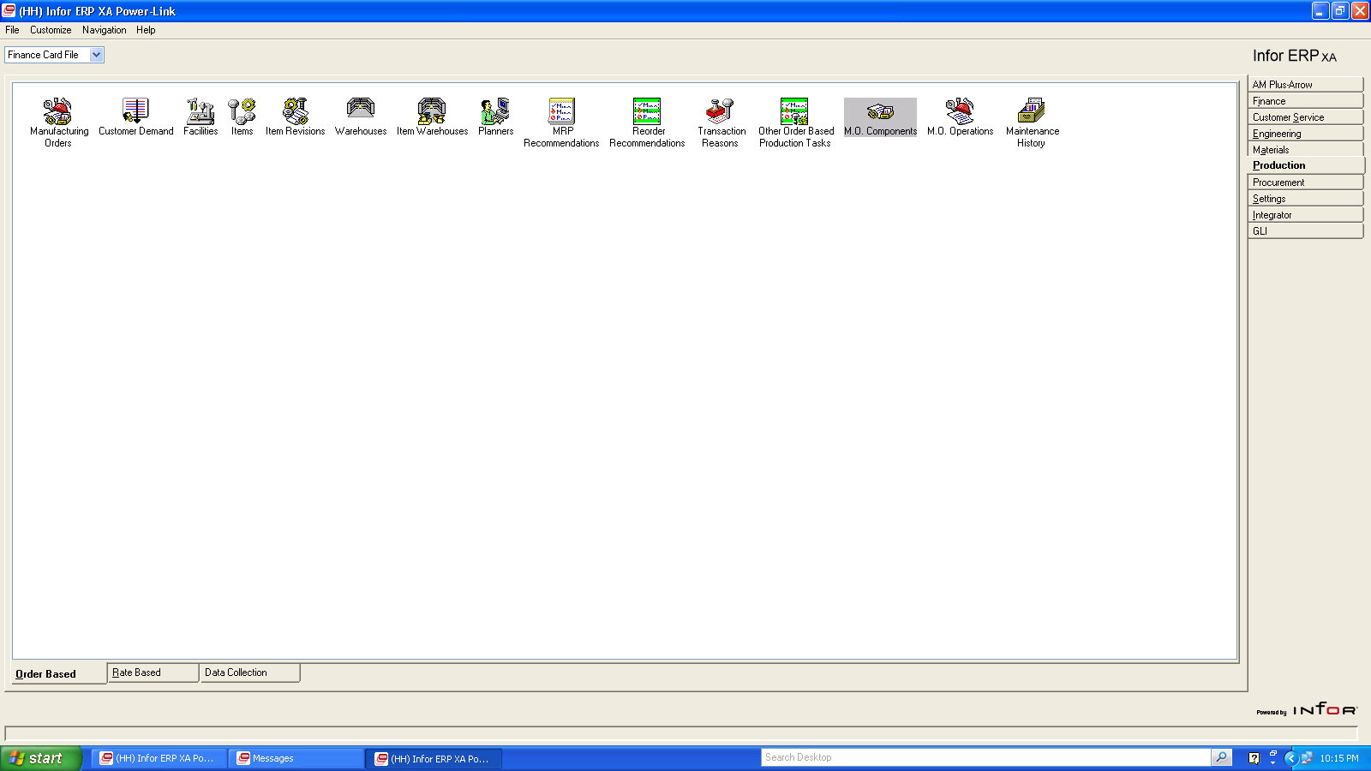
OBPM – MO Components
Ability to track shortages to
Workorders and mass delete
components

Slide 16
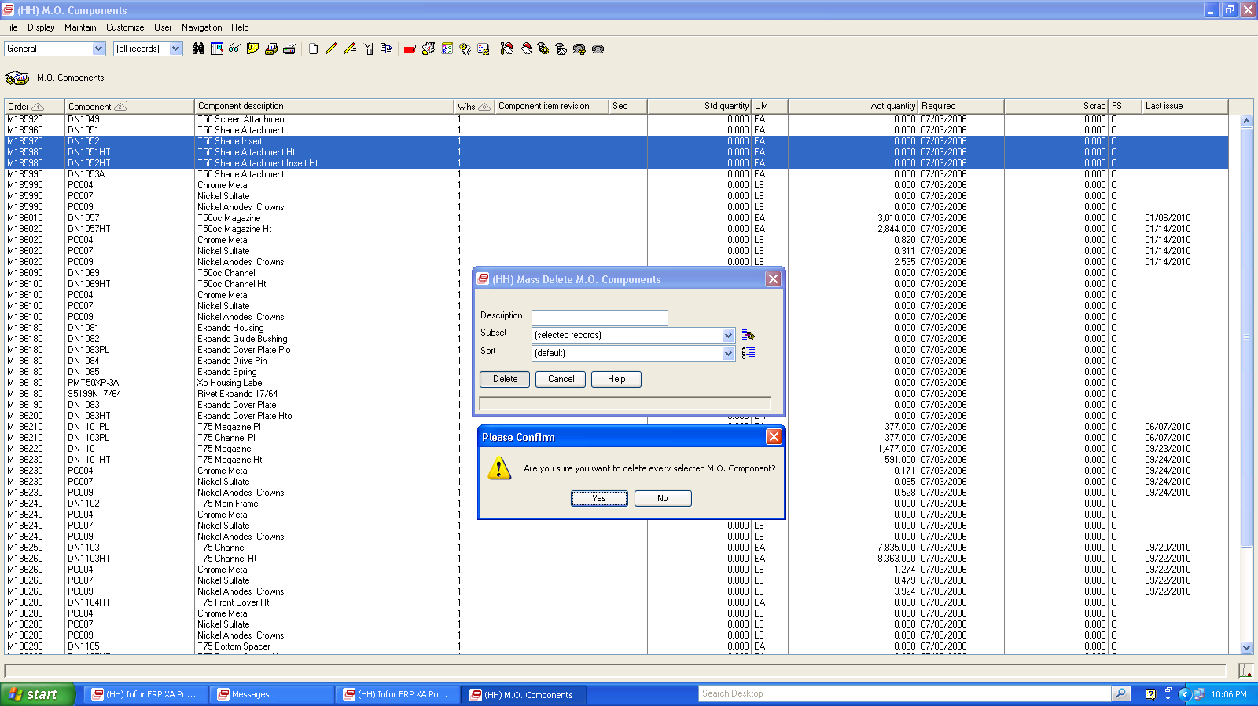
MO Components – Mass Delete Components Added
Ability to mass delete
Components to workorders
By selecting records

Slide 17
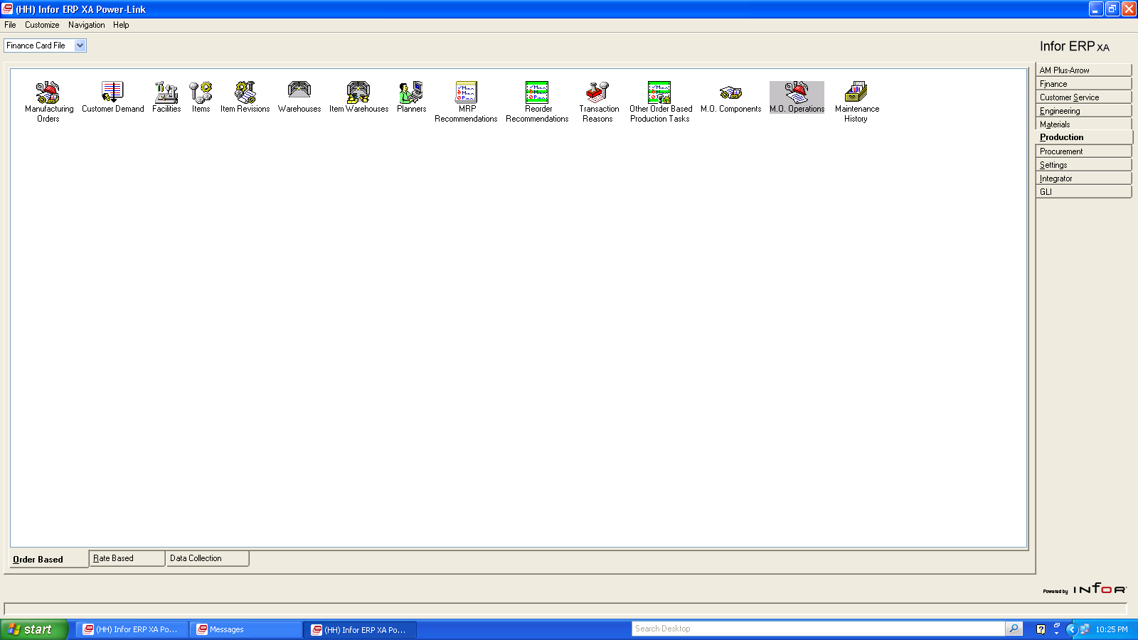
OBPM- MO OPERATIONS
Ability to create schedules by
Workcenter for Open MWO’s
and mass delete operations

Slide 18
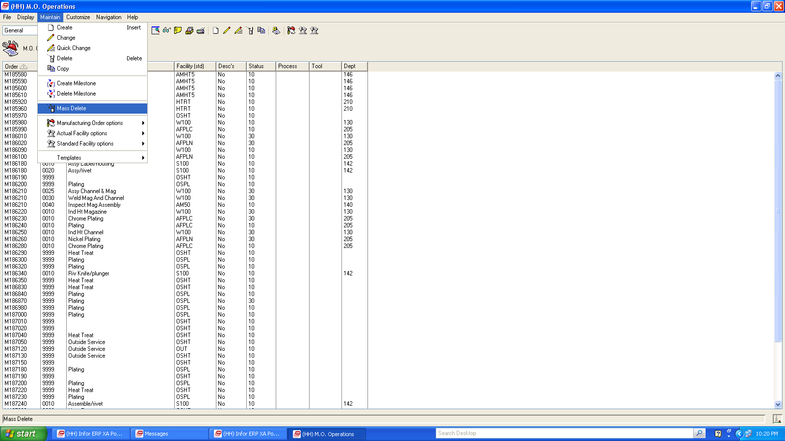
MO Operations – Mass Delete Operations to MWO’s
Ability to mass delete
operations to workorders
By selecting records or subsets

Slide 19
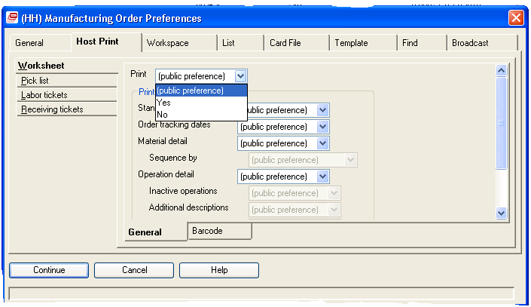
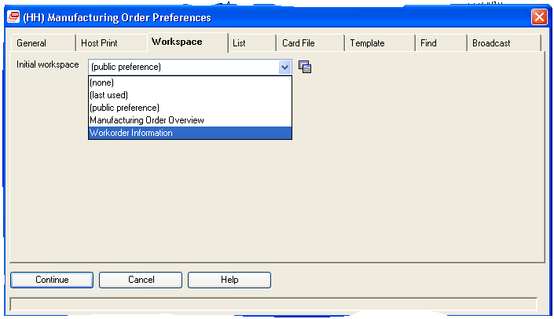
Public Preference setting on Host Print options .
Can set public preference on
Workspaces or create new ones
to set as preference

Slide 20
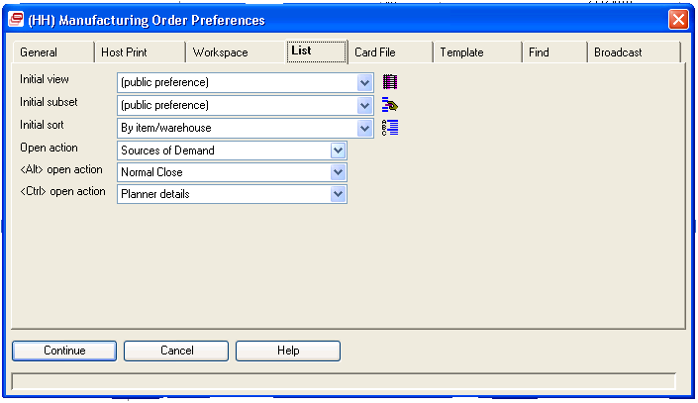
Can set “OPEN ACTIONS’ preference which calls up a screen based on click, or holding down “ALT” and “Ctrl” key and then click.

Slide 21
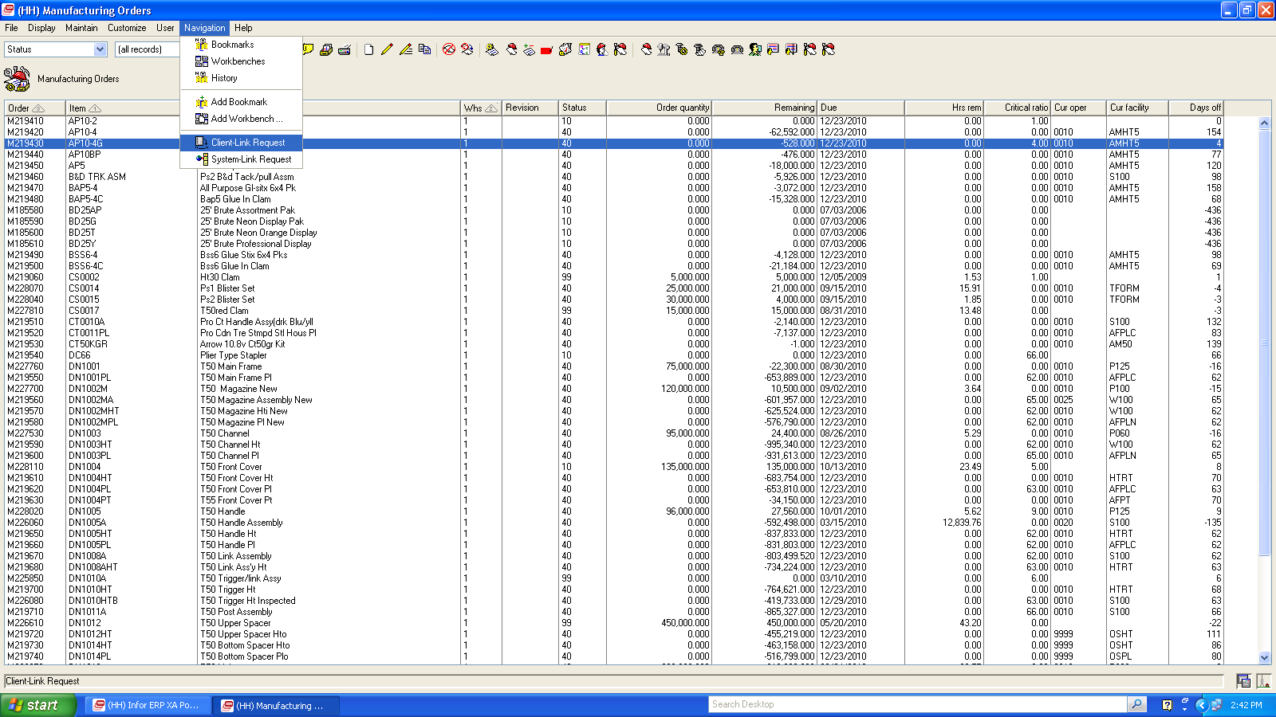
Client Link and System Link Request added
A System-Link request provides information required to form requests to send information to another system. Each System-Link request contains descriptive information about the request, control information for how to process the request, and audit controls to log the request

Slide 22
IDF FUNCTIONALITY- Infor Development Framework
Provides an integrated flow for users when working with information in both Power-Link and in the functions previously only accessible in the XA legacy applications.
Provides access to the IDF Level 1 tasks related to that application or to the Power-Link functions on the application card.
Allows a user to enter information or to select the options required to perform the task.
An IDF Level 1 application window contains the icons users click to start specific tasks. XA organizes the icons in groups of related tasks. Each task icon starts a specific task.
The IDF Level 1 windows cannot be customized in the same way that Power-Link windows can. Also, some advanced Power-Link functions, such as broadcasting and receiving information among application windows or attaching outside files to application records, are not available for IDF Level 1 functions.
IDF Level 1 does provide an Additional Tasks feature that allows users to add frequently used options to the IDF Level 1 application windows through the Menu Maintenance function in Cross Application Support

Slide 23
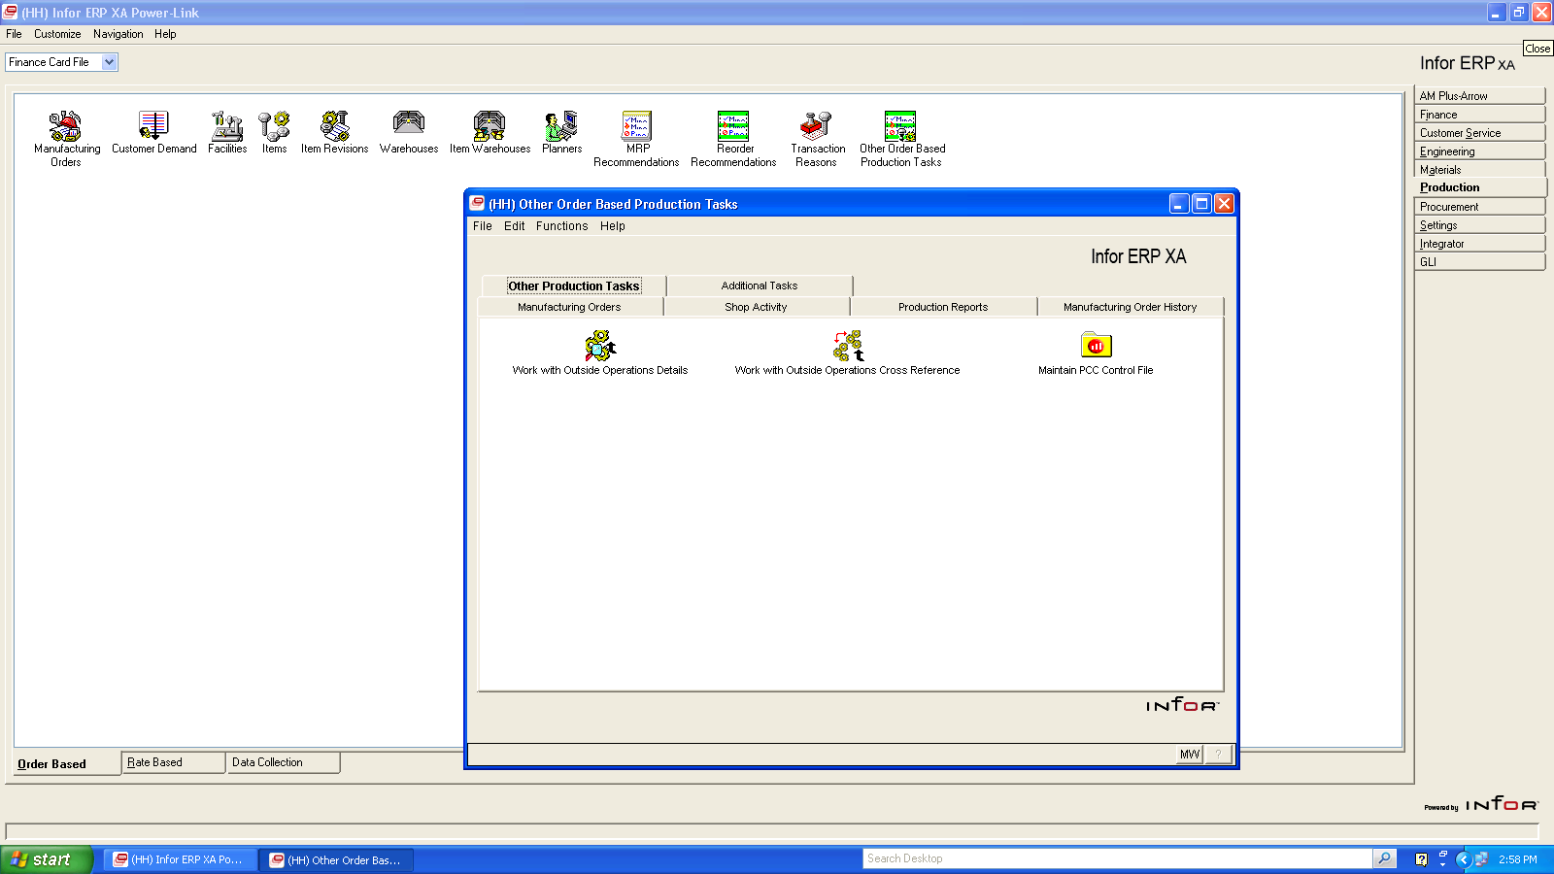
New Object “ Other Order Based Production Tasks”
Launches a series of applications from PCC
which are normally on green screen (IDF level 1)

Slide 24
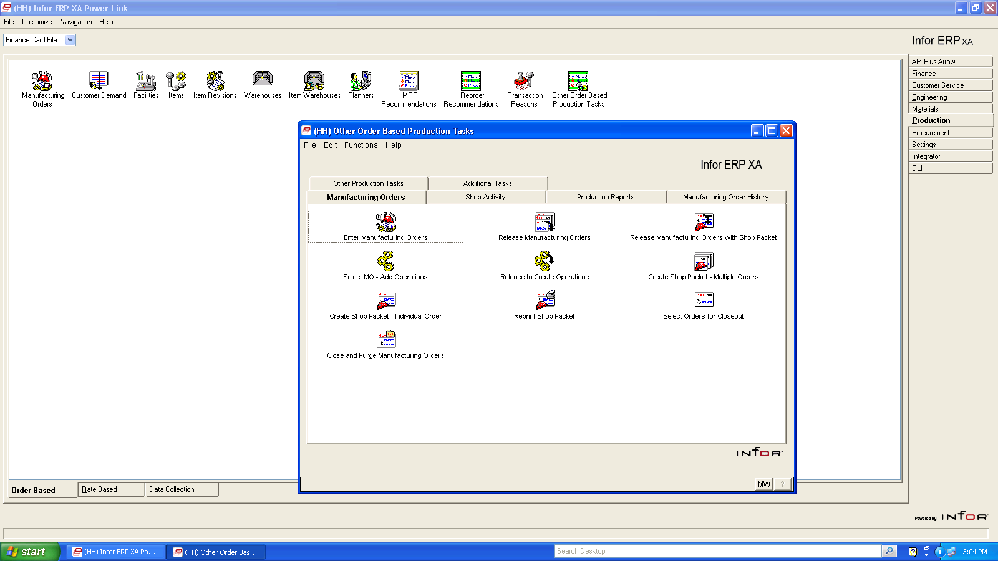
New Object “ Other Order Based Production Tasks”

Slide 25
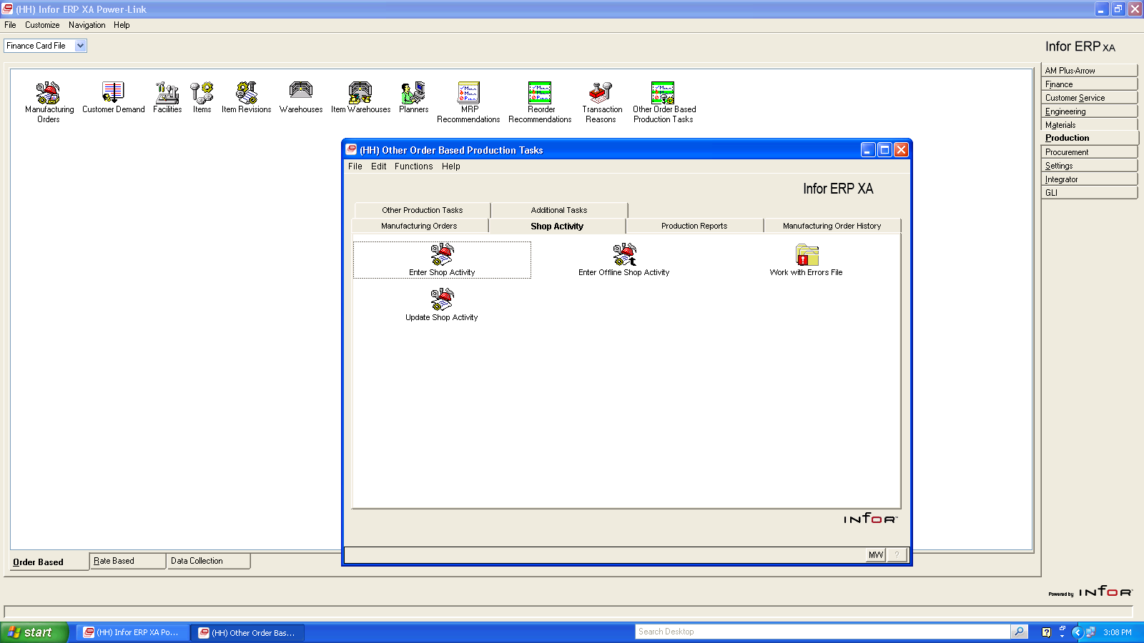
New Object “ Other Order Based Production Tasks”

Slide 26
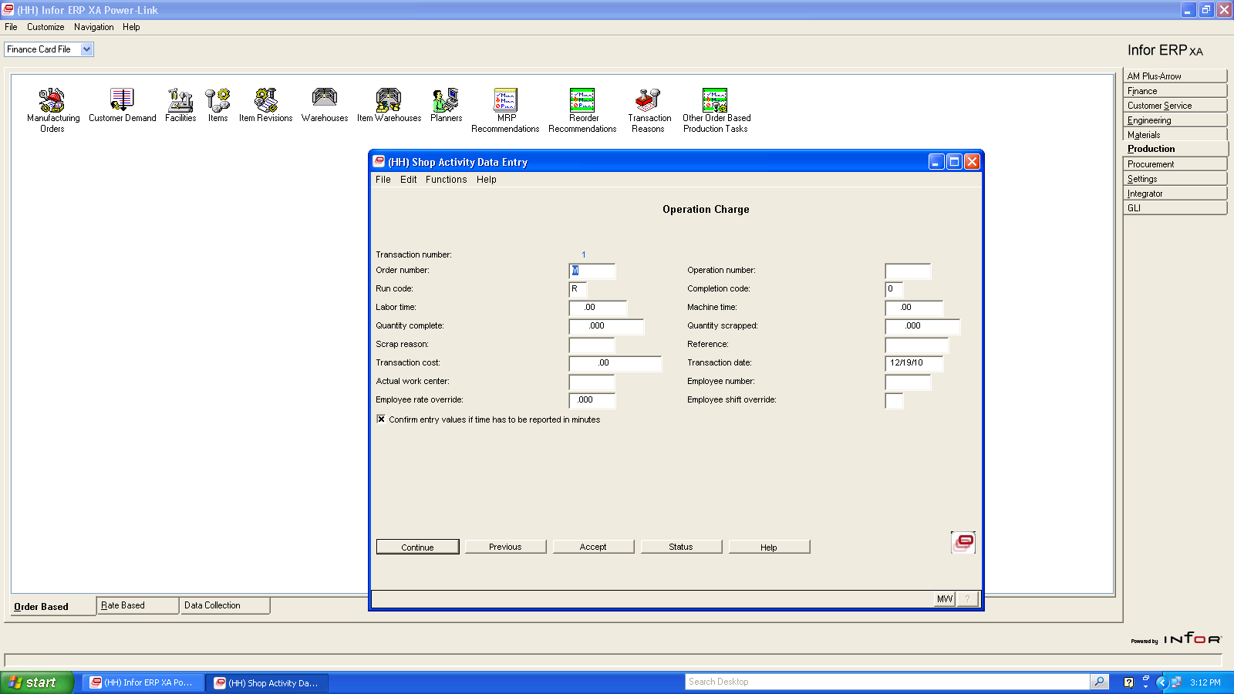
New Object “ Other Order Based Production Tasks”
Green Screen Entry
Replaced by IDF Level 1
Option.

Slide 27
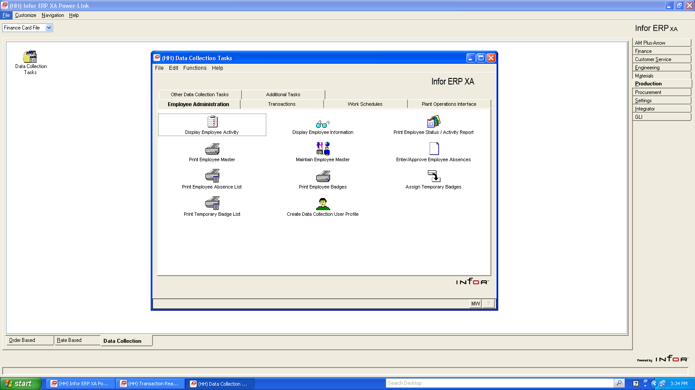
New Object “ DATA COLLECTION Tasks”
Launches dialog box
For PMC applications
In green screen

Slide 28
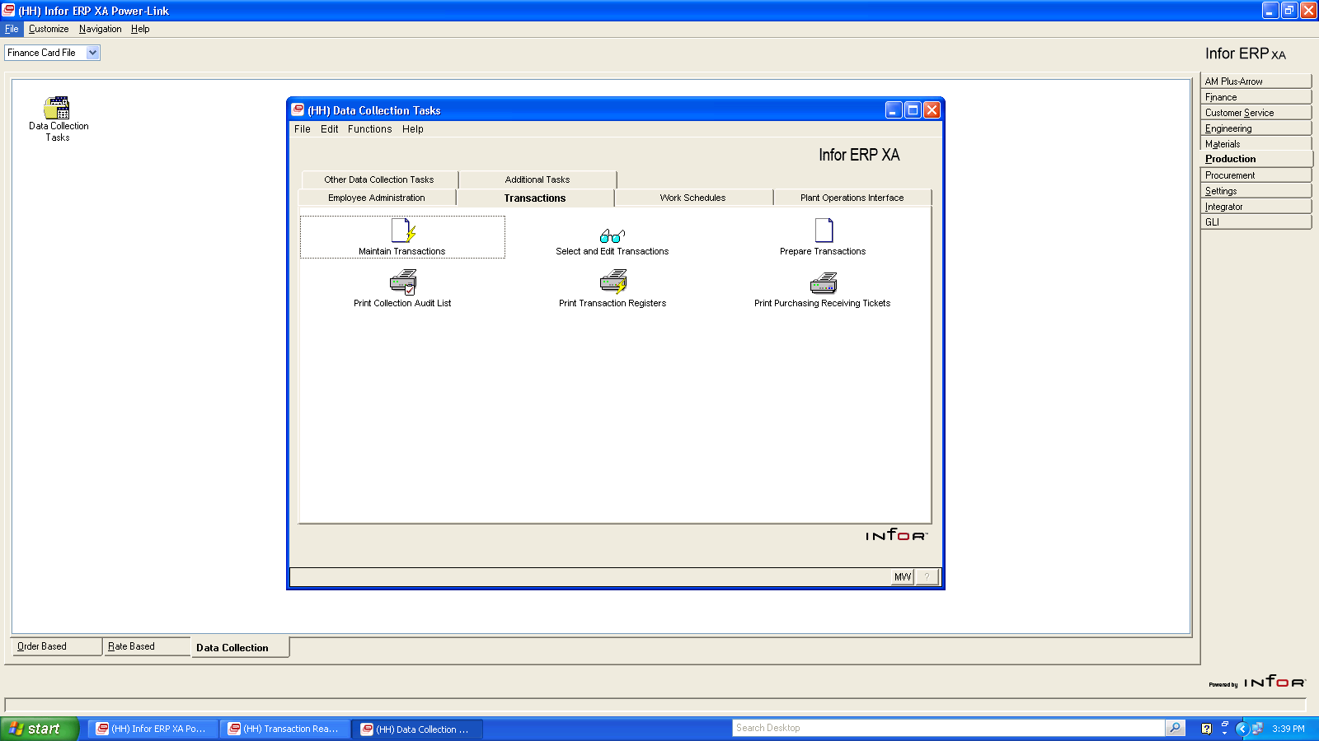
New Object “ DATA COLLECTION Tasks”

Slide 29
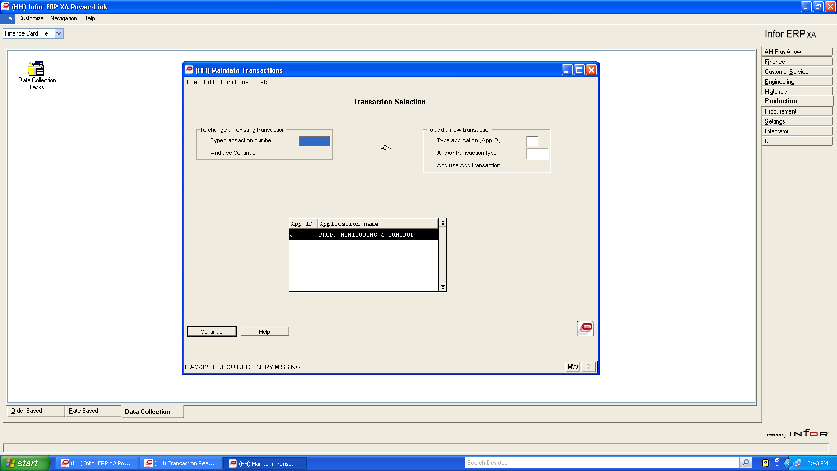
New Object “ DATA COLLECTION Tasks”
Dialog box
Entry replaces
green screen

Slide 30
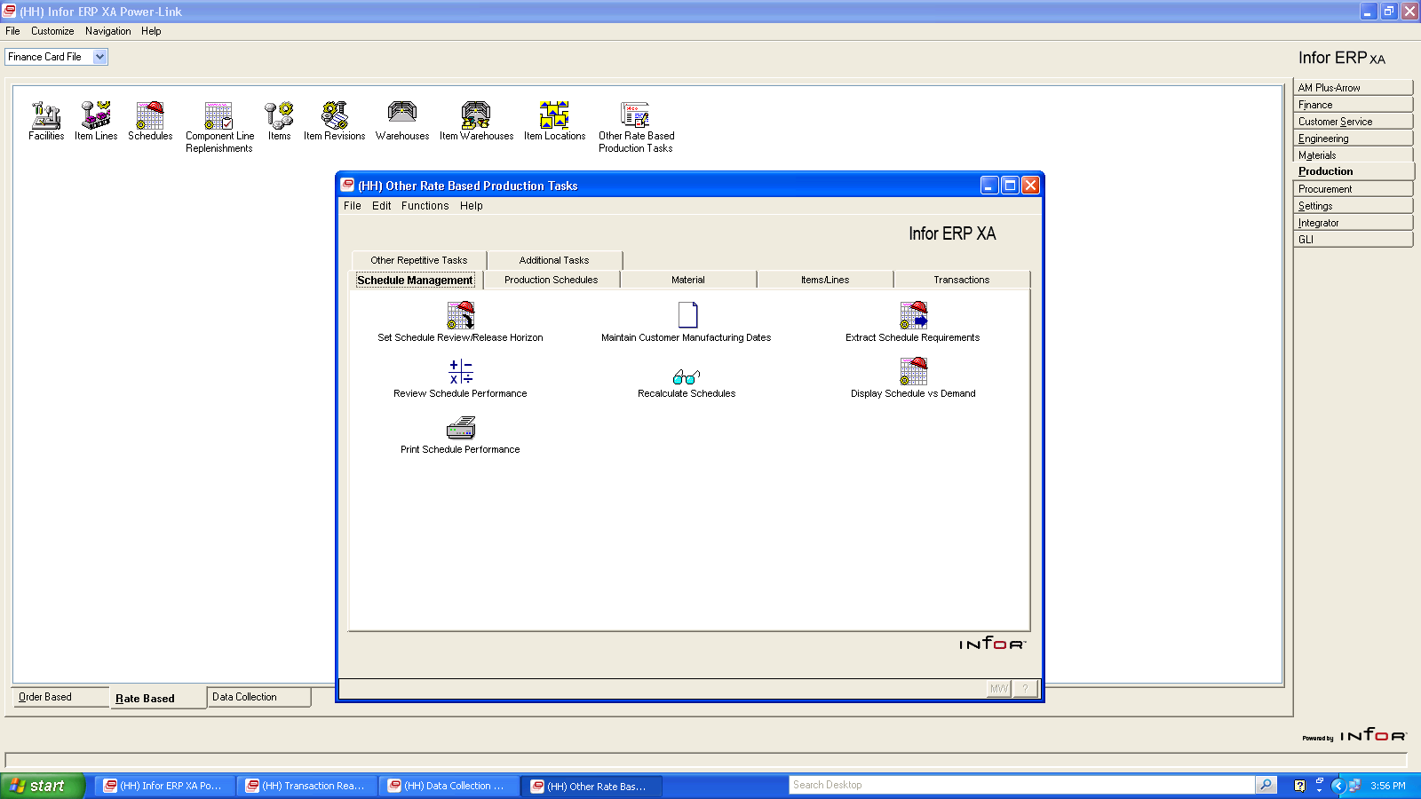
New Object “ OTHER RATE BASED PRODUCTION Tasks”
Repetitive parameters in
green screen can now be
entered thru IDF Level 1

Slide 31
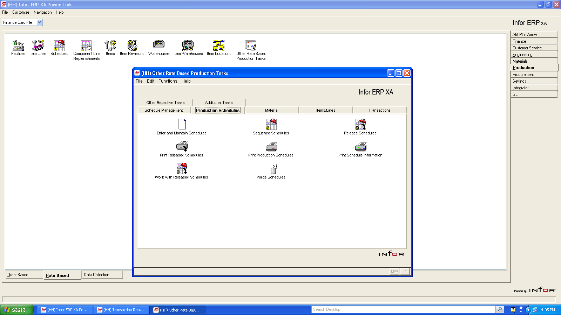
New Object “ OTHER RATE BASED PRODUCTION Tasks”
Repetitive schedules can now be entered
thru IDF Level 1.

Slide 32
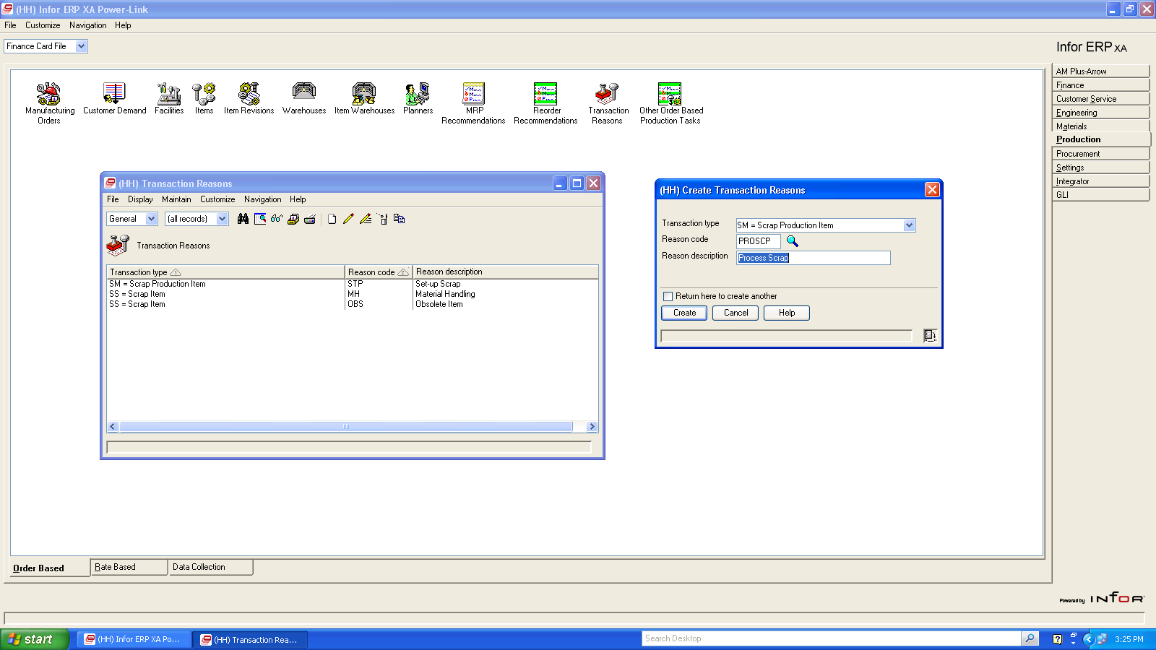
Transaction reason codes are required for key transactions

Slide 33
OBPM-MRP Recommendations
Ability to create MO’s from MRP Demand Generated Recommendations

Slide 34
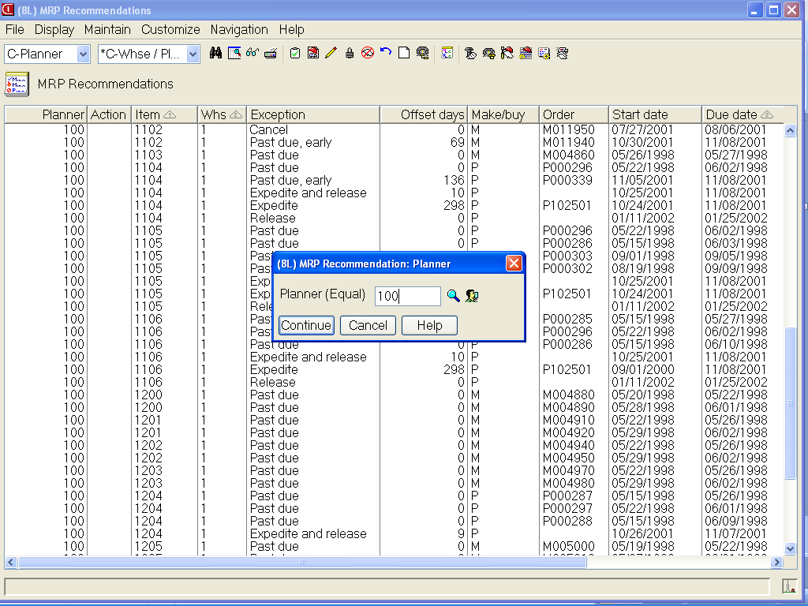
OBPM manages demand from MRP
MO’s, PO’s, Requisitions and Inter-site orders.
Full view/subset/sort capability from MRP now.

Slide 35
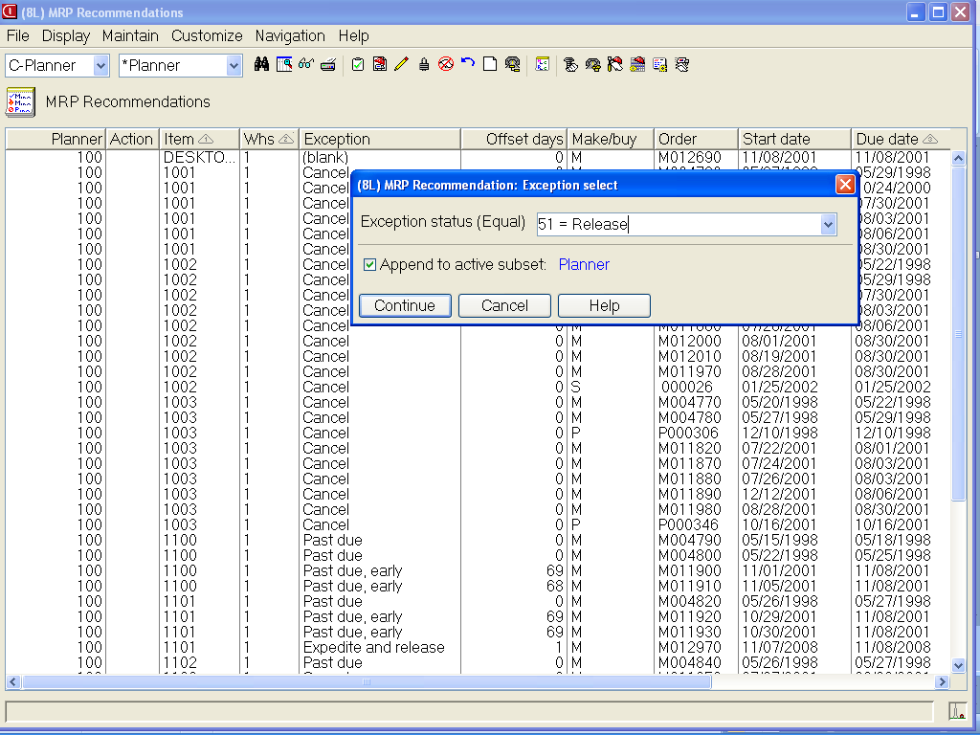
OBPM manages demand from MRP
Appending (connecting) subsets lets you select by planner and then “append” by selected exception (or due date or ?).
Deal with routine recommendations in bulk

Slide 36
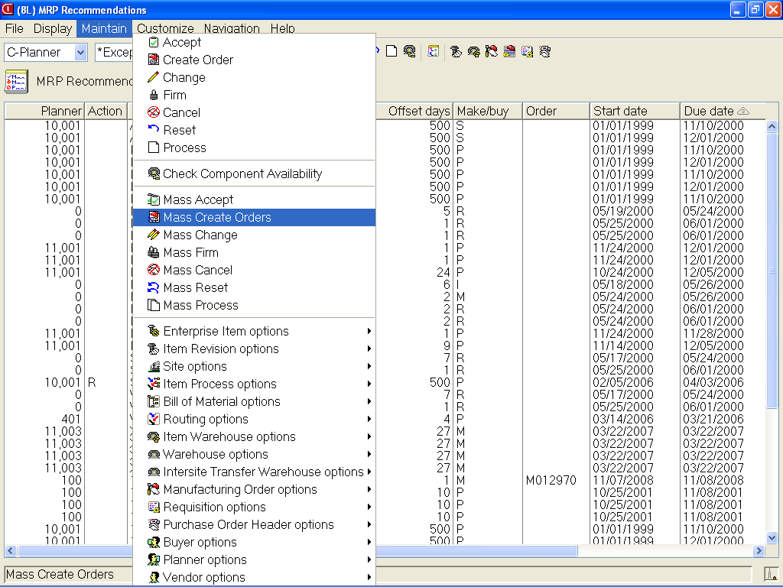
Mass process MRP recommendations

Slide 37
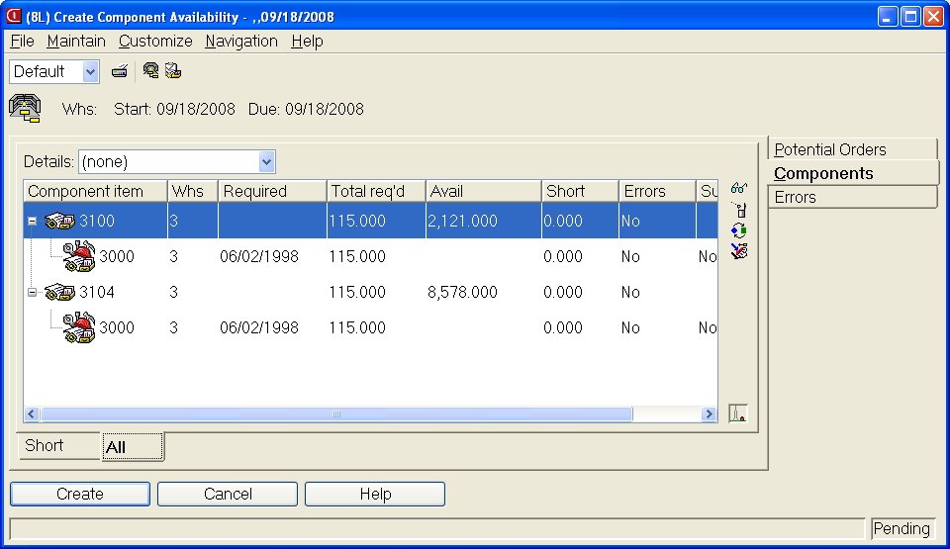
Check Availability
If shortages appear, use icons on right to check for substitutes or alternate process.

Slide 38
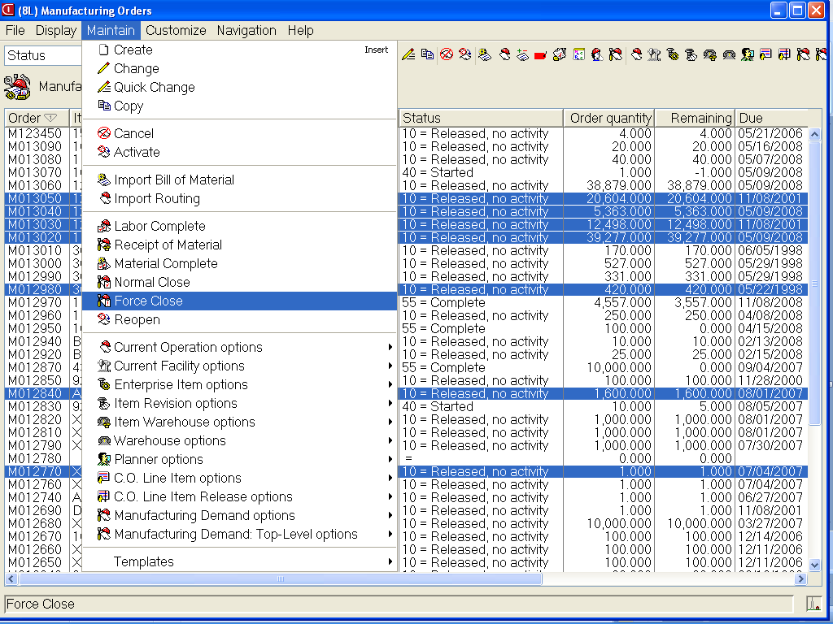
Mass cancel, normal, or force close
Perform single normal or force close actions. Or multi-select random MO’s for maintenance.

Slide 39
Other Bells and Whistle
Favorites
Sort arrow designators
Graph cards
Column statistics
Workspaces – multiple preference settings
Logical attribute text
Locate button
Workbench enhance- ments
Rounding choice when changing view decimals
Quick change
Subset additional
range options (last,
current, or next week,
qtr, year)
Host job notification
and e-mail of reports
Public preferences
Customizable toolbars
Workbench enhance-
ments
Presentation schemes

Slide 40
Thank you for attending!

