Slide 1


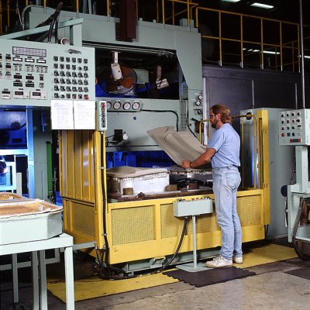
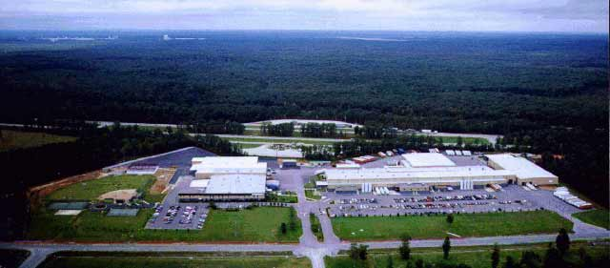
CISTECH – EDUCATION
XA Outside Processing
and the LRAP Transaction Purpose
A Quick Focus on Setup and the Process !
TUESDAY, MARCH 30, 2010 CISTECH SESSION

Slide 2
Your Host Today !
Rod Fortson, Sr.
Cistech
Sr. XA Consultant
Certified XA Educator
IFM and XA ERP Champion
Rod.Fortson@Cistech.net
  (770) 947-6961 Office
  (404) 434-6645 Mobile
  (770) 947-6965 (Fax)

Slide 3
Agenda
What is Outside Processing
Software and Facts
Setting up Service Items Correctly
The XA O/P Routing and Setup Fields
The PO/MO Outside Processing Steps
Acquiring Actual Costs in PCC for O/P Invoices
The LRAP GL Interface – Hitting the Books
Questions and Answers

Slide 4


Outside Processing for XA
What is Outside Processing ?
Outside processing is a common business scenario in many ERP manufacturing implementations where materials or sub-assemblies have value added services added to complete the Item or Finished Good.
Now days, outside processing can be an integral part of your value chain for a lot of reasons like capacity, nearness to the market, specialization, and even goodwill to the local community.
It might have been common to manufacturers but most ERP Systems just forgot about it when designing systems – “Work Arounds” were common.
WHEN A VALUE ADDED SERVICE IS PERFORMED ON WORK-IN-PROCESS BY AN OUTSIDE SUPLIER !

Slide 5

XA O/P – What it Takes !
To utilize XA Outside Processing requires:
Installation of the XA Integrated O/P Enhancements Software
  At R6 Download and apply SH62694 – Informational PTF is SH14754
  At R7 Download and apply download SH64730, then SH78554 for latest R7 Fixes for O/P.
The PROPER setup of Service Items in PDM or EPDM IS ESSENTIAL !
Proper setup of Cost Content and the use of O/P Operations in EPDM Routings.
The use of the XA Integrated Outside Processing Enhancement Module and understanding the ‘pieces’.
Coordination of the entire processes activities should be well managed with Materials, Production, Purchasing and Accounting – it takes everyone understanding HOW IT WORKS !

Slide 6
XA O/P – What it Takes !
The setup of the “Outside Operation Detail” Record in PCC.
The use of the “Outside Operation Cross Reference” to let the system know which PO is for what Manufacturing Order (and Operation).
Understanding and booking these charges and understanding the actual to standard O/P Variances – the LRAP and MO Closeout Variance transactions.
The education and training for Accounting to properly record AP Invoices for OP Charges to the Manufacturing Order. Training by your team for all Team Members!

Slide 7
XA Files for Integrated Outside Operations
Outside Operations Detail (OOPDTL)
Outside Operations Cross Reference (MOPORF)
Outside Operations Components (MOPOCM)
Outside Operations Cross Reference History (MOHPOR)
Outside Operations Components History (MOHPOC)
Put them on a Card, and establish Bi-Directional Relationships with Integrator – your Production and Purchasing Teams will appreciate you ! If you are at R7 contact Cistech and we can assist you easily with pre-existing objects.

Slide 8
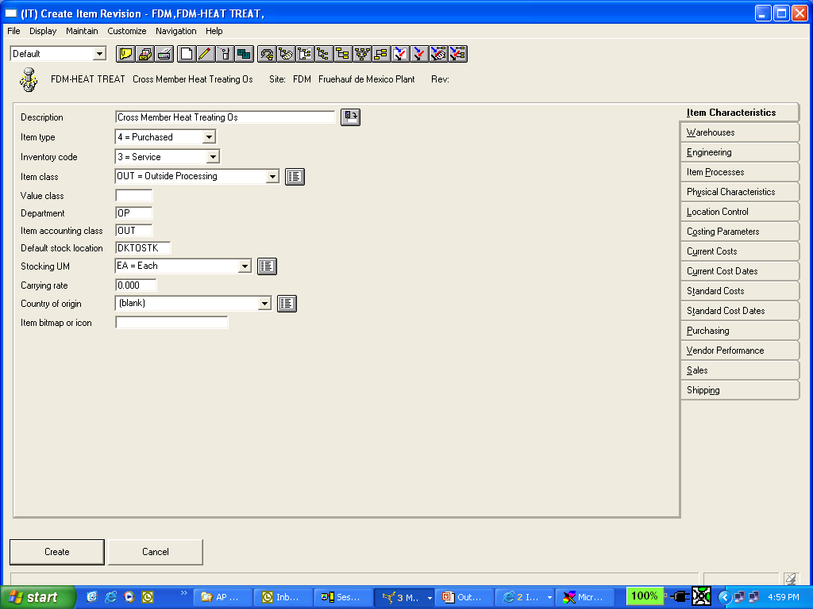
The Service Item - Characteristics
Proper setup of the OP Service Item in EPDM is essential.
INVENTORY CODE SHOULD BE 3 FOR SERVICE !

Slide 9
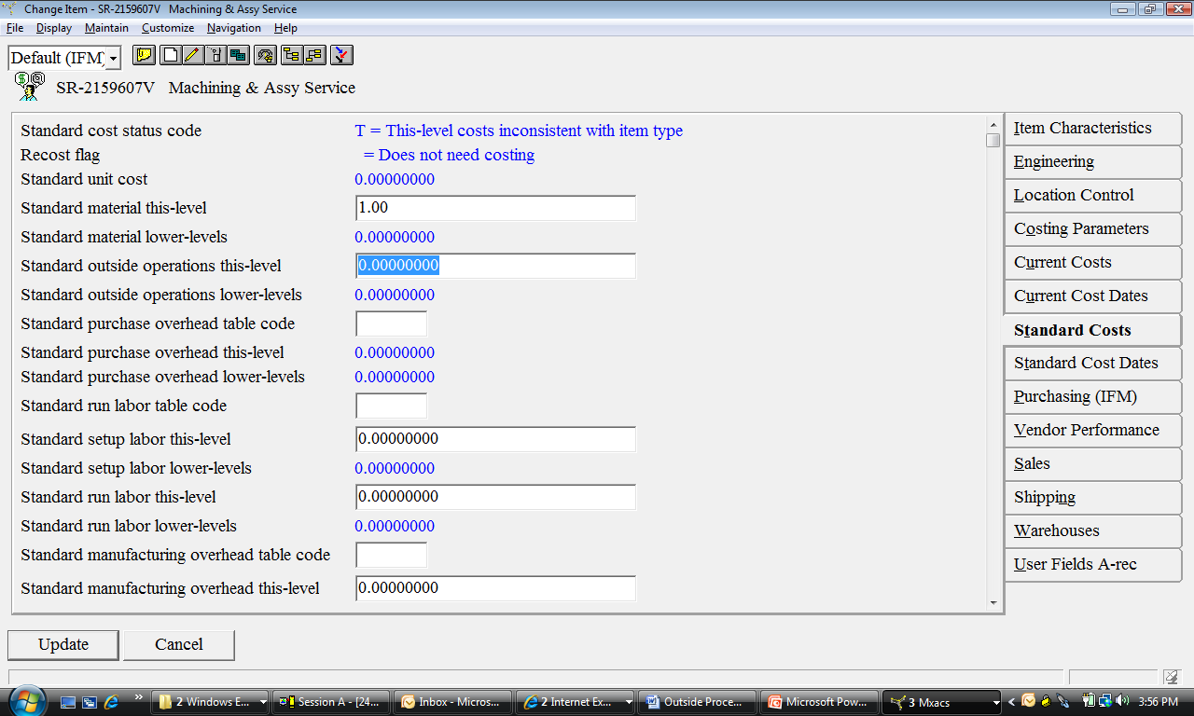
The Service Item - Characteristics
Your Service Item will have a
Cost but will not go on the BOM –
The cost is for the LRAP Txn
and AP/PCC Variances.

Slide 10
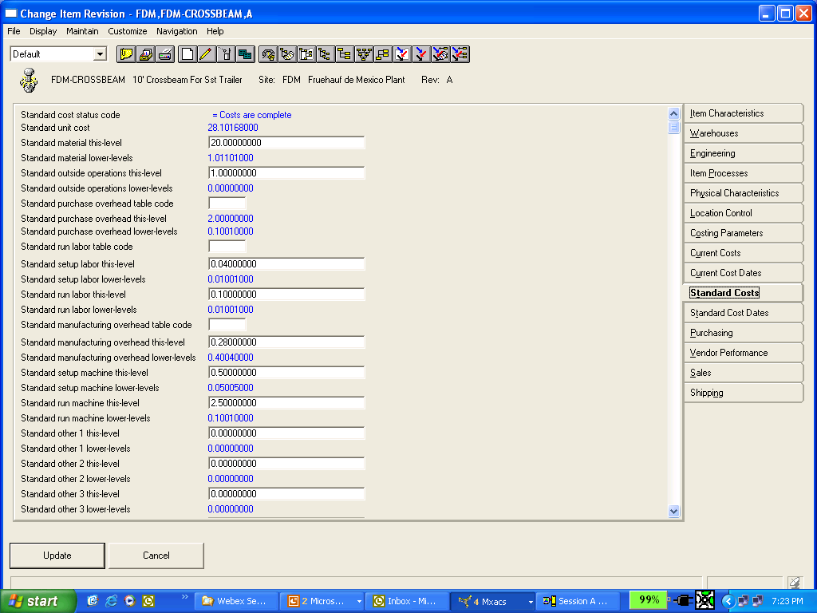
Costs will Rollup for O/P
After Cost Rollups on the Finished Good Item the O/P Costs will be pulled from the items “C” Routing Operation – do not set this field as it will be replaced !

Slide 11
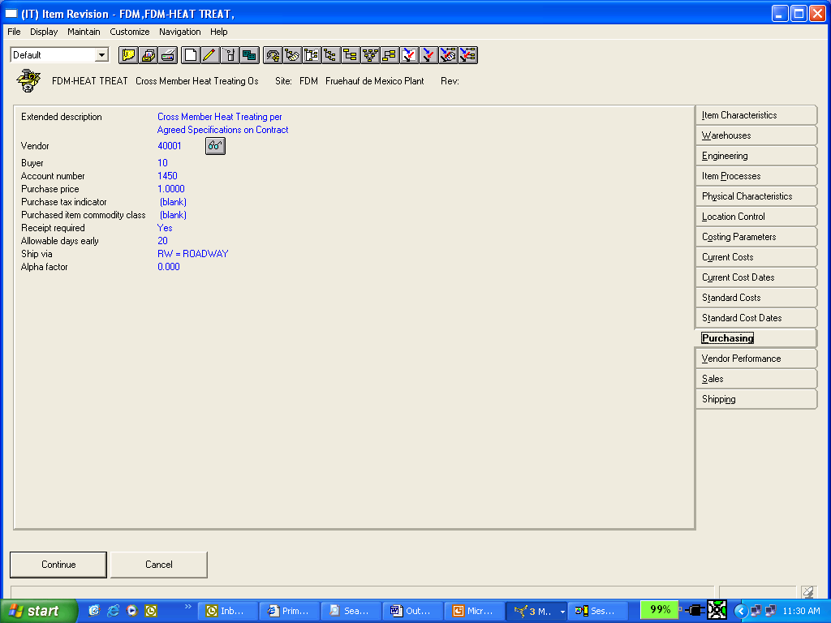
Service Item Setup – Purchasing & GL
For Finance - Make this a “WIP
Clearing” Account – because this is
What will be placed on the API
Add sufficient OP Extended Description for the PO if necessary – EXCELLENT FOR AUTO RELEASE.
Set your Default Buyer and Vendor – if Auto Release the Vendor in the O/P Detail will be used for PO’s and Reqs.
Set the GL Account Number to be a WIP Clearing Account if using GL Integration and the LRAP Transaction created during the AP Vouchering of the Service.
Set your Purchase Price (Check PUR Control File) – this will be the price per piece on the PO if using Auto Release!

Slide 12
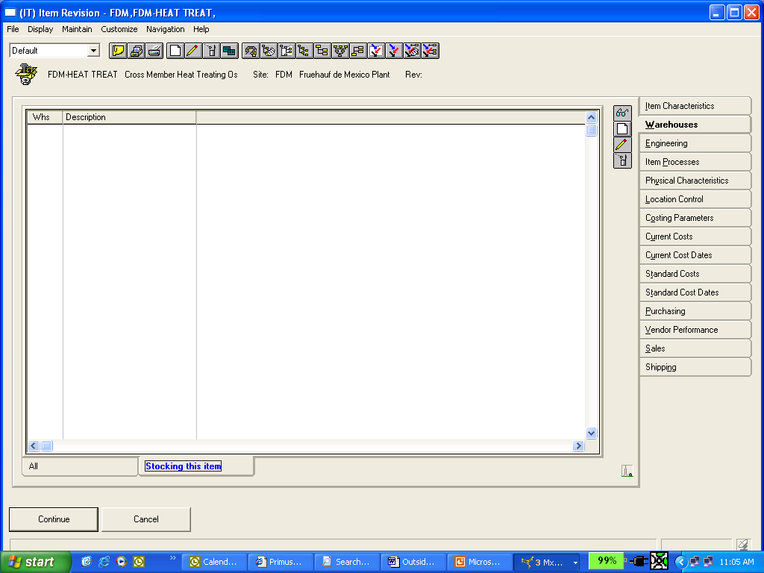
The Service Item Setup
The Service Item – Warehouses
Remember: If the OP Service Item has an Item Warehouse Record, with a cost, you will get unnecessary RP Transactions !
NO ITEM WAREHOUSE RECORD IS NEEDED for Service Items!

Slide 13
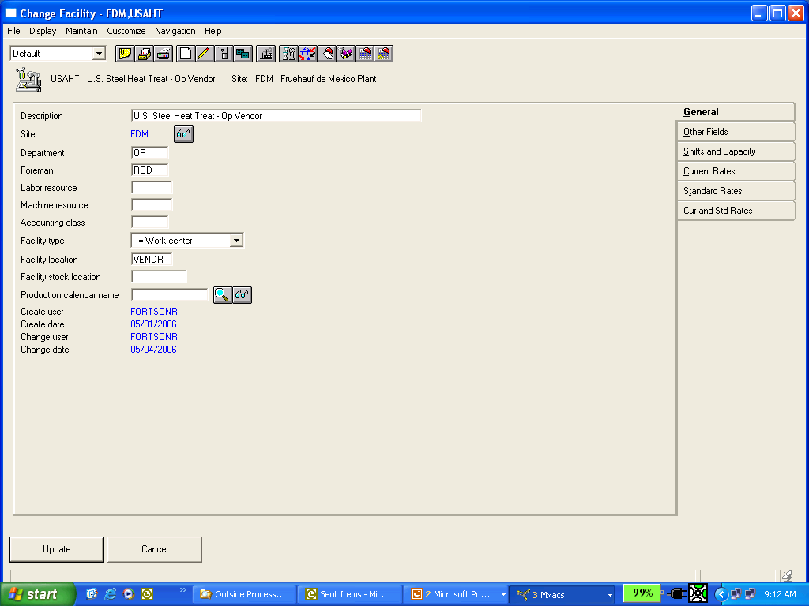
O/P Facility Setup
Setting up your O/P Vendors as facilities let’s you have
visibility on upcoming, current, and returning
OP Services for your Orders and
Schedules for Services using Work Center Dispatch or
your own Browser or Power Link View over MOROUT
Setup a Facility to be used on your Routing Operations. You can use a generic Facility for all O/P Operations, or setup your O/P Vendors as Facilities for better tracking and scheduling of your O/P Service Items – where are they, when do they go, when will they be back?

Slide 14
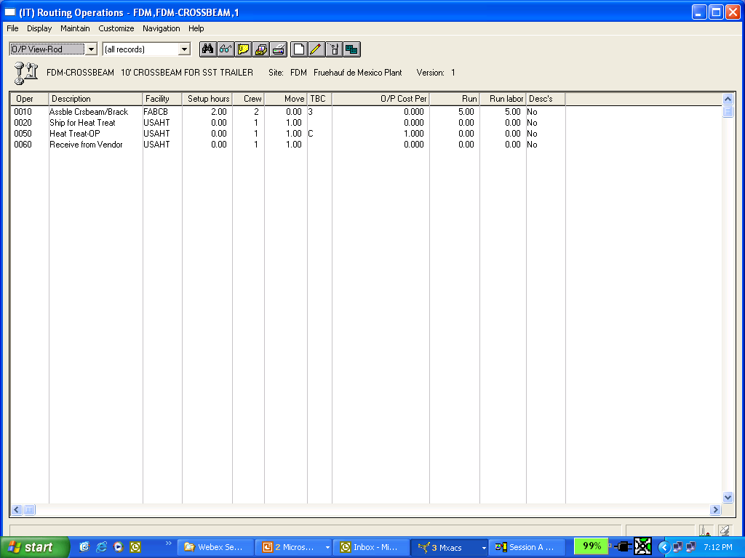
The Routing Operation for OP
An Operation should be added to the Manufactured Items Routing for the Outside Service to be performed. Key setup notes are:
TBC must be a “C”
Setup O/P “Cost per Piece” – costs will be rolled into T/L O/P Costs
Use the Move Days for proper scheduling and planning
You MAY ELECT to establish Operations for Shipping and Receiving the O/P items for tracking if so desired (see Operations 20 & 60 above)

Slide 15
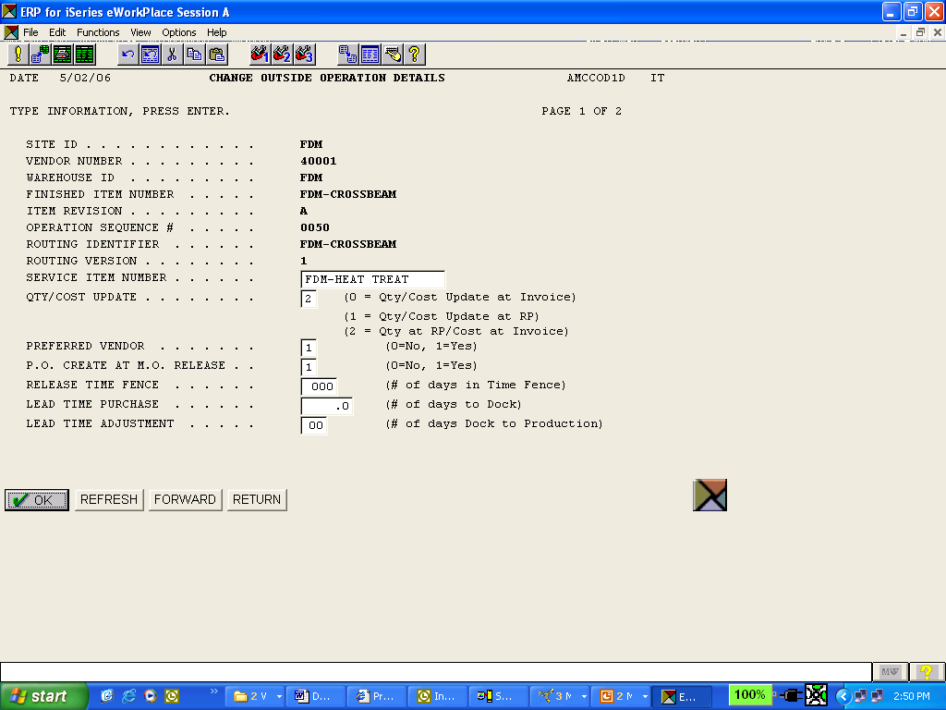
O/P Setup – The O/P Detail
This flag is essential in determining when to update the M.O. Operations Actual Quantities and Cost – Be Careful !
Setup the O/P Operation Detail which tells which Service Item is to be used and what Operation on the Assemblies Routing contains the Standard Costs.
Important: Make sure to set your “Qty/Cost Update” option accordingly.

Slide 16
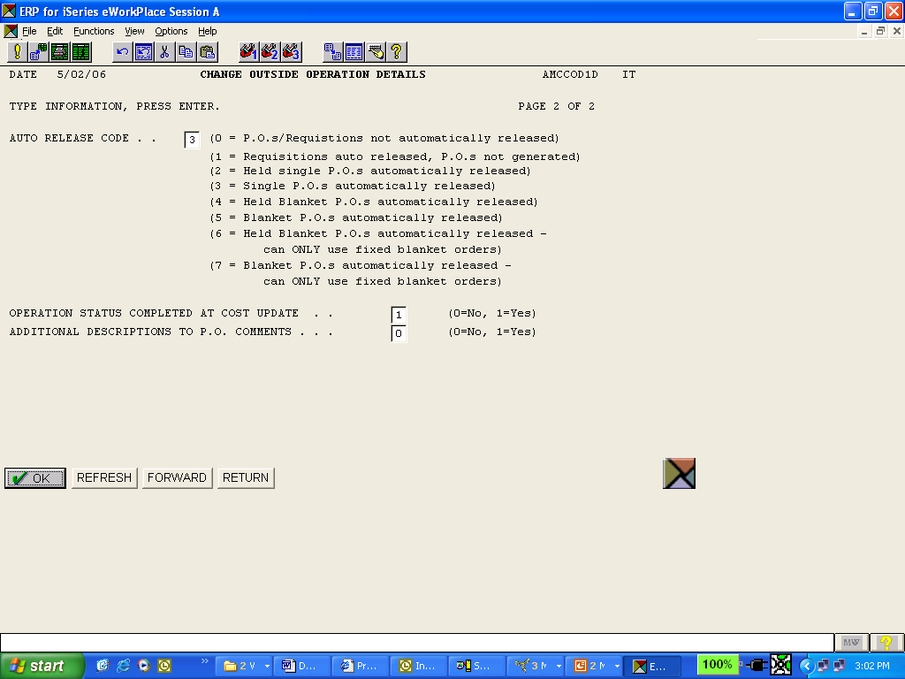
O/P Setup – The O/P Detail
You can also utilize Blankets, create Requisitions for Approval, or not Auto Release at all !
Another great feature, and an important part of the O/P Operation Detail setup, is the Auto Release Code . This options says “Create a PO when the MO is opened for the Assembly using this OP Service Item” – work with your Internal Team to decide on Auto Releasing O/P Purchase Orders.

Slide 17
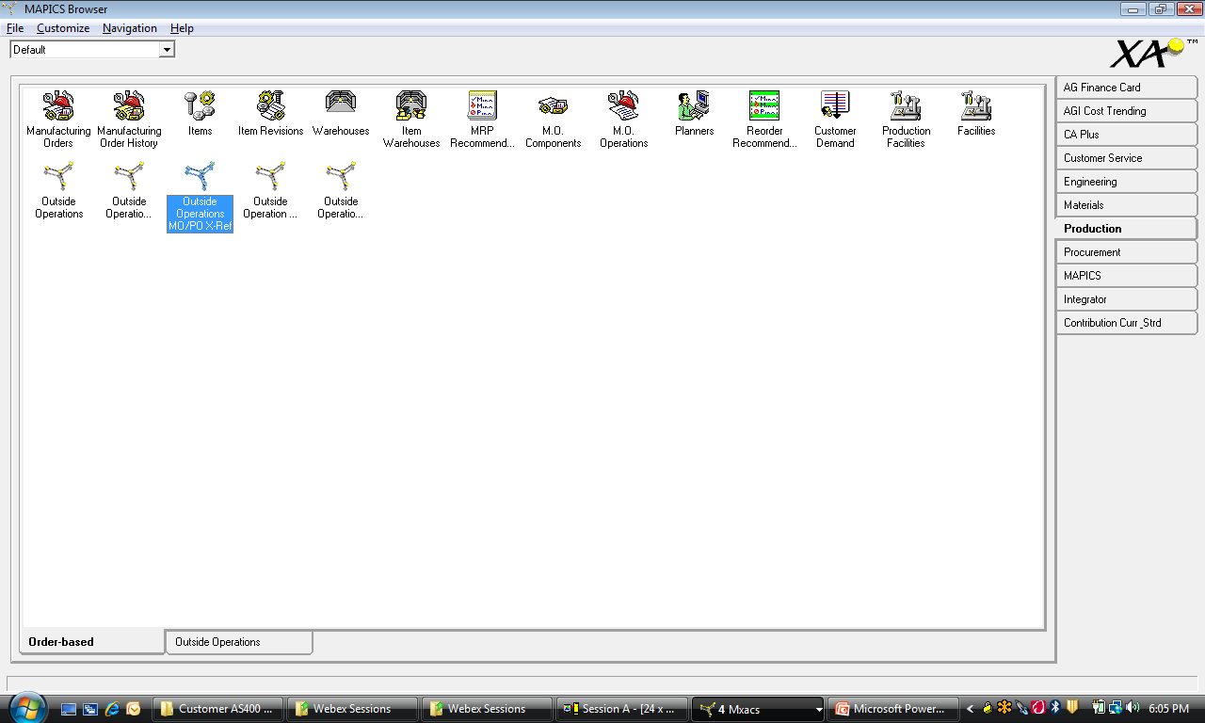
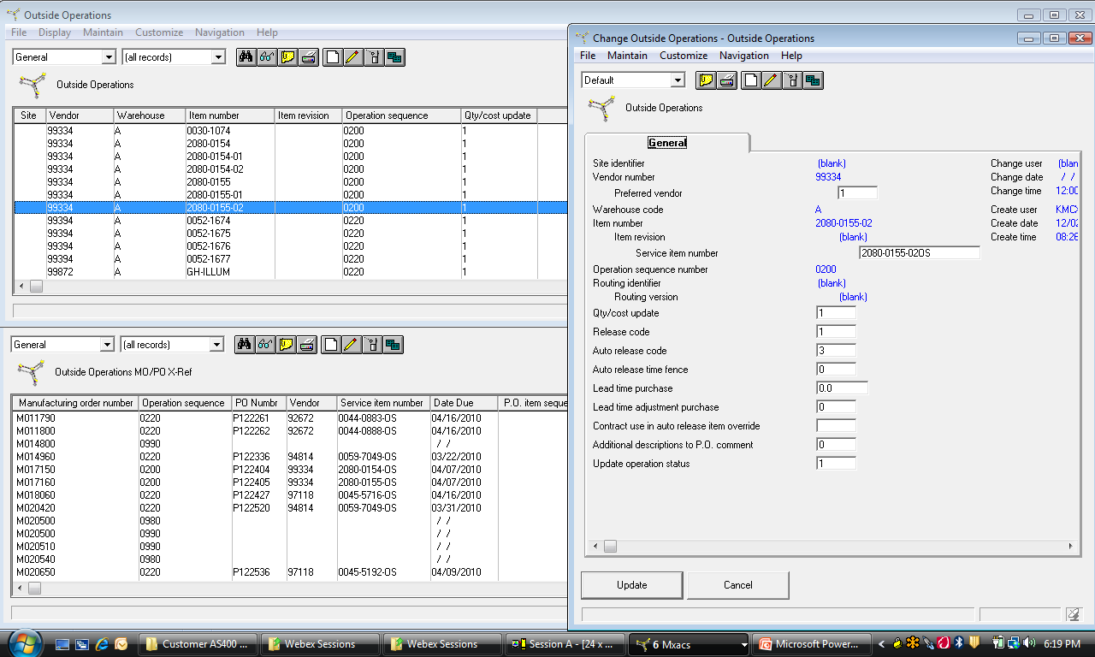
Integrate O/P Objects – R6 Quick Win

Slide 18
O/P & Service Item Setup Overview
Establish Item Revision for Service Items with Inventory Flag of 3, Item Type 3 or 3, and make sure to set your GL Account to WIP Clearing if you plan on booking your LRAP Txns.
Set Service Items Material Content This Level
Determine what Cost/Price field to utilize in the Item Revision for correctly Pricing Purchase Orders for your O/P Services – Review your PUR Control File.
Setup your Service Vendors – you may elect to use a single Default Vendor.
Establish a Routing Operation for the Subassembly or Finished Goods that represents the OP Service, Cost Per Piece, and corresponding Move Times for proper Planning.
Maintain the Integrated O/P Detail Record that establishes the relationship of the Service Item and the Manufactured Items Routing Operation.
Make sure to properly set your “Qty/Cost Update Flag” in the OP Operation Detail Record to specify when and how the Service Item Costs for that operation will be incurred.
Determine if you want to Auto-Release/Create Requisitions, Purchase Orders and specify this during the O/P Operation Detail Setup of the XA O/P Enhancement Tool.
YOU DO NOT need to add the Service Item to the Manufactured Items BOM.

Slide 19
O/P Setup Overview
LET’S LOOK AT THE O/P PROCESSES
And the AP Invoicing
Any Questions on the O/P Setup overview?

Slide 20
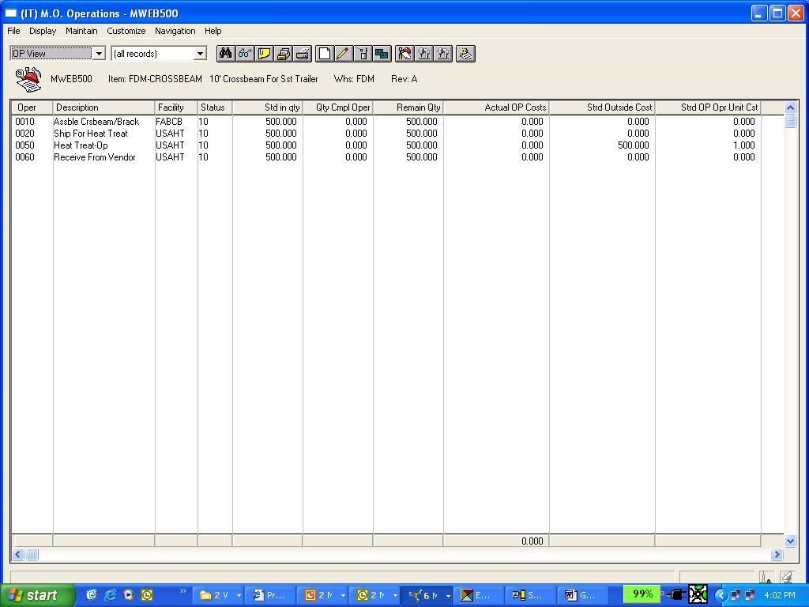
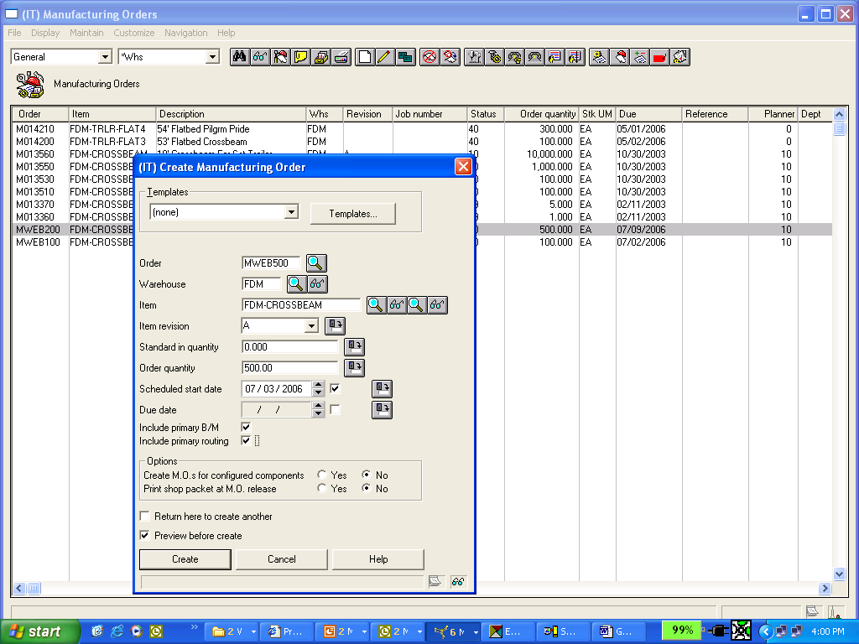
MO Release – Creates OP XREF & PO
Once an MO is Released for an Assembly that has an OP Operation on the Routing, and a corresponding OP Detail Record – the XA System will now know how to handle:
The Release of the Service Items PO’s or Requisitions
When to accumulate Actual Quantities Received and Invoiced for the Service Item
Review the new M.O.’s Operational Detail at this point and any PO’s for the Service Item to validate your OP Setup Tasks you have completed .
The Manufacturing Order now expects the above operations, and OP Quantities to be completed – note that no costs or quantities exist yet.
Notice the Operations for Shipping and Receiving which
can assist your organization tremendously on outbound
and In-Bound Service Items

Slide 21
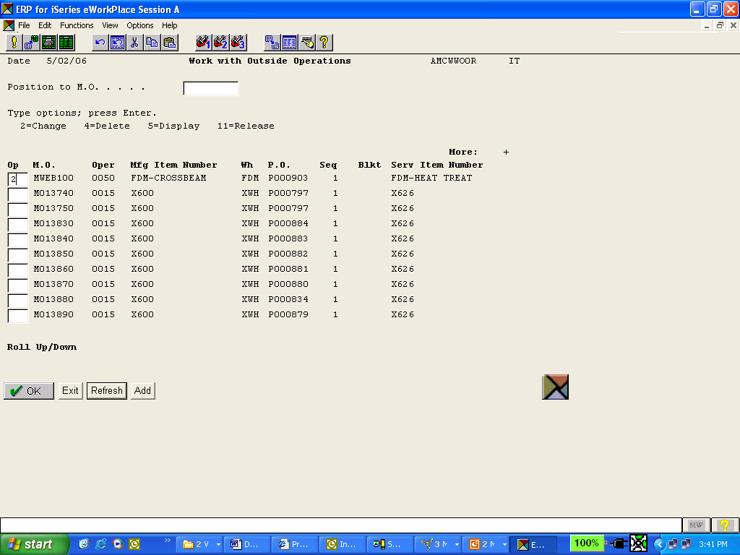
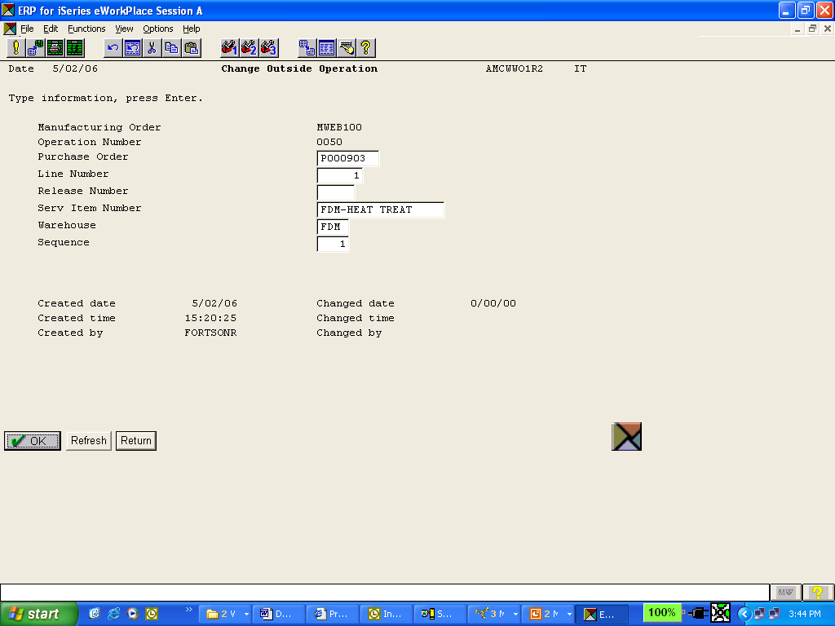
MO Release – Creates OP XREF & PO
Created at MO release time
The Manufacturing Order Release also knows from the OP Detail to Auto-Release a PO for the Service Item and to update the MO/PO Cross Reference for the O/P Service Item as reflected above.

Slide 22
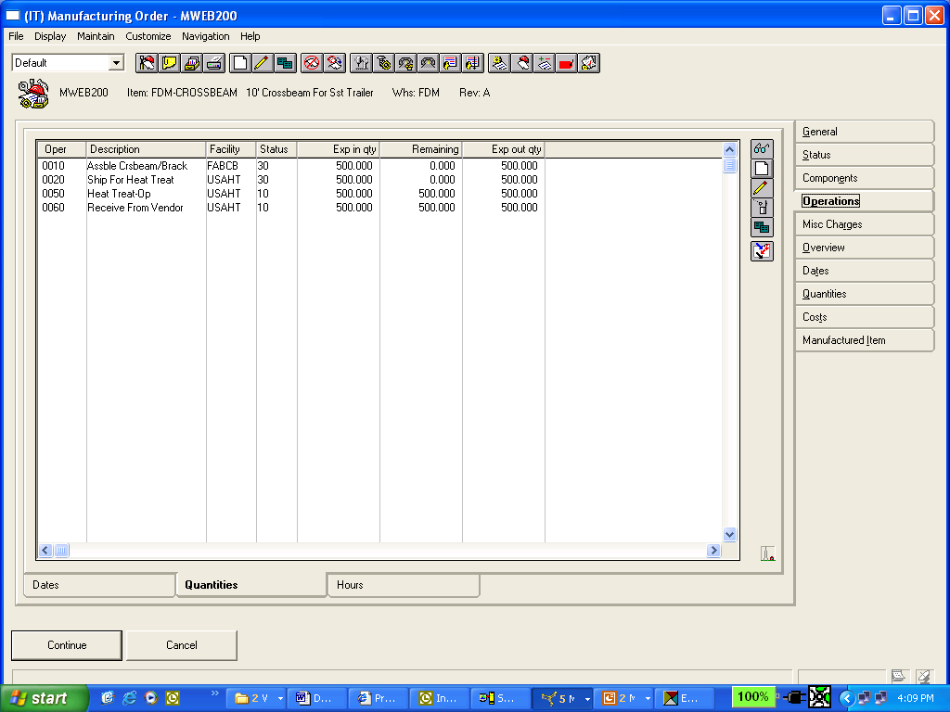
Ship the Item to the Vendor - Routing
The M.O. is routed to the floor and the Assembly occurs, is reported via Shop Activity Updates, and the Crossbeams are shipped to the Vendor as reflected in the M.O. Operational Status above.

Slide 23
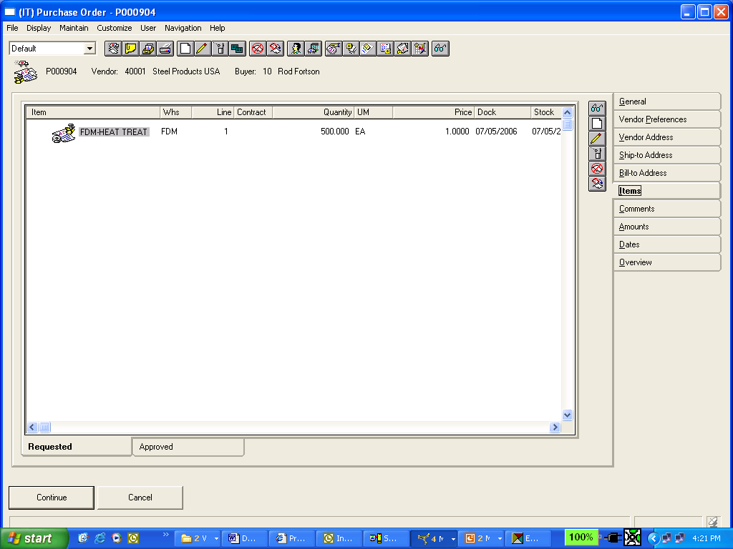
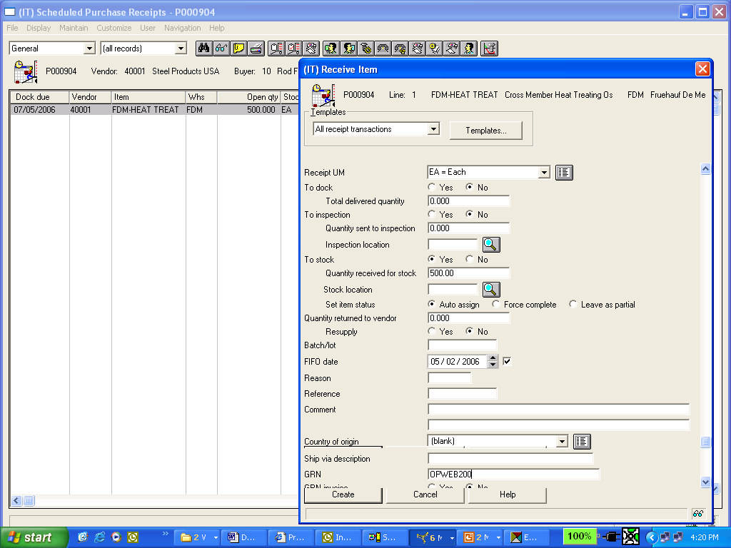
Vendor Completes-Receive Service
Receive the Service Items back from the Vendor.
Notice the GRN for an Exact Match during IFM/AM AP Invoicing.
Depending on your “Qty/Cost Update” Options on the OP Detail Record, the Receipt could update the Quantities at this point on the MO Operation for Outside Processing !
This PO was created at MO release time if
flagged in the OP Operation Detail –
“Auto-magically” !

Slide 24
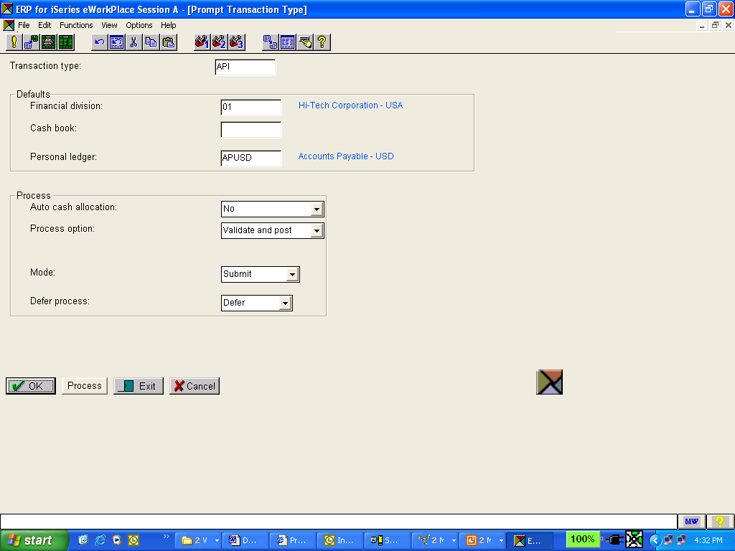
Process Vendors Invoice – AM or IFM
Your Companies AP Trade Ledger

Slide 25
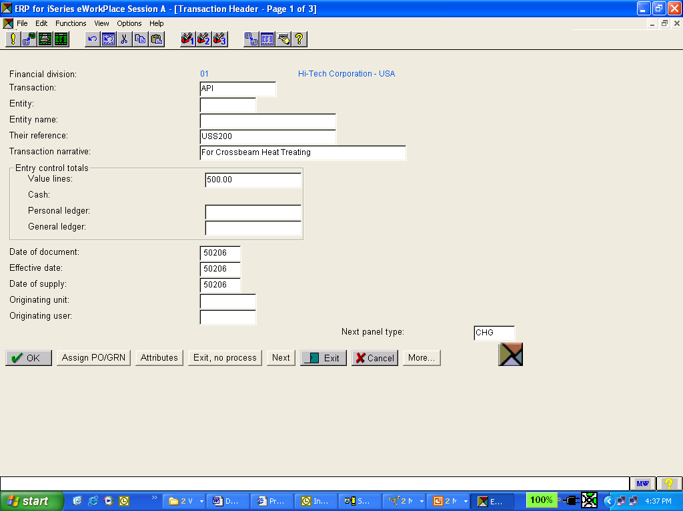
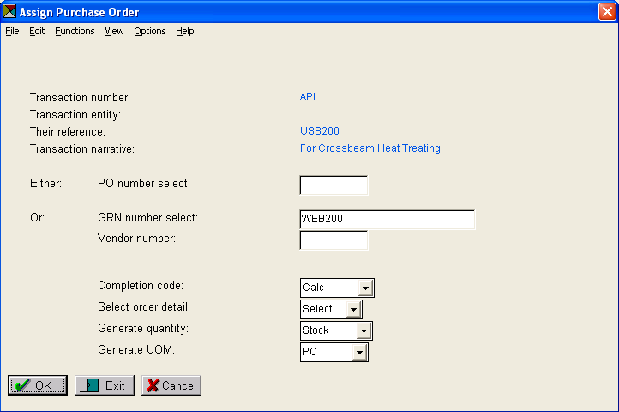
Perform 3-Way Match for Receipt
The invoice total from the vendor (this example does not reflect taxes, or any other Charge Lines).
Process the AP Invoice as normal, preferably using the PO, or GRN 3-Way Match, as illustrated to invoice the EXACT receipt for the Service Item received.

Slide 26
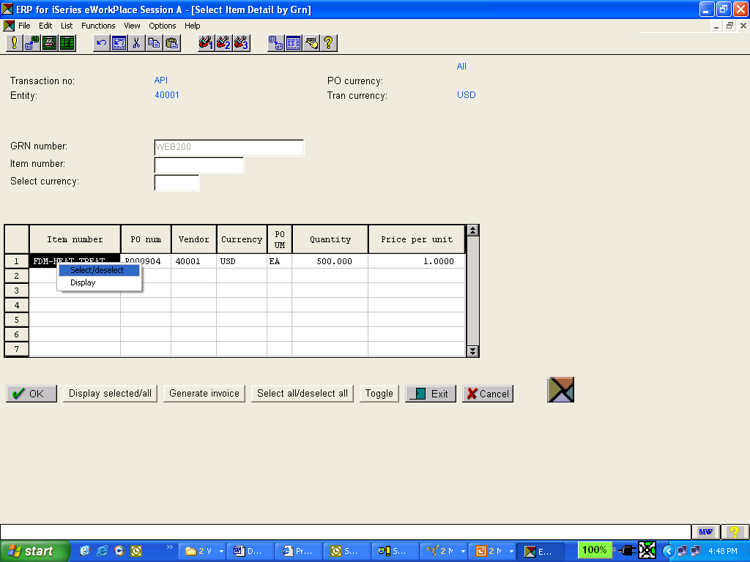
3-Way Match for Receipt-API IFM or AM
Using GRN insures the creation of the AP Invoice for the EXACT receipt for the Service Items coming back from your Vendor !

Slide 27
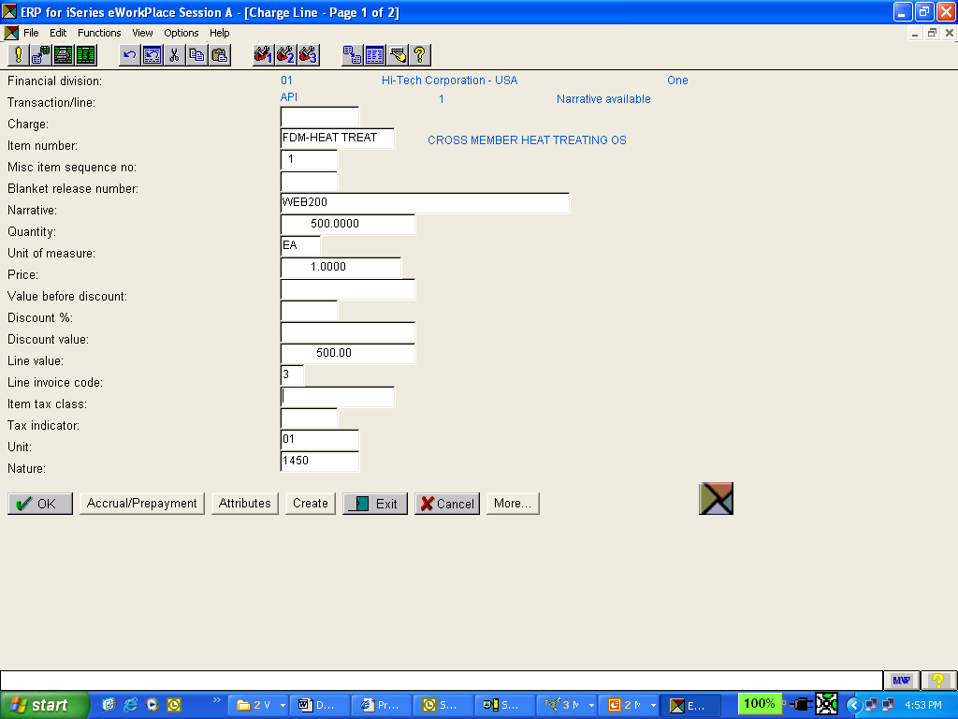
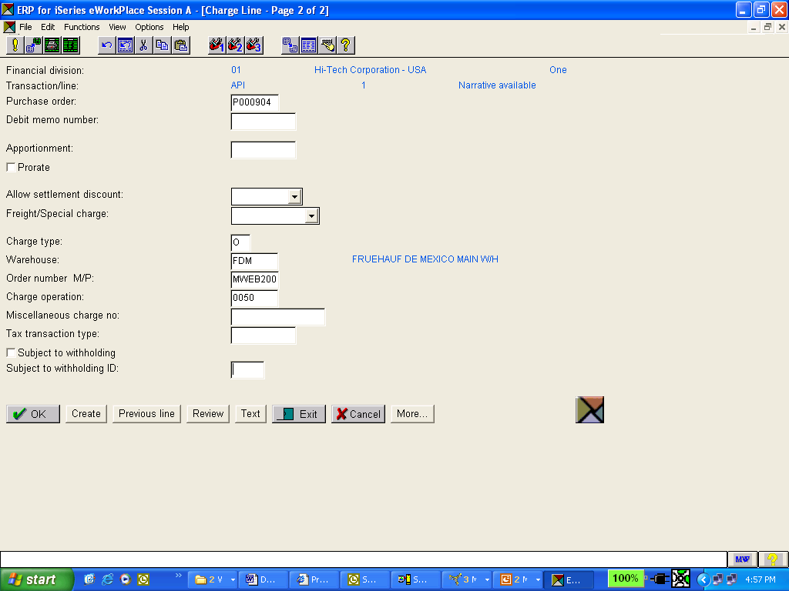
3-Way Match for Receipt-API IFM or AM
Mandatory !!
If you “Page Down” and look at the Second Page of the Charge Line – IT IS MANDATORY that the Charge Type be an “O” when vouchering Service Item Receipts otherwise an LRAP transaction to clear WIP Clearing will NOT be generated !
Remember that we want to place these dollars into a WIP/OP Clearing Account
The Charge Line on the AP Invoice is created for the Receipt. Notice that the Unit/Nature was INHERITED from the Item, to the PO, and to the API.

Slide 28
Impact of AP Invoice for O/P Service
As soon as we processed the IFM or AM Accounts Payable Invoice, the General Ledger will be updated IMMEDIATELY with the following entries:
IFM or AP Processing of the Vendors Invoice for the Service Performed
Acct/Nature: 2000
Acct/Nature: 1450
Accounts Payable Trade
WIP/OP Clearing Account
-500.00
+500.00
Note: The GL Account/Nature for AP Trade came from the IFM Personal Ledger, or if using AM AP, it comes from your Tailoring Questions.
The GL Account/Nature for “WIP/OP Clearing” comes from the Charge Line which is inherited from the PO Line Items Account Number.

Slide 29
O/P Flow – MO/PO/Receipt
Any Questions on the O/P Processing Flow ?

Slide 30
Updating the Actual Invoice Costs to MO’s/Schedules
PCC Suspended
Batch with the
LRAP
Transaction
A/P Invoicing
of the Service Items
Receipt from IMHIST
with 3-Way Match
IF O/P Charge Type O
Shop Activity Update
of LRAP Transactions
IFM or AP
Invoice
Charge line
for O/P Item
Mfg
Order
Costs
GL
Interface
Data

Slide 31
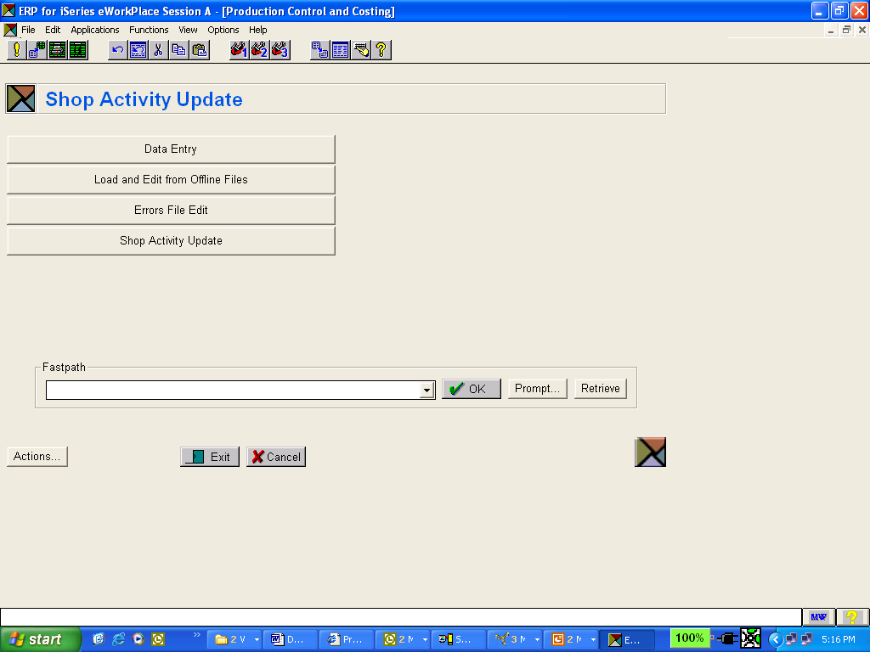
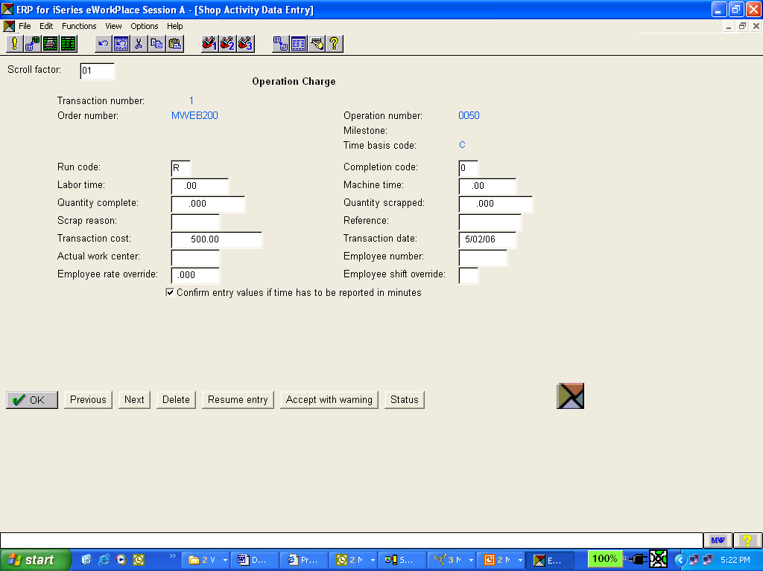
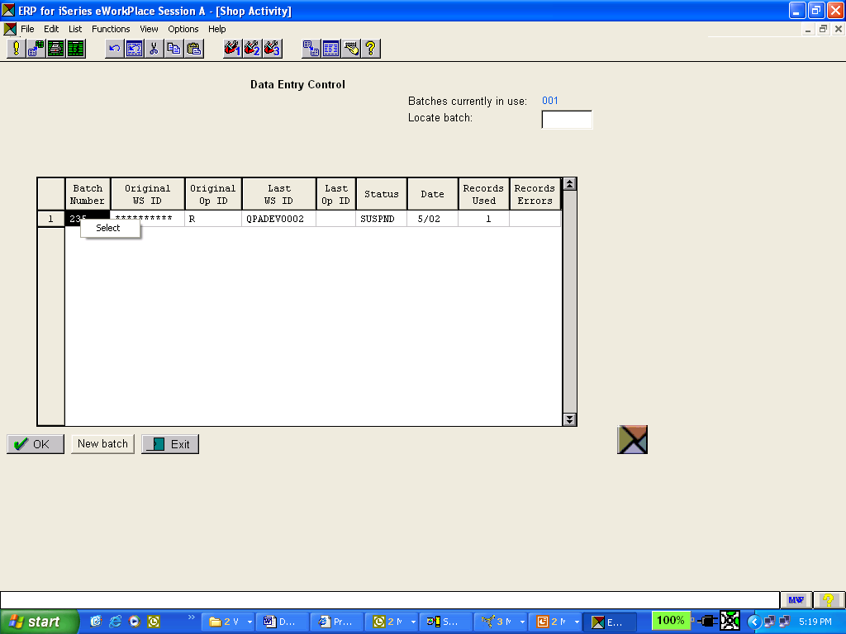
The LRAP - Origin
The purpose of the “LRAP” transaction is to drive the ACTUAL dollars that were just entered into A/P to the M.O. Outside Processing Operation and to the General Ledger via PCC.
Origin: AS SOON AS THE IFM/AM INVOICE WAS CREATED FOR A SERVICE ITEM (AP Charge Type of “O”) THE LRAP IS PASSED TO PCC IN A SUSPENDED BATCH.
The LRAP Transactions passed from AM AP or IFM AP are now in a Suspended Batch ready for Processing !
PCC Batch for LRAP
The PCC Transactions that were automatically created by AM or IFM caused by the AP Invoicing of “O” or OP Charge Types !

Slide 32

Process the PCC OP Txns !
Remember to process the PCC Batches created by the processing of IFM or AM/AP Invoices for Service Items.

Slide 33
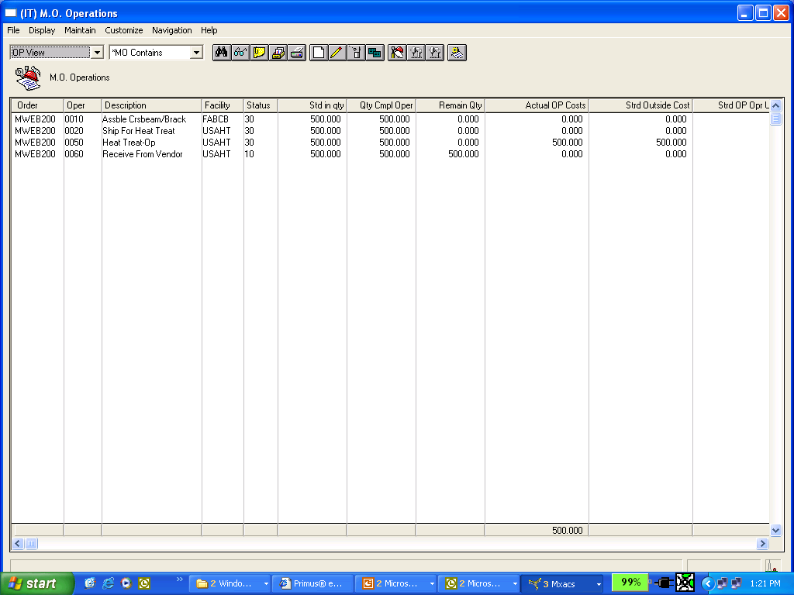
Mfg Order – Updated Costs
O/P
The Actual Costs entered on the IFM/AM Accounts Payable Invoice for the Outside Services, and updated by the PCC Batch, are now reflected on the Manufacturing Orders Operational Costs.

Slide 34
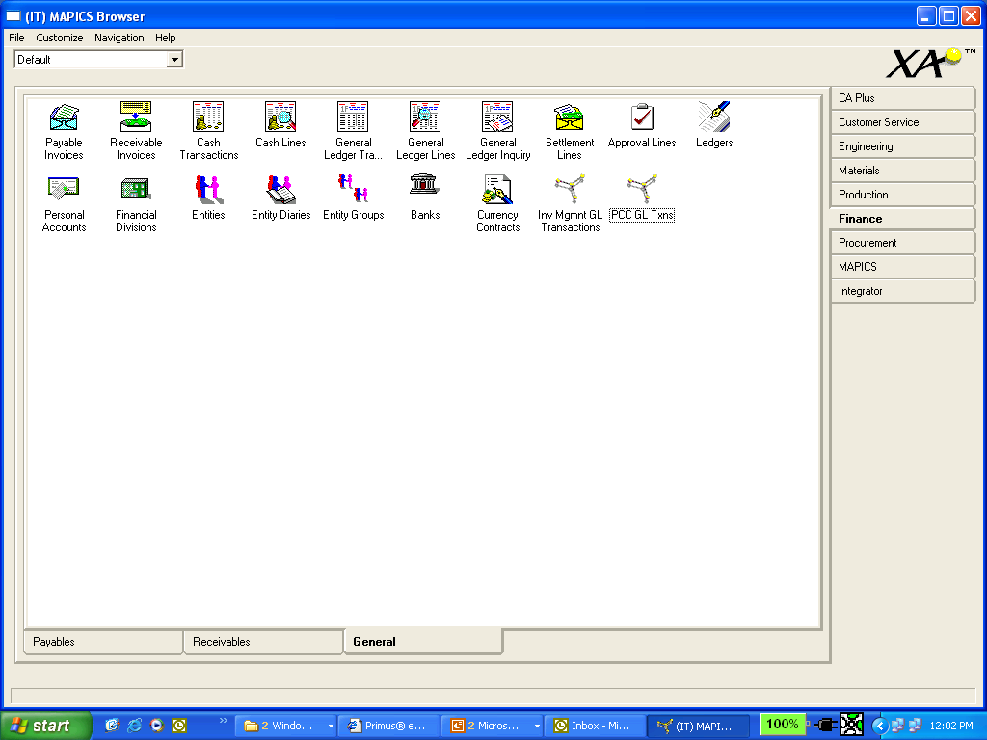
The PCC GL Entries for LRAP
The LRAP Transactions that were created by the “O” Charge Type Invoices being processed in IFM are captured in the PCC GL Interface File PCCTXN after the Shop Activity Update.
The Transactions will remain there until “Account Assignment” and the “Create GL Entries” process is completed

Slide 35
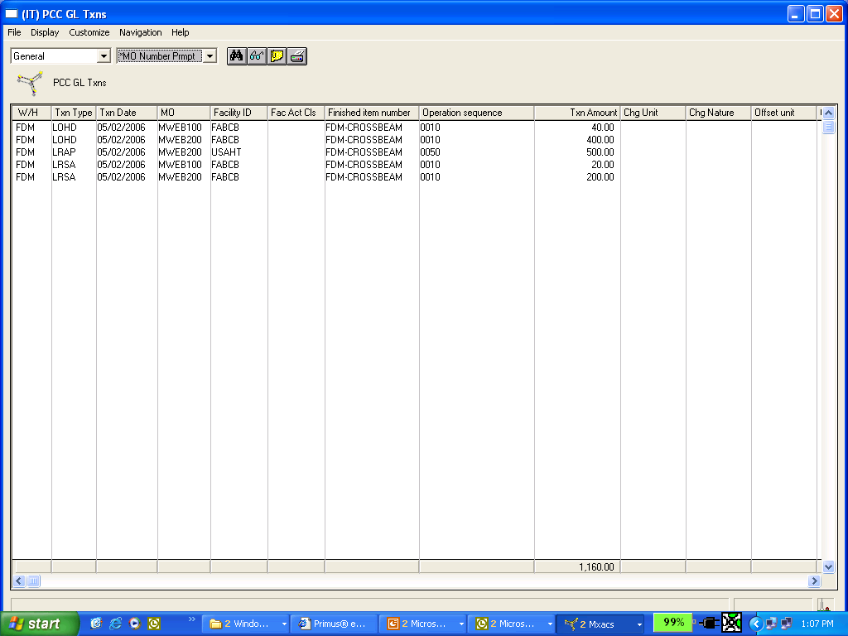
The PCC GL Entries for LRAP
Use Browser to Quickly Review any of your PCC Transactions – Assigned & Unassigned !
The Shop Activity Update for the LRAP Transactions that were passed from
IFM A/P or AM A/P. Notice the Charge & Offset Accounts are not yet
“Assigned”.

Slide 36
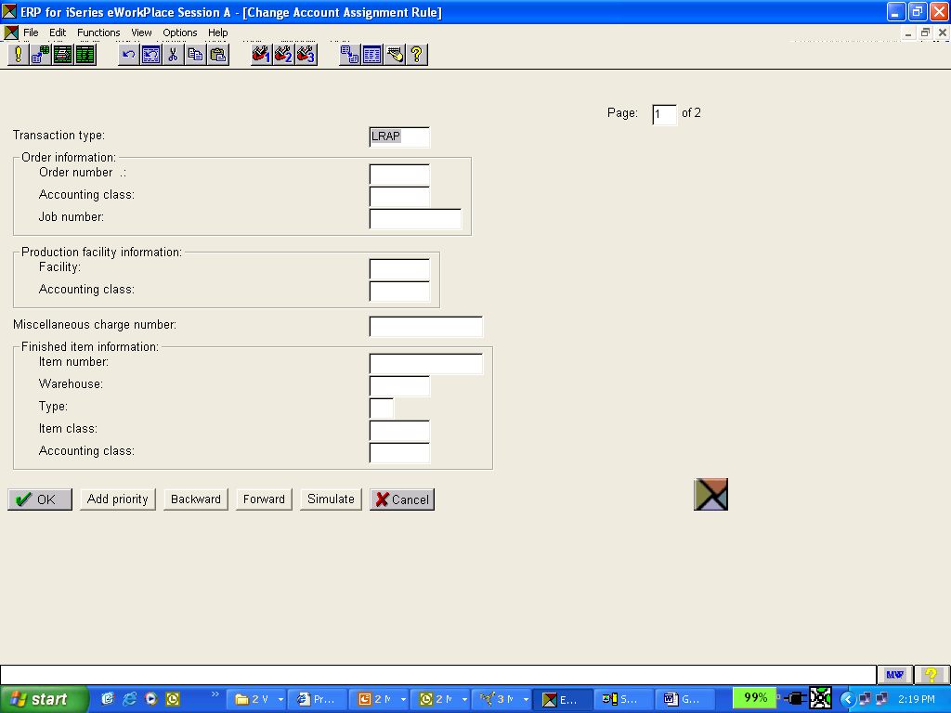
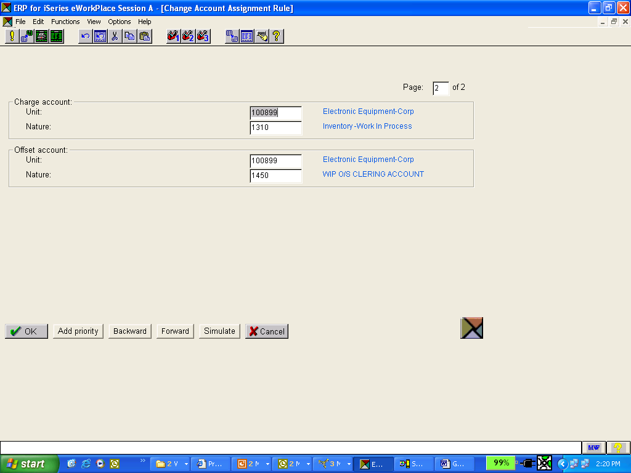
The GL Rules for LRAP
Establish a GL Rule for your LRAP Transactions – in MOST cases a single rule for ALL O/P Services. In the example above we are clearing our previous entry to our clearing account and updating WIP for the OP Services.

Slide 37
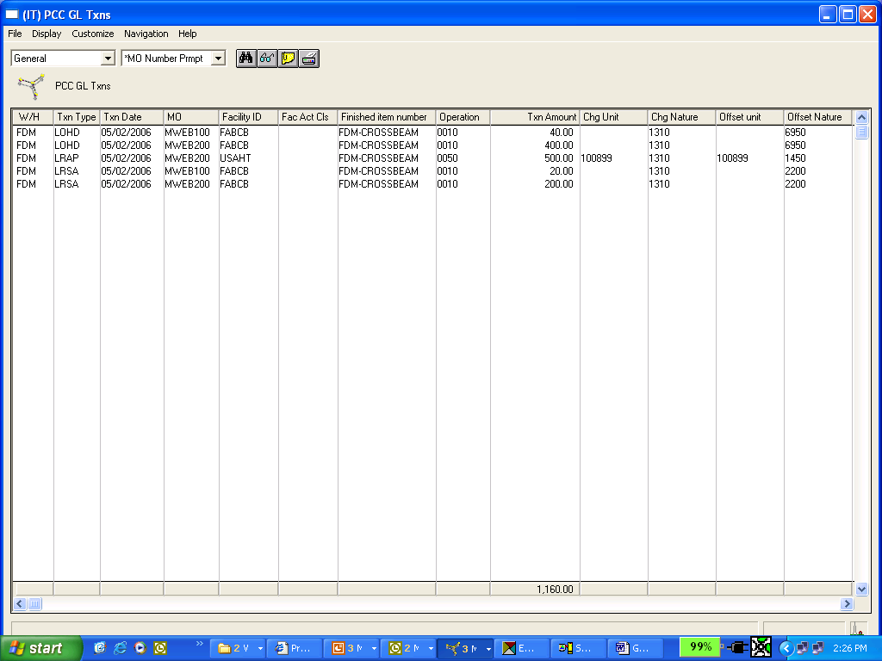
Account Assignment of LRAP
Use Browser to review your Assigned LRAP Transactions after setting up your GL Rules – here you see the effect of our Account Assignment on the $500.00 LRAP Transaction

Slide 38
The Financial Impact
The AP Invoice for Service Items
After processing your LRAP Transactions that were created by the processing of IFM/AM Accounts Payable Invoices for your OP Service Items –
YOU HAVE SUCESSFULY CLOSED THE FINANCIAL LOOP AND CORRECTLY UPDATED THE BALANCE SHEET AND YOUR MANUFACTURING ORDERS !
Acct/Nature: 2000
Acct/Nature: 1450
Accounts Payable Trade
WIP/OP Clearing Account
-500.00
+500.00
The LRAP Txn from Invoicing
Chg Acct/Nature: 1310
Offset Acct/Nature: 1450
WIP – Crossbeams
WIP/OP Clearing Account
+500.00
-500.00
API

Slide 39
O/P Flow – MO/PO/Receipt
Any Questions on the LRAP Transaction ?

Slide 40
O/P – Process Overview
Create Service Item and OP Detail
Add a Routing Operation for the Service Item
Manufacturing Order for the End Item.
Generate Purchase Order for the Service – can be done automatically.
Process the PO and Receive the Service for updating quantities and costs (if set to update at Receipt).
Enter the Invoice in AM or IFM with Charge Type of “O”.
Post the Invoice Quantity and/or Cost to the MO via the LRAP.
Process, Close and Purge the MO.
Post your PCC and IM GLI Transactions to correctly record you O/P Variances and other M.O. Variances.

Slide 41
O/P – Common Problems
Improper Setup of Item Revision for Service Item
People add an Item Warehouse Record and a Standard Cost and suddenly start getting RP Transactions for the Service Item itself
Wrong Account on Item, PO, or Charge Line that places dollars into the wrong Account Number during API - MUST BE THE SAME AS THE OFFSET ACCOUNT FOR YOUR LRAP TXN
The Charge Type of “O” isn’t being populated into the A/P “Charge Type” Field and LRAP Transactions are NOT being created to relieve the WIP/OP Clearing Acct
PCC Batches created by IFM or AM Accounts Payable processing are not processed in a timely manner – leaving dollars in the WIP/OP Clearing Account

Slide 42
O/P – Common Problems
Improper Setup of Item Revision for Service Item
People add an Item Warehouse Record and a Standard Cost and suddenly start getting RP Transactions for the Service Item itself
Wrong Account on Item, PO, or Charge Line that places dollars into the wrong Account Number during API - MUST BE THE SAME AS THE OFFSET ACCOUNT FOR YOUR LRAP TXN
The Charge Type of “O” isn’t being populated into the A/P “Charge Type” Field and LRAP Transactions are NOT being created to relieve the WIP/OP Clearing Acct
PCC Batches created by IFM or AM Accounts Payable processing are not processed in a timely manner – leaving dollars in the WIP/OP Clearing Account

Slide 43
Implementing the New Outside Operation Process to drive the LRAP
Technical Information on O/P
Integrated Outside Operations is supported for Infor XA Release 6 and higher.
Download SH62694 for the application code, and refer to the cover letter for installation instructions.
Set the implementation flag (position 106 in the PCOPS2 record in SYSCTL) equal to 1 to activate the integrated outside operations function.
The user documentation is available via informational download SH14754.

Slide 44
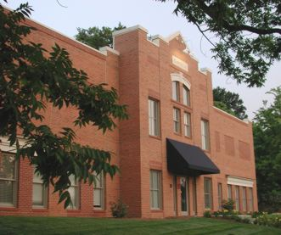
THANK YOU
Hundreds of years of experience and service on our Team – working for –
Your Teams

