Slide 1
PowerLink Navigation
The New Face of MAPICS
The Power Of the ‘Right Click’ in PowerLink
Jim Simunek
Jim.simunek@cistech.net

Slide 2
Introduction
Throughout PowerLink (and Browser) right clicking on a record will allow you to:
Retrieve information without having to open another object
Maintain a record or associated record
Format a view or subset
List Statistics
Set Preferences
Utilizing the right click to ‘mine’ for data can be a real time saver and get you to the information you need

Slide 3
Introduction
This session will explore:
The relationships between Mapics files
Some of the records/files where the right click can be used to retrieve data
Maintenance functions available for the record
Customizing the column in the view
Records where the right click can be used to invoke PowerLink settings
Compare function between 2 records/orders

Slide 4
Application Cards
Each object on an application card allows you to right click to set preferences
Preferences include:
Default view and subset for a list
Default card file and active card
Default templates for create, change and copy
Files to broadcast
Setting a default subset on large files (i.e. transaction history) will open the file quicker
Future Tuesday session on Setting Preferences

Slide 5
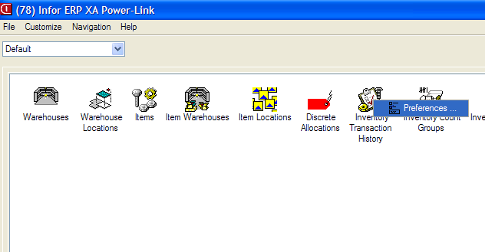
Main Browser

Slide 6
Main Browser

Slide 7
Mining for Data
Files where the right click/Display can be used:
Customers to display customer orders or CO history
Vendors to display PO’s
Planners to display MRP recommendations
Item Warehouses to display locations, MO’s, PO’s and CO’s
Item Revision to display bills of material and routings

Slide 8
Menu Layout
When bringing up a Display or Maintain menu, it is typically divided into sections
Information about the highlighted record
Details/Card file showing all information
Maintenance History
Associated information about highlighted record
Transaction History
Items
Associated files
Compare option

Slide 9
Display Menu

Slide 10
Manufacturing Orders

Slide 11
Manufacturing Orders
‘MO Details’ opens the card file for the MO
MO Transaction History opens transaction history for just the transactions that are associated with the MO
Component MO’s shows the manufacturing orders for sub-assemblies that are allocated to this MO

Slide 12
If using the display repeated, set up either a Workbench or Compound Card containing transaction history
Future Tuesday sessions will discuss both
Workbenches
Compound Cards

Slide 13
Associated Files
Where you see an arrowhead to the right of a file name ( ) you can drag your mouse over the file then to the right to select information about that file
You may or may not be able to use broadcast/receive to these associated files

Slide 14
Associated Files

Slide 15
Planner
Right click on a Planner Number/Display to see
Manufacturing Orders
Purchase Orders
MRP recommendations
Planner Item Warehouses
Transaction History

Slide 16
Vendor
Right click on Vendor/Display to see:
Purchase Orders
Purchase Order History
Scheduled receipts
Vendor Item Records
MRP Recommendations

Slide 17
Production Facilities
Right click on a Facility to see:
Routing operations
MO Operations
Repetitive Schedule operations

Slide 18
Item Revision
Single level or indented BOM
Single level or indented Where Used
Routing operations
Item Processes
Item Warehouses

Slide 19
List Card Right Click
When in a list card, you can right click on a record in the list to display or maintain information about the record
List cards include:
Customer Order Items
Purchase Order Items
Manufacturing Order components
Manufacturing Order operations

Slide 20
Within a List Card

Slide 21
Questions?

Slide 22
Format a List Column (view)
Whether in a list from an object on the Main Browser or in a list card, you can right click at the column heading to format the view
Alias, value or both for pre-defined fields
Scheme criteria's to add color, bold, italics, etc.
Change the width of the column
Modify Quick Change options
Column statistics (total, count, average, etc.)
Use ‘Customize’ ‘Column’ to bring up the card file

Slide 23
Format a Column in a View

Slide 24
Create a Temporary Subset
Right click on a Column Heading
Select ‘Customize’ then ‘Subset Criteria’
Using this feature allows you to create a temporary subset for a single selection field:
Item
Order
Status
Vendor
Customer

Slide 25
Create a Temporary Subset

Slide 26
Create a Temporary Subset
All subset options are available for the field
Equality
Inequality
Containment
Lists
Range

Slide 27
Create a Temporary Subset

Slide 28
Statistics
Right click on any column heading and choose ‘Statistics’:
Record Count
no more copying to Excel to see number of records
Available on any column
*Total
*Average
*Minimum
*Maximum
*Only available on numeric columns

Slide 29
Column Statistics

Slide 30
Compare

Slide 31
Summary
Use the right click throughout PowerLink to:
Display information
Maintain records
Set preferences
Compare records
Customize a column
Create a temporary subset

Slide 32
Summary
Save time by right clicking instead of exiting the file and opening another object
Drill down to associated information quickly
Improve efficiency/save time

Slide 33
Thank You for Attending!
Questions?

