Slide 1
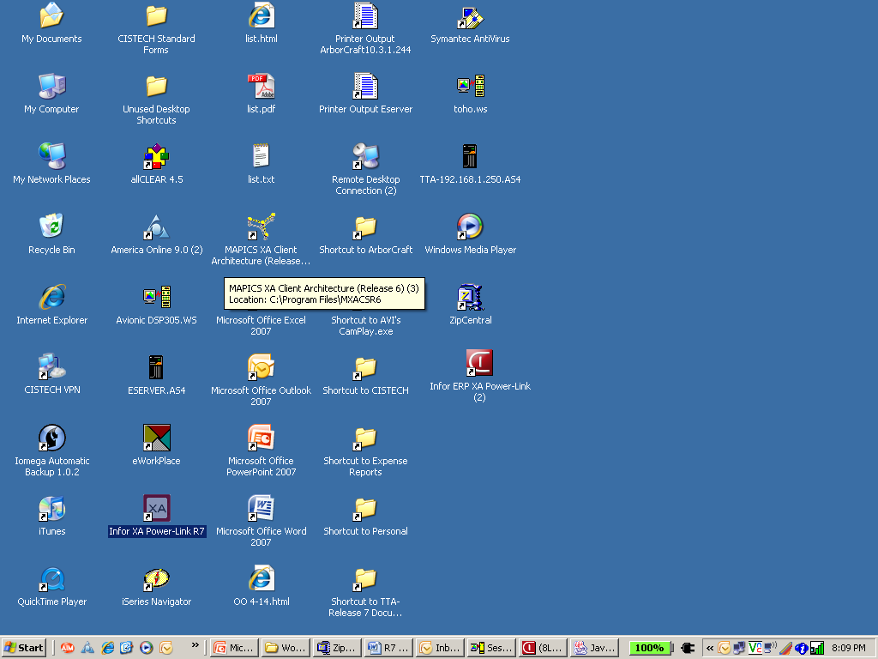
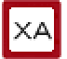

Infor XA R6 Browser to
Infor ERP XA Power-Link R7.8
Jim Simunek
Senior Business Consultant

Slide 2
Release 7 Overview
Takes a great application (Browser) and makes it exceptional (PowerLink)
Release 7 is written in Java (Browser was written in Small Talk)
Brings all of the Java functionality with it
  Select multiple records by holding Control + click
  Select range of records by clicking on the first record then Shift + click on the last record

Slide 3
PowerLink Improvements for Information Access
Quick change
Graph cards
Compound cards
Presentation schemes
Subset tip text
Cascading subsets
Power expand
URL & e-Mail buttons
Column statistics
Application settings
‘Locate’ Button
User definition favorites
Express customization
Logical field tip text
Change AND copy templates
Code file maintenance
Auto logoff
Auto key generation
Open action
Workspaces
Improved workbenches

Slide 4
Quick Change
The ‘Quick Change’ action (pencil with lines following) builds a card with the fields used in the view
Used when you need to change multiple records but cannot use Mass Change
‘Auto Advance’ allows you to go through all the records in the subset
‘Bypass’ allows you to skip a record

Slide 5
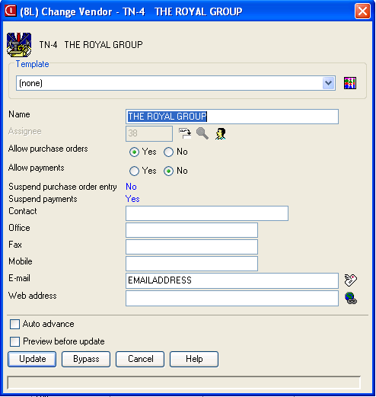

Slide 6
Locate Button
A new button has been added to the Toolbar to ‘locate’ a record on a list
Alternate to using ‘Customize’ then ‘Locate’

Slide 7
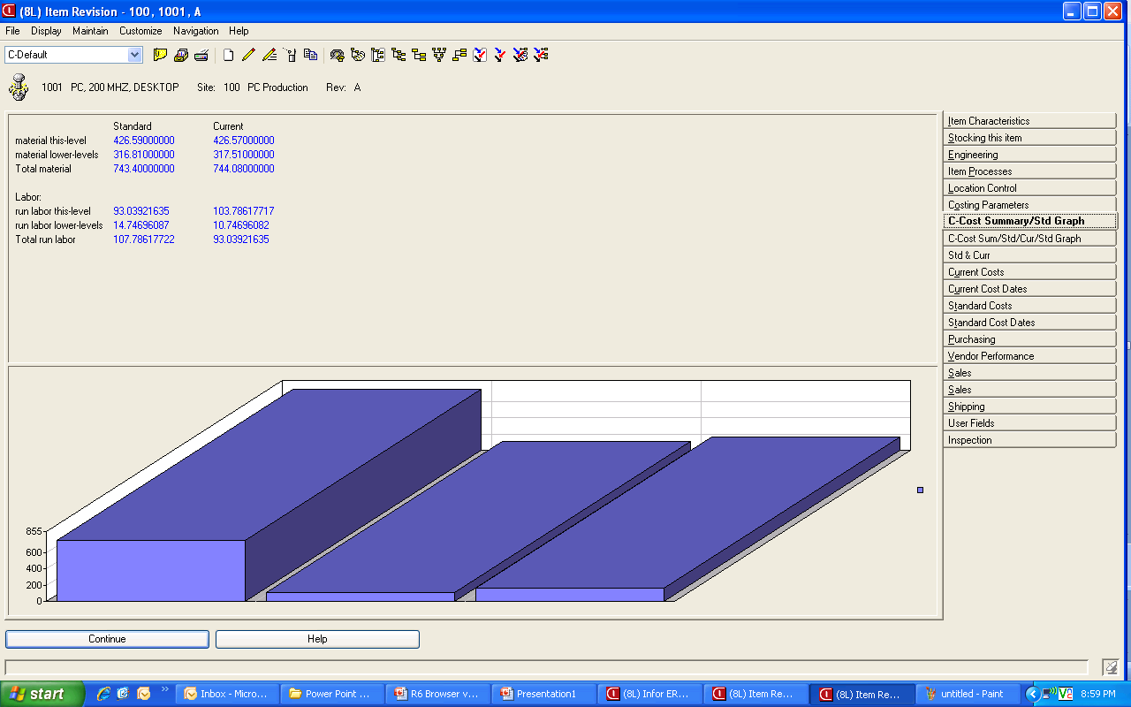
Graph Cards

Slide 8
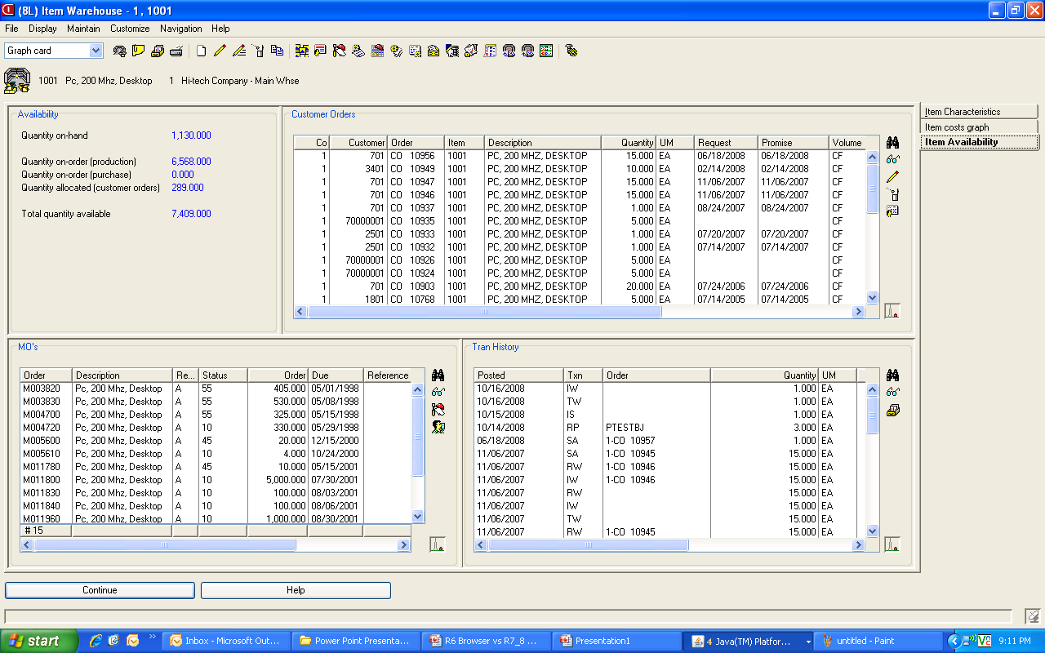
Compound Cards

Slide 9
Presentation Schemes
Can add color, bold, italics, etc. to lists based on conditions specified when creating the scheme
  Past Due PO’s
  Item Class
Can color a single field or the entire line
Can apply the scheme to the foreground (numbers/letters) or background

Slide 10
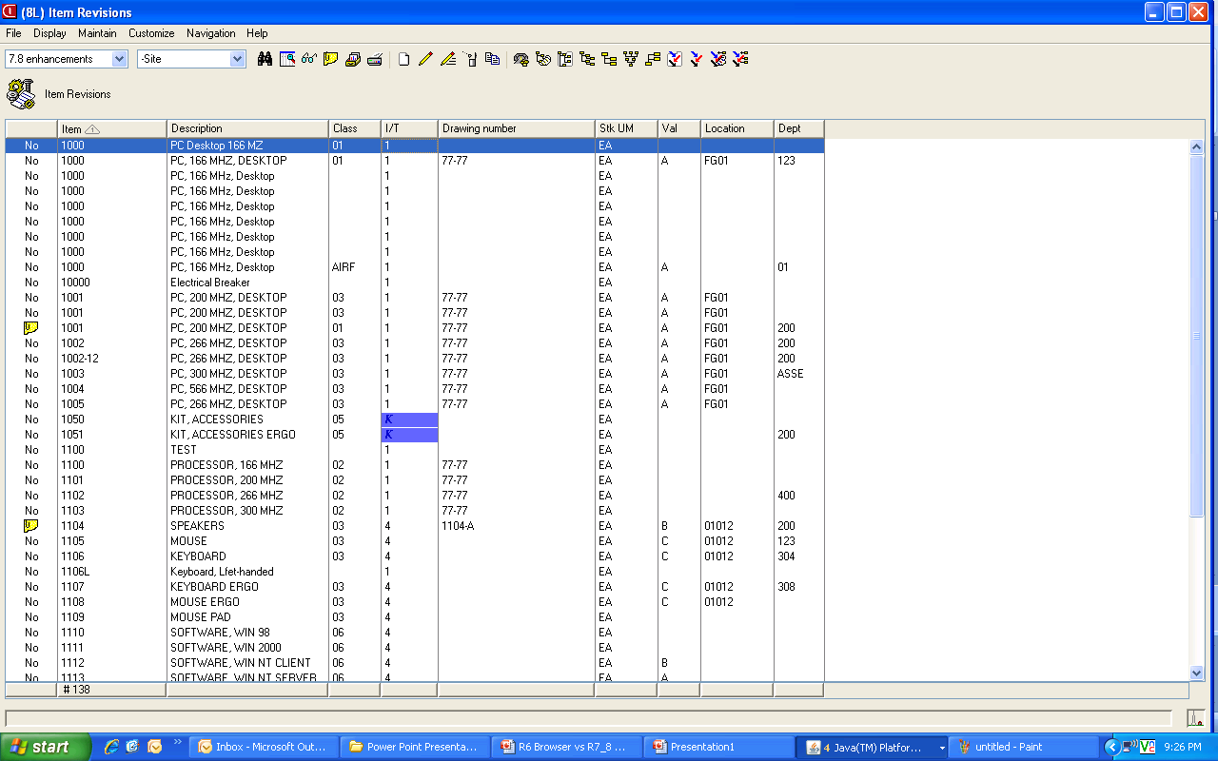

Slide 11
Column Customization
Can right click on any column and customize the view/column
  Set column width
  Change title
  Block from Quick Change
  Create presentation scheme
Allows for a quick change to the view without having to go through the all the ‘Customize’ – ‘View’ steps

Slide 12
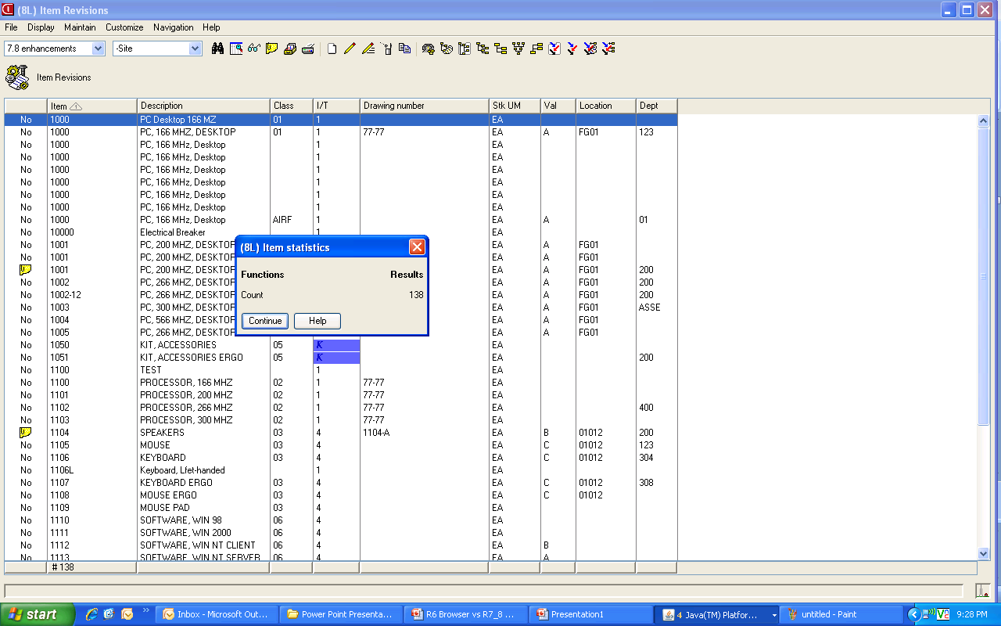
Column Statistics

Slide 13
Subset Improvements
Tip Text
  Move the cursor over the subset, view, calculated column and the criteria for the subset will be displayed without going to ‘Customize – Subset’
Cascading Subsets
  After applying the first subset, you can then use a secondary subset against the list being displayed

Slide 14
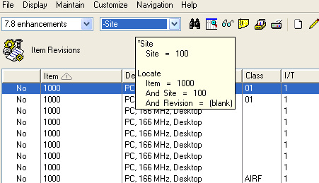
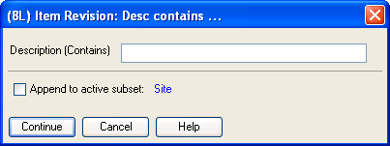

Slide 15
Favorites (subsets & views)
Subsets, Views & Sorts can be flagged as a favorites
When you pull down the list of available subsets, only the favorites will be displayed
Reduces the number of public options displayed to only those that apply to

Slide 16
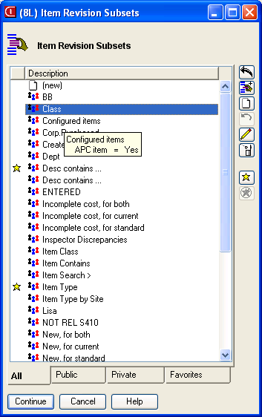
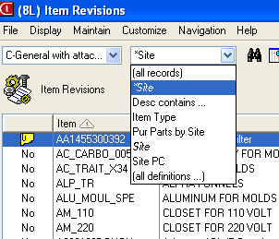

Slide 17
Workspaces
Multiple objects for the same file can be created on the PowerLink card
  For example, if there are multiple sites being used, a subset for a specific site can be used to create an additional object for Item Revisions that will only bring up records from the site
  Can create separate preferences for the workspace

Slide 18
E-mail Capabilities
Host Job and Host Print functions have the capability to e-mail
E-mail functionality on the iSeries must be activated
Can select format:
  HTML
  PDF
  Text

Slide 19
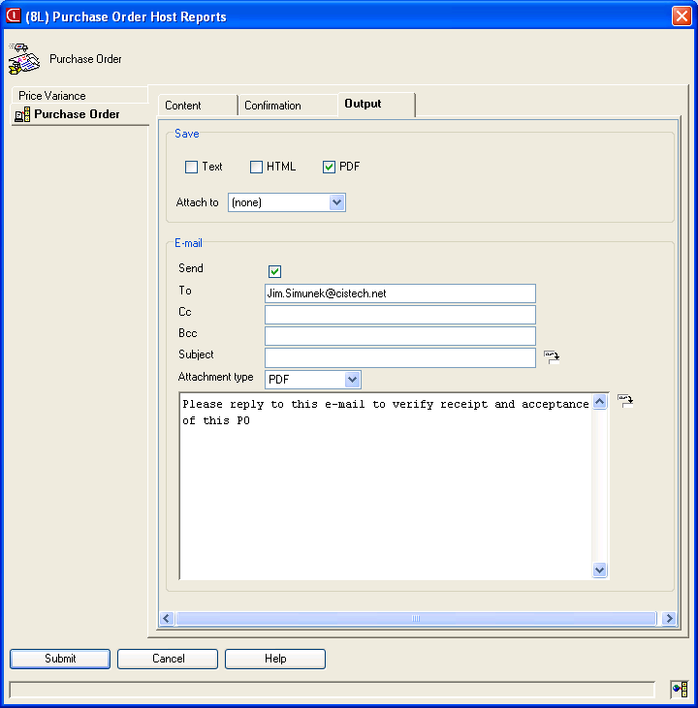

Slide 20
Power Expand
When using an overview card, Power Expand will open all levels instead of having to ‘click’ on each plus button
Default setting for Power Expand is set in system preferences – Miscellaneous Card
  Need to sign off PowerLink and sign back on for this Preference to become functional

Slide 21
Multiple Open Actions
When you double click on an item/order in a list you can specify what opens
  Open (double click)
  Alt + Open
  Ctl + Open
For example, on the Item Revision file, Open could bring up the card file in the change mode, Alt + Open would display the bill of material and Ctl + Open would display Item Warehouses

Slide 22
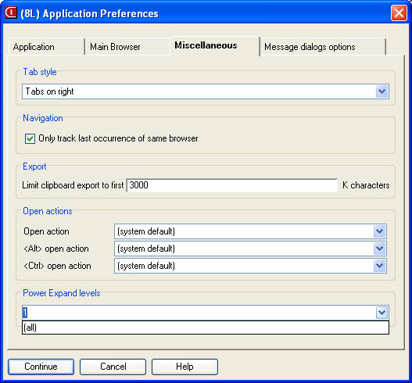

Slide 23
Templates for Change & Copy
Separate templates for Create, Change and Copy
Becomes more powerful when a Change template is used with Quick Change on a file that does not have Mass Change capabilities

Slide 24
Auto Logoff
Can set time outs for auto logoff of PowerLink, Net Link and/or System Link
From the ‘Enterprise’ card, Cross Application change can enable and set idle times for each application

Slide 25
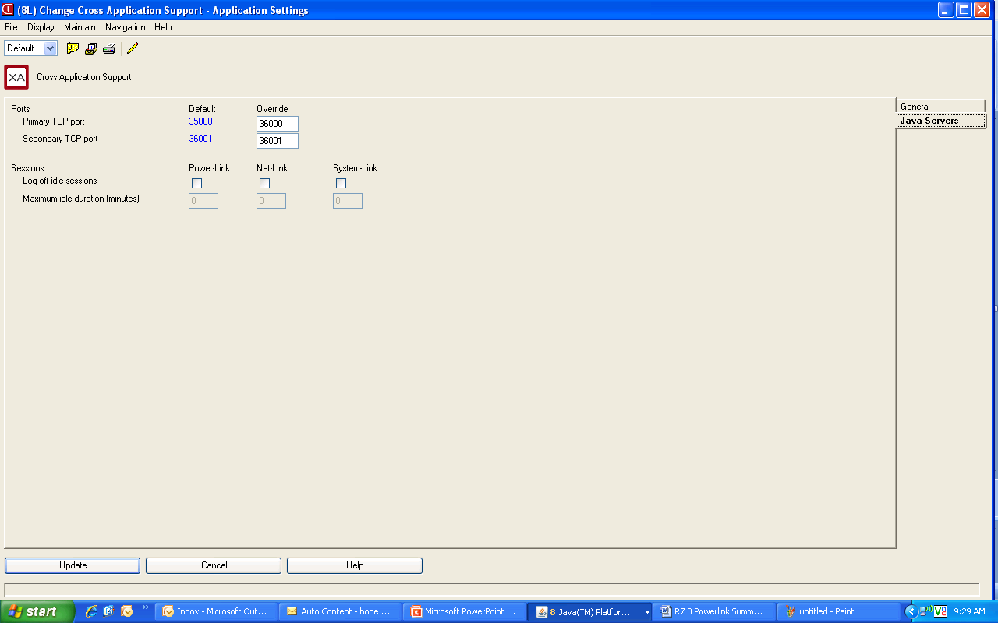

Slide 26
Now with R7.8 Power-Link!
Card enhancements
  List cards – presentation schemes, restricted data
  Graph cards – stacked bars available
  Overview cards – favorites available
  Compound cards – data/graph link
Subset enhancements
  Additional date range options (last week, last qtr, etc.)
Public preferences
Customizable menus and toolbars in workspaces

Slide 27
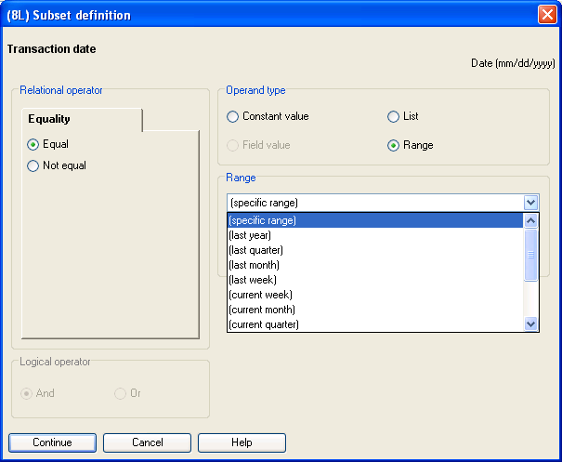

Slide 28
Now with R7.8 Power-Link!
Suppress nuisance information messages – a “Do not show again” box lets you eliminate.
Host process confirmation shows all jobs being submitted at the same time; i.e., multiple EPDM reports you are running together and includes “tip text.”
Specify landscape or portrait when exporting data to PDF—instead of having to change printer settings.
User Definitions and User Preferences are now available outside of Integrator.

Slide 29
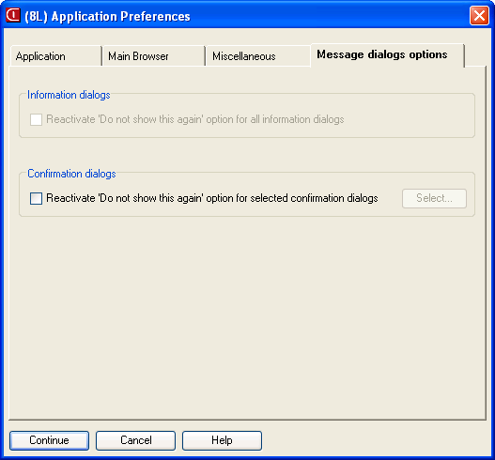

Slide 30
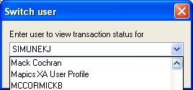
Now with R7.8 Power-Link!
“Auto-content security” has moved from Integrator to base Power-Link.
Users can now see transactions for other users instead of being restricted to their own Power-Link actions.

Slide 31
R7.8 Expanded Process Functionality
Customer Service Management
  End order enhancement
  Split commissions
  Price books
  Reports
  Invoicing from orders or shipments
  Holds – list view gives visibility
  Comments maintenance
  Customer/industry item maintenance
  Contracts/promotions maintenance
  IFM customer maintenance

Slide 32
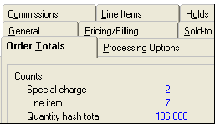
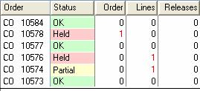
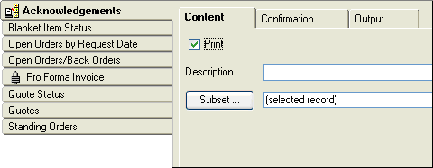
New End Order
Better Hold Management
CSM Reports

Slide 33

Invoicing
Invoices can now be generated from orders or
shipments.
As a standard host job, the invoices can be
e-mailed or stored as text, HTML, and/or PDF
documents.

Slide 34
R7.8 Expanded Process Functionality
Enterprise Product Data Management (non-EPDM environments still the same)
  Maintain kits and kit components
Procurement Management
  Integration with SRM SupplyWEB for electronic communication with vendors.
  Enhanced security for SOX requirements (federal tax ID/Social Security # has it’s own security and pre-set security for separation of duties)
Cameleon
  De-couples engineering data from line-item entry, speeding up data entry process.
  Configured item descriptions are saved in both CSM and EPDM.
  MO’s can be generated automatically from configured customer orders.

Slide 35
R7.8 Expanded Process Functionality
Materials Management
  New inventory transactions (IS, RC, TW, SA) and reversing transactions
  Reason codes for all IM transactions
  Receiving now has receipt by shipping notice, shipment containers and shipped items (SRM SupplyWEB)
  Visibility and receipt functionality for “in-transit” stock being transferred to another XA warehouse
  Inventory Status and Non-netting Locations
    New field, Inventory Status, added to the Warehouse Location object to classify items to be withheld from certain activities.
  Customer order pick lists – regular & stock pick combined
  Customer order shipments (complete only for now)

Slide 36
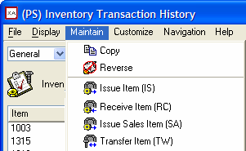
New Inventory Transactions
Issue Item (IS) – formerly
Miscellaneous issue.
Receive Item (RC) –
formerly Miscellaneous receipt.
Issue Sales Item (SA) – formerly
Sales Shipment.
Transfer Item (TW) – formerly
Interwarehouse Transfer, and the
related generated
Interwarehouse Issue (IW) and
Interwarehouse Receipt (RW).
(Renamed but same designator. Note Reverse action.)

Slide 37
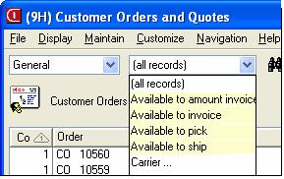
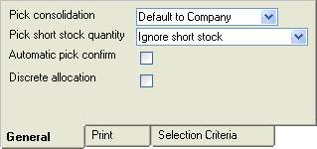

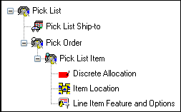
SHIPPING FUNCTIONALITY

Slide 38
R7.8 Expanded Process Functionality
IFM
  Maintenance of:
    Entities
    Customer
    Vendors
  New summary levels and analytical functions
  Credit information updated in real time
  Increased length of bank account number to 60 characters to handle bank ID codes and international bank ID codes.

Slide 39
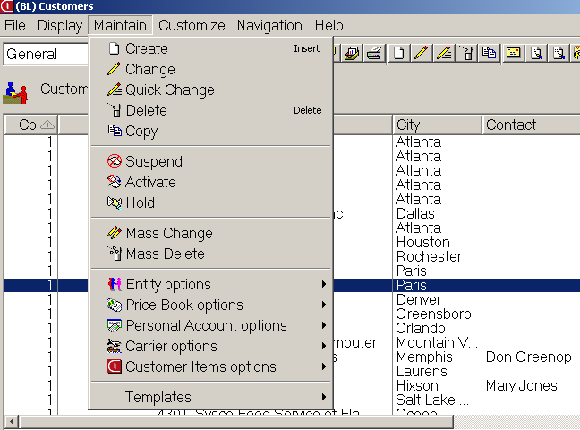
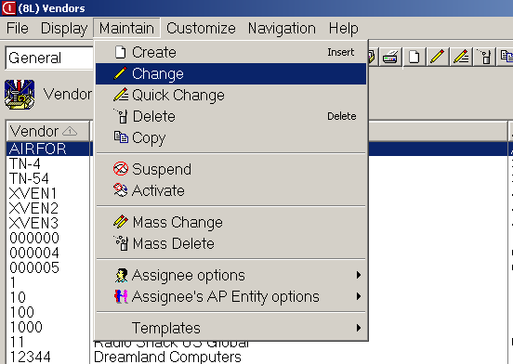
Add/maintain customers with IFM
Add/maintain vendors with IFM

Slide 40
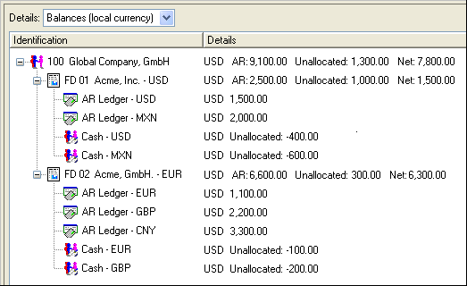
New IFM Summaries

Slide 41
R7.8 Expanded Process Functionality
Order-Based Production Management
  Application setting controls how users are notified when changing MO quantities with discrete allocations.
Net-Link
  Supports multiple internet browsers
Environment Management
  Includes Product Update feature to analyze and apply PTF’s, PCM’s and migrations from R6 to R7.

Slide 42
R7.8 Expanded Process Functionality
Integrator
  Imports and exports user code within user exits.
  Publish and subscribe supports notification subsets, including all fields on regular subsets.
  The User Definition and User Preference Administration functions have moved from Integrator to base Power-Link product.
Translation enhancements
  Add language to user profile and eliminate need for multiple MMLIST records and multiple database copies.
  Install new applications and apply code fixes once without regard to individual languages.

Slide 43
R7.8 Expanded Process Functionality
Link Manager
  Provides enhancements for managing machines, processes and environments.
System-Link
  Calls to host jobs and reports
  Define transactions groups
  Supports conditional blocks in System-Link requests
Performance
  Extra caching of customization data
  Use of System i SQL query engine

Slide 44
Summary
Release 7.8 functionality takes a good thing (Browser) and takes it to then next level to make it an exceptional tool
PowerLink works in conjunction with the other ‘Link’ applications
  System Link
  Net Link
  Link Manager

Slide 45
Summary
Taking the time to create custom cards, preferences, workspaces, etc. will allow you to be much more efficient and productive

Slide 46
Thank you for attending!

