Slide 1
How to release MRP planned orders through OBPM
The New Face of MAPICS
MO/PO create and maintain through OBPM
Jim Simunek
Jim.simunek@cistech.net

Slide 2
Introduction
Order Based Production Management (OBPM) has the ability to release MRP planned orders or maintain existing orders
User preferences will allow orders to be created immediately instead of having to run ‘Order Release’
New MO/PO numbers will be displayed on ‘Item Requirements Inquiry’ screen immediately
Right click on order recommendation will allow planner/buyer to retrieve information about item/order

Slide 3
Introduction
OBPM allows for selection of multiple planned orders to test for component availability
All planned orders selected for component availability test can be converted to MO’s as a group (as opposed to individually releasing each MO)
Can create the following order types:
Manufacturing
Purchase
ISL
Requisition
Cannot create Repetitive Schedules through OBPM

Slide 4
MRP Exception Preferences

Slide 5
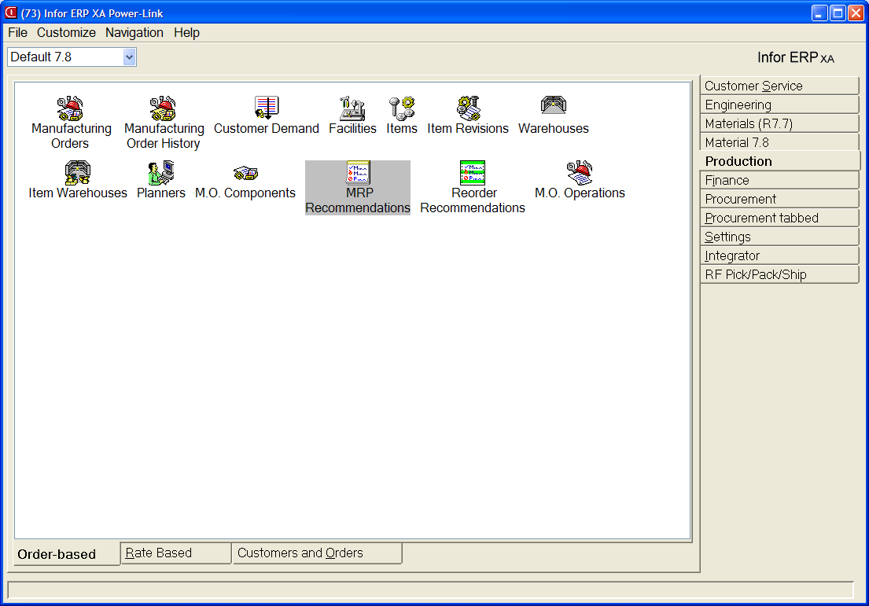
MRP Preferences

Slide 6
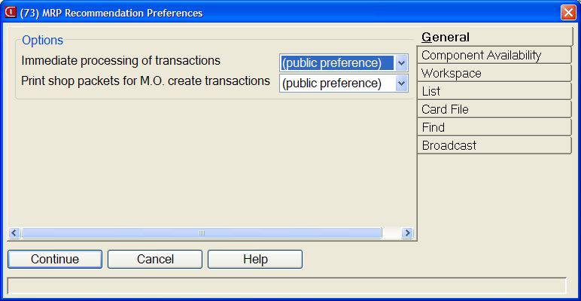
MRP Preferences
Right Click on the ‘MRP Recommendations’ object and left click on ‘Preferences’
General Tab
Immediate Processing of Transactions
If changing to ‘Yes’ need to sign off and back on to take effect
If Immediate not selected, will have to ‘Process’ orders after action is applied
Auto print shop packets

Slide 7
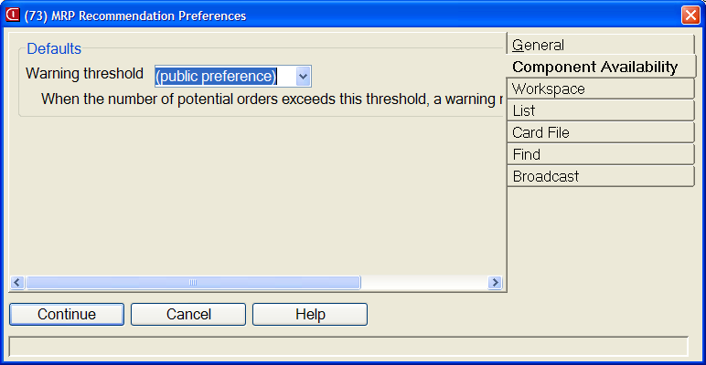
MRP Preferences
Component Availability
Set number of orders to test without getting warning message (default is 10; if you receive warning that the ‘threshold has been exceeded’ when testing component availability, change this setting)

Slide 8
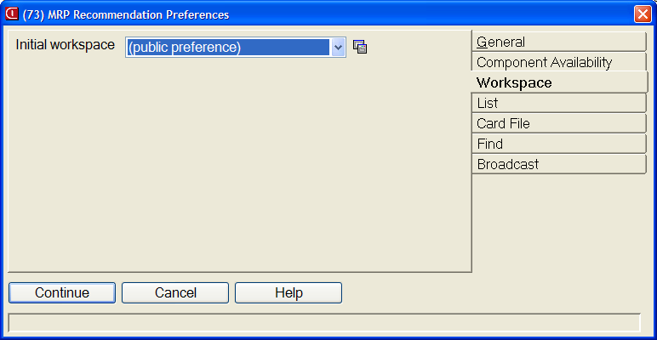
MRP Preferences
Workspace
Workspace can define subset, card file, etc. being used for the ‘MRP Recommendations’ object
For example, could create separate objects for make and purchased items

Slide 9
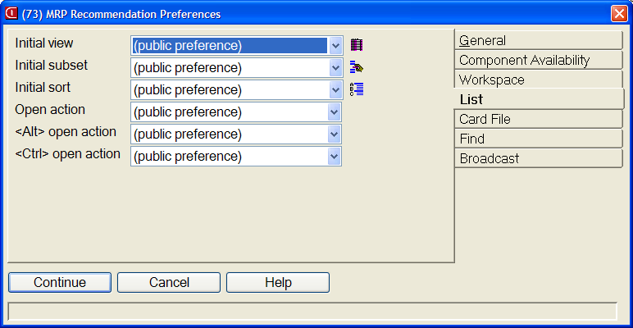
MRP Preferences
List
Default view, subset and sort for items on list
Open Actions
R7 and higher only
Defines what happens when you double click on an order

Slide 10
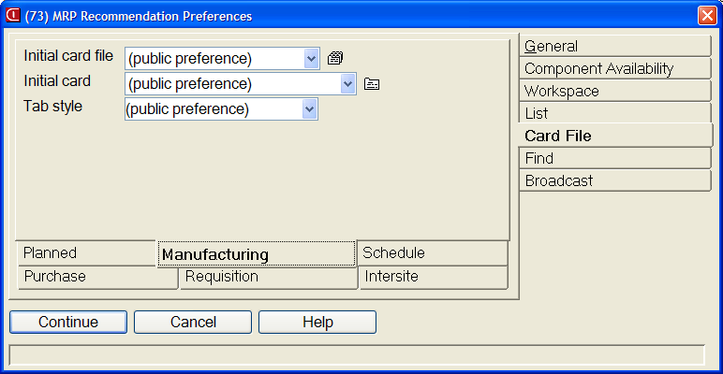
MRP Preferences
Card File
Default card file, active card and tab style
Notice that there are separate tabs for each type of order

Slide 11
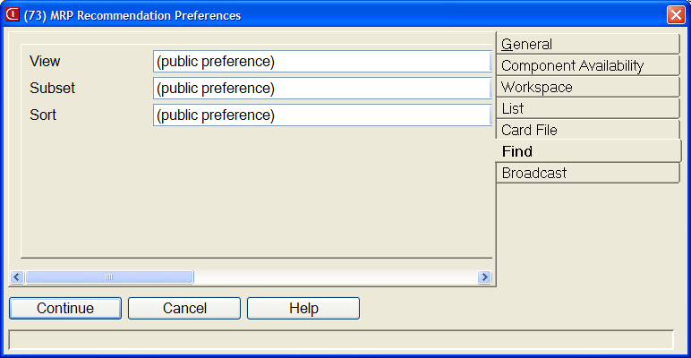
MRP Preferences
Find
Subset to be used when the ‘Find’ button is pressed
Separate subsets for each field (vendor, order, item, etc.)

Slide 12
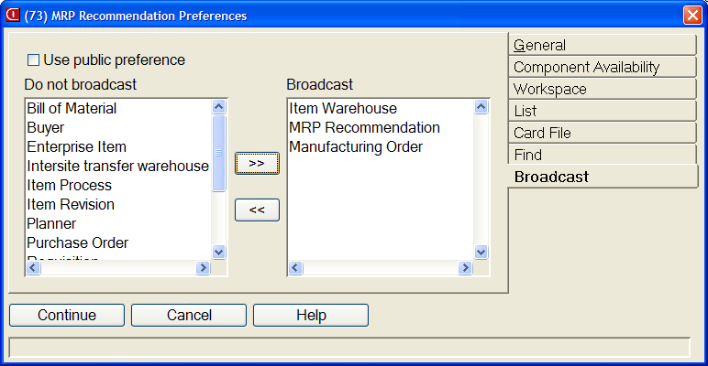
MRP Preferences
Broadcast
What files to broadcast when using a Workbench or Broadcast/Receive

Slide 13
MRP Recommendations
MRP recommendations (all records) shows all orders with MRP exception messages
Date Lo (Past Due)
Expedite (move due date up, cuts into lead time)
Reschedule (move due date up, full lead time)
Release
Defer (push due date back)
Cancel order (no requirements for item)

Slide 14
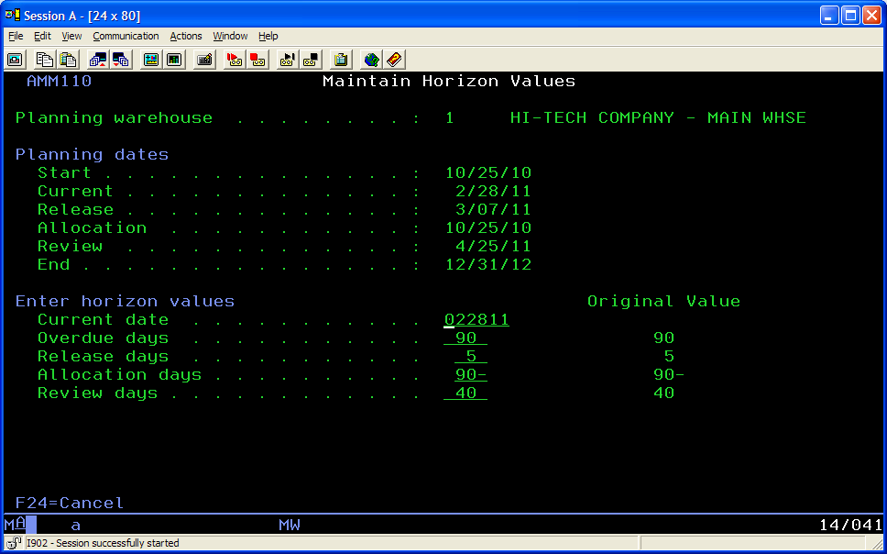
Planned Orders (No Exception)
Only planned orders with a start date earlier than the ‘Review Horizon’ will be displayed, even if orders were planned further out into the future

Slide 15
MRP Recommendations in OBPM
Advantages
Subsets allow for display of all items for a single planner or group of planner numbers
Can use subsets to filter out recommendations for a low number of days
Can create a Workbench to broadcast to MO, PO, Schedule or Requisition to see details
Can create a Workspace to specify card files, cards, subsets, views for a group of recommendations

Slide 16
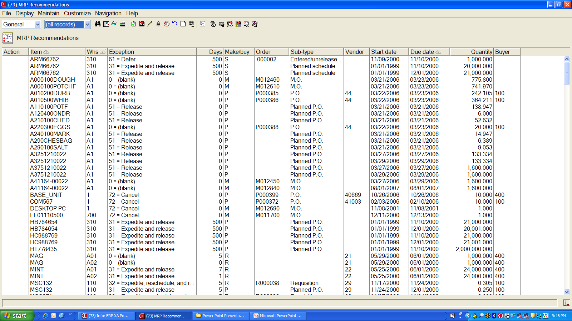
MRP Recommendations

Slide 17
Maintenance Options
Accept Recommendation
Works for 33 – Expedite, 41 – Reschedule or 62 – Defer
Automatically changes order without displaying card
Create Order
For planned orders, with or without Release recommendation
Change Order
To change an existing order manually

Slide 18
Maintenance Options
Firm
Firm plan a Planned Order
Cancel
Cancel an order
Reset
If Immediate Processing was not selected in Preferences and you have not manually processed the action, this will ‘undo’ the action taken
Process
If Immediate Processing was not selected in preferences, must use process to update orders worked

Slide 19
Mass Maintenance
All of these options have a ‘Mass’ option as well as a single order option
Use a subset to reduce the number of orders on the list then use ‘Mass’ accept, create, firm, etc. to perform the action on all the orders on the list

Slide 20
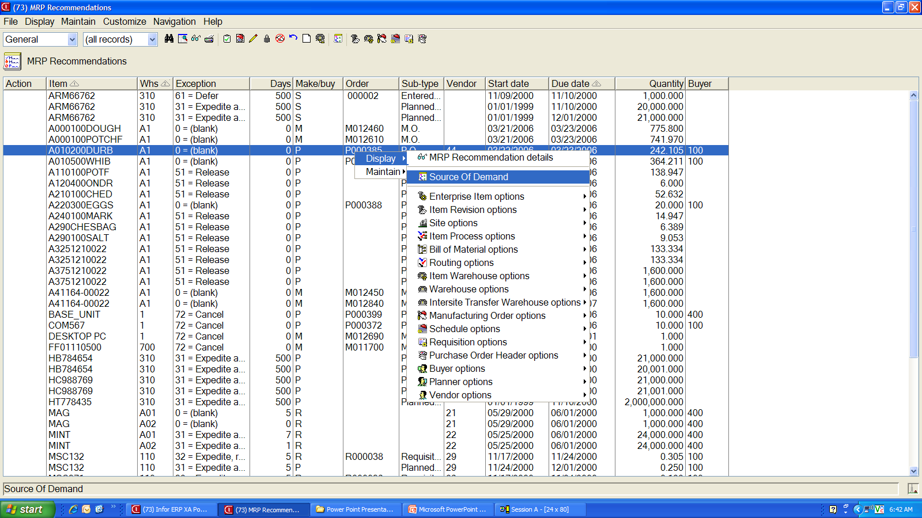
Source of Demand

Slide 21
Source of Demand
Displays top level requirements for the item
Is not an ‘Item Requirements Inquiry’ but does ‘Peg To’ the top level item that prompted the planned order
Only shows information if the ‘MRP Execution Options’ (green screen) was set to collect source of demand

Slide 22
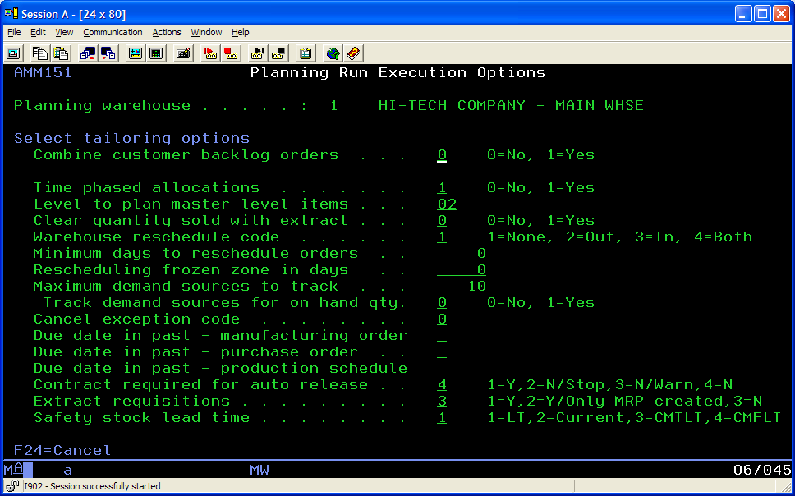
MRP Execution Option

Slide 23
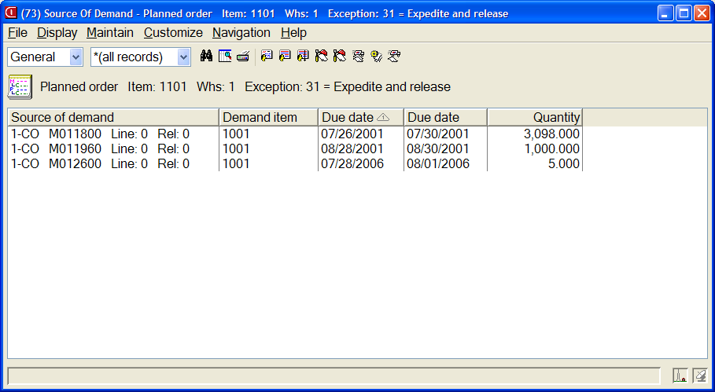
Source of Demand List

Slide 24
Purchase Orders

Slide 25
MRP Recommendations

Slide 26
MRP Recommendations
To Release the planned order
Single click on the line item
Click on the ‘Create Order’ button
Your Preference settings will determine what card/card file is displayed

Slide 27
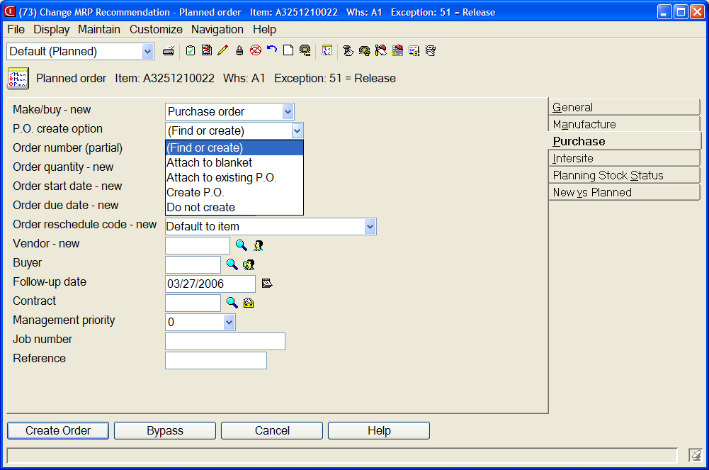
Create a PO from a P-Plan Order

Slide 28
PO Create
Options:
Create a new, single delivery PO
Attach the item, single deliver to an existing PO
Add the planned order as a release to a blanket PO
Attaching to existing or blanket will require entry of PO number in ‘Order’ field
Cannot input purchase price
Can customize the card to display field holding default PO Price (from Purchasing Control File)

Slide 29
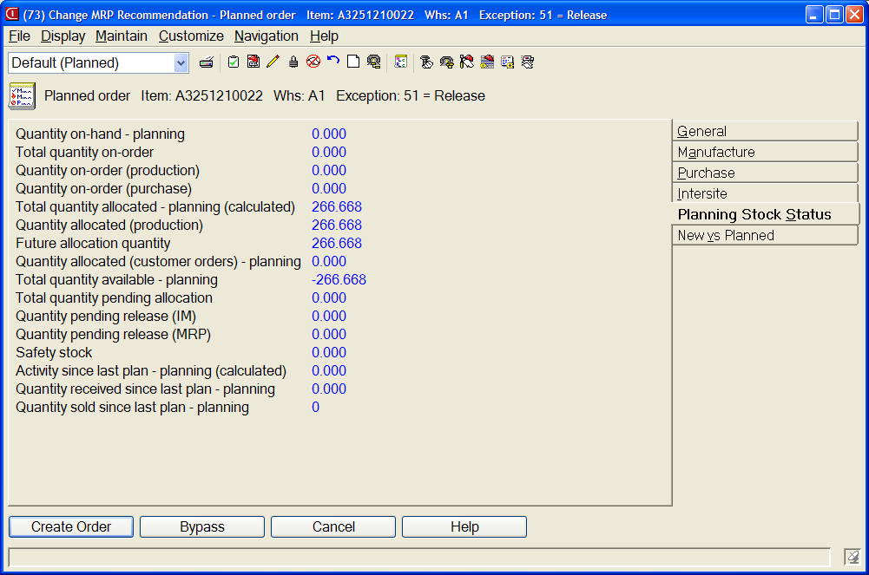
Stock Status Card
Use the Stock Status card to display on hand/on order information about the item
Use ‘Customize’ then ‘Cards’ to change the fields being displayed
If R7.8 or higher, can create compound cards with field information (attribute section) and list sections

Slide 30
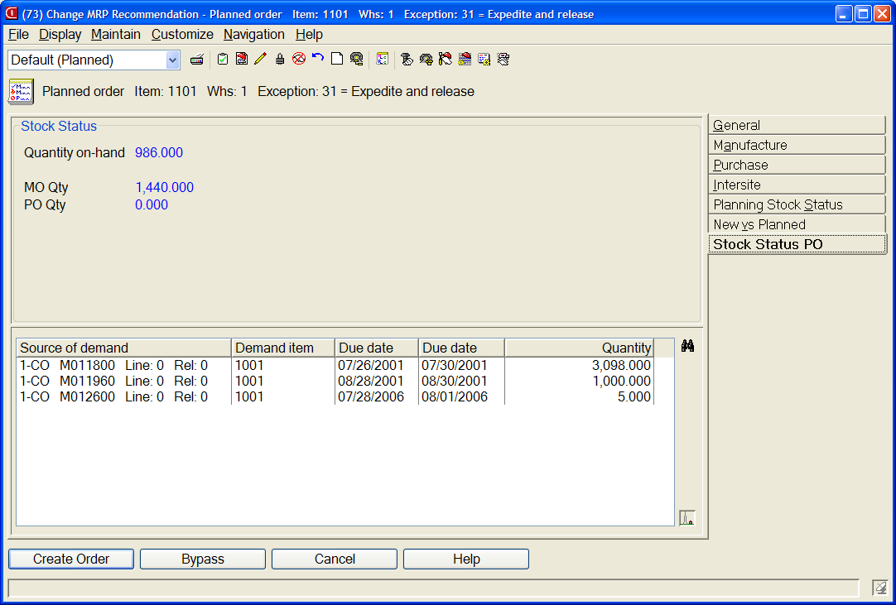
Compound Card

Slide 31
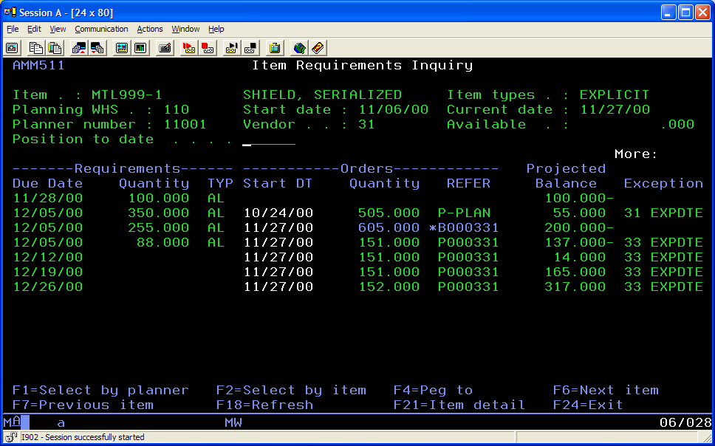
Expedite Exceptions

Slide 32
Expedite Exceptions
Use ‘Exception Days’ field to display number of days to expedite, reschedule or defer
If accepting the recommendation, use the ‘New vs. Planned’ card to see old/new dates

Slide 33
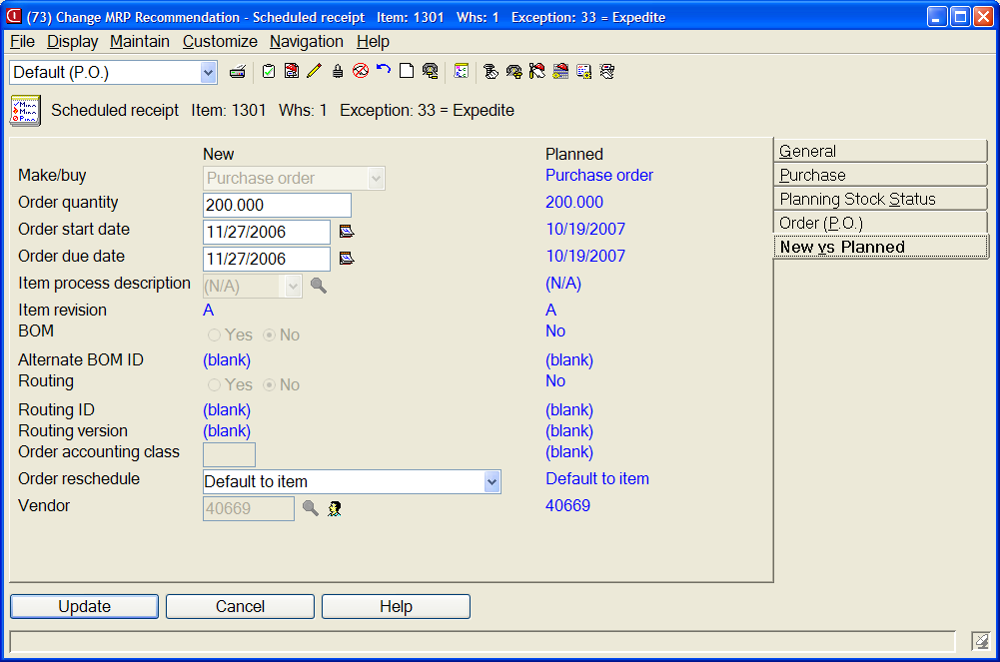
New vs. Planned
Single click on the PO to be changed
Click on the Pencil to change
‘New’ shows recommended new date; Planned is existing info
Clicking on ‘Update’ button will change order

Slide 34
Manufacturing Orders

Slide 35
Component Availability Check
MRP Recommendations allows you to select multiple planned orders and perform a component availability check
Use ‘Control’ + click to select individual orders
If all orders to be tested are in a range:
Click on the first order
Hold ‘Shift’ and click on the last order
All orders in the range will be selected
Select as many orders as desired then test for availability; Preference settings will determine if you get a warning about the number of orders selected

Slide 36
Component Availability
Selected Orders (below)
Then click on ‘Maintain’/’Check Component Availability’

Slide 37
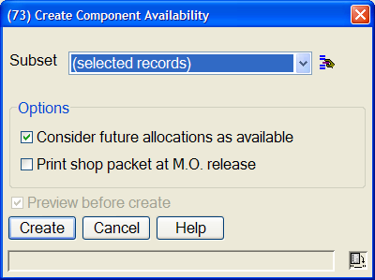
Create Component Availability
Subset would be ‘selected records’
Consider future allocations as available means the current inventory will be used
Click ‘Create’

Slide 38
Component Availability
‘Short’ card only shows components that will be short
‘All’ card shows all components
If you click on the plus (+) button to the right of the component card will display all of the MO’s that use this item
If you click the ‘Create’ button, all potential MO’s selected for test will be converted to MO’s

Slide 39
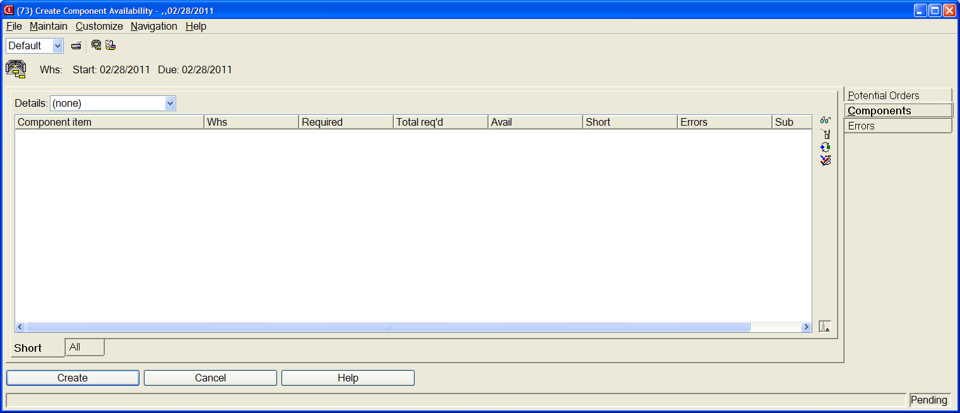
Component Availability - Shortages

Slide 40
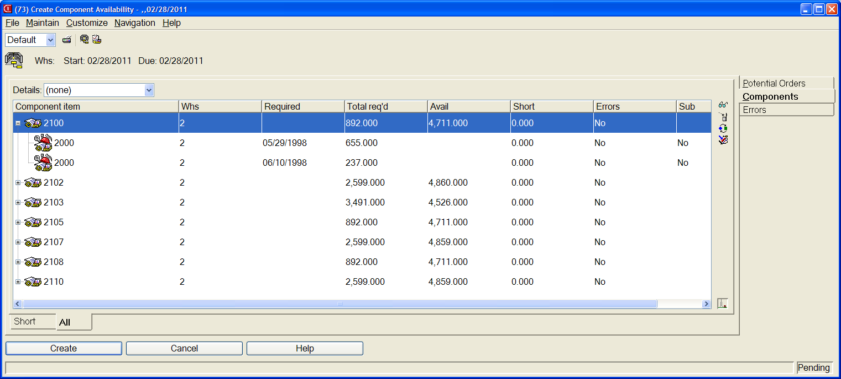
Component Availability – All Components

Slide 41
Create MO’s
Click on the ‘Create’ button from the ‘Component Availability’ card and an MO will be created for each planned order selected for component availability test
To view the orders first, click on the ‘Potential Orders’ tab
MRP recommendations and green screen ‘Item Requirements Inquiry’ will display MO number if ‘Immediate Processing’ (Preferences) was checked

Slide 42
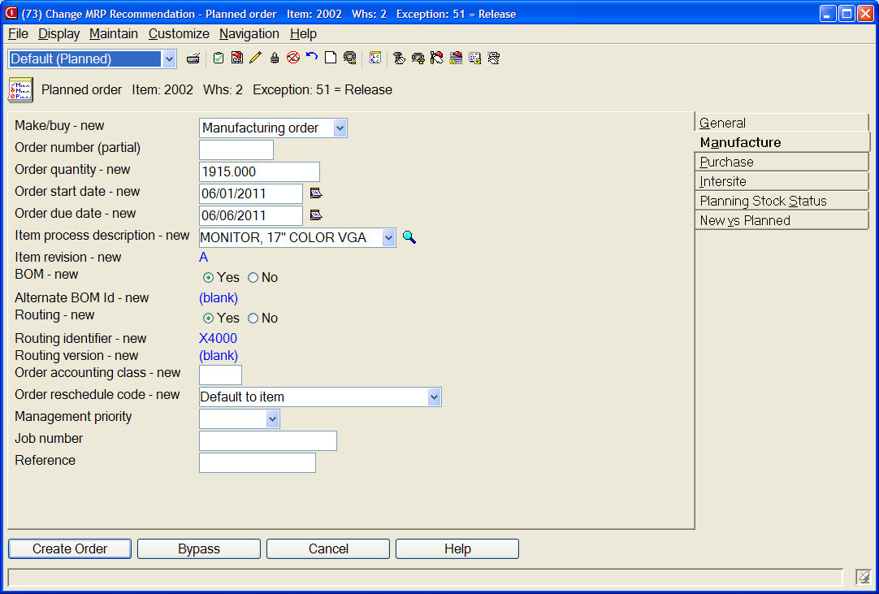
Create an Individual MO
Single click on the M-Plan order then click on the ‘Create Order’ button

Slide 43
Manufacture Order Card
Can assign MO number (without the leading ‘M’)
Change quantity, start and due dates
Select an alternate process (EPDM only)
Different bill or routing or both
After order is created, MRP list will show MO number assigned (may have to use ‘File’/’Refresh’ or F5 key)

Slide 44
New vs. Planned Card
If MRP is recommending Expedite, Reschedule or Defer, New vs. Planned card will display existing order dates (Planned) and MRP recommended dates (New)
If new dates are to be used, click the ‘Update’ button
If new dates are not to be used but you want to assign different dates, key the dates to change to and then ‘Update’

Slide 45
Cancel an Order (PO or MO)
Single click on the order then click on the ‘Cancel’ button

Slide 46
Summary

Slide 47
Summary
OBPM MRP Execution options present a real improvement over the green screen ‘Order Release and Review’ screens
Unfortunately, there is no ‘Item Requirements Inquiry’ card in PowerLink. However, you can right click and view ‘Source of Demand’ which will display top level requirements for the item
MRP Execution Options must be set to collect ‘Source of Demand’ information

Slide 48
Summary
Select multiple M-Plan orders to see component availability prior to creating the MO’s
Creative use of compound cards, subsets and views will provide much more information to the planner in a quicker time frame

