Slide 1
XA Advanced Development with Extender and Enterprise Integrator: RPG is so 1980s…
Denise Luther Senior Technical Consultant
denise.luther@cistech.net
704 814 0017

Slide 2
Engineering Change Control
and Notification
Enterprise Integrator tools for IDF
Catavolt XA Extender for web portal
2
Notes:
2

Slide 3
ECN Requirements
Entry of Engineering change information and approval hierarchy
As each level is approved, notify the responsible engineer for the next level
3
Notes:
3

Slide 4
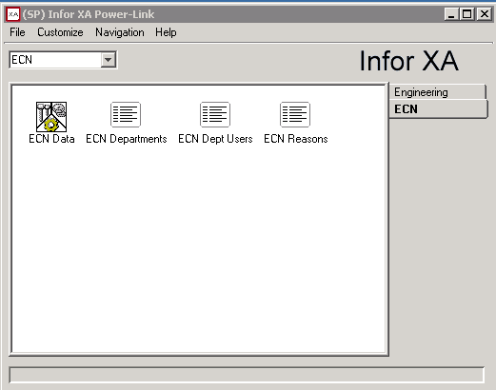
ECN - IDF
4
Notes:
4

Slide 5
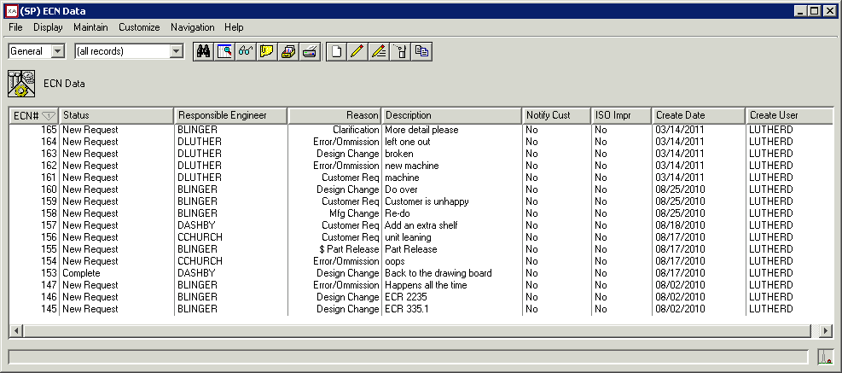
ECN - IDF
Header View
5
Notes:
5

Slide 6
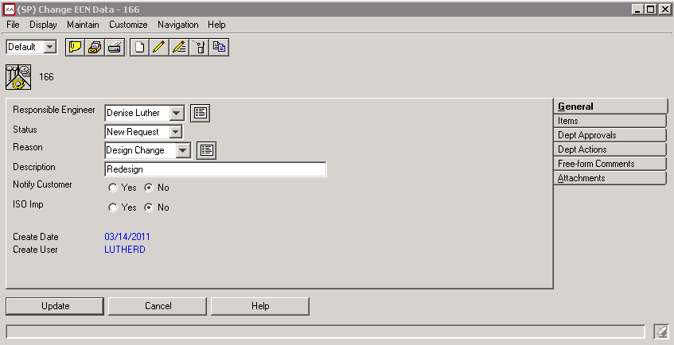
ECN - IDF
Card File
6
Notes:
6

Slide 7
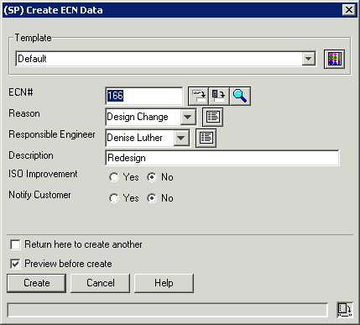
Create ECN - System-Assigned Keys
7
Notes:
7

Slide 8
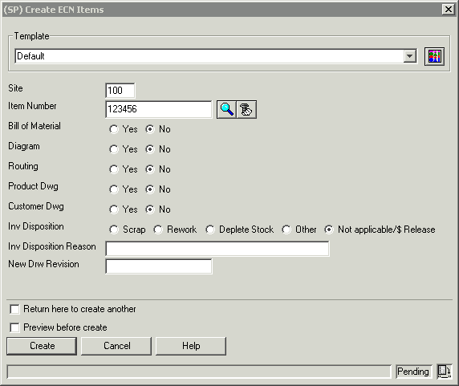
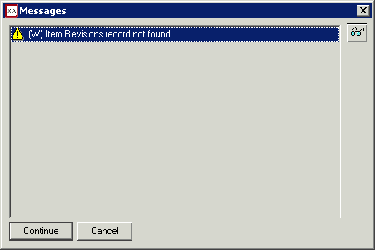
Create ECN Item – Referential Check Edit
Can be Hard or Warning error type
8
Notes:
8

Slide 9
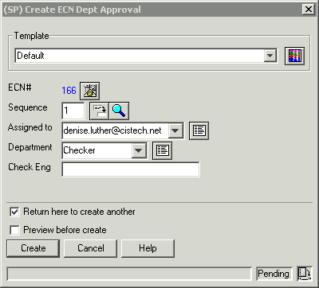
Create ECN Approval Step - Detail
Detail Relationship auto-sequence
9
Notes:
9

Slide 10
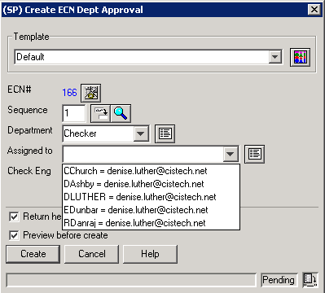
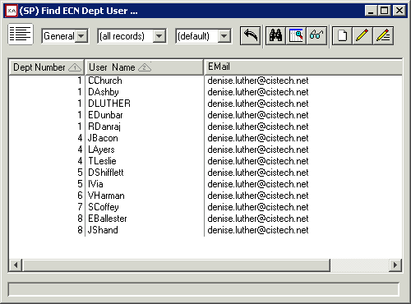
Create ECN Approval – Multi Key Code Files
Limits entry based on Department Selection
10
Notes:
10

Slide 11
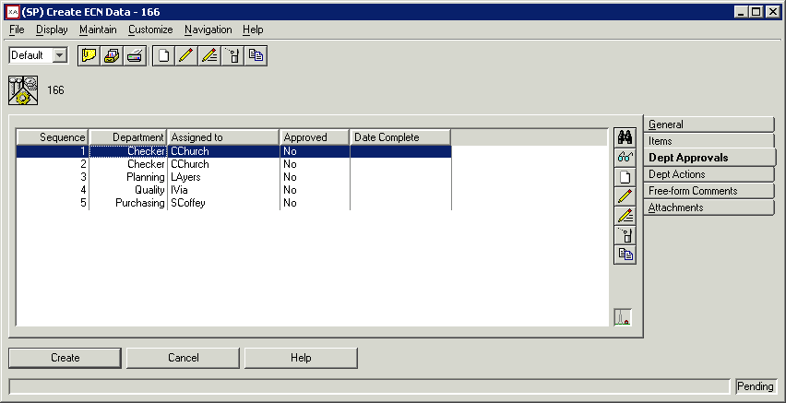
Create the ECN
Actions, Comments or Attachments ?
11
Notes:
11

Slide 12
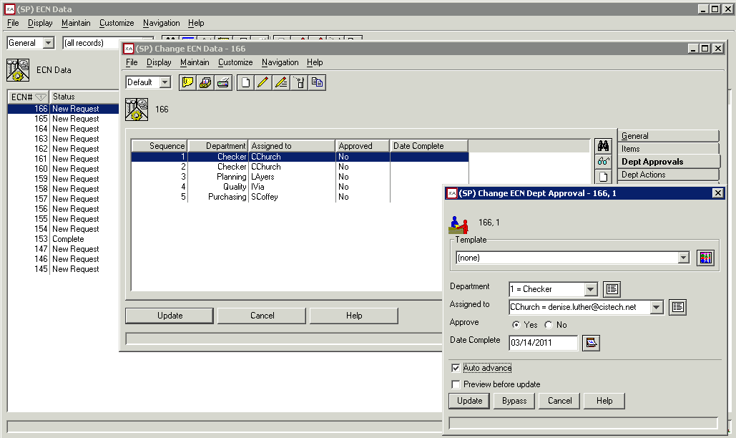
Approval Completion and Notification
Comments, Attachments or Create the ECN
12
Notes:
12

Slide 13
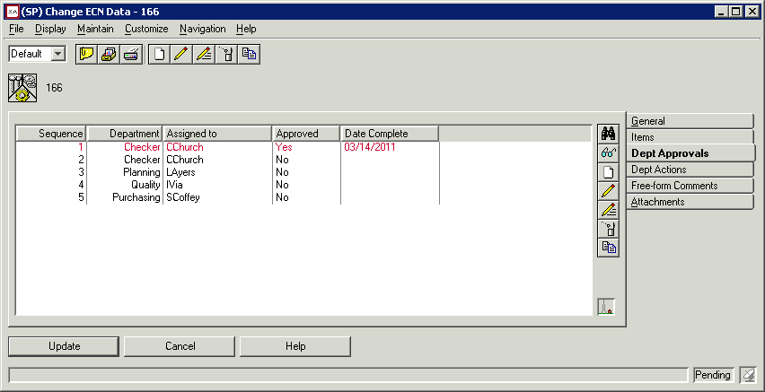
Approval Completion and Notification
Presentation Scheme - Red
13
Notes:
13

Slide 14
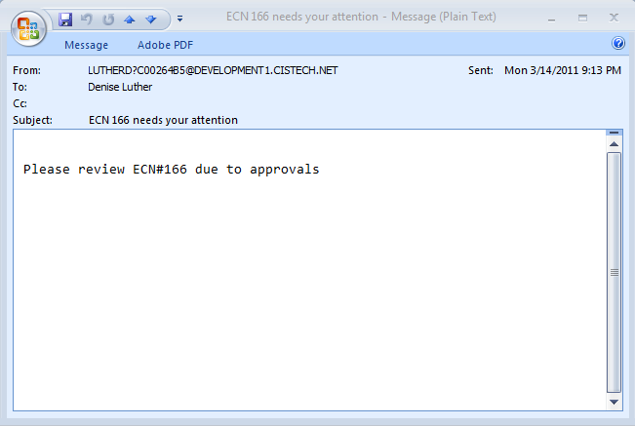
Publish Subscribe Notification
14
Notes:
14

Slide 15
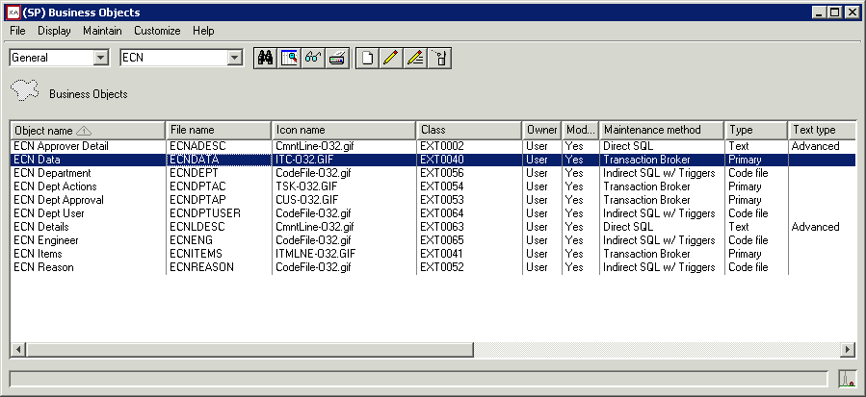
EI Business Objects
Transaction Broker Maintenance Method
15
Notes:
15

Slide 16
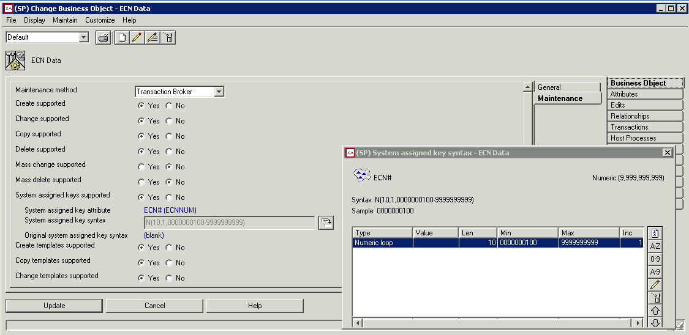
System assigned key setup
16
Notes:
16

Slide 17
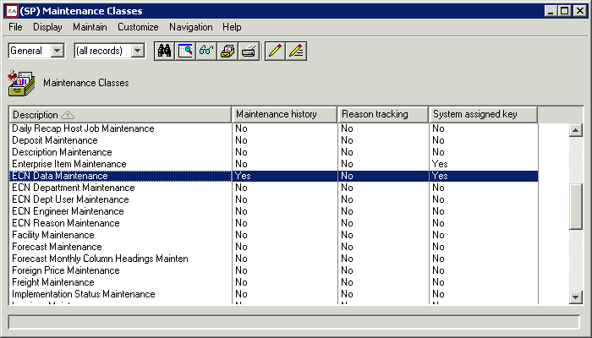
System assigned key setup
Cancelling the transaction will not lose the assigned key
17
Notes:
17

Slide 18
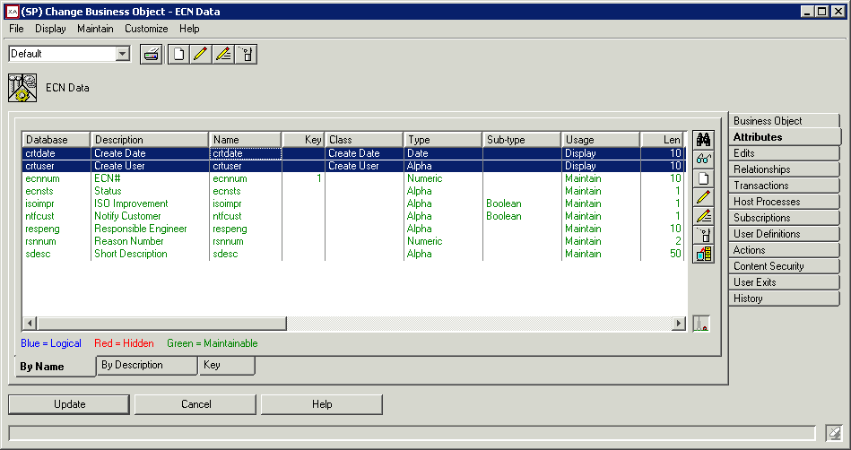
Automatic Date, Time User Stamps
18
Notes:
18

Slide 19
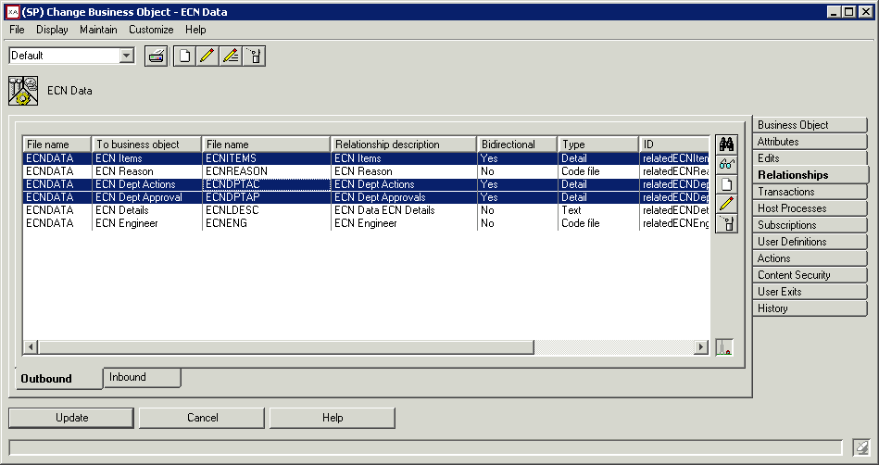
Detail relationship type
19
Notes:
19

Slide 20
Detail relationship type
Assigned key fields populates in details
Deleting Header deletes all related details
Access data in header buffer before commit to database
20
Notes:
20

Slide 21
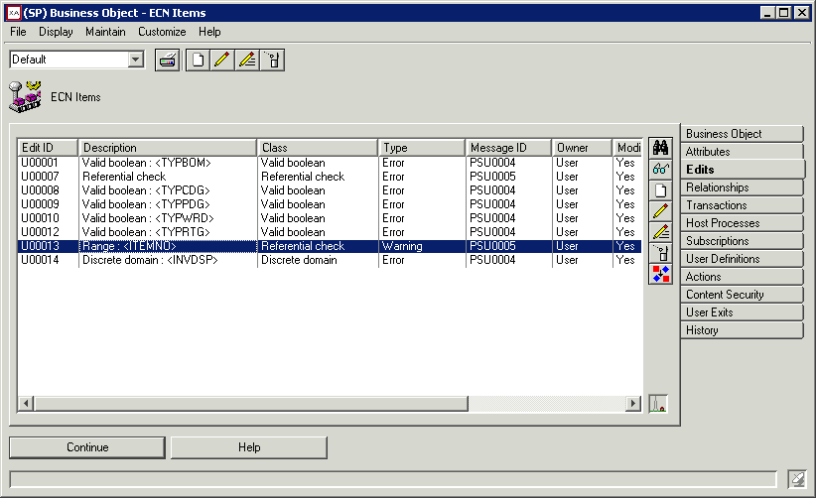
Referential check – edit class
21
Notes:
21

Slide 22
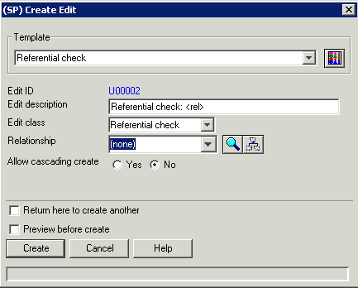
Referential check – edit class
Use the Referential check Template
Then select the relationship in the drop down
User exit code is auto generated
22
Notes:
22

Slide 23
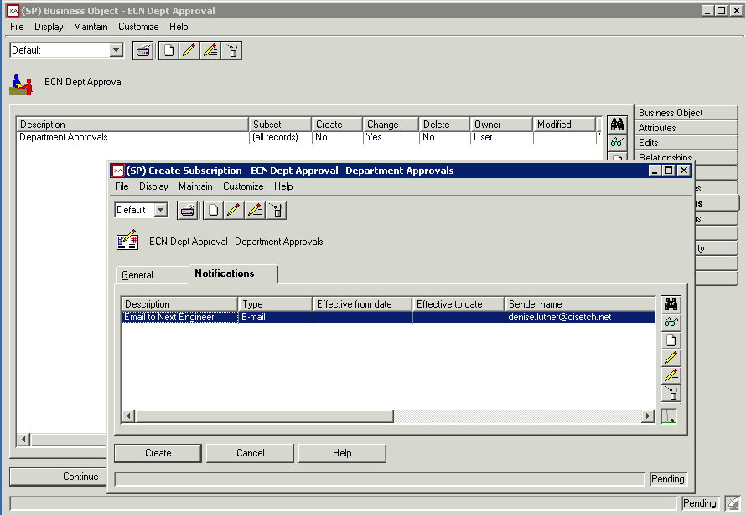
Publish/Subscribe for notifications
Use the Referential check Template
Then select the relationship in the drop down
User exit code is auto generated
23
Notes:
23

Slide 24
Publish/Subscribe for notifications
Also, Maintenance history must be on for the business object
24
Notes:
24

Slide 25
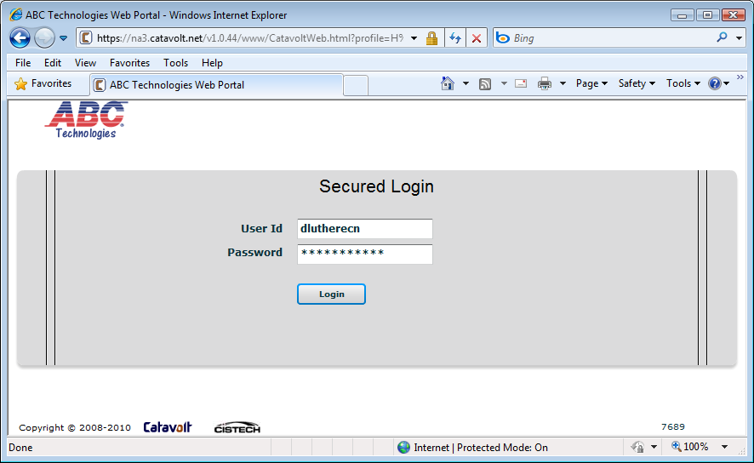
Approve from the web
25
Notes:
25

Slide 26
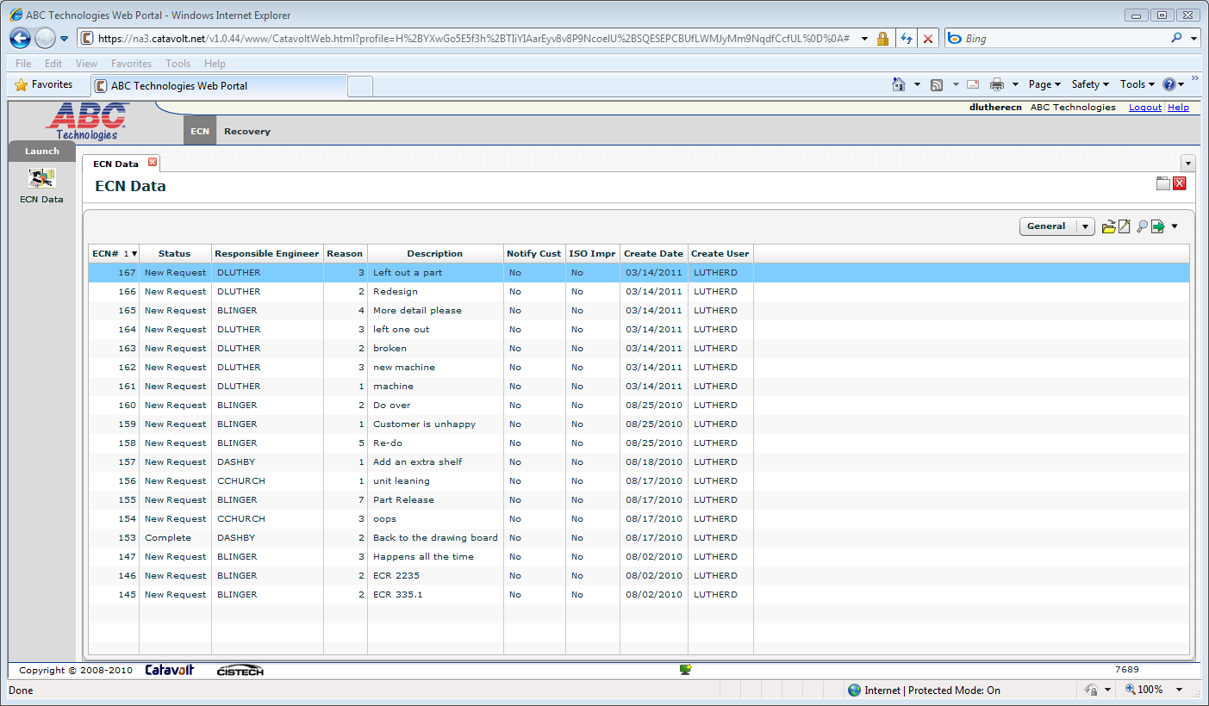
Approve from the web
26
Notes:
26

Slide 27
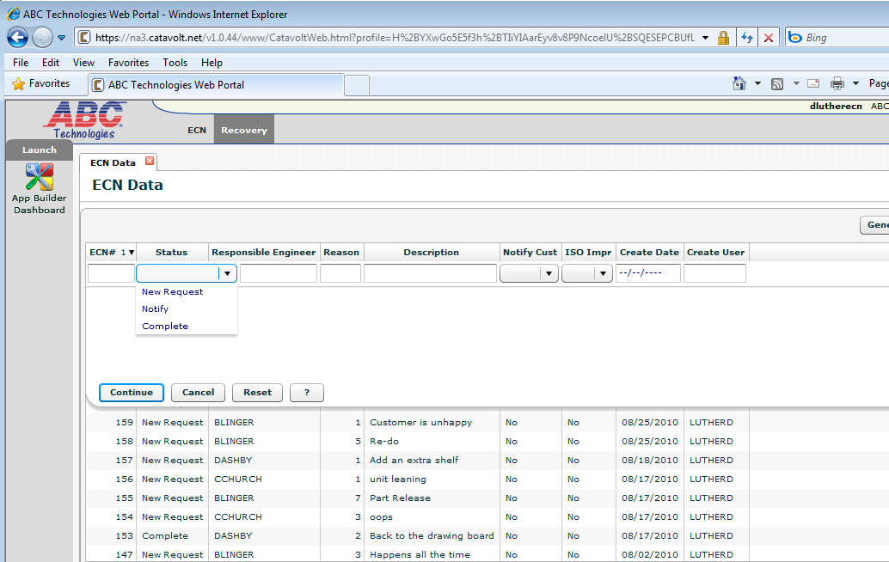
Approve from the web – only the open ones
27
Notes:
27

Slide 28
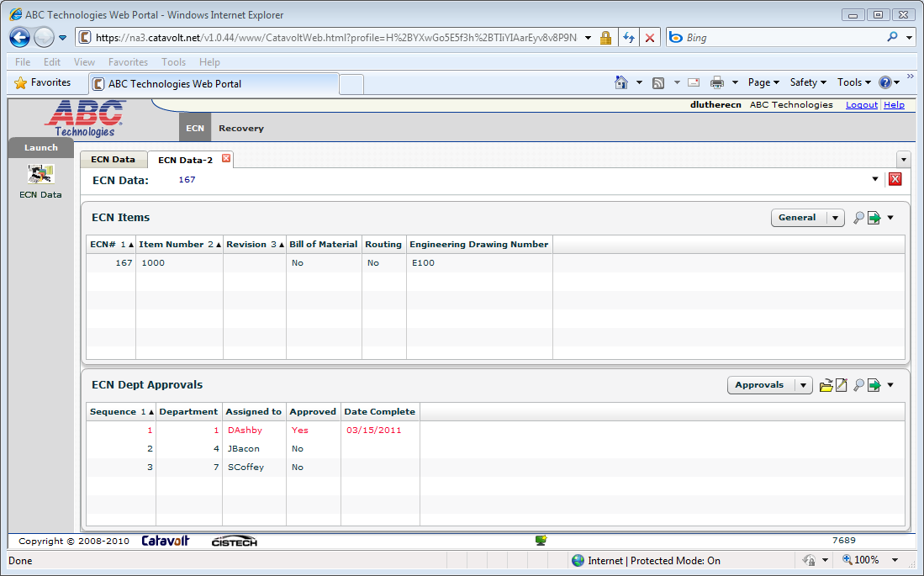
Approve from the web - details
Extender has presentation schemes
28
Notes:
28

Slide 29
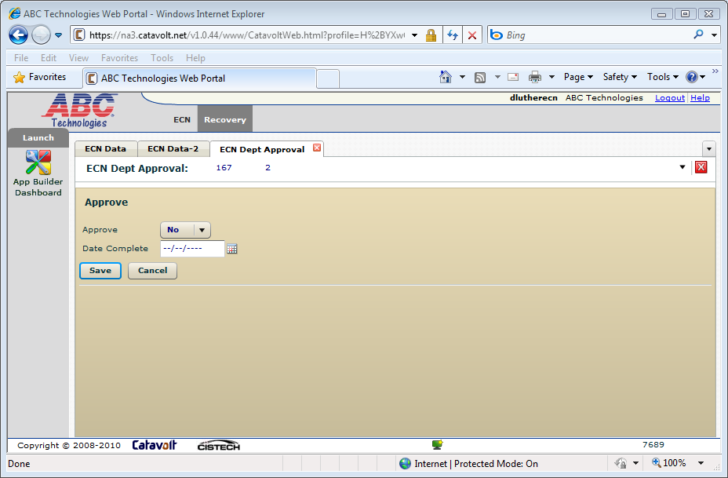
Approve from the web – do it here
29
Notes:
29

Slide 30
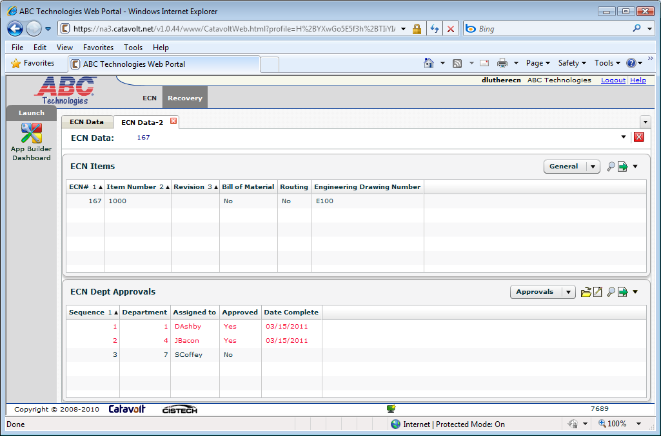
Approve from the web – all done
30
Notes:
30

Slide 31
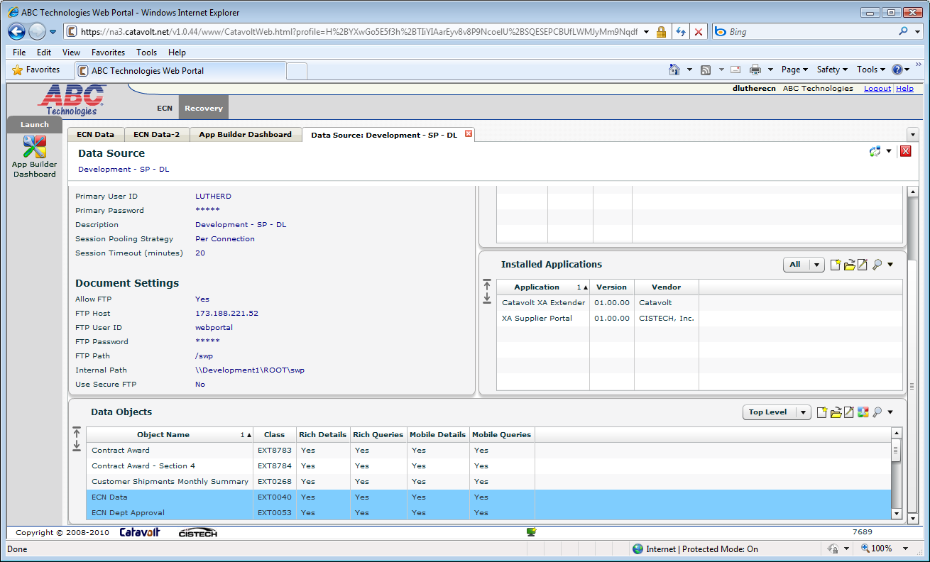
XAX – Sees EI objects
31
Notes:
31

Slide 32
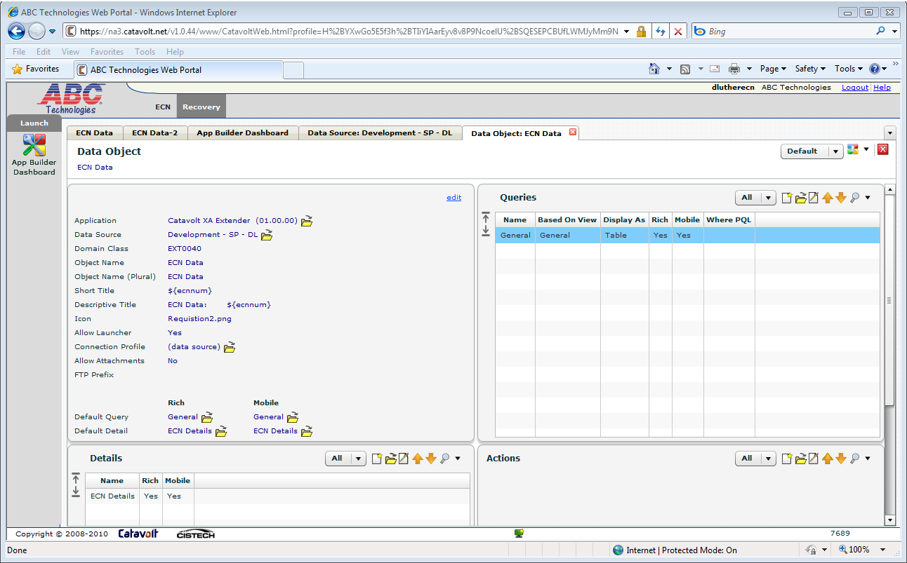
XAX – Also sees Views (queries)
32
Notes:
32

Slide 33
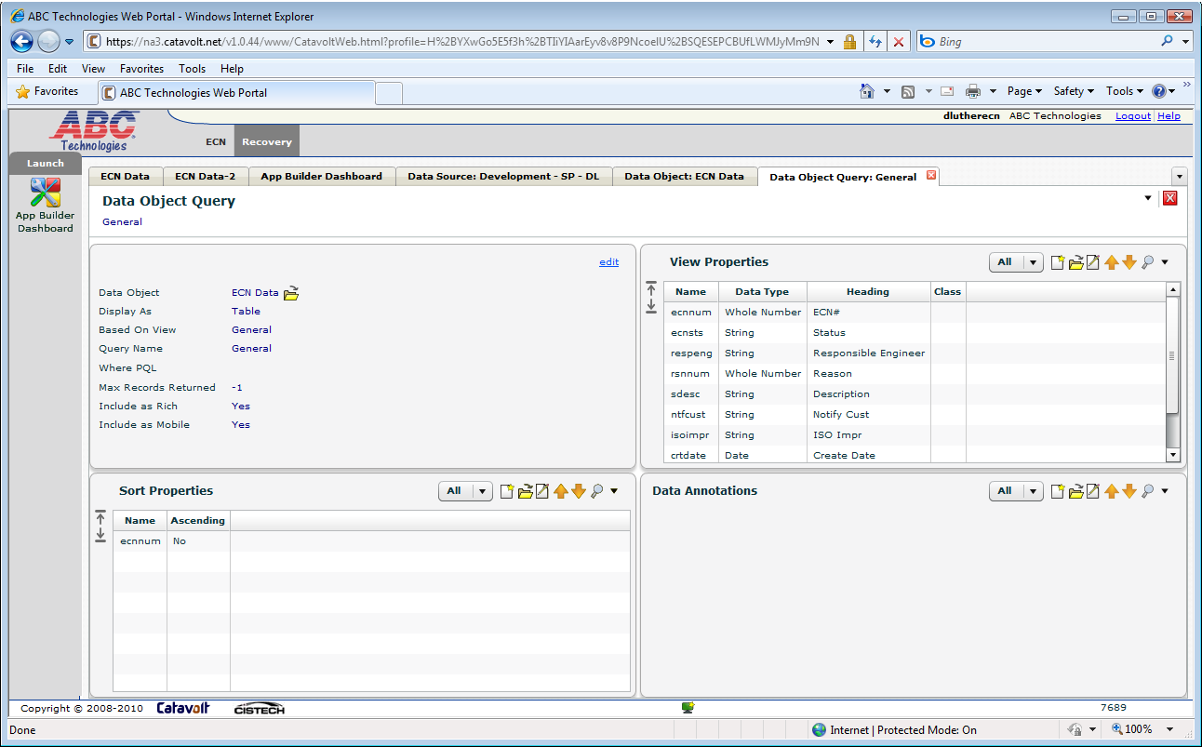
XAX – Customize the query
33
Notes:
33

Slide 34
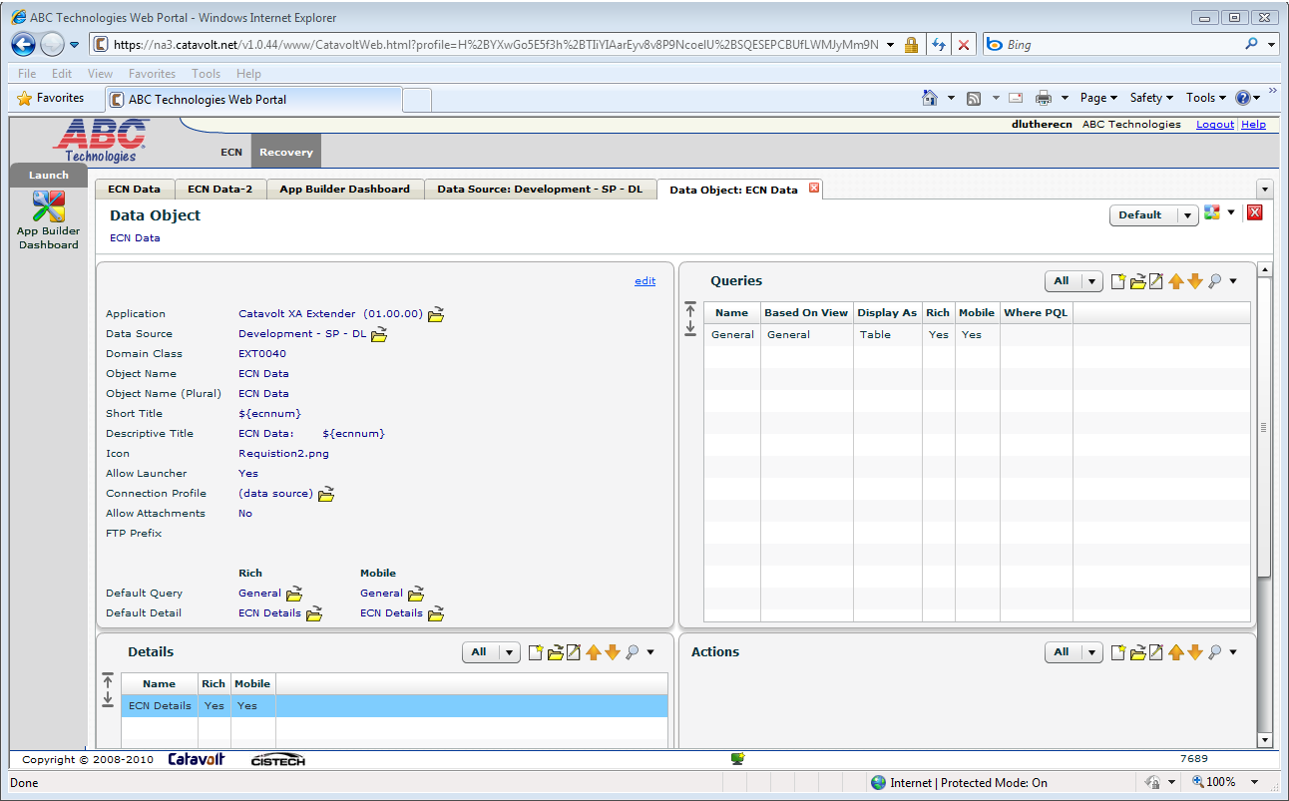
XAX – Define the details
34
Notes:
34

Slide 35
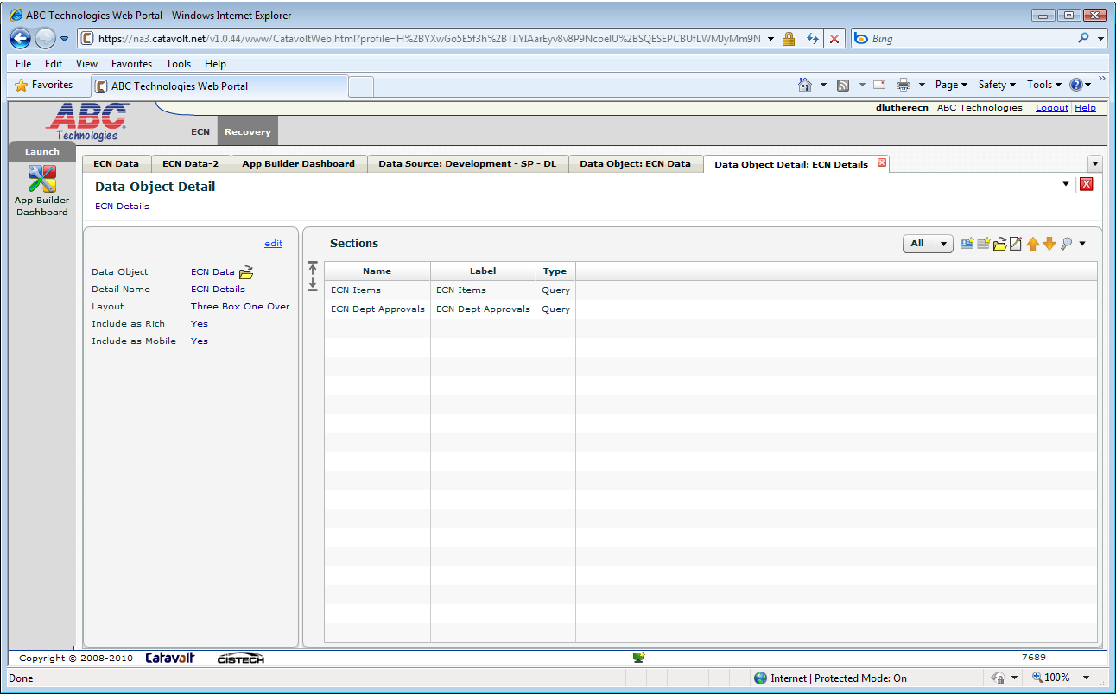
XAX – 1 Detail – 2 Sections
35
Notes:
35

Slide 36
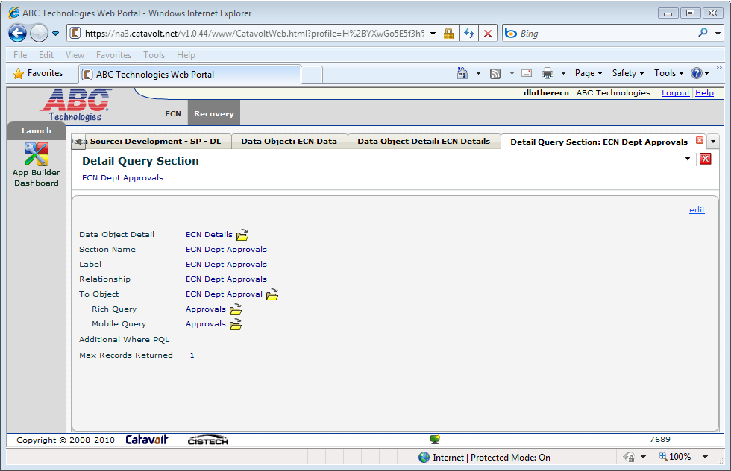
XAX – Approval Section
Find it by the EI relationship
36
Notes:
36

Slide 37
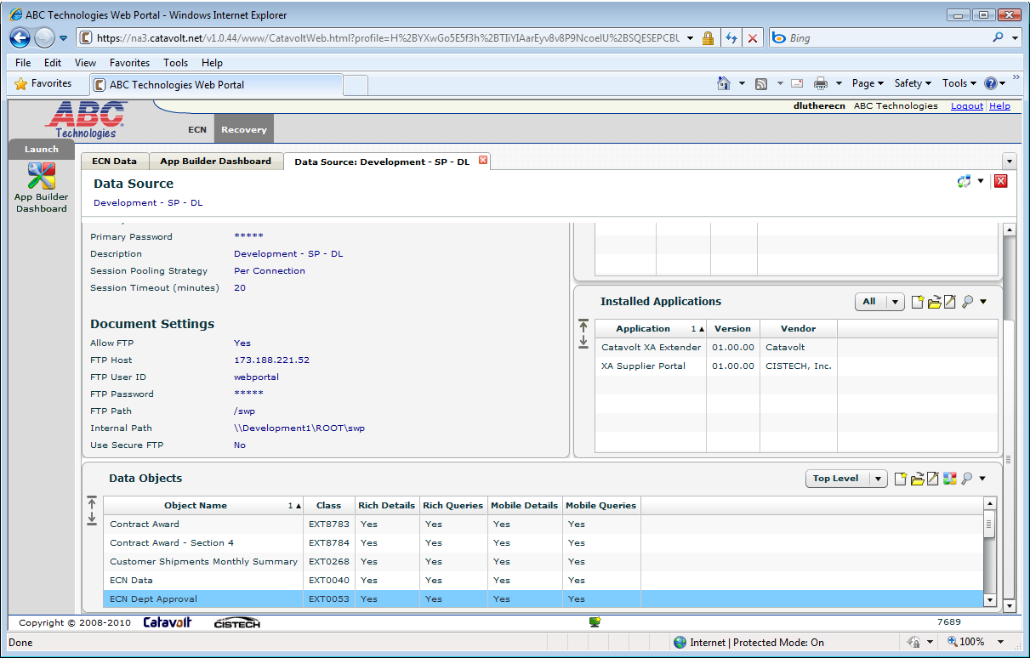
XAX – Approval Object
37
Notes:
37

Slide 38
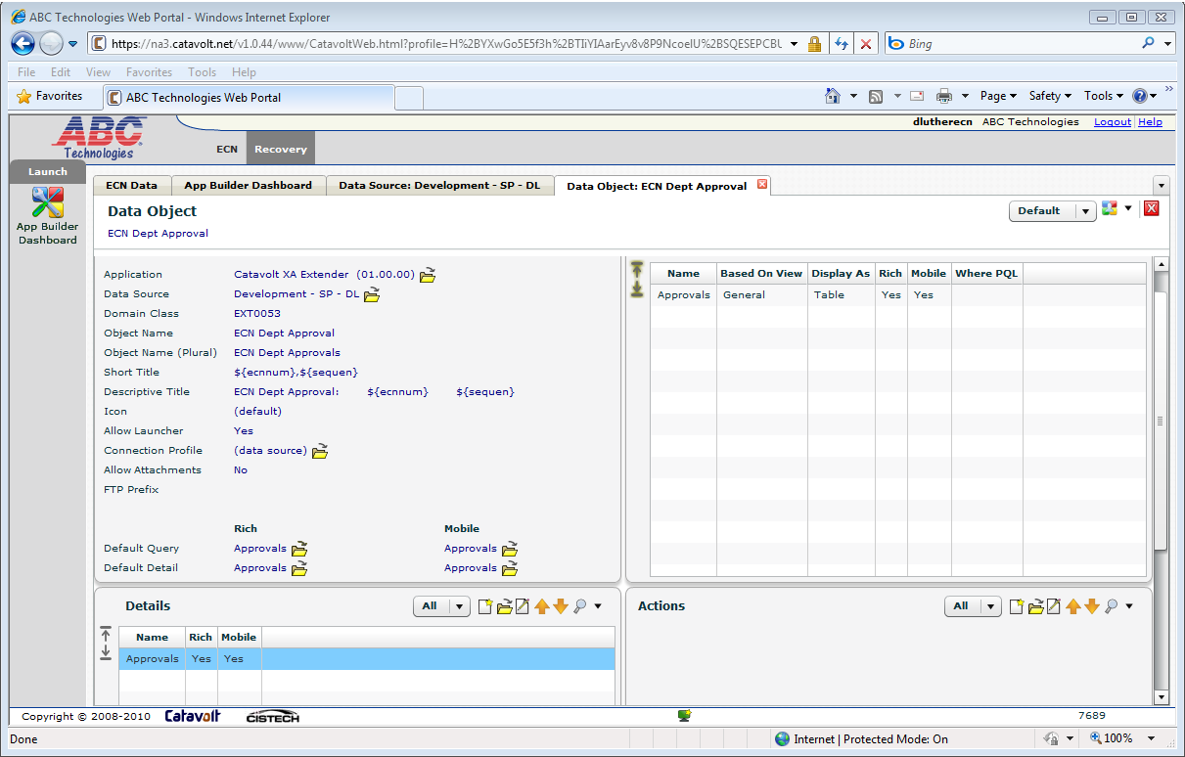
XAX – Approval Object details
Need to approve from here
38
Notes:
38

Slide 39
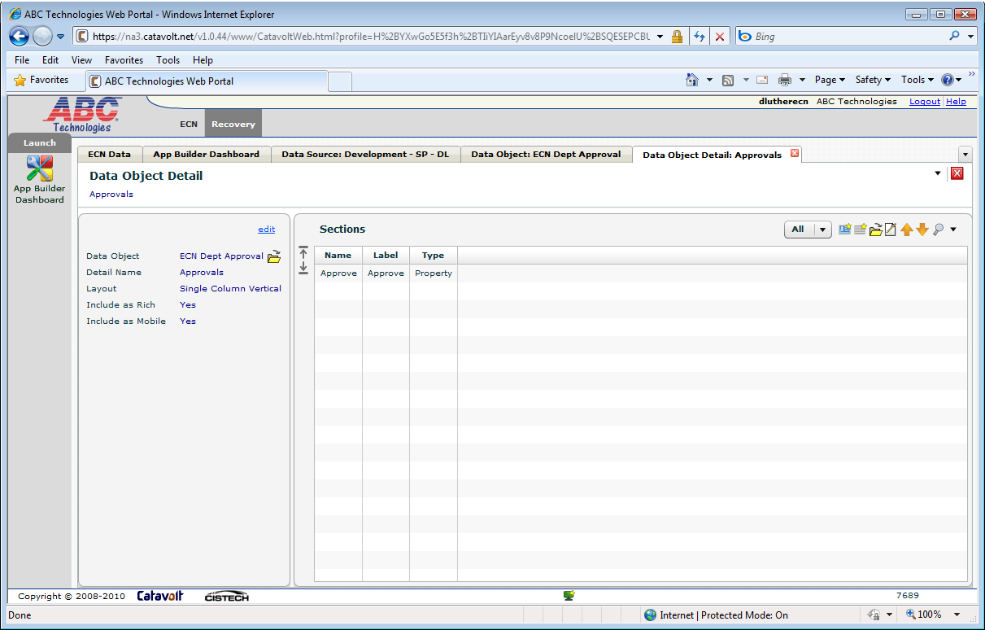
XAX – Approval Object details
Create Maintainable Property Section
39
Notes:
39

Slide 40
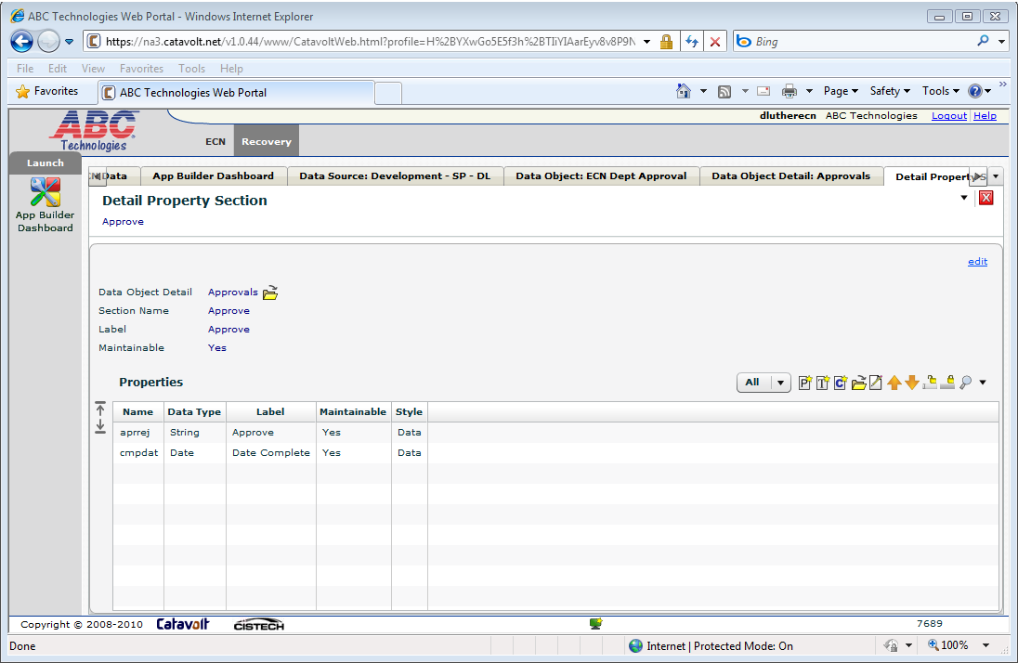
XAX – Approval Object details
I only want to update approval switch and date
40
Notes:
40

Slide 41
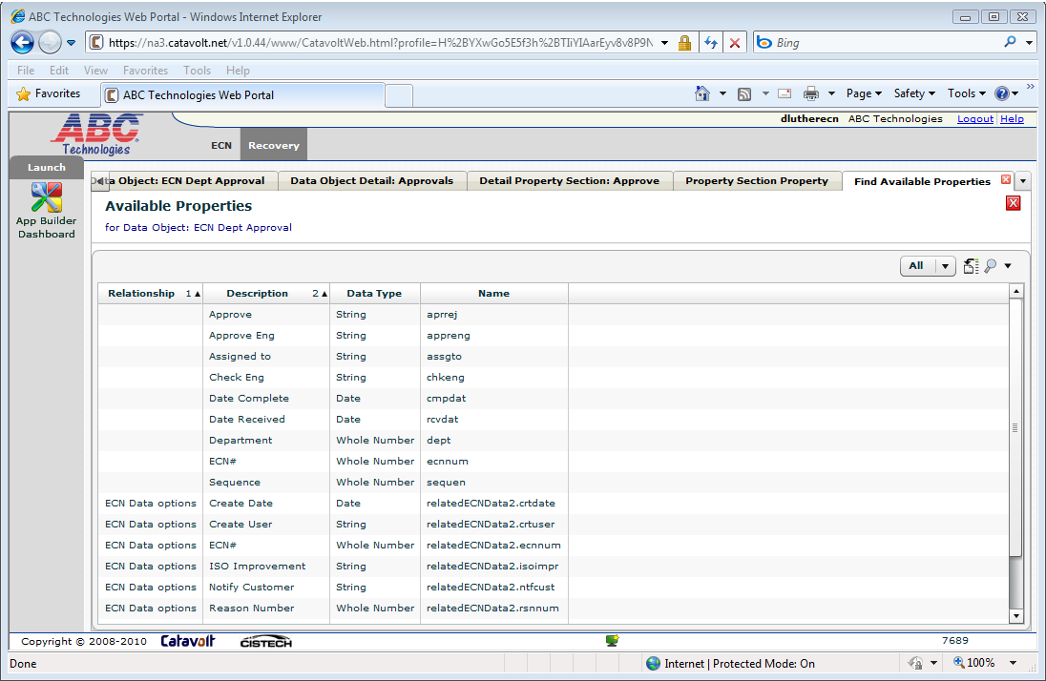
XAX – Approval Object details
XAX lets you search for the attributes – name contains…
41
Notes:
41

Slide 42
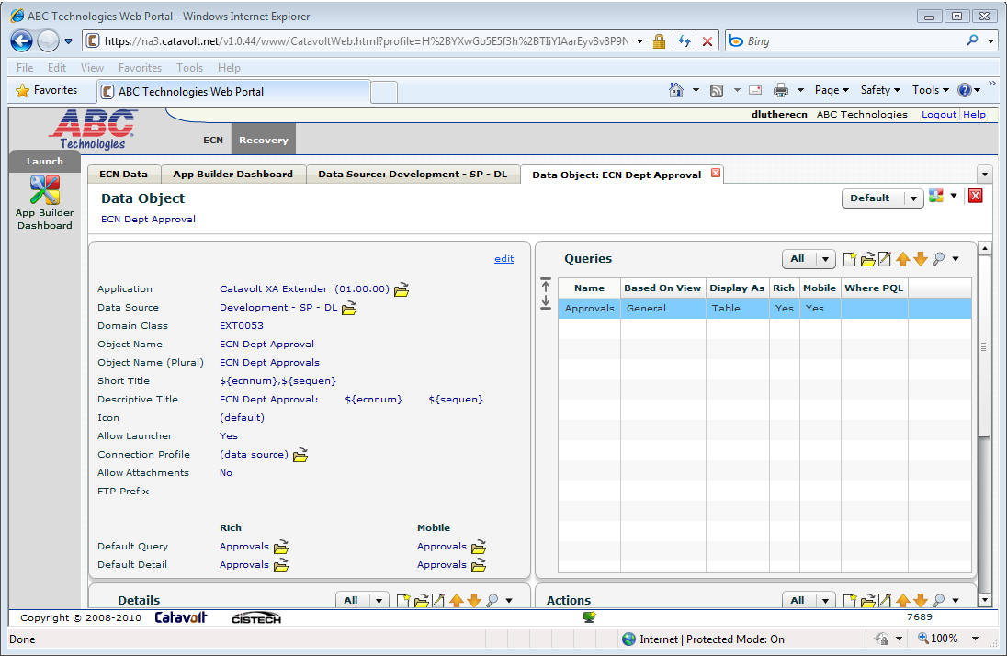
XAX – ECN gadgets and mobile
Define the mobile queries and details
42
Notes:
42

Slide 43
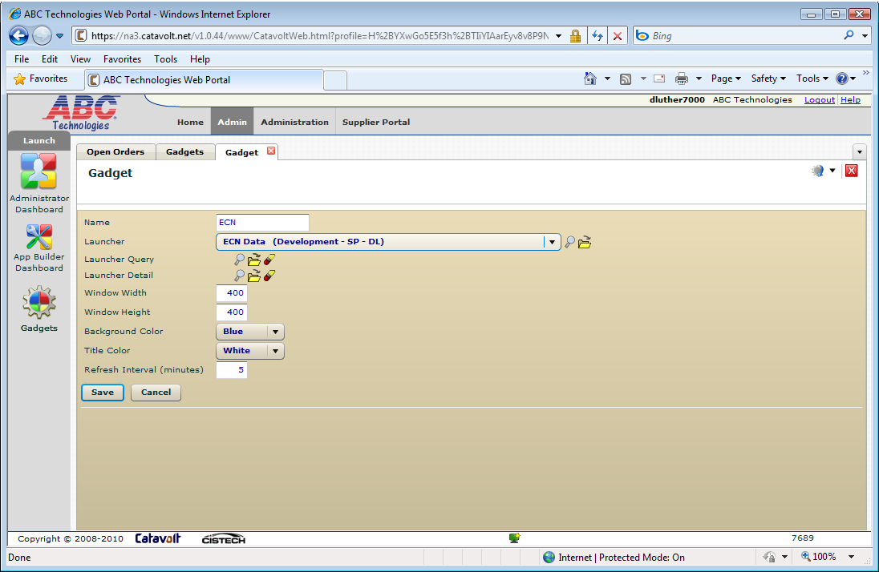
XAX – ECN gadgets and mobile
Create the gadget
43
Notes:
43

Slide 44
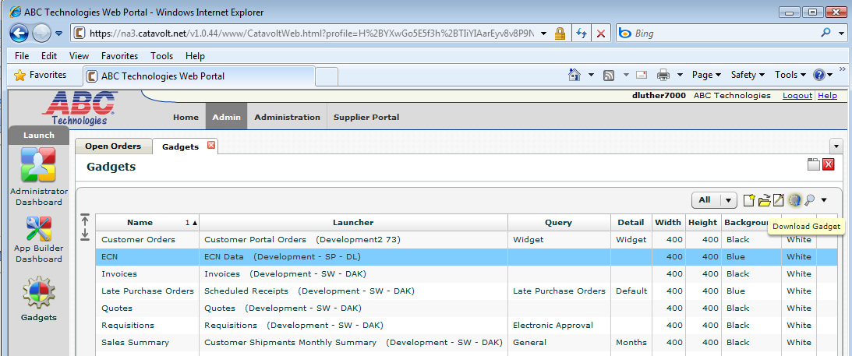
XAX – ECN gadgets and mobile
Download the gadget and install
44
Notes:
44

Slide 45
EI and XAX
Very little RPG programming – used for custom logic in the business object user exits:
Edits
Data default
During Update database – this application updates the ECN status after all actions have been completed.
No Display or Report File design and programming
XAX – no system-link in example shown
45
Notes:
45

Slide 46
QUESTIONS??

