Slide 1
XA Environment
Archive and Purge Strategy
Optimize your XA environment!
Belinda Daub
CISTECH Sr. Technical Consultant
belinda.daub@cistech.net
Ben McCormick
CISTECH General Manager
ben.mccormick@cistech.net

Slide 2
Today’s Agenda
XA Environment Housekeeping
Cleanup for Common Applications
IFM Archive Concepts
Tips and Techniques
Q & A

Slide 3
CISTECH’s Data Cleanup Offering
iSeries custom file analysis using Upgrade Assistant tool
Review system for common large files
Purge planning sessions and documentation
Purge testing and review
Execution and documentation of future housekeeping strategies
Enhancement Tools:
  Upgrade Assistant
  Enhanced IFM Archive tools
Typical engagement is 5-10 days

Slide 4
XA Environment Housekeeping Benefits
Why is regular cleanup important?
Optimize your XA environment
  Huge files slow down access to data
  PowerLink response can be unacceptable
  Can negatively impact all users on the system
Prevent data corruption
  Errors responded with ‘C’ or ‘D’ and records not written
  Corruption can be significant if not recognized immediately
Disk utilization is approaching limits
  No slots available to upgrade
  Don’t want to buy additional hardware
Backup downtime is exceeding your available window
Notes:
IMHIST logical access paths can grow significantly larger than the file itself. You should watch these and if you are getting close to the maximum default of *MAX4GB, consider purging the file or increase the logical file to *MAX1TB

Slide 5
XA Environment Housekeeping
Typical Environment:
MAPICS Backup runs daily and cleans up transaction and work files
ERP Files are reorganized regularly
IMHIST archived when it gets too large
IFM files are extremely large
Organization won’t release old years for removal because they may need access to the data
Custom files are not addressed by any cleanup

Slide 6
XA Environment Housekeeping
XA Data Cleanup Terminology
Archive
  saves records to a separate ‘archive’ image before removing the data from the master files
  often provides inquiry and reporting to data (not always)
Purge
  removes selected records from the files
  saving the data is optional or not provided
  inquiry typically not provided (some exceptions)
Reorganize (Reorg)
  recovers space from deleted records in physical files and makes it available for other applications

Slide 7
XA Environment Housekeeping
XA Archive Functions
Archive data to tape
  Moves selected records to archive file and saves to tape
  Optionally delete records from the archive file after save
Delete archived records
  If not deleted during archive option
Restore archive records from tape
View Archived data (if on system)
  Access archive groups if associated tape is still available
Delete Control record
  When the tape is cycled for reuse
  Archived records for the group must be deleted first
Notes:
A note regarding tapes – MAPICS archive and restore procedures often require the media be initialized to a specific volume id in order to be recognized by the application. You will need to use more than a single tape to use the archive capabilities.

Slide 8
Cleanup for Common Applications
COM
  Order Shipments - archive
  Quotes – manual
IM
  Transaction History – purge with save/restore
  LIFO/FIFO transactions – purge only
Finance - GA
  AP/AR and journal History – archive
  Payroll History – archive
PUR
  PO History - archive
Materials
  Purchase Planning Schedules - purge
  Manufacturing Order History – archive
Others
  EC – ISL – Workflow - CAS

Slide 9
Cleanup for Common Applications
COM Order Shipment History - Archive
  Follows basic archive process
  Dedicated mode NOT required
    Can affect response time if run during peak activity
  Interactive Job (PTF allows batch)
  Prereq’s
    Order must be fully shipped and each shipment of the order must be invoiced
    Invoices for the order must be printed
    Consolidated invoices – all orders must be invoiced complete
Notes:
Most cleanup routines have prerequisites or criteria that must be met before data can be available for purge. Be sure to check the user guides or request information from Infor Support prior to working with an application archive.

Slide 10
Cleanup for Common Applications
Inventory Transaction History - Purge
  Purge
    Options to save purged transactions and reorg files after purge
    Dedicated mode recommended (required for reorg)
    Interactive Job
  Restore Transaction History
    Restored to separate history file (add or replace)
    Select from save image from control file
    Transactions will appear in inquiries and reports
  Delete Restored Transaction History
Wait to specify tape drive before leaving the job to run.
Purge in increments rather than one large selection
Make sure you have sufficient disk space or your system will crash!!!

Slide 11
Cleanup for Common Applications
Client (Browser / Power Link)
  Maintenance Header and Detail
    On the MAPICS or SYSTEMS tab
    Select Subset and delete
  Transaction Status, Data, and Task Message
    Set transaction purge days in Application Settings for CAS
    Start the PDMPlus Ujob PSVTUP

Slide 12
Cleanup for Common Applications
Where to begin?
  Review user guides for installed applications
  Request and apply latest fixes for each application
  Define a strategy
    What will be archived
    When
    How often
    How much will be available in archive history
    How long will it be retained
  Document Procedures

Slide 13
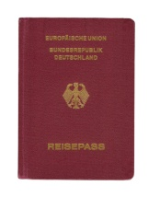
Cleanup for Common Applications
Get help if you are short-staffed
Archive Planning Assistance
  to help to get your annual strategy moving
  Identify cleanup activities for each installed application
  Basic training for IT personnel
  Sample documents you can customize
    Annual Archive Plan document
    Archive/purge procedures
Archive assistance
  to help you get it all done

Slide 14
IFM Archive Concepts

Slide 15
IFM Archive Concepts
ENTDTA
NARDTL
Archive Procedures
10 shipped with IFM
Perform specific functions
Made of one or more phases
CPYDTA
TRNARC
FLDHDG
PRSACC
TRNCUR
RPTGEN
AUDSTM
FLGTRN
Submit to batch w/option to delay or hold
Must be run in sequence
Made up of one or more actions
PAYLST
DLTOBS
RGZDTA
PRTLST
CPYDTA1-5
Call programs to remove data, print lists and reorganize files
Configure parameters needed to run each phase
Library
Division
Period

Slide 16
IFM Archive Concepts
Archive procedures carry out 3 core activities:
  Create an image of IFM data from the live environment
  Purge all but oldest year from the image and save it to tape
  Purge oldest information from live environment
Very time-consuming, especially for large companies with many environments
No restore or inquiry capabilities after removal

Slide 17
IFM Archive Concepts
1. CPYDTA Procedure – Roll IFM Files to Work Library
5 Phases
Live data
AMFLIBy
Dedicated IFM required
Runs a long time
Nothing is changed
CPYDTA5
Son
2yrs ago
CPYDTA4
Father
3 yrs ago
CPYDTA3
Grandfather
4 yrs ago
By the book
CYPDTA2
GrtGrdfather
5 yrs ago
Downtime is #1 complaint
CPYDTA1
GrtGrtGrdfthr
6 yrs ago
Notes:
CPYDTA5 copies IFM data base, one file at a time, from production to the work library.
Can run 10 hours or more depending on your system resources and the size of the files.
Just a preparatory step – you get nothing for this time…

Slide 18
IFM Archive Concepts
Enhanced CPYDTA
Move IFM Files to Single Work Library
Enhancement to IFM programs
Dedicated mode not required
Copy from restored image
More efficient – runs very fast
Previous years consolidated to single history library
Live data
AMFLIBy
MAPICSbackup
1 Phase
IMAGE
AMFLIBcpy
A better Approach!
CPYDTA5
ARCLIB
Work Library
NO Downtime!!!
Notes:
Don’t use the live environment to create your archive image.
Since all current data will be removed from it anyway, use a recent backup. It has everything you need, and with our enhancements, you can cut the time from 10 hours or more to less than 1. And the users never have to get off the system.
IMPORTANT: make sure you are not already at capacity for disk arm utilization. If so, you should run during hours when there is less disk activity.

Slide 19
Archive Process
2. TRNARC Procedure – Delete Transactions from Archive Library
  Dedicated mode not required
  Run this procedure for each financial division
  Three archive phases used to isolate selected year in each image (son, father, grandfather, etc.)
    Delete everything prior to the desired year
    Delete everything after the desired year
  Cannot delete live data until archive is complete
1999 - 2001
2002
2003+

Slide 20
Archive Process
Streamlined TRNARC
Delete Transactions from Archive Library
  Purge old data from live first to receive immediate benefits
  Use a test environment to separate data for each year at your own pace
  Save the archive image to be used for separating years
  Copy archived data to history library for inquiry purposes before removing the archive library to tape
MAPICSbackup
Test Env
AMFLIBy
ARCLIB
Work Library
IFM History

Slide 21
Archive Process
TRNCUR – archive transactions (live library)
  Deletes old records from the live library
  Dedicated mode not required
  Run once for each financial division
  Four archive phases:
    Flag transactions that meet criteria and prerequisites
    Print transactions for review and resolution
    Delete records
    Reorganize files
  Common problem – why is data for selected division and period still in the environment after the archive?
  Run a second time to remove interdivisional transfer transactions
  Review the prerequisites for each procedure component

Slide 22
Archive Process
PAYLST – archive Payment Lists
PRSACC – archive Personal Accounts
ENTDTA – archive Entities
  To be eligible for deletion, records must
    not be referenced by any previously archived components
    be flagged as Record Status ‘3’ (please archive)

Slide 23
Archive Process
RPTGEN – archive report generator
  must be flagged with Record Status ‘3’ (please archive)
FLDHDG – archive field headings
NARDTL – archive narrative
  Check to see if you are using these features and skip the archive step if you are not

Slide 24
Archive Process
AUDSTM – archive audit stamps
  Delete unused audit stamps from the live library
  Two archive phases
    delete audit stamps associated with records that have been archived
    reorganizes the file
  Dedicated IFM environment is required
  Exit IFM to release the lock on the Audit Stamp file
    Submit the jobs on hold
    Exit IFM
    Release the jobs to run

Slide 25
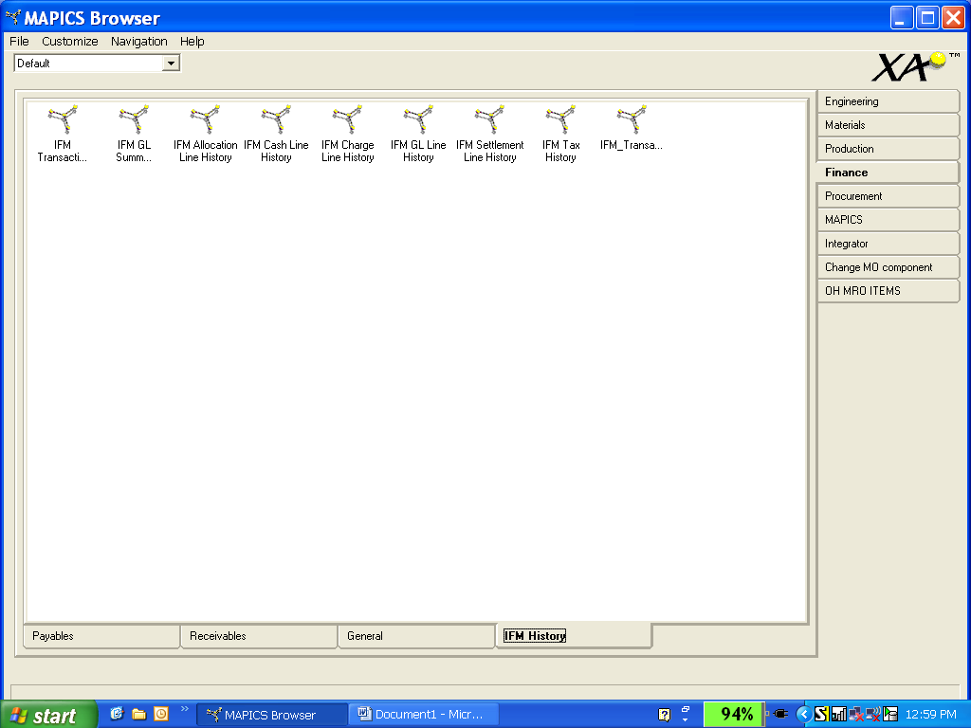
Viewing Historical Data

Slide 26
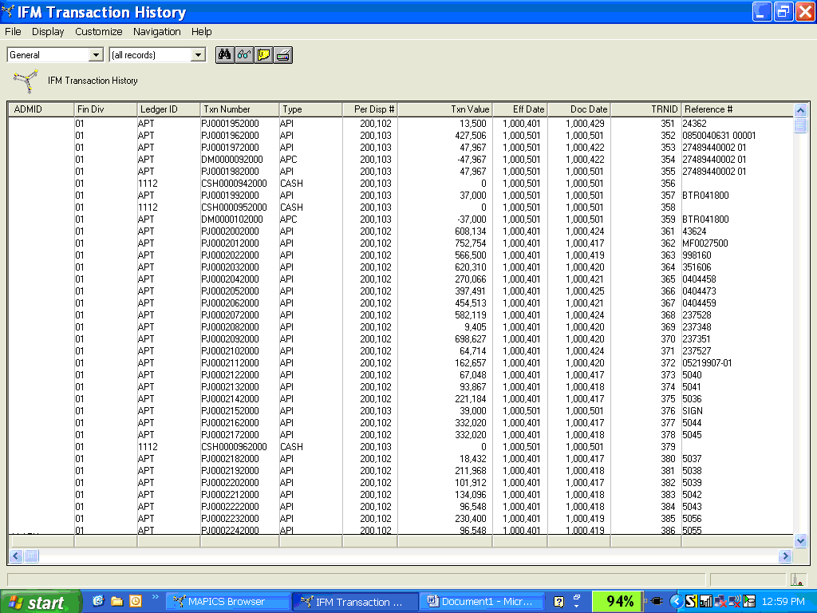
Viewing Historical Data

Slide 27
Tips and Techniques
Archive in smaller increments
  If you are low on disk space
  If you have small downtime window
Apply latest fixes for the release level prior to running archive process
Review Archive information in User Guides for each application
Check with Infor to see if there are individual fixes required for the applications you will purge/archive
Refresh your test environment and experiment if you have not run the process before
  Familiarize yourself with the procedure
  Establish benchmarks to help planning and scheduling in live

Slide 28

IFM Resources
Get help if you want to get started quickly
  Define your archive strategy
  Implement tools to help with IFM Archive
    minimize downtime using simplified strategy and application enhancements
    Streamline process to complete live archive quickly
  Training for IT personnel
  Assistance in ensuring successful purge of old data
  Templates for documented procedures and data flow

Slide 29
XA Data Cleanup
THANK YOU!
Ben McCormick
704-814-0016
Ben.mccormick@cistech.net

