Slide 1
XA R9 INVENTORY
TRANSACTION PROCESSING
Managing the “Ins” and “Outs” of Inventory
CISTECH Tuesday Education Session Series
Rod Fortson, Sr.
Sr. XA Consultant
404-434-6645
Rod.Fortson@CISTECH.net

Slide 2
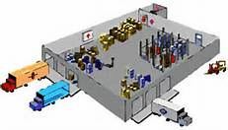
TRANSACTION PROCESSING AGENDA
1) What’s new at Release 9 in IM and MM
2) XA Transaction Processing
Receipt Transactions – The “In’s of Inventory”
Movement of your Inventory
Issue Transactions – The “Out’s of Inventory”
Costing and Adjustment Transactions
3) GLI – Integrate it all to your General Ledgers

Slide 3
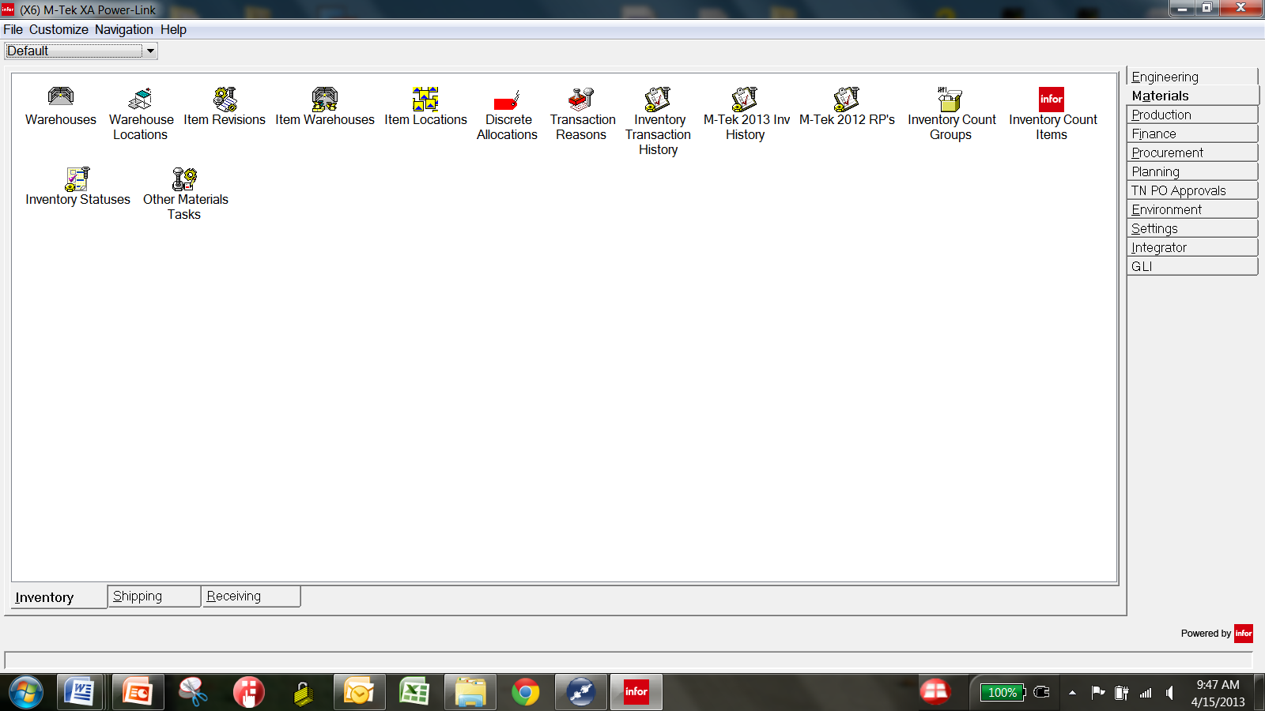
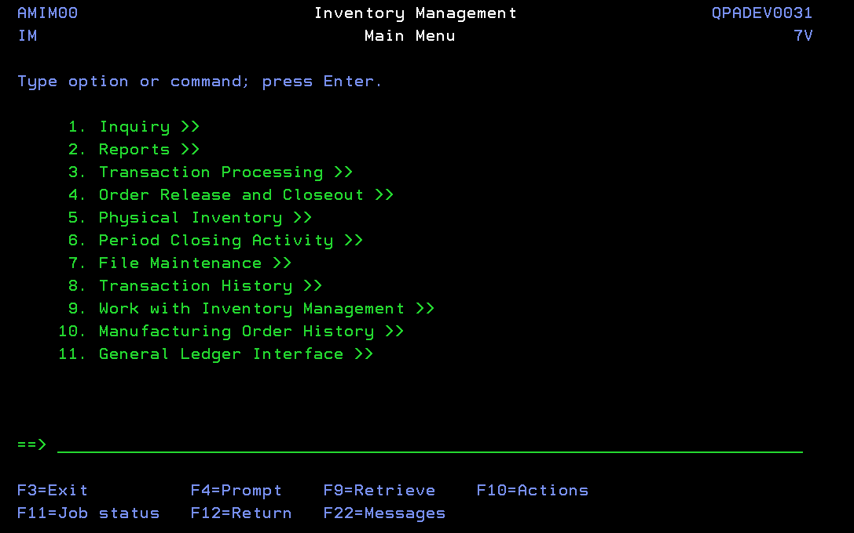
What’s new at R9 – Inventory Transactions
IDF L1
At R9 ….all Inventory Transactions can be accessed from Power Link Cards, using a
combination of Power Link and IDF Level 1 transactions.
Good Bye ….Finally !!

Slide 4
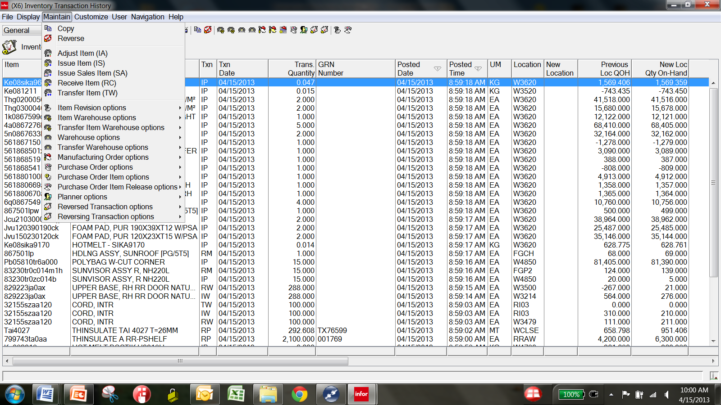
R9 – Power Link Transaction processing
Copy and Reverse also now available for those Transactions. Only for the Transactions you perform from Transaction History Object.
5 Transactions can now be processed from Inventory Transaction History Object in Power Link.

Slide 5
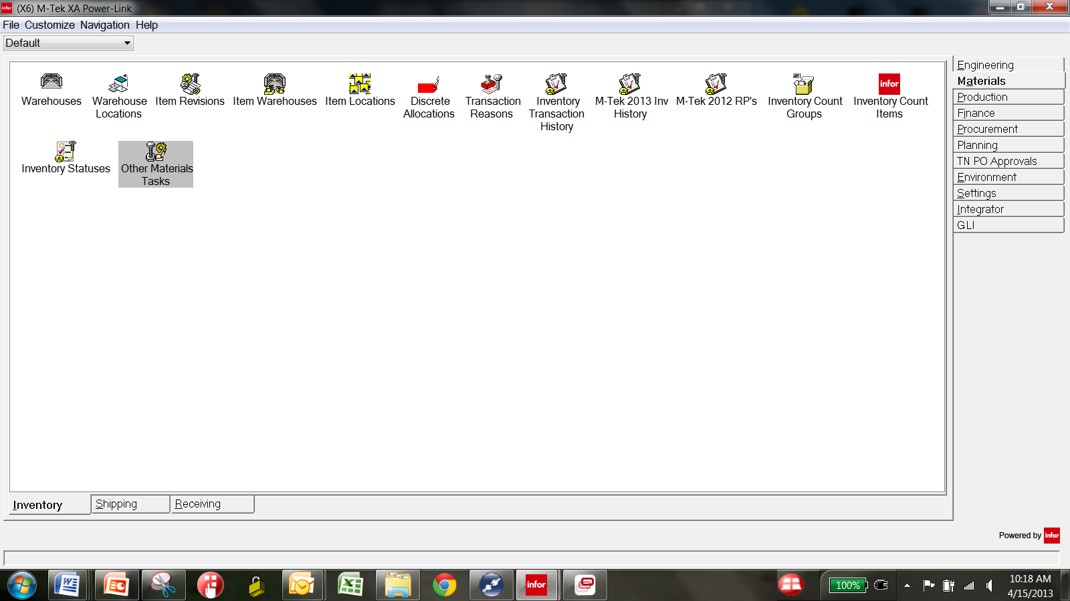
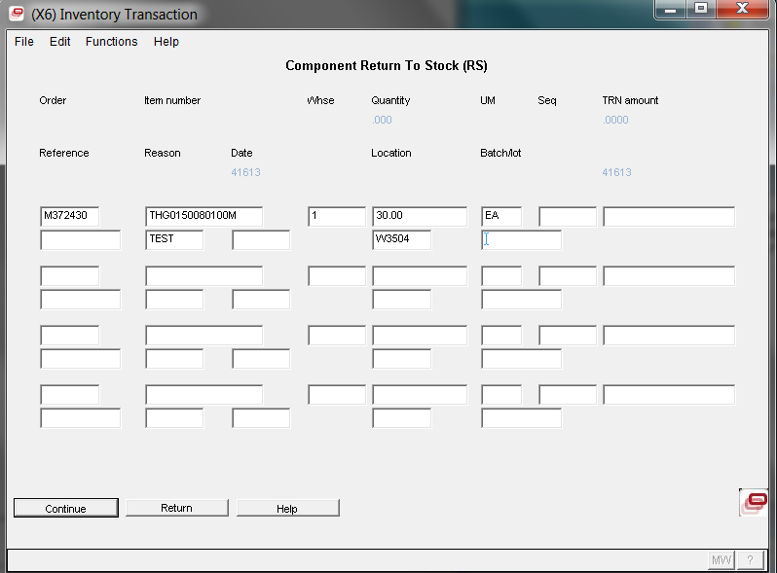
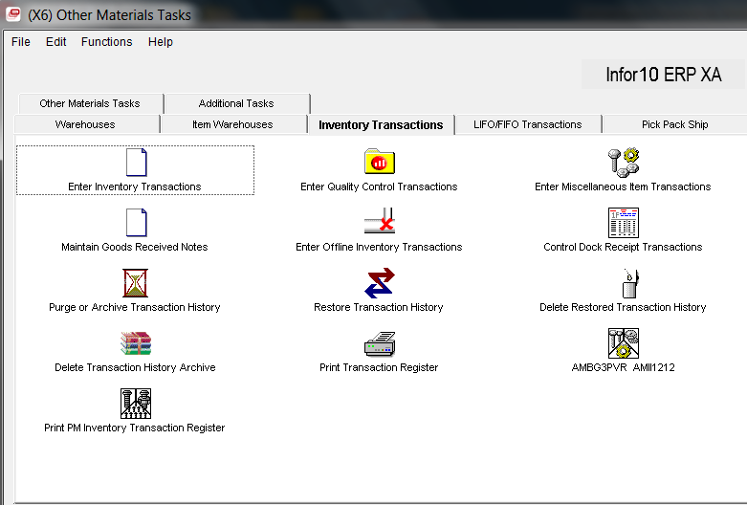
R9 – IDF Level 1 from Power Link Card
What is IDF Level ?
Graphical representation of green screen transaction…..same Transaction Screens and Format.
Improvements are on the way…..

Slide 6
R9 – IDF Level 1 from Power Link Card

Slide 7
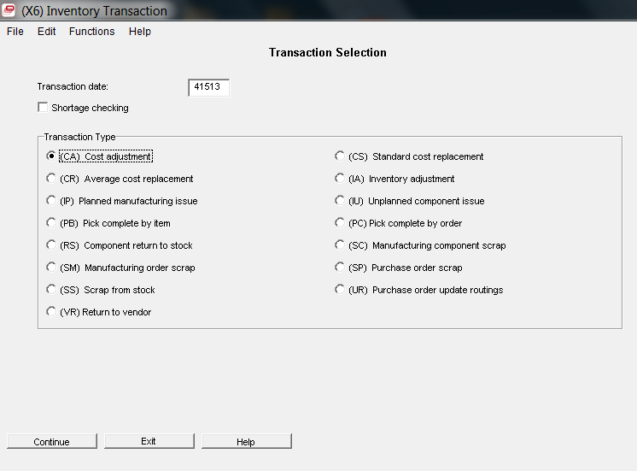
R9 Other Tasks – Transaction Processing
No RM !
No RP !
No RC !
No IS !
No TW !
No SA !
Most all Transactions that users perform are accessible from MM, OBPM, PM, and the Inventory Transaction History Object
These remaining Transactions can be performed from Power Link “Other Material Tasks”. They are IDF Level 1 transactions.

Slide 8
TRANSACTION PROCESSING AGENDA
2) XA Transaction Processing
Receipt Transactions
Movement of your Inventory
Issue Transactions
Costing and Adjustment Transactions
The
XA
In’s
The
XA
Out’s

Slide 9
R9 – The In’s of Transaction Processing
These “In” Transaction Types put value into inventory
RP = Receipt from Purchase Order
PQ = Passed Quality to Stock Transaction - QC
RM = Receipt from Manufacturing
MQ = Passed Quality – Manufacturing - QC
RC = Miscellaneous Receipt
RS = Component Return to Stock
RW = Receipt from Inter-Warehouse Transfer
RD = Receipt to Dock – No Inventory Impact
RI = Receipt to Inspection – No Inventory Impact
CN = Schedule Component Return to Inventory

Slide 10
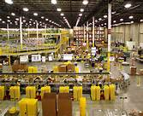
R9 – The In’s of Transaction Processing
Raw Material Receiving
Production Receipts

Slide 11
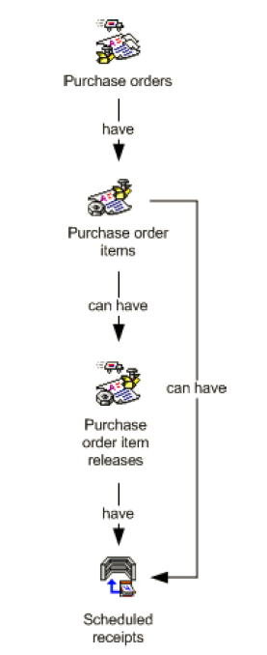
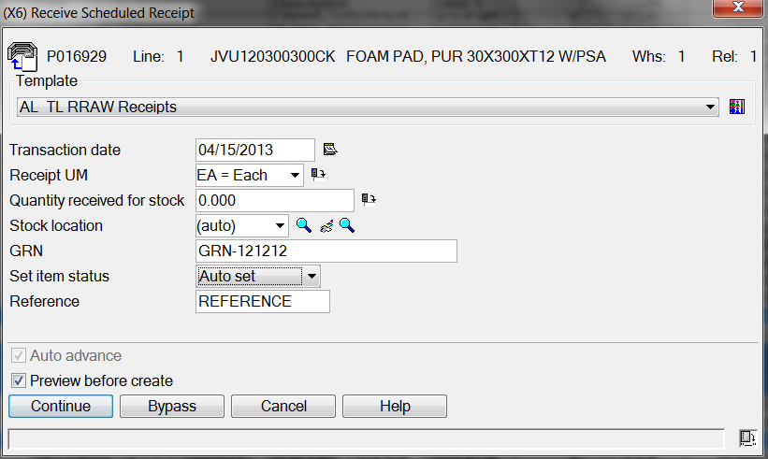
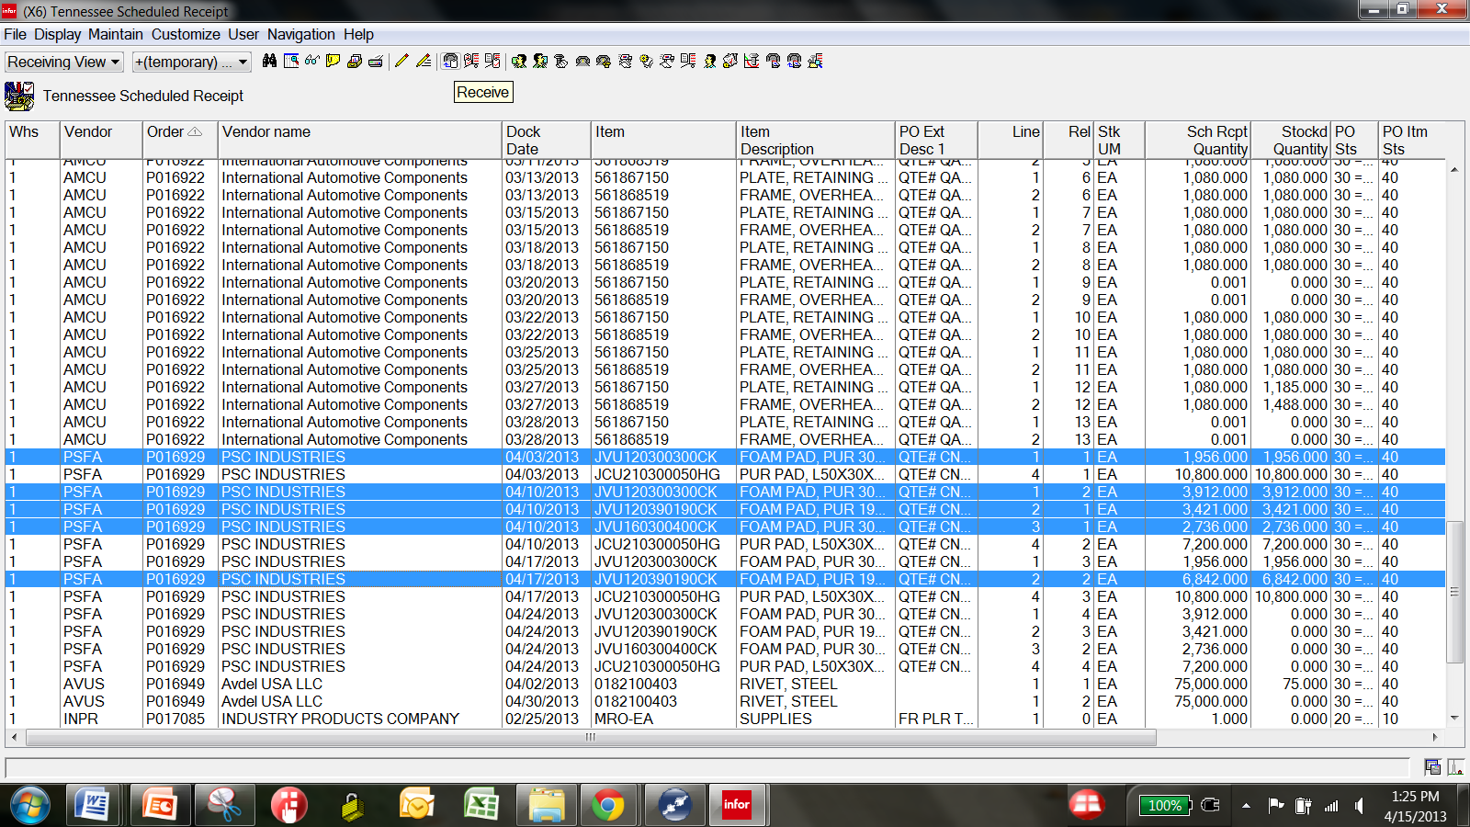
R9 – Raw Material Receipts – The RP’s
PO Creation
Revisions
Complete for RCV
Use powerful Power Link Workspaces to make reviewing
WH expected receipts easy !

Slide 12
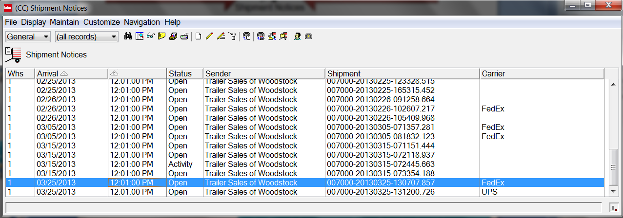
R9 – Raw Material – Shipment Notices
EDI – 856 from Vendors
XA Transfers w/Sch. Receipt
Supplier Portal ASN’s
In-Bound Before Receipt
Huge Win!
Production can review In-Bound Materials before Receipt occurs
Receiving can perform Receipt by Shipment Notice - ASN - 1 Scan

Slide 13
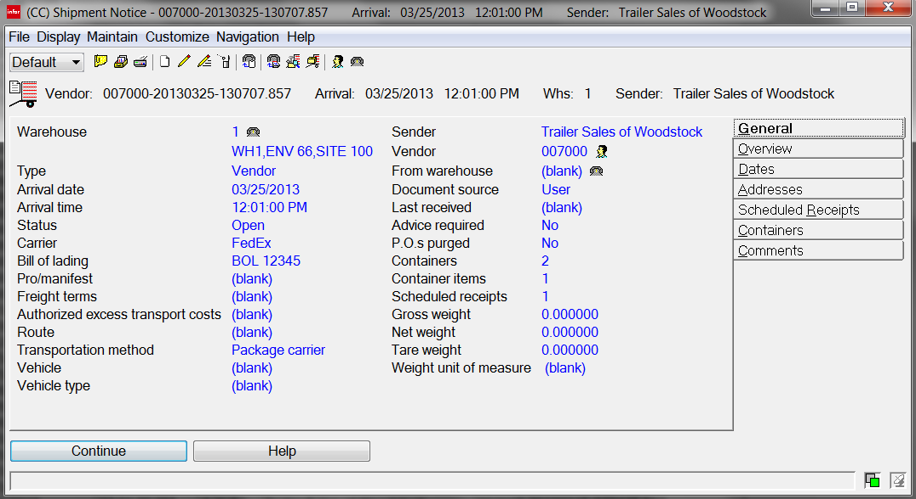
R9 Enhanced Receiving with Shipment Notices
Shipment Notice/ASN Header
When? By Whom? How many Containers/Items? Number of Scheduled Receipts? …..Know in Advance!

Slide 14
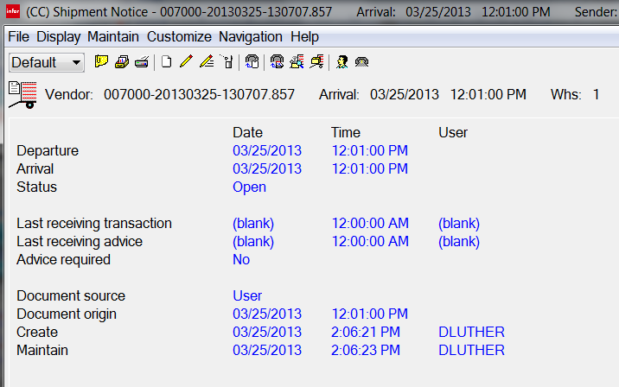
R9 Enhanced Receiving with Shipment Notices
Shipment Notice/ASN Detail
Review Shipment Notice/ASN Dates quickly !

Slide 15
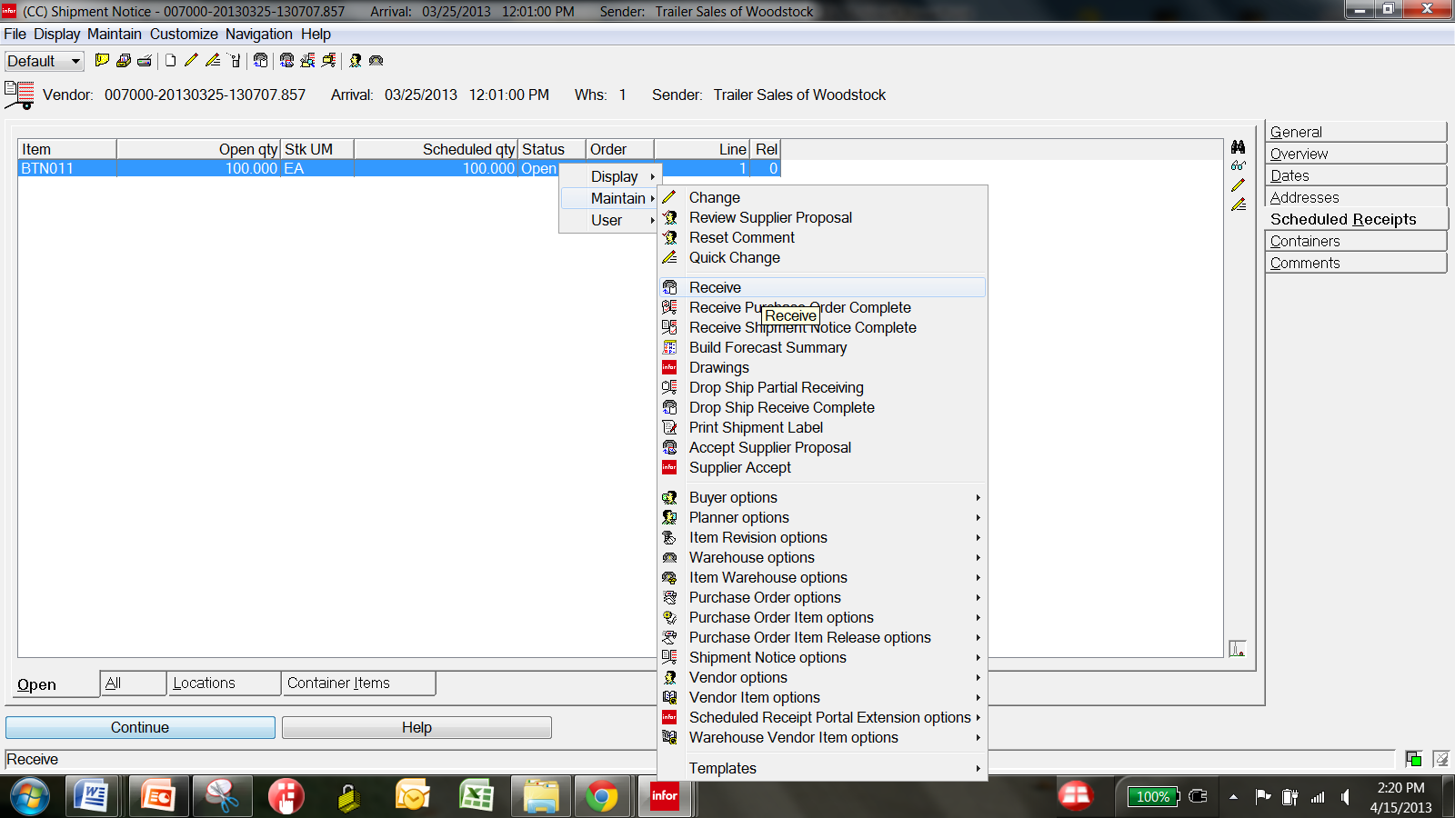
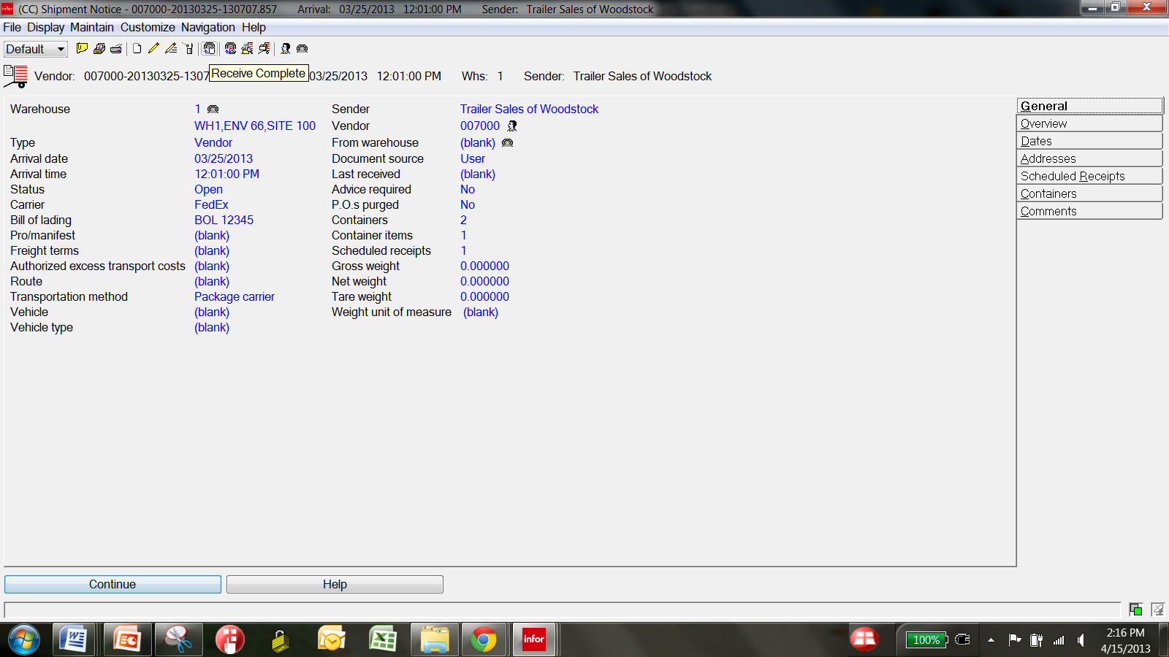
R9 Enhanced Receiving with Shipment Notices
Shipment Notice/ASN Receiving
ASN Items
ASN Items are displayed for the Warehouse …..Receive Selectively or Complete!
Receive Entire ASN, or……

Slide 16
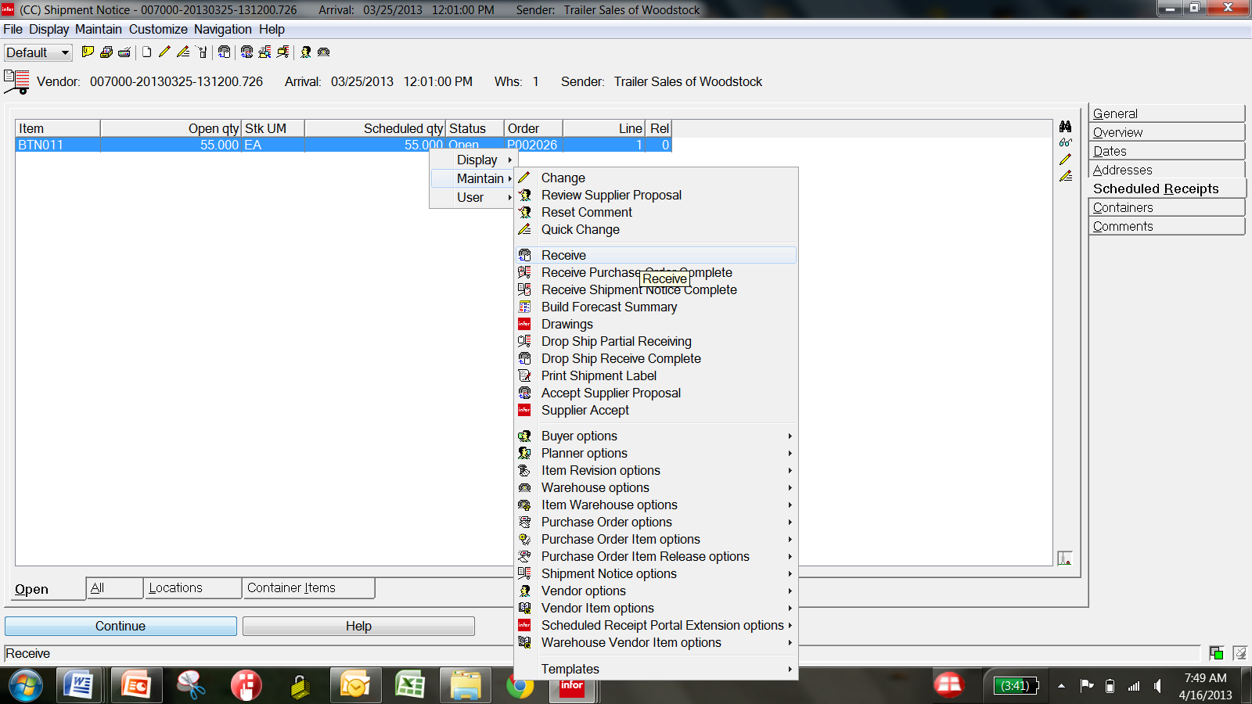
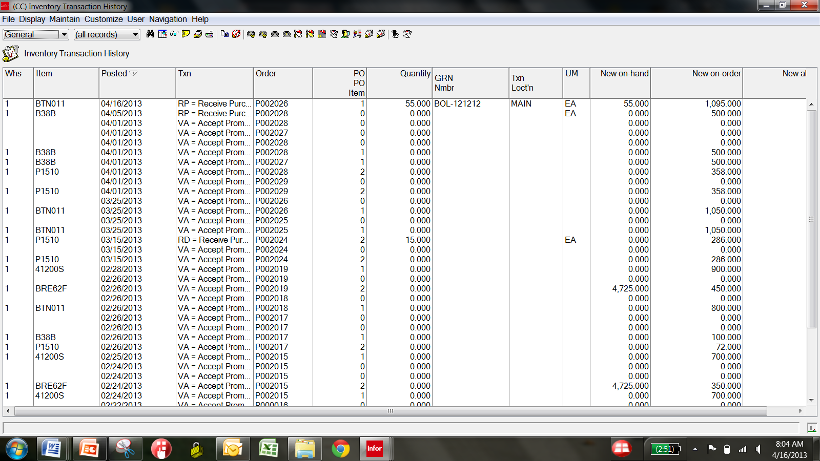
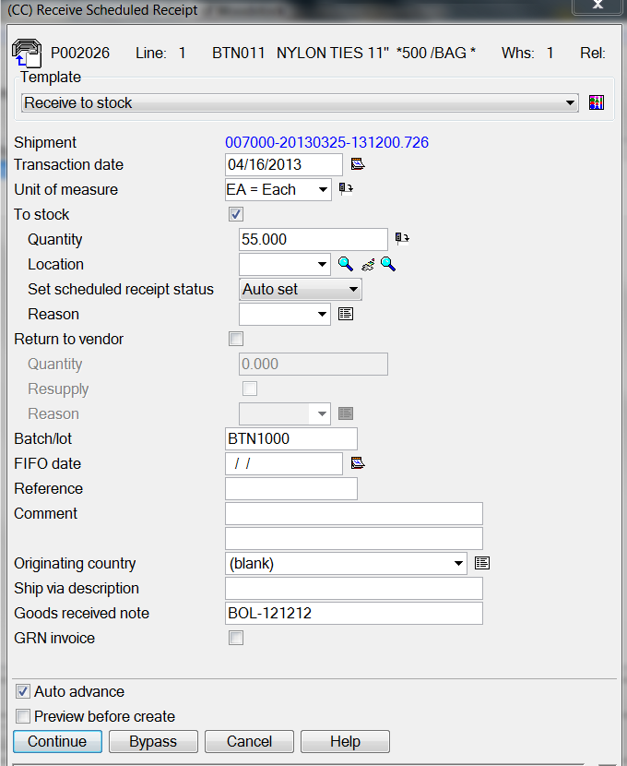
R9 Receiving – Scheduled Receipts - RP

Slide 17
R9 Inventory Receipts – Production Receipts
The R9 Production Receipts Icon at Release 9 is the “Scheduled Receipts for MO’s”. Use it to review open Manufacturing Orders and create special Work Spaces for your reporting points on WIP and FG RM Transactions.
MFG
Order
Board
MO Creation
Changes
Deviations
OBPM
Production
Receipts
Open/Waiting

Slide 18
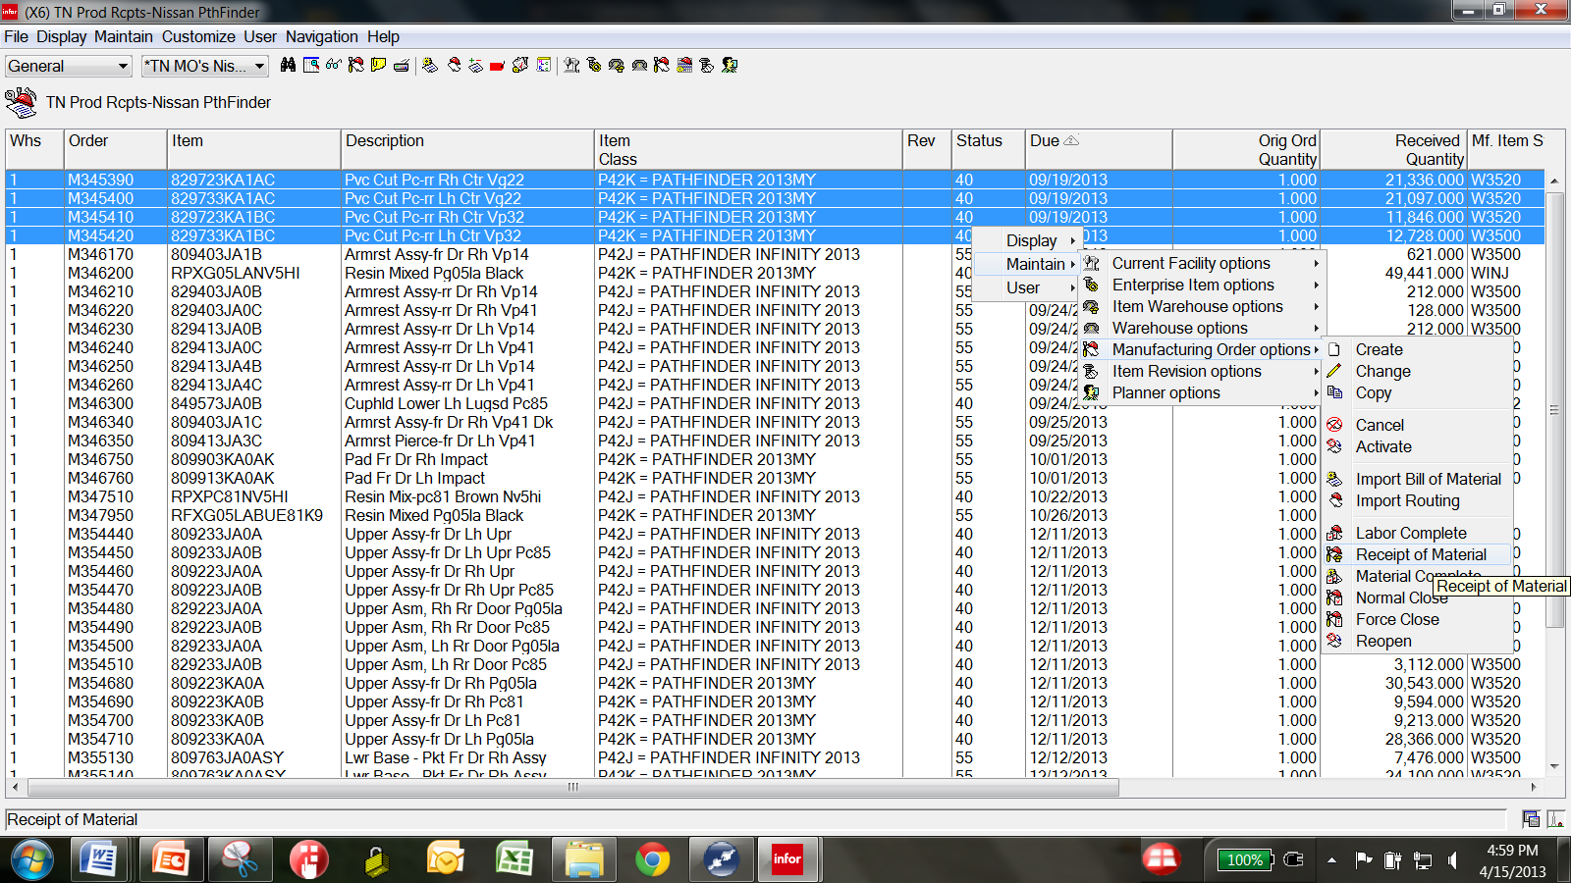
R9 Receipts – Production Receipts
With Production Receipts – build powerful Power Link Workspaces to make Production Reporting and your RM Transactions easy!

Slide 19
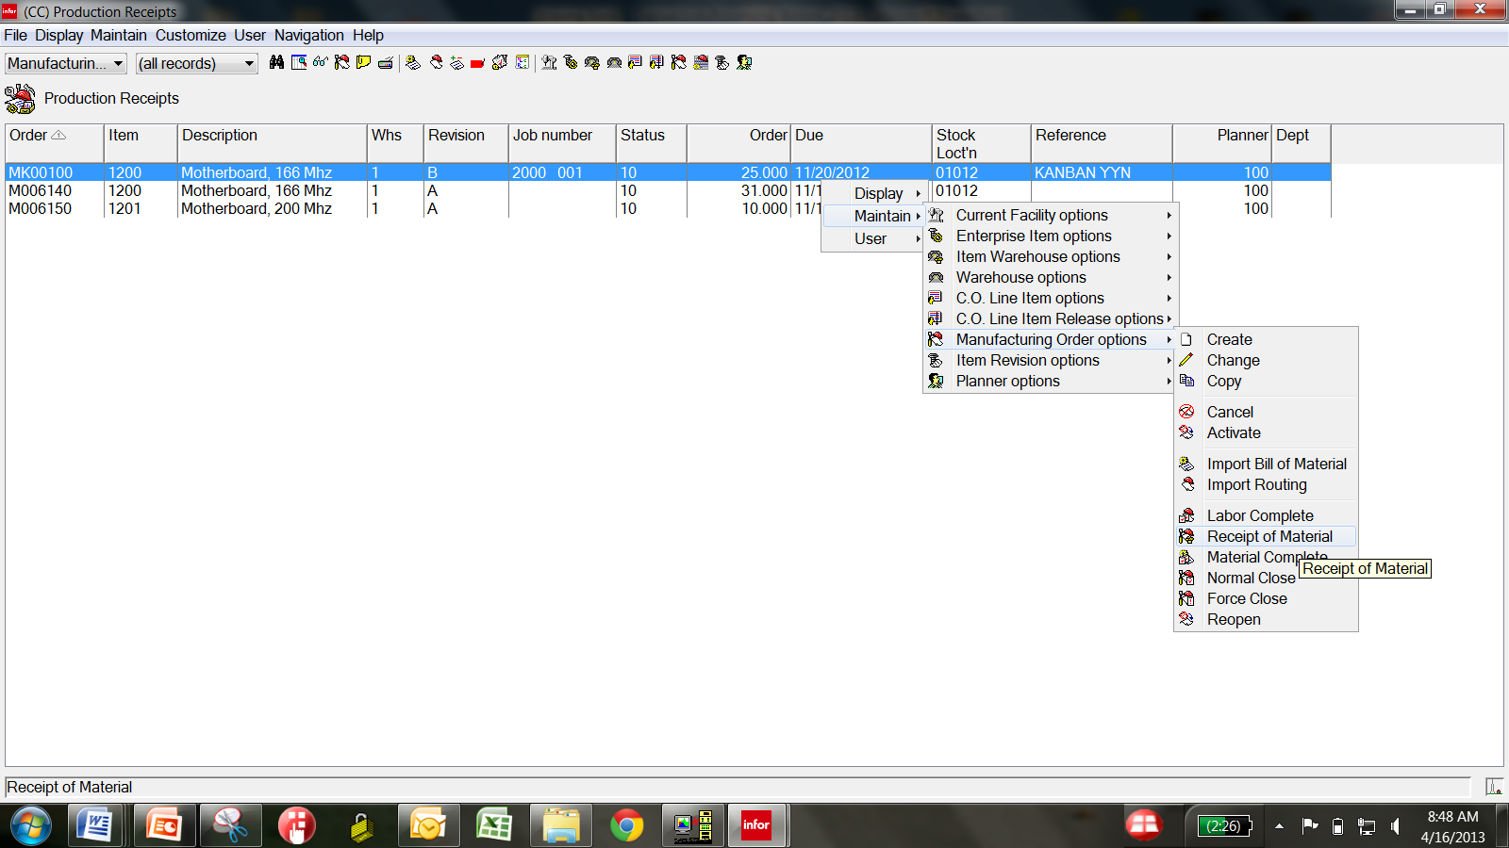
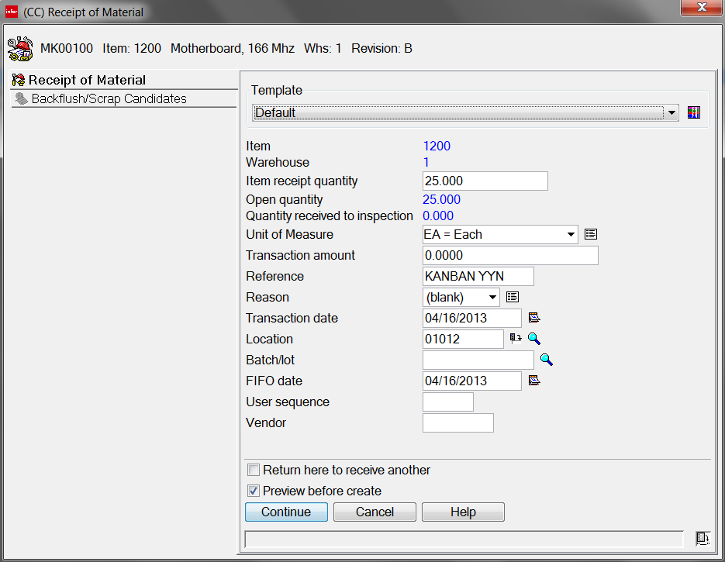
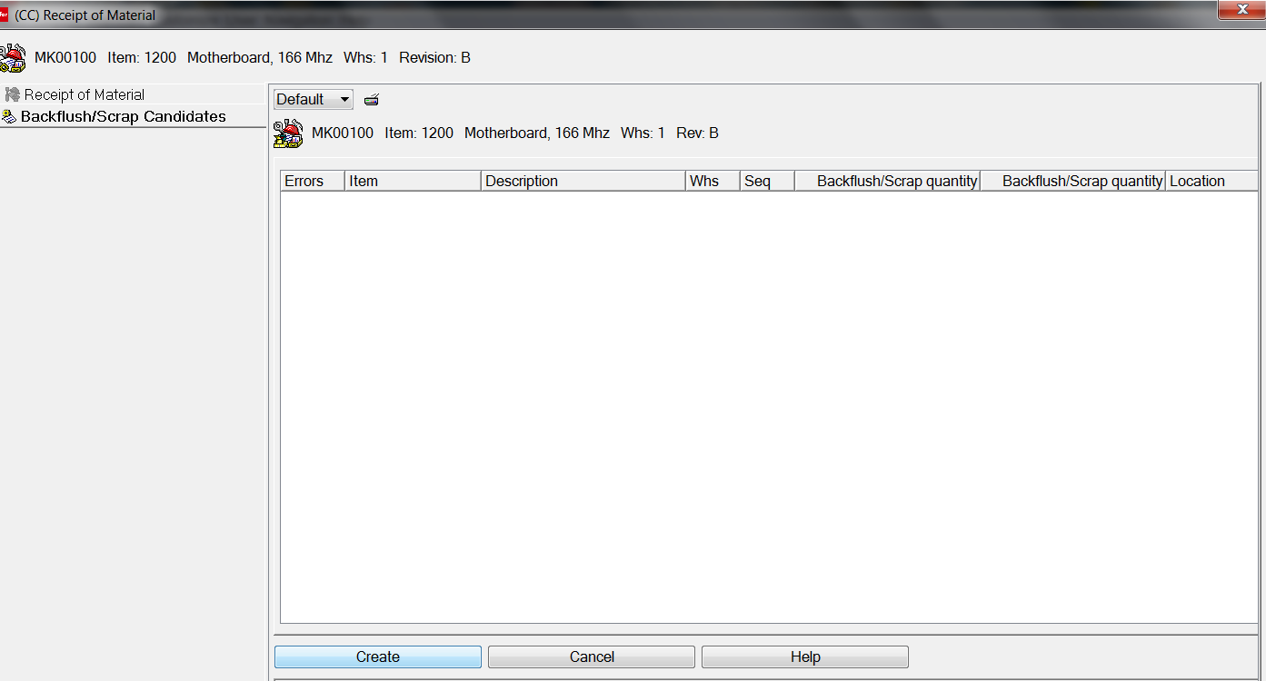
R9 Receipts – Production Receipts – The RM Txn

Slide 20
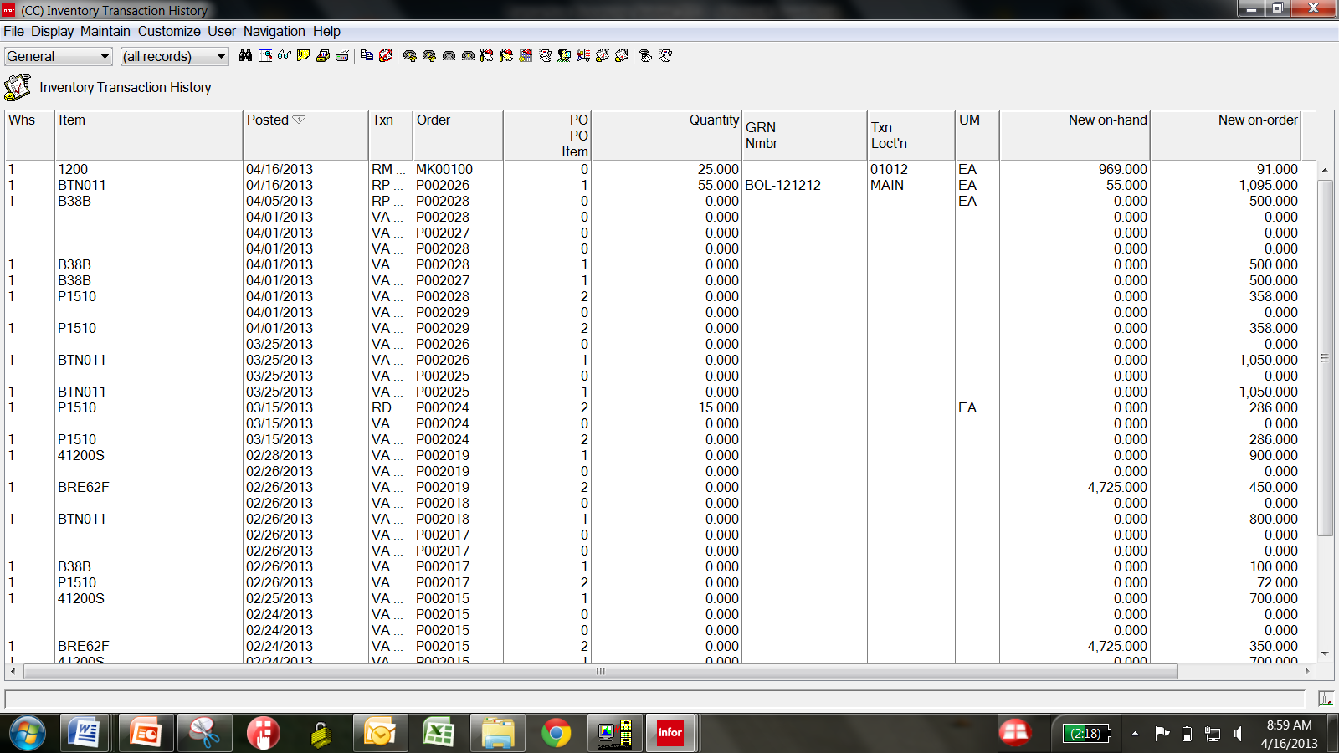
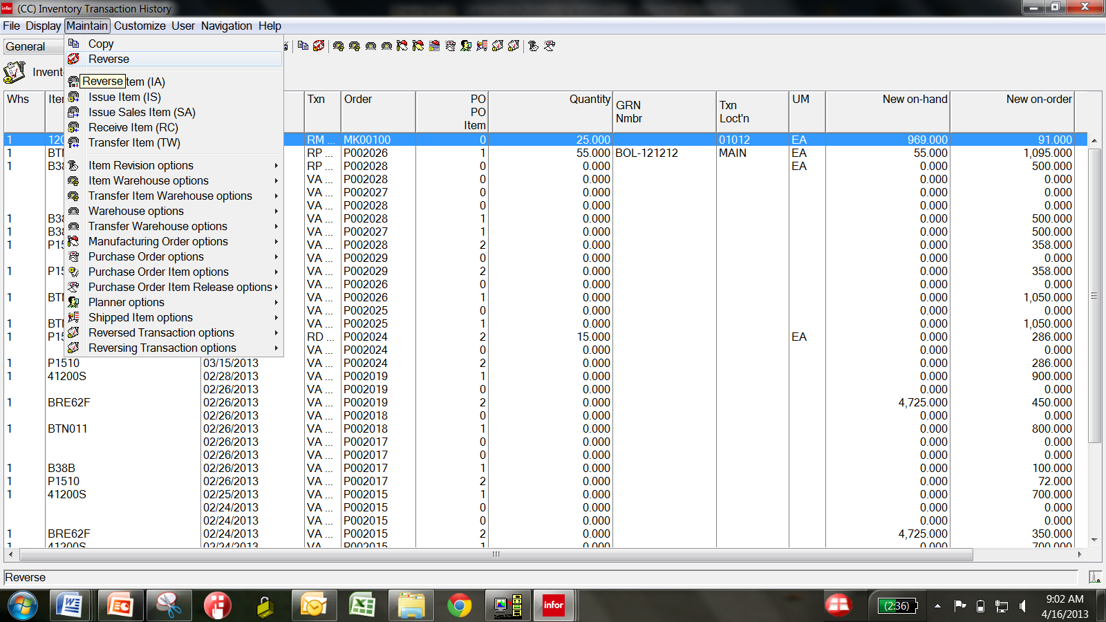
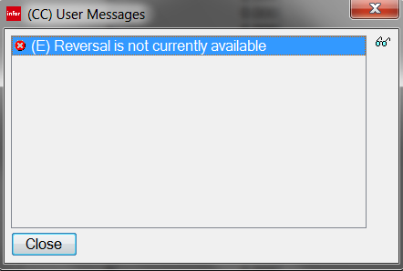
R9 Receipts – Production Receipts – The RM Txn
You can reverse these..
MO/PO related Transactions can only be
reversed from OBPM and PM …
You can reverse any of the transactions you can perform from Inventory Transaction History …..

Slide 21
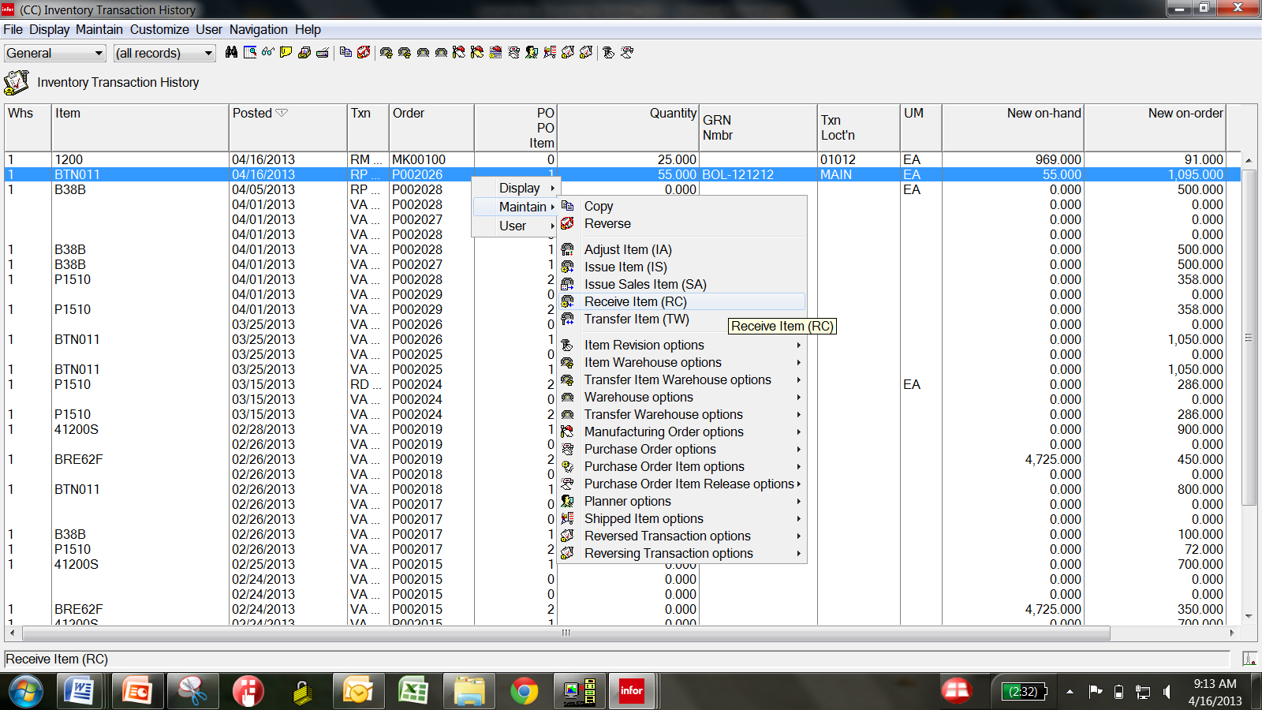
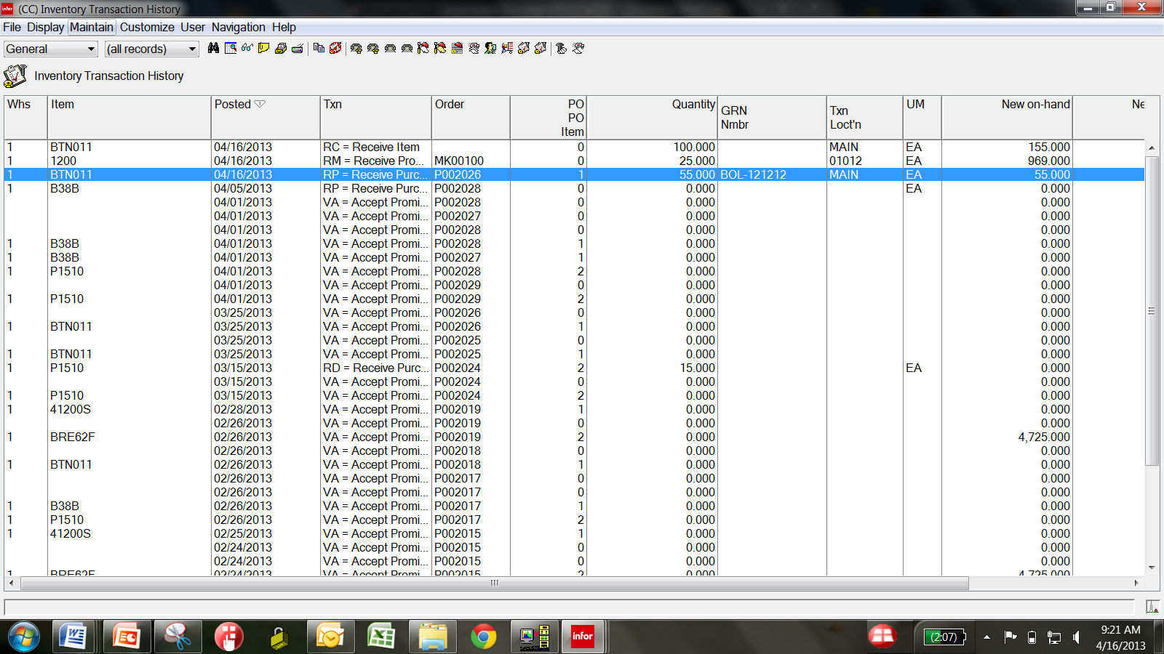
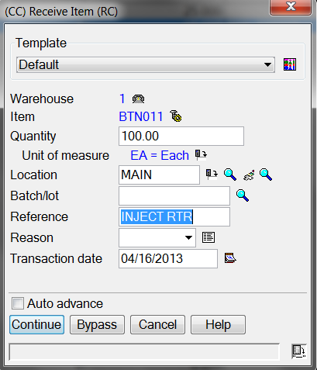
R9 Receipts – Miscellaneous Receipts– The RC
Immediate visibility of Transactions Processed after entering the RC Transactions….
Multiple Selection of Items Allowed

Slide 22
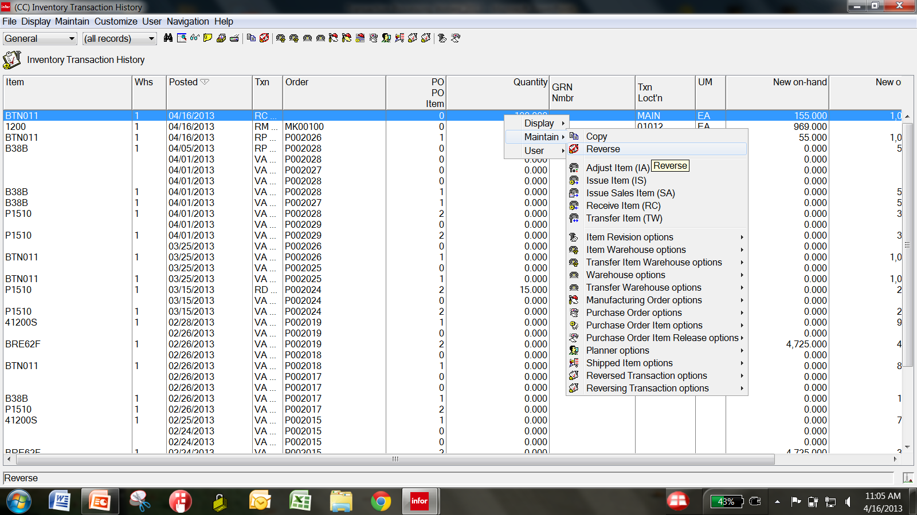
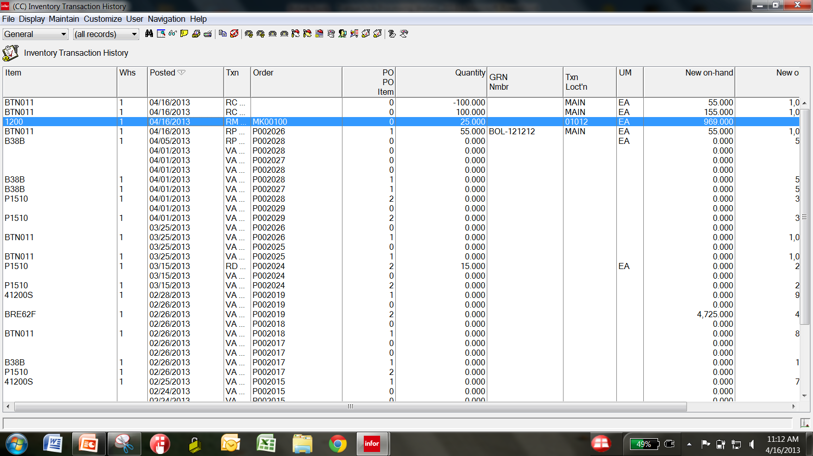
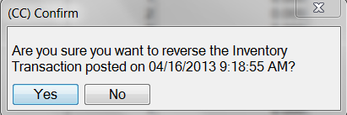
R9 Receipts – Reversing the RC in History
Immediate refresh of the view reflects the reversal transaction(s)….
Transactions done in Power Link can be reversed quickly and efficiently from Inventory Transaction History …

Slide 23
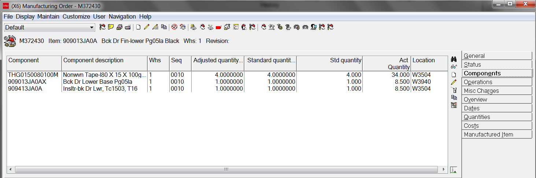
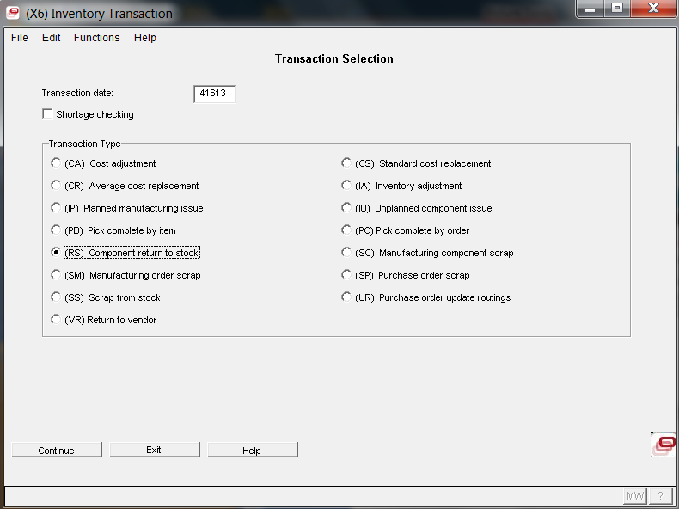
R9 Receipts – Component Returns - RS
Uses IDF L1 Transaction Processing

Slide 24
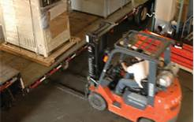
R9 Receipts – The RW part of the TW
TW
IW Issue from WH/Location
+
RW Receipt to WH/Location
The ability to perform TW Transactions to Line Locations and from Production Staging Locations in Power Link is great. RF is recommended but manual entry has improved dramatically for your Materials Teams.
Create Workspaces for Specific Locations to perform transfers quickly to Shipping from Production, from WIP to Final Assembly or Packaging, and much more…..

Slide 25
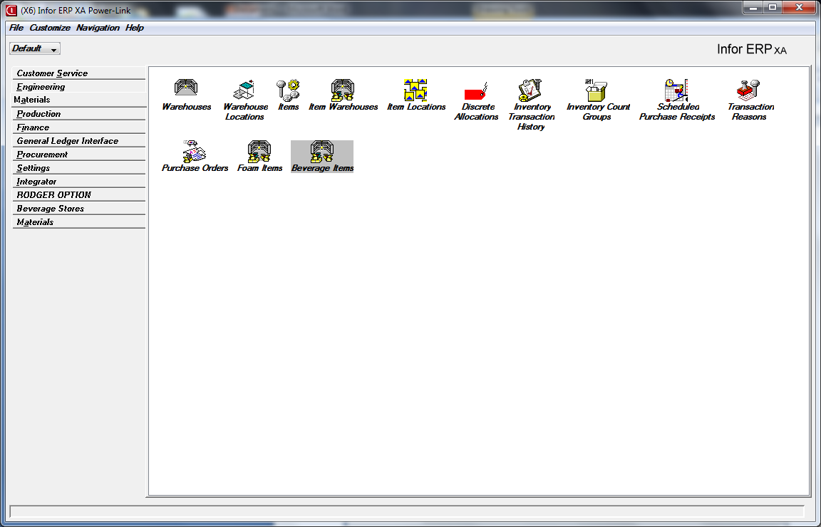
R9 Receipts – RW Receipt to Warehouse Location
At XA R9 – Transfers must be performed from Inventory Transaction History.
Note: Recommend the CISTECH RF Suite for processing all your material transactions as they occur at your plants and warehouses.

Slide 26
R9 Receipts – The TW Transaction & Receipts
At Release 7.8 and higher, the TW Transaction can now have two types of material transfers:
A Transfer Transaction without a Scheduled Receipt.
Happens Immediately – usually used to record the movement of material after it has occurred, or at time the Transfer is complete in the Warehouse.
No impact on Inventory Balance – just the movement from WH/Location to another WH/Location.
Generates the TW/IW/RW transactions immediately
A Transfer Transaction with a Scheduled Receipt
Issues the Item out, but delays the receipt of the materials until an RT Transaction is performed. Great for remote Warehouses, Milk Runs from Distribution Centers!
Allows you to exclude the Items quantities being transferred from MRP and Planning Reports/Tools while they are in-transit
Store the items in an in-transit warehouse or location until they are received, for accounting control and visibility
Select multiple Items to be Transferred and create a single Shipment Notice to help control the shipment and simple receipt of the materials
Generates an RT/IW/RW and an RC Transaction if any receipt differences

Slide 27
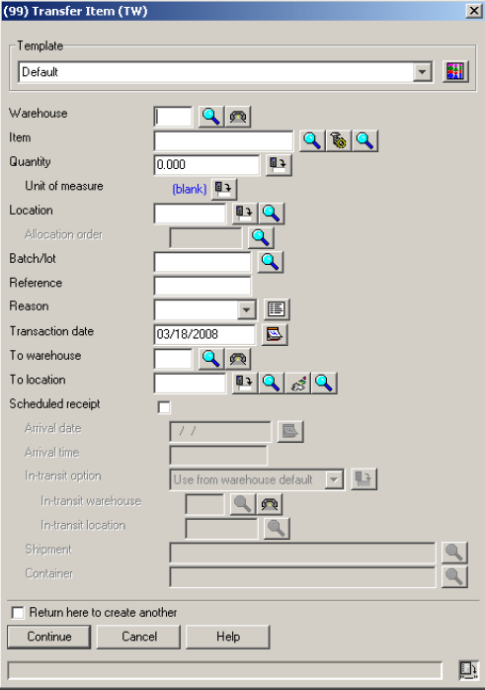
R9 Receipts – RW Receipt to Warehouse Location
Transfer WITHOUT a Scheduled Receipt
Happens immediately when the TW is performed….you will receive an IW out, and an RW into the “TO WAREHOUSE AND LOCATION” immediately.
Won’t be received at final WH and Location until the RT (Receive Transit) is performed through Scheduled Receipts.
Transfer WITH a Scheduled Receipt

Slide 28
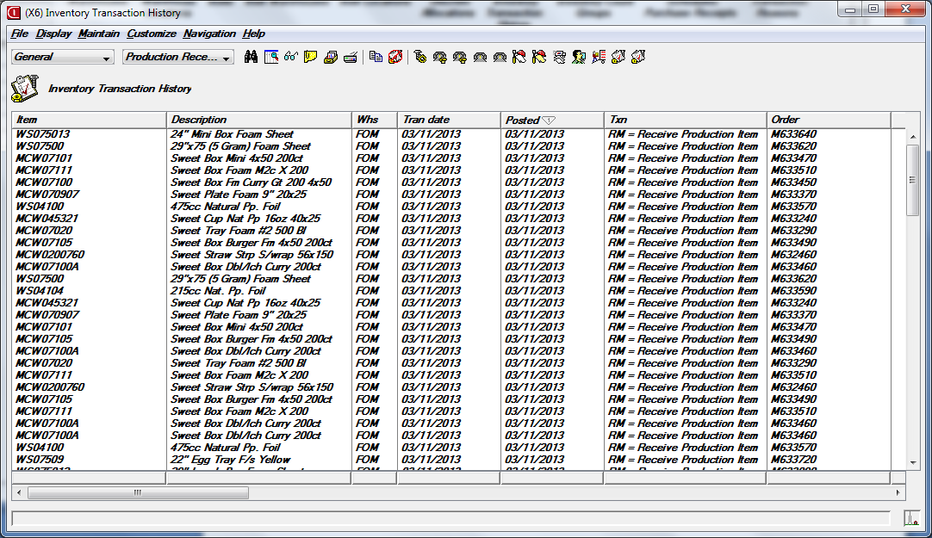
R9 – Transfers without Scheduled Receipt
You can select the items to transfer from the recent Production receipts (RM’s), that are in a specific location requiring movement, ready for packaging, Final Assembly……the list is unlimited.

Slide 29
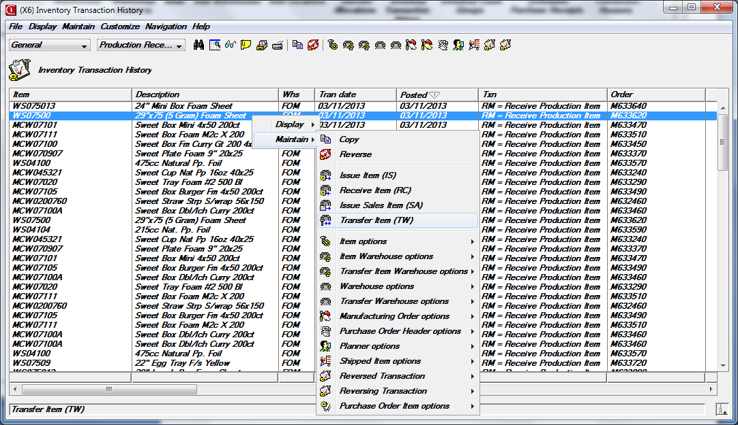
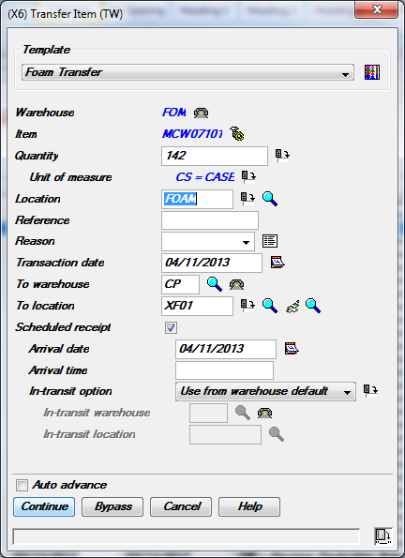
R9 Receipts – RW Receipt to Warehouse Location
Use Templates for Quick Transfers
Highlight a record, or group of records, right click and select the TW Transfer option from the dropdown list – complete the transaction.

Slide 30
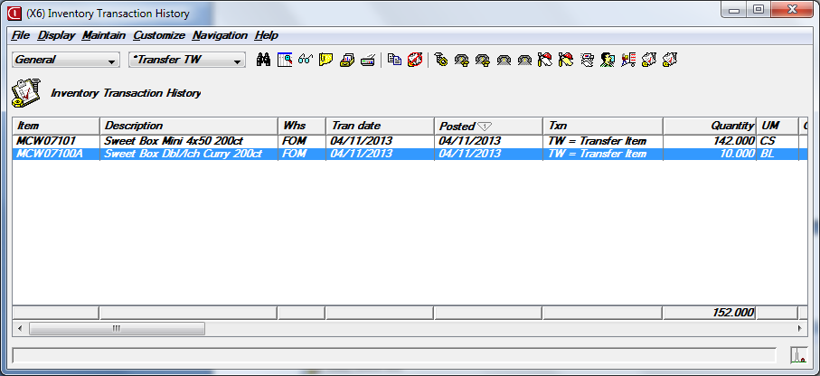
R9 Receipts – RW Receipt to Warehouse Location
Instant visibility of the performed transfer in Power Link after the transaction is completed by the Users…
Remember, the TW, creates an IW to issue material OUT of a Warehouse/Location for an Item, it also creates the RW for the Receipt of the materials INTO the new WH/Location as shown below….

Slide 31
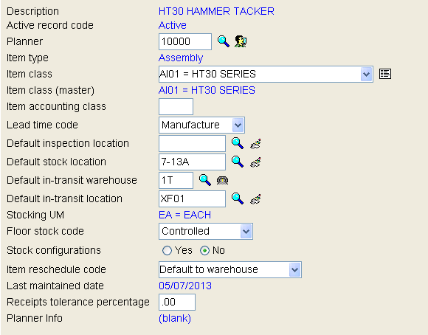
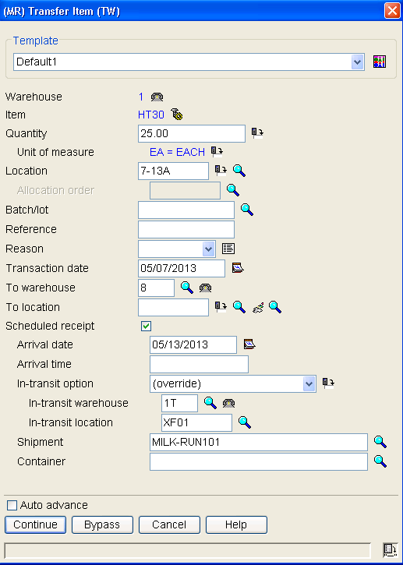
R9 – TW with Scheduled Receipt – WOW!
For the In-Transit Options you can use:
The Sending WH’s in-transit WH and Location
The Receiving WH’s in-transit WH and Location
Select an In-Transit WH and Location for tracking movement
If Scheduled Receipt is selected for the Transfer, you can create Shipment Notices for easy receiving.
Each Item Warehouse Record now has a Default In-Transit Warehouse and Location which can default on to the TW transaction.
Notice we are transferring this to WH 8, but, until received, inventory is in 1T, XF01.

Slide 32
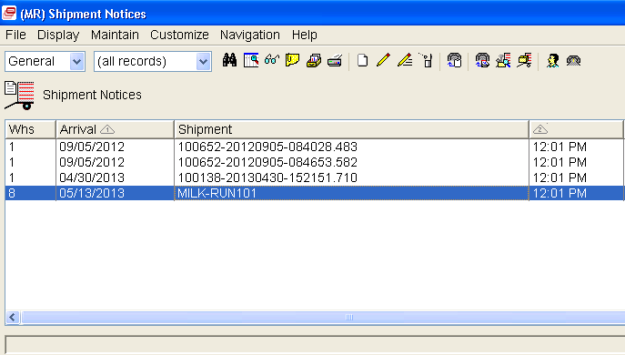
R9 – TW with Scheduled Receipt – WOW!
When transferring the materials – you can create Shipment Notices for the Transfer. The Receiving WH can validate the receipt, and perform “Receive Complete” on the entire Shipment and all Containers. VISIBILITY ON WHAT IS IN TRANSIT AND THE SHIPMENTS COMING !!
Great stuff at Release 9 !!

Slide 33
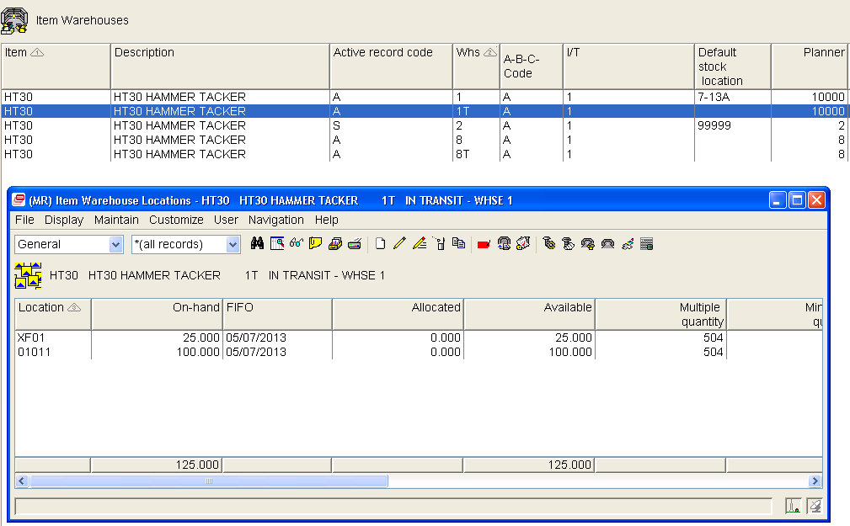
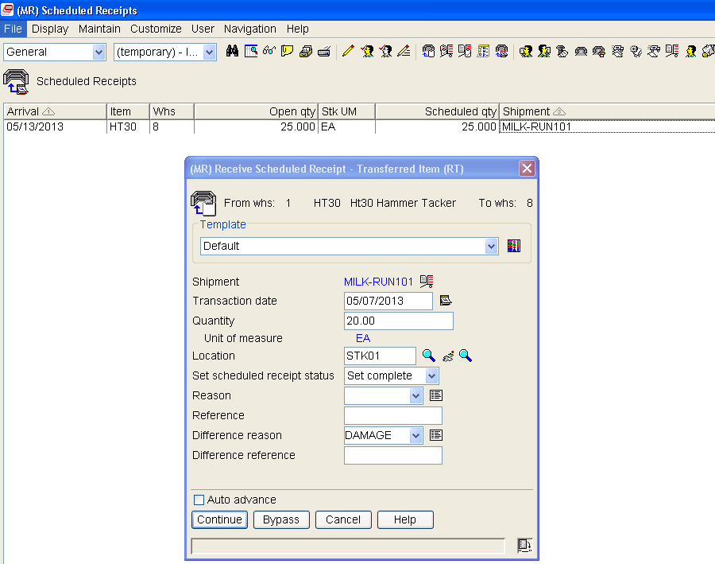
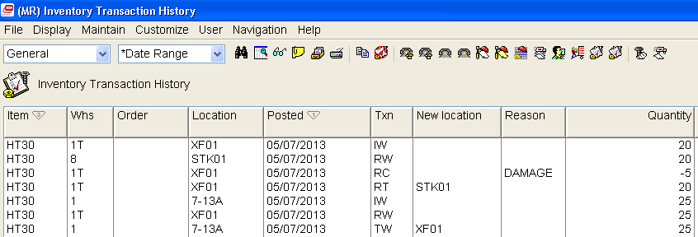
R9 Receipts – RT – Receive from Transit
Scheduled Receipt is ready for WH 8 to perform the RT Transaction.
Immediate visibility on what is “in-transit” but not yet received at final destination! Remember the TW was to transfer the materials to Warehouse 8. Let’s look at Scheduled Receipts for WH 8.
If you under receive the Transferred Quantities, and flag the Scheduled Receipt as complete, you will receive an RC Transaction for the difference. In this case something happened to 5 of the units being transferred.
Reason codes allow Finance to create GL Rules for this condition.

Slide 34
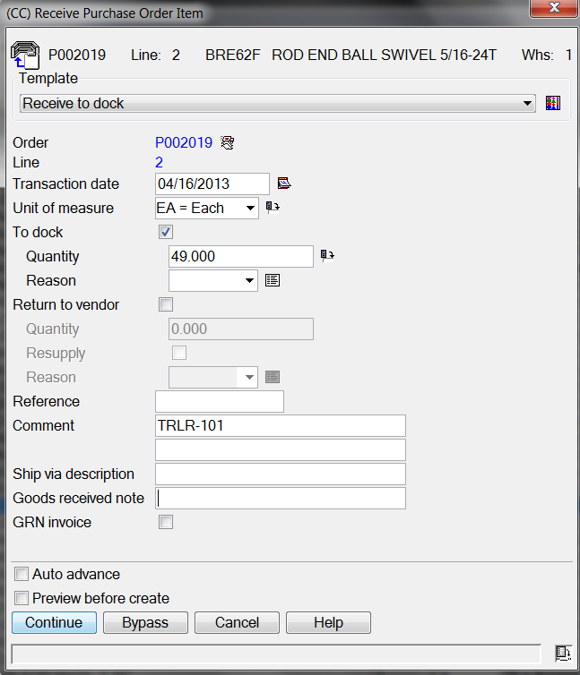
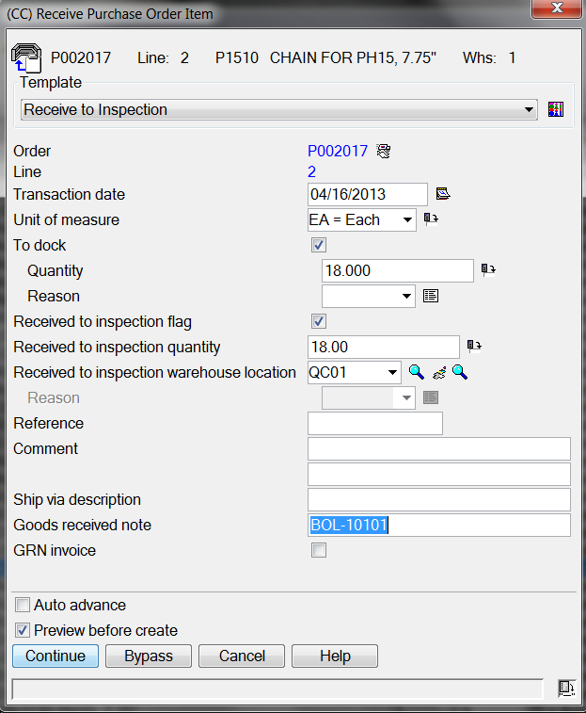
R9 Receipts – Other “R” Transactions
RD = Receipt to Dock
RI = Receipt to Inspection
Requires Quality Transaction (PQ) to receive materials to stock and update the Item Balance record once the RI Transaction is created.

Slide 35
The “OUTS” of Inventory – The “I” Transactions
The most common causes of Inventory Relief – the XA “I” Transactions
Raw
Material
Out
Mfg Orders - OBPM
Line Schedules – REP
Bulk Issues of Uncontrolled
Samples, NDT/DT, etc.
IP, IU, IS, IX Transactions
Sub-Assmbly
Out
Mfg Orders – OBPM
Line Schedules – REP
Samples, NDT/DT, etc.
IP, IU, IS Transactions
Finished
Goods
Out
SA, IP, IU, IS Transactions
Sales Order Shipments
MO’s/Schedules
Samples, NDT/DT, etc.

Slide 36
The “OUTS” of Inventory – The “I” Transactions
XA MATERIAL RELIEF TRANSACTIONS
IP = Issue of Planned Production Component to MO/Schedule
IU = Issue of Un-Planned Production Component to MO/Schedule
IS = Issue Item
IW = Issue Inter-Warehouse Transfer (Part of TW)
IX = Issue of Uncontrolled Floor Stock to MO/Schedule
PB = Pick Production Component
PC = Pick Production Complete
RL = Replenish Schedule Component
SA = Sales Item/Shipment (from COM or your EDI 856)
VR = Vendor Return (if returned from Stock and not Dock)

Slide 37
R9 Issues – The IP Transactions
IP Transactions are used to issue materials to MO’s and Schedules. IP Transactions will also be generated when back-flushing occurs for Controlled Floor Stock.

Slide 38
R9 Issues – The IP Transactions
IP Transactions are done using IDF L1 at Release 9…..no major differences other than how the Transaction Engine is accessed!

Slide 39
R9 Issues – The IU Transactions
The IU Transaction is used to issue material to MO’s and Schedules that were not initially a requirement on the BOM. Nothing major has changed at Release 9, other than how the Transaction is accessed.
Same Transaction input as prior releases….nothing different here!

Slide 40
R9 Issues – The IS Transactions - Miscellaneous
The IS Transaction is most often used for:
The most common use of the IS Transaction is to issue low cost bulk materials to a consumption location for Back-flushing.
Commonly used to issue materials from the Warehouse to Sales, Engineering, or Quality for Testing, Trade Conferences, and other reasons. Reason Codes allow you to properly account for the inventory relief. Examples: QC, MKTNG, CUST
Also used If you have a controlled warehouse for Maintenance Items. The IS can be used to Issue out tooling and other MRO Items to the Shop Floor Lines/Work Centers.
UC
Floor Stock
QC
Testing
MRO
For
WC’s
Sales

Slide 41
R9 Issues – The IX Transactions – “Automagically”
Facts about the IX Transaction
IX Transactions record the issue of Uncontrolled Floor Stock items to Manufacturing Orders/Schedules.
THEY DO NOT AFFECT THE ON-HAND BALANCE OR LOCATION QUANTITIES.
Uncontrolled Floor Stock items are usually low cost items like nuts, bolts, rivets, washers, etc. These items are usually issued in Bulk and are used by multiple MO’s as they pass through the production operations.
When MO’s are released, components on the BOM that are Uncontrolled Floor Stock are issued to the MO from the Bulk Location, or from available locations if no Bulk Areas are defined.
When an RM is done for the Parent Item on the MO, if production is over-reported, additional IX Transactions will be generated.
When the RM is Completed for Material, if the total RM Quantity was for less than the MO Quantity, correcting IX Transactions will be generated.

Slide 42
R9 Issues – The IS – Miscellaneous Issues
IS Transactions are now performed from Inventory Transaction History at Release 9

Slide 43
R9 Issues – The IS – Miscellaneous Issues
Locate and highlight Item(s) that you wish to Issue, and click “Issue Item”……
No To Location, No MO, No PO, you are just issuing inventory OUT for a specific Reason. Map those to specific GL rules to handle different Miscellaneous Issue scenarios.

Slide 44
R9 Issues – The IX Transactions
Stock
Location
Comp A
UC Floor
Stock Bulk
Line Location
MO Release
IS Txn
Immediate Issue of Uncontrolled Floor Stock Components – IX Transactions
IMHIST
IX
Txns
TRANSACTION HISTORY

Slide 45
R9 Issues – The IS and IX Transaction GL Impact
Stock
Location
Comp A
UC Floor
Stock Bulk
Line Location
IS Txn
The IS Transaction GLI
GLI
INVTXN
IS and IX
Raw Material-Hardware
Bulk Inventory/Transit
-100.00
100.00
IX
MO Release
The IX Transaction GLI
Bulk Inventory/Transit
WIP - Widgets
-100.00
100.00

Slide 46
R9 Out’s of Inventory – VR Vendor Returns
Vendor Returns can be performed
At receiving, if using Materials Management
At QC approval – PQ transaction
From stock in IM transaction processing – “Other Tasks” VR Transaction
If you are performing a “Return to Vendor” during a Receipt to Stock, you will receive an RP for the 2000 units, and a VR reducing the receipt by 100.00 units - you will get a warning stating you are performing the VR from Stock as shown

Slide 47
Outs of Inventory – The Vendor Return
Reduction
A Vendor Return during the Receipt to Stock results in the total receipt being recorded by the RP Transaction, with a reduction from STOCK of the 100 Units returned recorded by the VR Transaction. The GRN Number will be the same for proper matching of AP Invoices and Credit Memo’s created from the Debits.
Manage your Debit Memo’s for your Returns ! You can see that these have not had Credit Memo’s entered…….
Every VR that does not request a ‘resupply’ of the materials returned, results in a Debit Memo. You can view the Debit Memo’s in the PO Debit Memo Card, or you can manage all Debit Memo’s in the Power Link Object…….

Slide 48
Outs of Inventory – The Vendor Return
If you have already received the material into Stock, you can perform a VR from “Other Material Tasks” in Power Link as shown below:
Same screens we have been used to since Release 4.

Slide 49
Outs of Inventory – The Vendor Return
If the Item being returned is being done during the Inspection process, you must use the Quality Transactions at IDF Level 1 to perform the VR
QC Enters the Quality Transaction Header Information……
VR Txn
The VR will be created…..no reduction in Inventory since the 200 received never made it passed your Inspection Team into Stock.

Slide 50
Outs of Inventory – The IW (Part of TW)
TW
IW Issue from WH/Location
+
RW Receipt to WH/Location
Great for DC’s, Milk Runs and more
Select Item, or multiple Items, to perform your Transfer Transactions……….
Net effect on inventory for the TW is zero….remember you are ISSUING OUT from one WH/Location and RECEIVING IN to another….
At Release 9, all TW transactions must be performed from Power Link Inventory Transaction History.

Slide 51
Outs of Inventory – Other Relief Transactions
PB = Pick Production Component
PC = Pick Production Complete
Order Pick Transactions

Slide 52
Outs of Inventory – Requests for Line Replenishment
RLx = Replenish Line Transactions
RLx ARE REPETITIVE TRANSACTIONS!
NO INVENTORY IMPACT – REQUEST FOR LINE/SCHEDULE MATERIALS WHEN RUNNING REPETITIVE PROCESSING !

Slide 53
R9 – Inventory Adjustments
Inventory Adjustment Transactions can be done from Power Link or from IDF L1 “Other Material Tasks”.
Same as Green Screen – all manual entry! Power Link is MUCH more powerful and less keypunching…locate transaction and correct with Power Link !!

Slide 54
R9 – Inventory Adjustments
Auto Advances to Next Item
In Power Link ….locate your Items, or Transactions to correct, and perform your Adjustments quickly and easily.
Retains Previous Values

Slide 55
R9 – Inventory Adjustment Facts
IA Transactions directly impact your Companies Inventory levels. If interfaced to GL Inventory Accounts these have a direct impact to the General Ledger.
Work with Finance on the use of Reason Codes for IA Transactions to properly impact your Companies General Ledger(s).
Auditors hate IA Transactions !! Why didn’t you correct the PO Transactions, the MO Transactions, the Schedule Transactions…..use as last resort. Perform a quick Cycle Count whenever possible!
Establish tight security for the use of the IA Transaction!
Know WHO can perform these transactions and WHY they use them !!

Slide 56
Cost Transactions – The CU, CS, and CA
CU = Unit Cost Default – Revalues Inventory if existing quantities On-Hand exist for the Item.
CS = Standard Cost Change – if maintaining Standards at the Warehouse Level (instead of Default Cost), a change to the Warehouse Standard Cost will revalue the inventory for that Item if quantities exist in the Item Warehouse.
CR = Average Cost Replacement – used to adjust Inventory Balances when last receipt cost is different that the Average Cost currently in Item Revision Cost.
CA = Cost Adjustment. Most commonly used when running Standard Cost and an Invoice is generated for more/less than Standard Cost, the system will drive an entry for Un-Invoiced Receipts, AP Clearing and the difference will be driven to PPV/Material Variance Accounts – the more complex transaction.

Slide 57
Cost Transactions – CU and CS at R9
Changing the Unit Cost Default of an Item Revision, will generate a CU Transaction if any quantities exist in Warehouses associated with the Item Site.
Also, at R9, if you are using Revision Control, if a new Release becomes ‘effective’ with a different Unit Cost Default a CU will be generated – BE CAREFUL!

Slide 58
TRANSACTION PROCESSING AGENDA
3) GLI – Integrate it all to your General Ledgers

Slide 59
XA R9 – Inventory Transactions with GLI
Automate Inventory Postings with Financial Rules – keep Perpetual to GL Book synchronized for Finance!
XA Transactions
Your XA GLI Rules determine how XA Transactions impact your Companies General Ledger.
Manage changes in business, new Program Launches, New Inventory Classes with Finance. Teamwork!

Slide 60
XA R9 – Inventory Transactions with GLI
XA
IM
Issues, Receipts, Cost
Changes, SA, etc.
INVTXN
IM GL
Holding
XA AR
Ledger
Activity
Assign
GL Account No
To IM
Transactions
(Based on Rules)
Create GL Entries
To
IFM or AM GL
GL Line
TRANSACTIONS
XA PCC
Labor, Overhead,
Variances, etc.
REP/PCC
GL
Holding
Assign
GL Account No
To REP
Transactions
(Based on Rules)
Create GL Entries
To
IFM or AM GL
XA COM
Cost of Sales,
Sales/AR
Returns
Taxes, etc.
OEITXN
GL
Holding
Assign
GL Account No
To REP
Transactions
(Based on Rules)
Create GL Entries
To
IFM or AM GL
XA AP
Ledger
Activity
CISTECH
GLI Tools

Slide 61
XA R9 – Inventory Transactions with GLI

Slide 62
XA R9 – Inventory Transactions with GLI
Use Transaction Fields to determine what G/L Accounts should be impacted.
This RP for Item Type 3 (Purchased Raw Materials)…..based upon the Rule, will…….

Slide 63
XA R9 – GL Impact Examples – Your Rules Work!
Receipt Transaction GL Impact
Issue Transaction GL Impact
RP, PQ Transactions
IP, IU Transactions
Raw Material - Steel
Un-Invoiced Receipts
Raw Material - Steel
Work-in-Process
1000.00
-1000.00
-1000.00
1000.00
Charge Account
Offset Account
Charge Account
Offset Account
Key Note: The Charge Account is not always a Debit to Inventory, it depends on the Transaction Type. Setup your GL rules for Transactions using the GL Interface Guide in each XA Application Manual to guarantee proper results.
Map with Finance and then Test your results to the General Ledger.
RM, MQ Transactions
IX Transactions
Finished Goods
Work-in-Process
Transit Line Inventory
Work-in-Process
1000.00
-1000.00
-1000.00
1000.00
Each XA Application that creates GL Interface Transactions has a GL Rule Guide – Use it for accurate results!!
RC Transactions
IS Transactions-Vary
Inventory-Varies
Samples -Returns
Inventory-FG or Raw
Eng NDT/DT Expense
1000.00
-1000.00
-1000.00
1000.00

Slide 64
Cost Transaction – The RP & CA Complexities
The Receipts – RP, PQ Txns
XA Inventory
CA TRANSACTION
CREATED
Debit Inventory
Un-Invoiced Receipts
Variance/No Variance
$100,000.00
$100,000.00
IMMEDIATE CA TXN
Un-Invoiced Receipts
$100,000.00
The AP Invoice - API
Debit AP Clearing
Credit A/P
$90,000.00
Credit AP Clearing
$90,000.00
$90,000.00
Credit P&L Material Variance
Fav. Variance
$10,000.00
If Gross Profit: 1,000,000.00
Material Variance: 10,000.00
EBITA: 1,010,000.00

Slide 65
XA R9 – GLI Things to Know
Work with Finance – Examine your Companies GL Inventory Accounts. Multiple Raw Material, WIP, and Finished Good Accounts will take more GL Rules.
Identify the XA fields that will be used on Transactions that will allow you to record GL Transactions to the correct GL Accounts:
Inventory Management – Possibly Item Class
PCC – Possibly Facility Accounting Class/Facility
COM – Possibly Item Class for proper relief of FG Inventories and Cost of Sales
Map out your GL Transactions to correctly see the “In’s and Out’s” for all your Companies GL Accounts.
Establish your GL Rules and Priorities in XA
Test your Transactional Impact to your Companies GL for all Transactions being used
Communicate with all areas if Business Processes change. New Program Launches, New Classifications of Inventory, New GL Accounts…require new GL Rules.

Slide 66
CISTECH Web Education - Q&A
Thanks for attending !!

