Slide 1
MRP Tune Up
A look at the various fields that have an impact on how MRP develops its order recommendations
Jim Simunek, CPIM
Senior Business Consultant

Slide 2
Introduction
MRP creates exception messages and planned orders to create a material plan that is required to support the production of the Master Schedule
To accomplish this MRP will go through a 5 step process for each level of the Bill of Material using the ‘Low Level Code’ in the Item Master/Revision record
  Gather all requirements for the item and put them in date sequence
  Net the requirements against the existing on hand inventory and open orders
    Creates Expedite, Reschedule, Defer and Cancel messages for existing orders
  Plan orders where there is not enough on hand/on order
    Due date of the planned order will be the same as the requirement date
    Order quantity is determined by multiple fields in the Item Warehouse/Balance record
  Calculate the Start Date of the planned order using Lead Times
  For make items with M-Plan orders, access the BOM to create ‘Peg To’ requirements for components in the next (lower) level

Slide 3
Introduction
Setting the planning fields in the Item Warehouse/Balance record is akin to putting together a jigsaw puzzle. All the pieces must fit to create a valid plan
At release 9.1 and above, the Warehouse Master holds the MRP Execution Options and Horizon (date) values
  At lower levels of XA, these are menu options from the MRP Planning Options menu
  MRP Execution Options are fields that apply to all items
  Horizon values control:
    What Customer Orders are included as a requirement
    What Planned Orders get a ‘Release’ message
    How many MRP orders are displayed in the ‘MRP Recommendations’ (PowerLink) or ‘Order Release and Review’ screen (Green Screen)
MRP uses the Calendar File to determine which days are working days and is used when calculating the Planned Order start date

Slide 4
MRP Step 1
Gather all requirements for an item and arrange them in ascending date sequence (oldest requirements first)

Slide 5
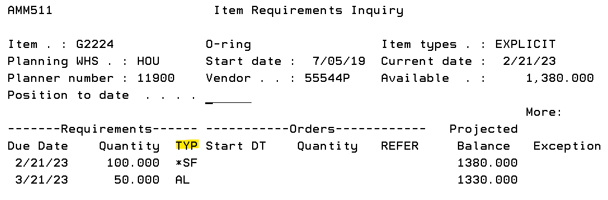
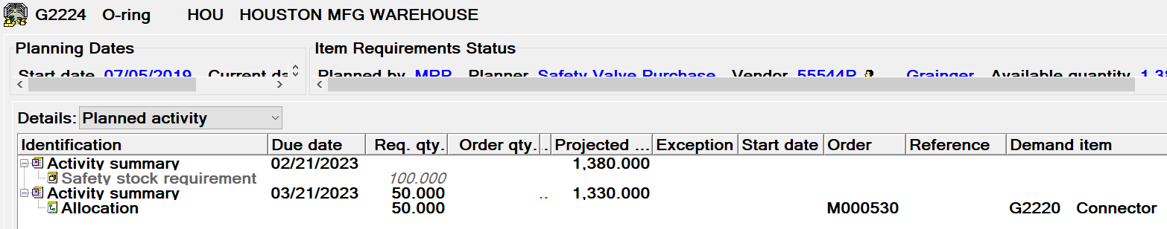
Gather Requirements – MRP Screen/Card

Slide 6
Gather Requirements
When looking at the requirements for an item, there is a code that defines the type of requirement. The requirement types include:
  AL – Allocation. MO Allocation in the future.
  IA – Immediate Allocation. MO Allocation that is past due.
  CMH – Customer (order) Manual Held. Customer order for the item with the ‘Manufacturing Due Date’ on the CO line item as the Required Date.
  MNL – Manual. A manually entered requirement. MRP will delete a Manual requirement when the MRP CURRENT date is AFTER the requirement date.
  HLD – Held Manual Requirement. MRP will delete a held requirement when the MRP START Date is AFTER the requirement date.
  SF – Safety Factor. The item has a quantity in the ‘Safety Stock’ field. The date of the requirement is determined by an ‘MRP Execution’ option.
  SHK – Shrinkage. The item has a value in the ‘Shrinkage’ (expected loss) field.
  FCR – Forecasted Requirement. A forecast quantity from either XA Forecasting or from a manually imported forecast.

Slide 7
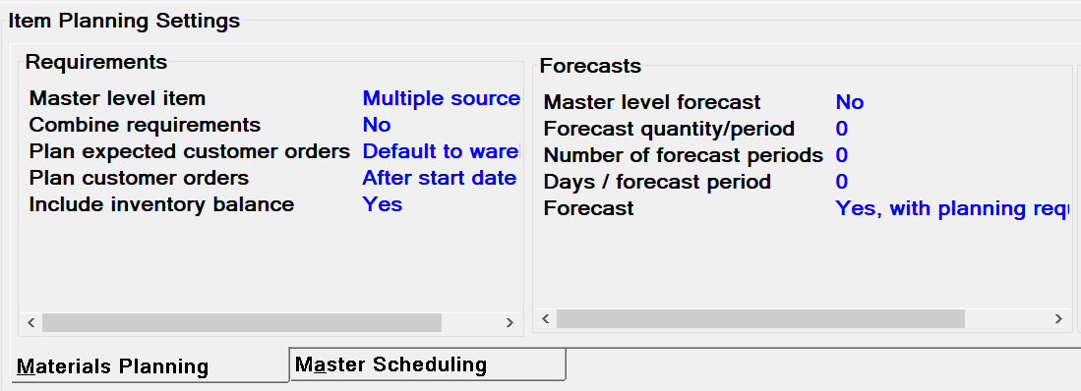
Gather Requirements – Field Settings

Slide 8
Gather Requirements – Field Settings
Master Level Item (MLI)
  M – Multiple sources of requirements
    Can have Manual Requirements & Customer Orders driving planning
    Recommendation: Set all items to MLI code ‘M’
  S – Single source of requirements
    Can only have Manual Requirements to drive planning
  Blank – not a Master Level Item
Combine Requirements
  Instead of displaying each requirement individually, combining requirements will add the requirement quantity for x number of days (defined in the Period Interval table)
  NOT recommended. The ‘Peg To’ functionality will not work if requirements are combined.

Slide 9
Gather Requirements – Field Settings
Plan Expected Customer Orders
  Only available for companies that use XA’s ‘Electronic Commerce’ EDI application
  Provides the option to include customer provided forecasts for items
  Options are:
    Default to Warehouse
    No
    Make items
    Make & buy items
    Make, buy and firm
    All Types

Slide 10
Gather Requirements – Field Settings
Plan Customer Orders
  Brings customer orders (CO/CMH) into MRP as a requirement where the ‘Manufacturing Due Date’ on the CO line item becomes the ‘Requirement Date’ in MRP
  Only applies if ‘Master Level Item’ (MLI) code = M (Multiple sources of requirements)
  Options
    1/Plan all CO’s after the MRP CURRENT date
    2/Plan all CO’s after the MRP RELEASE date
    3/Plan all CO’s after the MRP REVIEW date
    4/Do not bring CO’s into MRP as a requirement
    5/Plan all CO’s after the MRP START date
  Recommendations
    If the item has a chance of being sold, set the ‘Plan Customer Orders’ field to ‘Plan all CO’s after MRP START date’.
    NOTE: If there are CO Line Items with a Manufacturing Due Date earlier to the ‘MRP START date’ the CO will NOT be included as an MRP requirement

Slide 11
Gather Requirements – Field Settings
There are 2 ways to bring forecasts into MRP as a requirement
  Use XA’s Forecasting module to create the forecast and send to MRP
  Use the Master Level Forecast (seldom used) fields
  Neither method lowers the forecast quantity based on sales which can lead to ‘over planning’ an item by having too great a requirement quantity

Slide 12
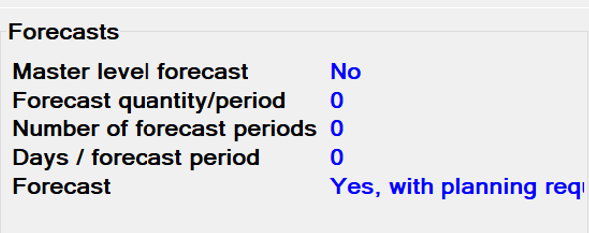
Gather Requirements – Field Settings
Master Level Forecast
  Creates a ‘flat’ forecast for a user defined period of time using the following fields
    Forecast quantity per period
    Number of periods to create forecast
    Number of days in a period
  For example, if I wanted a requirement of 100 per month for the next 3 months you would set up the fields as follows:
    Forecast quantity/period 100
    Number of forecast periods 3
    Days/forecast period 20 (assuming 5 day work week)

Slide 13
Gather Requirements – Field Settings
Forecast Code
  Used with XA’s Forecasting Module
  Field settings are:
    0/No - Do not develop a forecast for this item
    1/Yes – No Planning. Create a forecast but do not copy it into MRP
    2/Yes – Create a forecast but have MRP treat it as a reference for the Planner to review
    3/Yes with Planning Requirements – Create a forecast and copy into MRP
  Any of the ‘Yes’ responses will cause Forecasting to build a Forecast Item Master during its month end process

Slide 14
MRP Step 2
Net Requirements against on hand & on order

Slide 15
Net Requirements Against Inventory
After all requirements for an item have been generated the second step of MRP is to ‘consume’ the available inventory using the on hand balance and existing orders (PO & MO)
  The assumption in MRP is that it will be quicker to expedite an existing order as opposed to creating a new order
The requirement with the earliest date (even if it’s past due) will be subtracted from the on hand inventory balance to calculate a ‘Projected Balance’

Slide 16
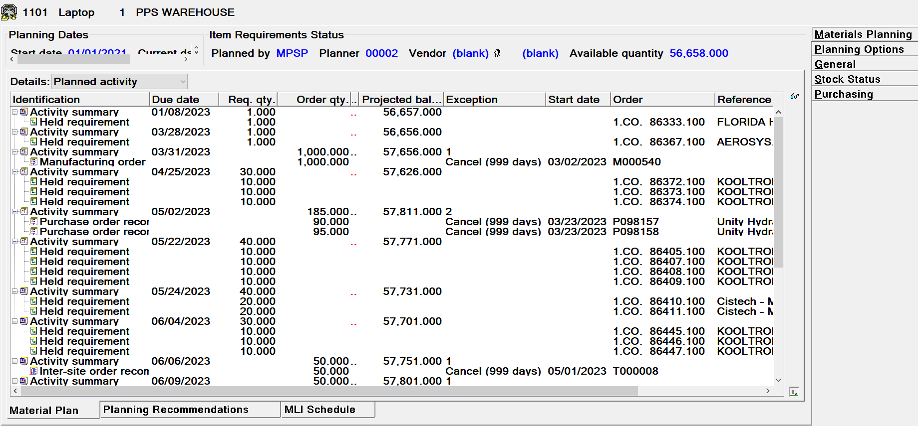
Net Requirements Against Inventory

Slide 17
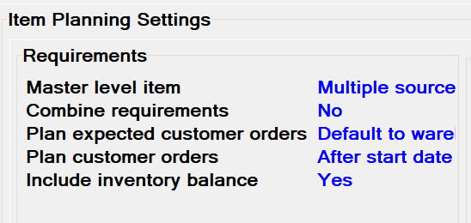
Net Requirements Against Inventory
There may be some items where you do not want MRP to net the requirement against the inventory.
  A customer that builds to a forecast may not want to have netting
There is a field in the Item Warehouse/Balance record to have MRP treat the item as having zero on hand:

Slide 18
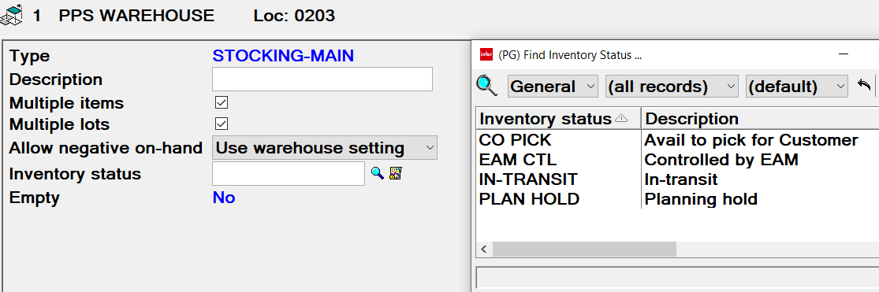
Net Requirements Against Inventory
If you want MRP to net requirements against inventory but want to exclude the inventory in specific locations (such as an MRB location), you can set the Location Status to ‘Plan Hold’
  This field is only available for maintenance in PowerLink/Net-Link
  It is accessed via the ‘Warehouse Locations’ object
    All items in a location with a ‘Plan Hold’ status will have the quantity in the location subtracted from the Item Warehouse on hand before MRP Netting begins

Slide 19
Create Exception Message for Existing Orders
It is also during this step of MRP that MRP will compare the due dates of Manufacturing Orders (MO) and Purchase Orders (PO) and make recommendations to move the date of the order to satisfy requirements on the requirement’s date
  Expedite – bring the order in earlier. The Vendor (PO) or Shop Floor (MO) will not have the full lead time to produce the item
  Reschedule – Bring the order in earlier. The Vendor/Shop Floor still has the full lead time to produce the item
  Defer – Push the due date of the order out, the order is bringing in the item earlier than the requirement date
  Cancel – There are no requirements for this order and MRP recommends cancelling it
In the MRP Recommendations, the ‘Offset Days’ field will show the number of days to move the order.
  Use this field in a subset to limit the number of messages that are displayed

Slide 20
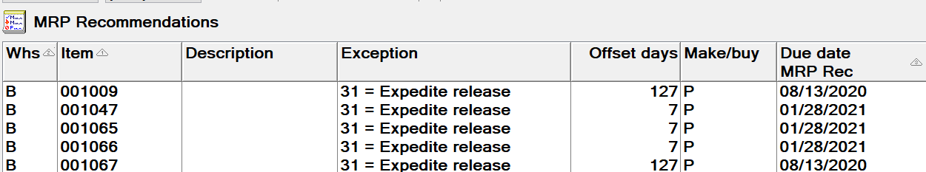
Create Exception Message for Existing Orders

Slide 21
MRP Step 3
When there is not enough on hand and on order to satisfy requirements, create a planned order

Slide 22
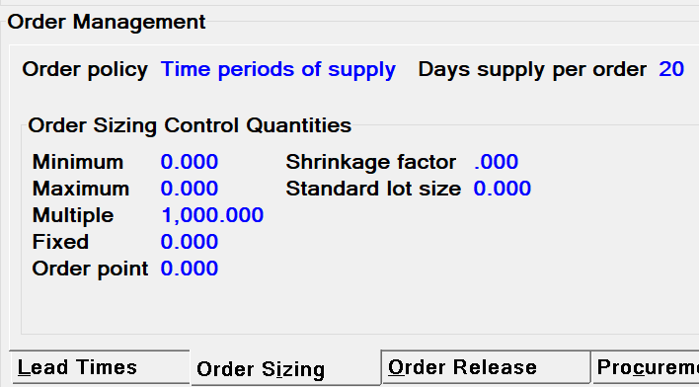
Create Planned Orders
When there is not enough inventory on hand and on order to cover all the requirements, MRP will create Planned Orders to cover the requirement quantity
The Due Date of the Planned Order will be the same as the Requirement Date
The quantity of the Planned Order is determined by a number of fields in the Item Warehouse/Balance record

Slide 23
Create Planned Orders
To calculate the Planned Order quantity, MRP starts with the ‘Order Policy Code’ to determine what fields/information is needed to calculate the orders quantity
  Depending on the Order Policy Code of the item, other fields may come into play:
    Days Supply per Order
    Fixed Order quantity
    Maximum (Order Quantity)
After it calculates the quantity based on the Order Policy Code it looks at the following fields to determine if the quantity needs to be adjusted:
  Minimum (Order Quantity)
  Multiple (Order Quantity)

Slide 24
Order Policy Code ‘A’ - Discrete
Plans a separate order for each day that has a requirement
  If there are multiple requirements on the same day, they will be totaled and one order created
  If Minimum and Multiple fields are zero, planned order quantity will equal the requirement quantity

Slide 25
Order Policy Codes ‘B & C’ – Order Point
Items with Order Policy Codes (OPC) B & C are not planned by MRP; they are planned using the Reorder Report
When the Available Inventory (on hand + on order – allocated) is less than Order Point quantity, the Reorder report will recommend an order
Recommended order quantity is calculated differently depending on OPC
  OPC = B ‘Order Point, Order Quantity’ means that the Reorder Report will recommend ordering the ‘Fixed Order Quantity’ field. For example:
    100 (on hand) + 10 (on order) – 45 (allocated) = 65 (available)
    Order Point = 70, so available is less than Order Point
    Fixed Order Quantity = 200
    Reorder report recommends an order for quantity of 200

Slide 26
Order Policy Codes ‘B & C’ – Order Point
  OPC = C ‘Order Point, Order Up to Level’ means that the Reorder Report will recommend order enough to bring the Available Inventory up to the Fixed Order Quantity
  For example:
    100 (on hand) + 10 (on order) – 45 (allocated) = 65 (available)
    Order Point = 70, so available is less than Order Point
    Fixed Order Quantity = 200
    Reorder report recommends an order for quantity of 135
      65 (available) + 135 (recommended order) = 200
  Potential uses for Order Policy Codes B & C
    Vendor Managed Inventory
    Tool Crib items
    Anything else you don’t want MRP to plan

Slide 27
Order Policy Code ‘D’ – Fixed Quantity
OPC ‘D’ works like a minimum order quantity
If the ‘Projected Balance’ will go negative due to requirements, MRP will plan an order for the ‘Fixed Order Quantity’
  If the required quantity is greater than the Fixed Order Quantity then MRP will plan for the greater quantity
There is no ‘look forward’ for additional requirements

Slide 28
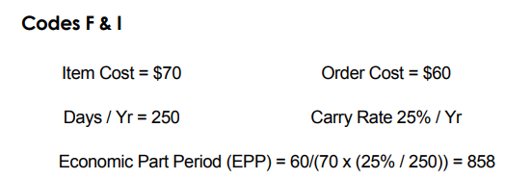
Order Policy Codes ‘F & I’ – Part Period Balancing
Antiquated method (from the 1960’s & 70’s) that calculates the carrying cost of inventory, cost of placing an order, etc. to determine the quantity of the planned order
  OPC F uses the Standard Cost of the item in its calculations
  OPC I uses the Current Cost of the item in its calculations
Just in Time/Kanban principles have made this methodology obsolete

Slide 29
Order Policy Code ‘G’ – Days Supply per Order
Days Supply per Order goes through the following steps to calculate order quantity
  When Projected Balance will go negative, MRP will look forward x number of days (defined in the ‘Days Supply per Order’ field) and add all the requirements in that time period
  It will then recommend an order for the sum of the requirements in the time period (assuming no minimum or multiple quantity)
If the item has a ‘Safety Stock’ quantity in the requirements, the trigger to order will be when the ‘Projected Balance’ goes below the Safety Stock quantity (instead of waiting until Projected Inventory goes negative)
This is the default value when adding a new item warehouse/balance record
OPC ‘G’ with ‘Days Supply’ = 0 is the same as OPC ‘A’ (Discrete)

Slide 30
Order Policy Code ‘H’ – Discrete Above Minimum
OPC ‘H’ has 2 methods to calculate order quantity depending on supporting fields
  Fixed Order quantity is used by OPC ‘H’
OPC ‘H’ (Discrete Above a Minimum) will add requirements (similar to OPC ‘G’ but it ignores the date of the requirements) until the Requirement total equals or exceeds the Fixed Order Quantity. At the point that the sum of the requirements exceed the Fixed Order Quantity it will recommend an order for the quantity required to meet the requirements.

Slide 31
Order Policy Code ‘H’ – Kanban
With the introduction of Kanban in the 1980’s, MRP needed to plan order quantities that matched the Kanban quantity
Instead of creating a new OPC, XA decided to use an additional field with OPC ‘H’
  Fixed Order Quantity = Maximum Order Quantity
  When the same quantity is entered in both Fixed and Maximum Order Quantity fields MRP will plan every order for the same quantity
  For example, if every order for an item must equal 200 then set both Fixed Order Quantity and Maximum fields to 200
    If there is a requirement for 350, then there will be 2 planned orders for 200 both with the same due date
    If the requirement is for 75 then MRP will plan 1 order for a quantity of 200

Slide 32
Order Policy Code ‘Z’ – User Option
If none of the Order Policy Codes listed meet your company’s requirements for order quantity calculation, OPC ‘Z’ allows you to insert your own program to calculate order quantity
  Requires a modification to MRP code (last time I asked – several years ago). There are now pre-MRP, mid-MRP and post-MRP user exits and the mid user exit may be able to be used
If you do not have a custom program to calculate order quantity, XA MRP will treat OPC Z the same as OPC G

Slide 33
Minimum & Multiple Order Quantities
Except for ‘Kanban’, the MRP order quantity, once calculated, can be adjusted by the Minimum and/or Multiple order quantity values
Minimum
  If the calculated quantity is 90 and the ‘Minimum’ field is set to 100, MRP planned order will be for a quantity of 100
  If the calculated quantity is 120 and the ‘Minimum’ field is set to 100, MRP planned order will be for a quantity of 120
Multiple
  If the calculated quantity is 90 and the ‘Multiple’ field is set to 100, MRP planned order will be for a quantity of 100
  If the calculated quantity is 120 and the ‘Multiple’ field is set to 100, MRP planned order will be for a quantity of 200

Slide 34
Maximum Order Quantity
Maximum Order quantity does not change the planned order quantity (unless using Kanban – OPC ‘H’)
When the MRP planned order quantity is greater than the ‘Maximum’ quantity MRP creates an exception message to notify the Planner
  If using Visual Planner (VPi) or Thru-Put, multiple planned orders will be created with none of them exceeding the Maximum quantity

Slide 35
MRP Step 4
Calculate Planned Order Start Date

Slide 36
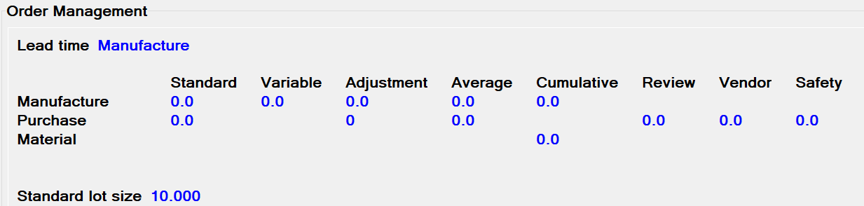
Calculate Start Date – Lead Times
All Lead Times are entered in working days
Lead Time Code
  Manufacture – create M-Plan Orders for the item & use Manufacturing Lead Times
  Purchase – create P-Plan orders for the item & use Purchasing Lead Times
MRP uses the lead times to calculate the Start Date of the planned order
  It is critical that the start date be accurate in that the planned MO start date will become the required date for the components in the BOM

Slide 37
Calculate Start Date – Make Items
Manufacturing Lead Time fields:
  Standard – fixed time to make the item, regardless of quantity
  Variable Manufacturing – run time portion of the Manufacturing LT
  Adjustment Manufacturing – additional LT (typically ‘pad’)
Standard Lead Time is made up of Move, Queue, Set Up and Run times for a make item
  Move, Queue and Set Up are not dependent on order quantity
  Run time can change based on the MO quantity

Slide 38
Calculate Start Date – Make Items
Formula for calculating MO Start Date
(Mfg LT – Variable LT) + (MRP Order Qty/Std. Lot Size * Vari LT) + Adjustment LT
  (Mfg LT – Variable LT) represents Move, Queue, Set Up & Run Lead Times for 1 Standard Lot
  (MRP Order Qty/Standard Lot Size) represents the number of lots that the MO will produce. Multiply by the Variable LT to determine number of days to run the job
    NOTE: Standard Lot Size is also used by the Cost Roll Up to amortize set up costs
  If the fields have the following values
    Standard Mfg LT = 5
    Vari Mfg = 2
    Adjustment = 0
    Standard Lot Size = 100
    MRP planned order quantity = 300
  (5 – 2) + (300/100 * 2) + 0 = 9 days LT

Slide 39
MO Dates
Due Date
  Date that the item should be made and received into inventory
Start Date
  Date that the MO needs to start to support the lead time of the item
  Start date of the MO becomes the required date of the components on the MO
Calculated Start or Due date
  XA will use the routing times to calculate either the start or due date based on the PC&C tailoring question that asks if you’re using Forward or Backward scheduling of the MO
    Forward Scheduling uses the start date of the MO and moves forward through the operations calculating operation start & due dates. MO will show ‘Calculated Due Date’
    Backward Scheduling uses the MO due date as the due date of the final operation and moves backward through the routing to calculate operation start & due dates. MO will show ‘Calculated Start Date’

Slide 40
Calculate Start Date – Purchased Items
As with Manufacturing Lead Times, Purchasing Lead Times are in working days based on your company’s calendar
Lead Time fields:
  Purchase Review – internal time for the Buyer/Planner to review the MRP recommendation, source the vendor for the purchase
  Vendor – Vendor quoted lead time including transit time from the vendor to the plant
  Purchase Safety – additional lead time, is used in the calculation of the ‘Due To Dock’ date on the PO
  Adjustment Purchase – internal Dock to Stock lead time which includes unpacking, QC inspection, etc. Is also used in the calculation of the ‘Due to Dock’ Date
Review + Vendor + Safety + Adjustment = Total purchase Lead Time

Slide 41
PO Dates
Due to Dock
  Date that prints on the PO to tell the vendor when you except the goods to arrive on your dock
Due to Stock
  Date that MRP uses to add the PO quantity to the ‘Projected Balance’ quantity
PO Start Date
  Date that the PO was placed
Receipt Date
  Depending on system tailoring, either the date of the first (partial or complete) receipt or
  Date when the complete quantity orders has been received

Slide 42
Validate Lead Time
During MO and PO ‘Close & Purge’ jobs, the actual Lead Time of the orders being purged (deleted from the open order files and added to the history files) will update the ‘Average’ Lead Time in the Item Warehouse/Balance record.

Slide 43
MRP Step 5
For M-Plan orders, go to the item’s BOM and create Peg To requirements for the components in the bill

Slide 44
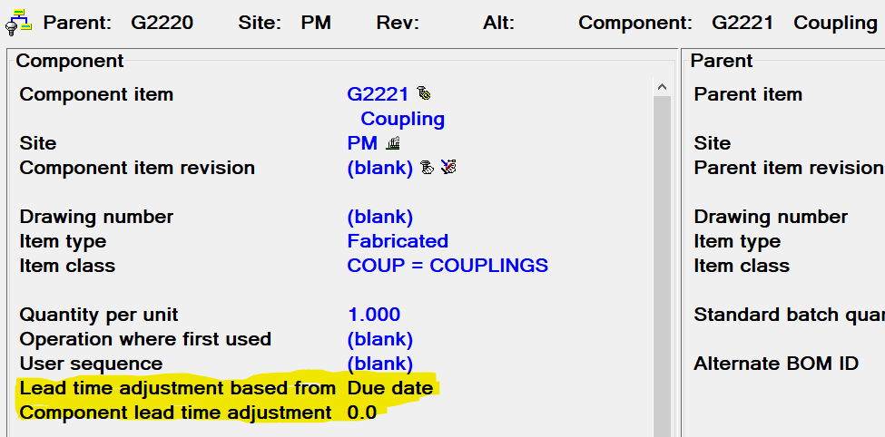
Generating Peg To Requirements
The M-Plan’s Start date is the Requirement Date for the components of the BOM unless the bill of material Lead Time Adjustment is entered
If you use EPDM then the BOM that’s flagged in the Item Process record as the ‘Primary’ process is the BOM that will be used by MRP

Slide 45
Generating Peg To Requirements
The adjustment can work off of the MO start or due date depending on the setting in the ‘Lead Time Adjustment based on’ field
The ‘Component Lead Time Adjustment’ is the number of working days to adjust the date
An example, there is an item that must be on hand before the MO can begin
  A company decides that they want the item to be on hand 2 weeks before the MO Start Date
  Set the ‘LT Adjustment based on’ field to ‘Start Date’
  Enter ‘10’ (assuming a 5 day work week) in the ‘Component LT Adjustment’ field
  An MO is created with a start date of 10/15
    The component with the LT Adjustment will have a required date of 10/2 all other components will have a required date of 10/15

Slide 46
Other Files
Files that are used by MRP not related to individual items

Slide 47
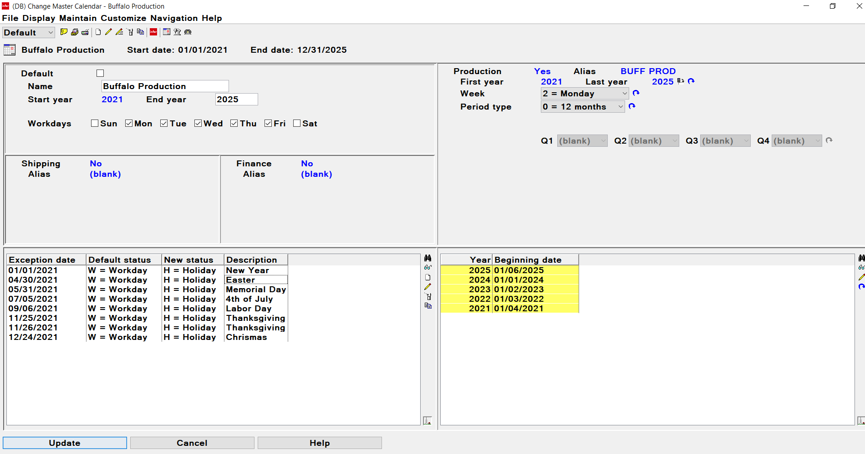
Master Calendar
At XA’s release 9.2 the Inventory Management calendar was changed to the ‘Master Calendar’ that is maintained via PowerLink
In the Master Calendar, work days and holidays are defined:

Slide 48
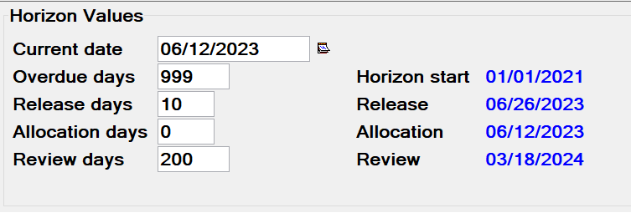
MRP Horizon Values

Slide 49
MRP Horizon Dates
Start Date
  Date in the Past (calculated by subtracting ‘Overdue’ days from the ‘Current’ Date)
  CO’s with a Manufacturing Due Date on or after the Start Date will be included in the MRP requirements, depending on the ‘Plan Customer Order’ code
  CO’s with Manufacturing Due Date before the MRP Start Date are ignored by MRP
Current Date
  Manually set date that MRP will use as today’s date
Release Date
  If the Planned Order’s start date is on or before the Release Date, MRP will create a ‘51-Release’ message
Review Date
  If the Planned Order’s start date is on or before the Review Date, the order will be displayed in the ‘MRP Recommendations’ object
  There can be planned orders after the review horizon but not shown in ‘MRP Recommendations’
Allocation Date
  MO Allocations can be subtracted from the On Hand Inventory instead of showing them on their required date

Slide 50
MRP Execution Options
Combine customer backlog orders
  If there are multiple customer orders for the same item to ship on the same day, should they show as requirements individually or just the total for the day
Time phased allocations
  Instead of showing MO allocations on their required date, subtract allocation quantity from the on hand
  Works in conjunction with the ‘Allocation Horizon’
Level to plan master level items
  Low Level Code to limit MRP run

Slide 51
MRP Execution Options
Clear quantity sold with extract
  ‘Yes’ response will clear a shipped quantity field when CO’s are extracted for MRP
  ‘No’ response will clear the field when the current date is changed
Minimum days to reschedule orders
  If using Auto Reschedule, the minimum Offset Days to change an order’s due date
Reschedule frozen zone
  If using Auto Reschedule, the number of days from the MRP current date where orders will NOT be rescheduled
Maximum sources of demand to track
  Source of Demand is the top level requirement that caused the planned order
  Number of sources to track, per order
Track (source of) demand for on hand inventory
  Yes/No

Slide 52
MRP Execution Options
Warehouse reschedule code
  For orders that have Expedite, Reschedule or Defer messages, options to have MRP change the due date. Options are:
    No Auto Rescheduling
    Only reschedule/move dates in (expedite & reschedule)
    Only reschedule/move dates out (defer)
    Move dates both in & out
Due date in the past – MO
Due date in the past – PO
Due date in the past – (repetitive) schedule
  If an order or planned order has a due date in the past and Auto Reschedule is active
    Take no action
    Change order due date to MRP current date
    Change order due date to recommended date

Slide 53
MRP Execution Options
Cancel exception
  If an order has a ‘Cancel’ exception message
    Do not change date
    Change the date to the calendar end date less one month
Contract for Auto Release
  If using PO auto release is a contract for the vendor & item to create the PO
    Yes an unexpired contract is required
    A contract is not required but if there is an expired contract do not create the PO
    A contract is not required; if there is an expired contract generate a warning
    A contract is not required
Extract Requisitions
  Treat a purchase Requisition as if it’s a Purchase Order
    Yes, from Purchasing (i.e. All open requisitions regardless of who created them)
    Yes, from MRP (only those open requisitions where the creator is ‘MRP Auto’)
    No

Slide 54
MRP Execution Options
Safety Stock lead time
  If an item has Safety Stock, what date should be used to for the requirement
    MRP current date
    MRP current date + Item’s Lead Time (either Purchase or Manufacture depending on the LT Code)
    MRP current date + item’s Cumulative Manufacturing Lead Time
    MRP current date + Item’s cumulative Material Lead Time
APS (Advanced Planning System) active
  No, use MRP for planning
  Yes, either Visual Planner (VPI) or Thru-Put is used for planning

Slide 55
Conclusion
There is no right or wrong way to set the planning codes as long as they support your company’s goals
A ‘Class A’ MRP system will lower inventory and increase on time shipments
There are 6 business elements required for a ‘Class A’ MRP system
  Valid Master Schedule of what’s to be built and when
  Accurate Bill of Material that matches how the item is made
  Accurate on hand inventory balances
  Valid Planning Codes (Order Policy, Minimum, Multiple)
  Accurate lead times
  Manage orders to the start, due and ship dates

